Slide 1
Runtime-Quality Tradeoff in Partitioning Based Multithreaded Packing
FACULTY OF ENGINEERING AND ARCHITECTURE
Dries Vercruyce
Elias Vansteenkiste and Dirk Stroobandt
Dries.Vercruyce@UGent.be

Slide 2
Toolflow
HDL description
Packing
Synthesis
Technology mapping
Packing
Placement
Routing
FPGA configuration

Slide 3
Packing
Seed based | Partitioning based
Bottom-up approach Seed block Affinity metric | Top-down approach Hierarchical partitioning of the circuit
Fast Tight packing | Slow Constraints
Local minima No multithreading | Quality of results Multithreading
Notes:
Once a circuit is split in half, we thread both subcircuits independently during partitioning. This leads to the opportunity of multithreading.
QoR Wirelength and channelwidth

Slide 4
Constraints
LUT
FF
Local interconnect
BLE
Fixed # input pins
Complete/sparse crossbar
Fixed # LUT/FF

Slide 5
Related work
Constraints enforcing step required
Simplified architectures

Slide 6
Contributions

Slide 7
Contributions
No constraints enforcing step required
Fast multithreaded packing
  Multithreaded seed based packing (MultiPart)
Realistic heterogeneous architectures (MultiPart)

Slide 8
Outline
Packing
Contributions
Circuit partitioning
PartSA
MultiPart
Experiments
Conclusions and Future work

Slide 9
Circuit partitioning
A
FF
FF
B
MULT
FF
FF
LUT
FF
LUT
FF

Slide 10
Circuit partitioning
A
B

Slide 11
PartSA
N
1
1
1
1
1
1
1
1
1
Clustering based on design hierarchy
Simulated annealing fine-tuning cost function

Slide 12
Simulated annealing: cost function

Slide 13
Simulated annealing: cost function
P_{TH}
P_{MAX}

Slide 14
Problem: cutting critical paths

Slide 15
Problem: cutting critical paths
W_{edge}
W_{edge}

Slide 16
Problems with PartSA
Partitioning runtime increases as you go deeper in the hierarchy
Unused threads on first hierarchy levels
Large amount of subcircuits

Slide 17
Problems with PartSA
Partitioning runtime increases as you go deeper in the hierarchy
Hard to target commercial architectures
Commercial architectures contain sparse local interconnect crossbars
Legal solution after block swap?
Detailed routing required in kernel of simulated annealing
Infeasible due to the large amount of required swaps

Slide 18
MultiPart
No partitioning required on deep hierarchical levels
Detailed routing is feasible with seed based packing
Subcircuits are threaded independently
Multithreaded seed based packing

Slide 19
Partition depth

Slide 20
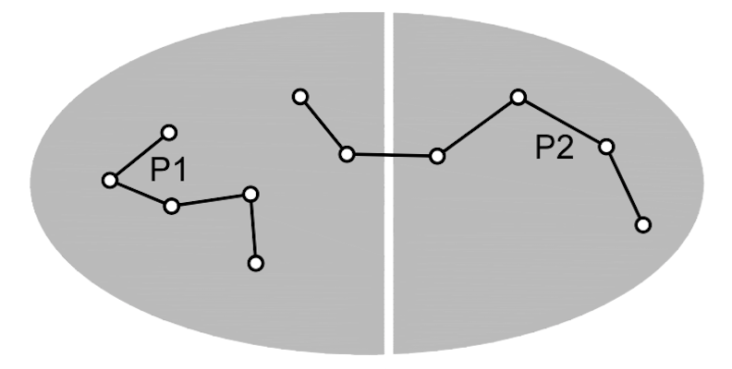
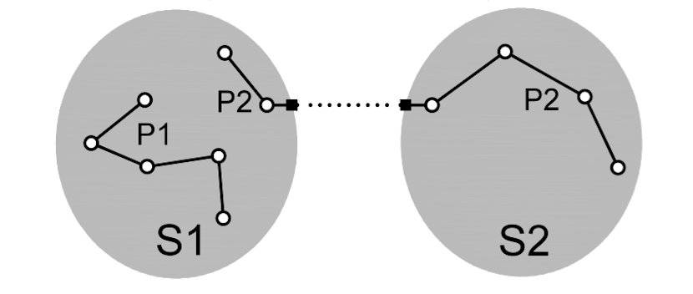
Problem: cutting critical paths
SDC File
Notes:
Even though timing edges are added during partitioning, there is a chance that a critical path is cut during partitioning.

Slide 21
Experimental results
Notes:
None of the packers shown before is able to pack the VTR benchmarks and is not publicly available.
All results are related to AAPack

Slide 22
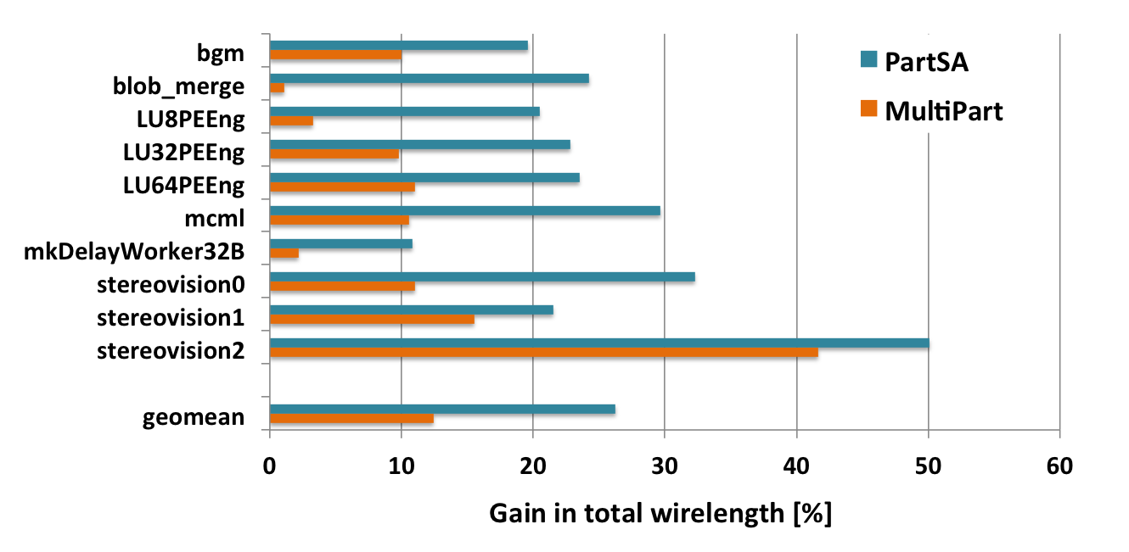
Total wirelength
Notes:
Related to AAPack!

Slide 23
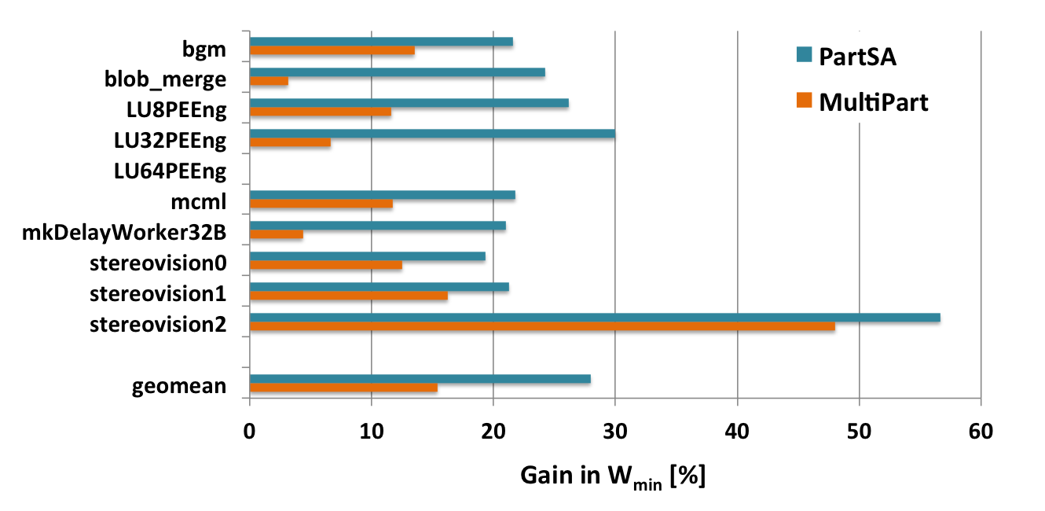
Minimum channel width
Smaller and cheaper FPGA’s

Slide 24
Execution time and scaling behaviour
Name | Area | Runtime speed-up
 |  | PartSA | MultiPart
LU8PEEng | 770K | 1.7x | 2.6x
LU32PEEng | 2.7M | 2x | 3.3x
LU64PEEng | 5.3M | 2.3x | 4x

Slide 25
Summary
 | Total wirelength | Critical path delay | Runtime speed-up
K6_N10_40nm (complete crossbar)
PartSA | -26% | -1.5% | 1.8x
MultiPart | -12% | -2.6% | 2.7x
K6_N10_gate_boost_0.2V_22nm (sparse crossbar)
MultiPart | -20% | -3.7% | 2.9x

Slide 26
Conclusion and future work
Partitioning based packing methods
    Design hierarchy preserved
    Multithreaded parallelism
Higher quality packing in less runtime
    Total wirelength
    Minimum channel width
    Critical path delay
Future work: Extend MultiPart Titan benchmark design suite

Slide 27
Extra: Results for Titan
 | Total wirelength | Critical path delay | Runtime speed-up
VTR | -20% | -3.7% | 2.9x
Titan | -28% | -6% | 3.6x

Slide 28

Acknowledgement
Supported by European Commission H2020-FETHPC EXTRA project:
The author is supported by a PhD grant of the Research Foundation Flanders (FWO)

Slide 29
ADDITIONAL SLIDES

Slide 30
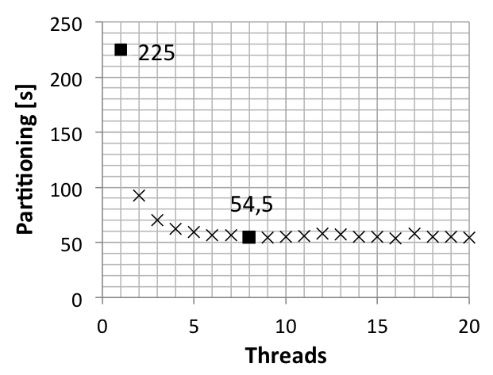
Multithreaded partitioning
CPU with 4 cores

