Slide 1
26th International Conference on
Field-Programmable Logic and applications, 2016
TeSHoP:
A Temperature Sensing based Hotspot-Driven Placement Technique for FPGAs
Weina Lu, Yu Hu, Jing Ye, Xiaowei Li
State Key Laboratory of Computer Architecture
Institute of Computing Technology
Chinese Academy of Sciences

Slide 2
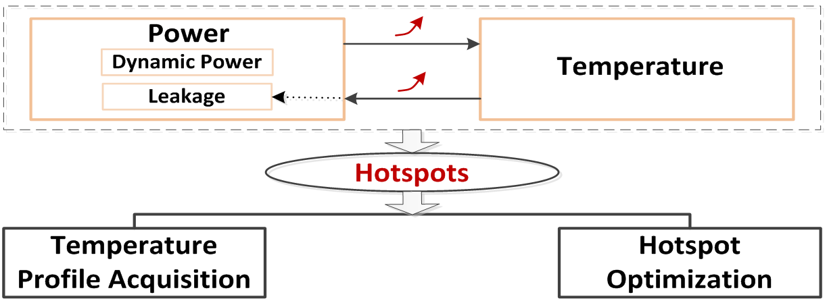
Motivation
Online thermal management
Coarse-grained
Significant performance overhead
Temperature sensing
At run-time
Accurate
Simulated-based optimizing method
Thermal simulation
At design stage
Large deviations
Fine-grained

Slide 3
TeSHoP
Key Idea:
Online thermal management
Temperature sensing
At run-time
Simulated-based optimizing methods
Thermal simulation
At design stage
Online
temperature sensing
Fine-grained
design optimization
TeSHoP

Slide 4
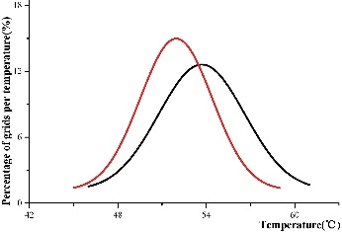
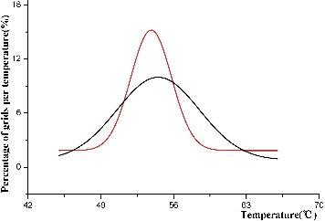
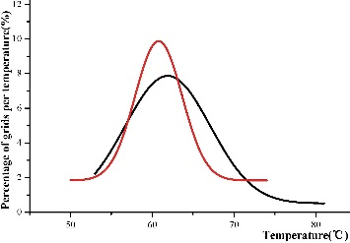
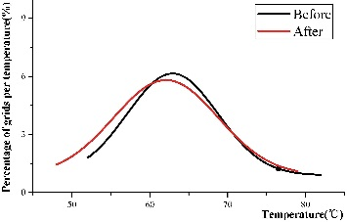
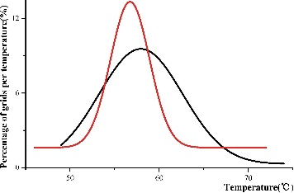
Experimental Results
Xilinx ML605 FPGA
stereovision3
LU8PEEng
mcml
LU32PEEng
Circuits | Peak Temperature |  |  | Thermal Uniformity
 | VPR (℃) | TeSHoP (℃) | Reduction (℃) | VPR (σ) | TeSHoP (σ) | Improvement Ratio
stereovision3 | 61.43 | 58.90 | 2.53 | 3.14 | 2.71 | 13.93%
LU8PEEng | 66.01 | 65.60 | 0.41 | 4.06 | 3.76 | 7.39%
stereovision2 | 73.96 | 72.24 | 1.72 | 4.39 | 4.26 | 3.06%
mcml | 81.02 | 73.51 | 7.51 | 5.09 | 4.83 | 5.11%
LU32PEEng | 81.89 | 79.22 | 2.67 | 6.83 | 6.37 | 6.83%
Average |  |  | 2.97 |  |  | 7.26%
stereovision2

Slide 5
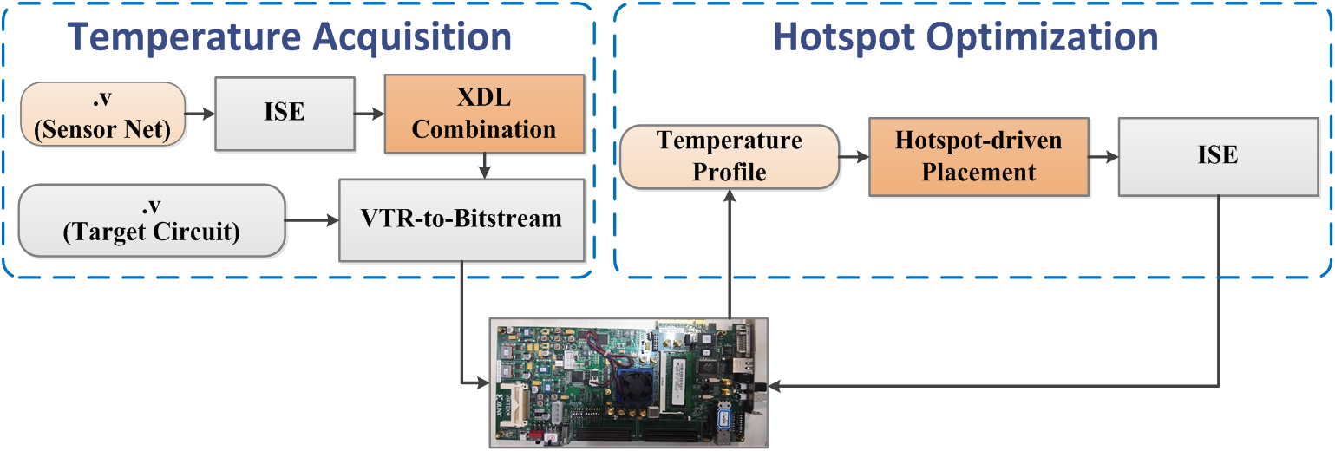
TeSHoP
Innovations:
1. Expansion of VTR-to-Bitstream can insert sensor network into circuits and implement hotspot optimization
2. Experiments for design optimization are implemented on a real FPGA

Slide 6
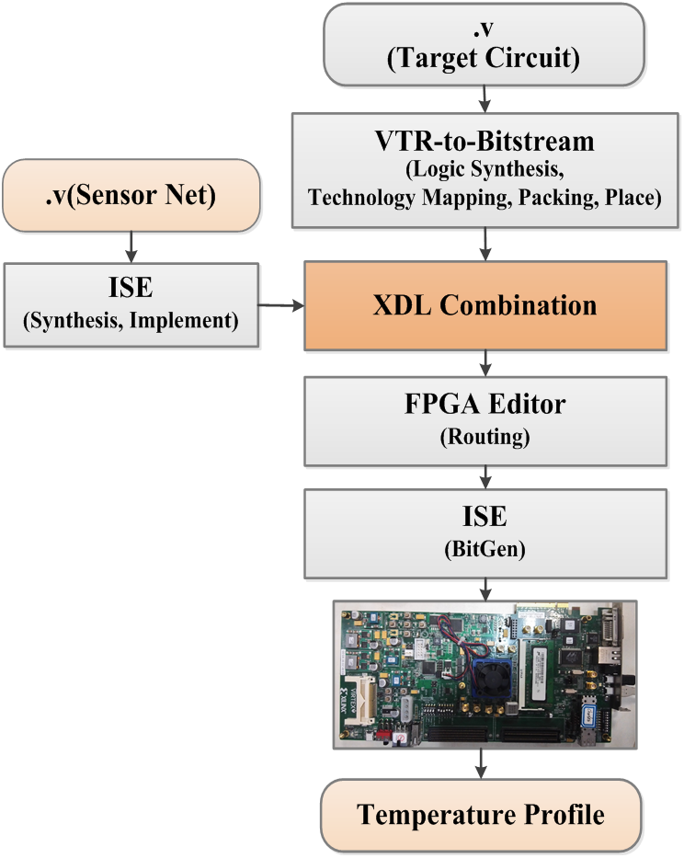
Temperature Acquisition
The on-chip temperature profile is acquired by a programmable sensor network, which is composed of N×N Ring Oscillator-based sensors and a sensor controller.
TeSHoP technique inserts the sensor network after the placement stage to preserve the calibrated sensor structure and avoid recalibration.

Slide 7
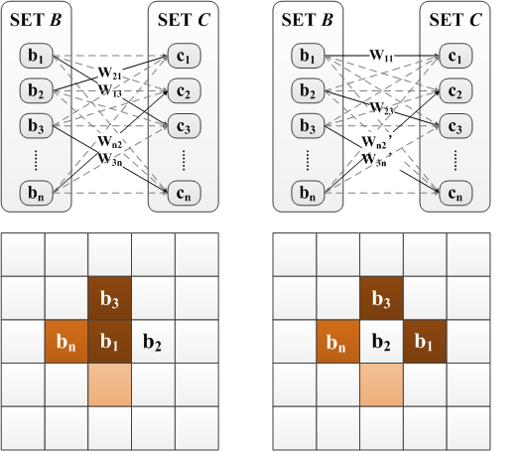
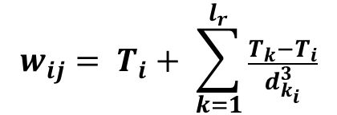
Hotspot Optimization
TeSHoP takes peak temperature reduction and thermal uniformity as the optimizing objectives for reducing hotspots.
The hotspot-driven placement problem can be described as a hyper weighted bipartite graph G = (B, C, E, W) where weight is dynamically changed with every perfect match of G.
The objective of TeSHoP is to find a minimum weight match in these perfect match for graph G.
Weight of each edge eij in G,
$$w_{ij}= T_{i}+ \sum_{k=1}^{l_{r}}{\frac{T_{k}−T_{i}}{d_{k_{i}}^{3}}}$$
Weight of hotspots,
$$cost\left(Hotspot\right)= w_{max}×(w_{max}−w_{min})$$
Overall cost function,
$$cost=α∙cost\left(Area\right)+β∙cost\left(Delay\right)+γ∙cost(Hotspot)$$

Slide 8
References
VTR-to-Bitstream
E. Hung, F. Eslami, and S. Wilton, “Escaping the Academic Sandbox: Realizing VPR Circuits on Xilinx Devices,” in FCCM, 2013, pp. 45–52.
Online Thermal Management
S. Golshan, E. Bozorgzadeh, and C. Schafer, B, “Exploiting Power Budgeting in Thermal-aware Dynamic Placement for Reconfigurable Systems,” in ISLPED, 2010, pp. 49–54.
H. Khdr, T. Ebi, M. Shafique et al., “mDTM: Multi-objective Dynamic Thermal Management for On-chip Systems,” in DATE, 2014, pp. 1–6.
D. Pagano, M. Vuka, M. Rabozzi et al., “Thermal-aware Floorplanning for Partially-Reconfigurable FPGA-based Systems,” in DATE, 2015, pp.920–923.
R. Chafi, P, M. Moradi, N. Rahmanikia et al., “A Platform for Dynamic Thermal Management of FPGA-based Soft-Core Processors via Dynamic Frequency Scaling,” in ICEE, 2015, pp. 1093–1097.
I. Christoforakis, O. Tomoutzoglou, B. D et al., “Dithering-Based Power and Thermal Management on FPGA-Based Multi-core Embedded Systems,” in EUC, 2015, pp. 173–177.
H. Shen and Q. Qiu, “An FPGA-based Distributed Computing System with Power and Thermal Management Capabilities,” in ICCCN, 2011, pp. 1–6
Simulated-based optimizing method
C. Chu and D. Wong, “A Matrix Synthesis Approach to Thermal Placement,” IEEE TCAD, vol. 17, no. 11, pp. 1166–1174, 1998.
C. Tsai and S. Kang, “Cell-level Placement for Improving Substrate Thermal Distribution,” IEEE TCAD, vol. 19, no. 2, pp. 253–266, 2000.
P. Sundararajan, A. Gayasen, N. Vijaykrishnan et al., “Thermal Characterization and Optimization in Platform FPGAs,” in ICCAD, 2006, pp.443–447.
S. Bhoj and D. Bhatia, “Thermal Modeling and Temperature Driven Placement for FPGAs,” in ISCAS, 2007, pp. 1053–1056.
J. Jaffari and M. Anis, “Thermal-aware Placement for FPGAs using Electrostatic Charge Model,” in ISQED, 2007, pp. 666–671.
H. Amrouch, T. Ebi, J. Schneider et al., “Analyzing the Thermal Hotspots in FPGA-based Embedded Systems,” in FPL, 2013, pp. 1–4.

Slide 9
Welcome to the Poster Session for further discussion!
Thanks!

