Slide 1
Optimizing Hardware Design for Human Action Recognition
X. Ma, J. Rodriguez Borbon, W. Najjar, A. K. Roy-Chowdhury
University of California, Riverside

Slide 2
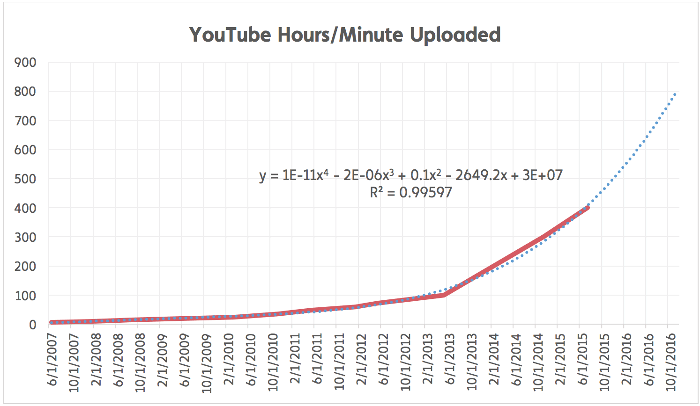
Video Explosion
Number of Video Hours
Source: http://www.reelseo.com/hours-minute-uploaded-youtube/
Notes:
Over the past decade, we have witnessed an explosive growth of videos from various source. Taking YouTube as an example, it was started in 2005 with one upload in a couple of months. Last year, youtube has reached 400 hours of video every minutes. The video is growing in quartic power.

Slide 3
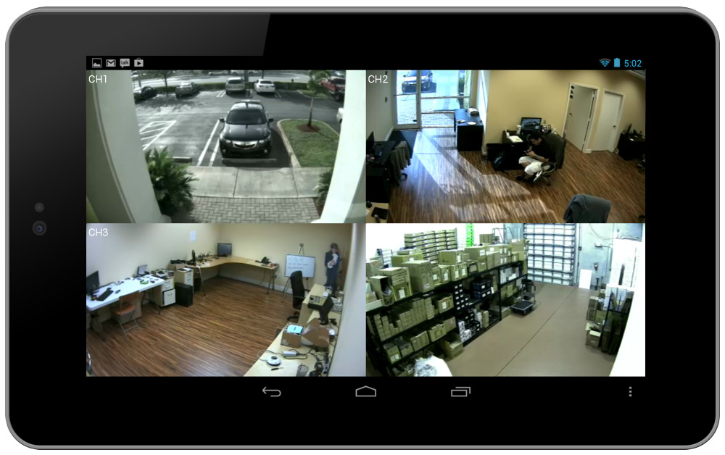
Near Camera Processing
Use computer vision
techniques to label/tag/
sort videos
Monitoring situations
rely on networks of
wireless cameras
Perform feature
extraction near camera
Reduce transmission
power
Reduce network bandwidth requirement
Low power hardware-based acceleration
Notes:
On the other hand, real-time monitoring applications normally reply on a network on wireless cameras. It is desirable to have a feature extraction algorithm running just behind the camera to reduce the network bandwidth usage. Also the feature extraction should consume as little power as possible to lengthen the running time between recharge batteries.

Slide 4
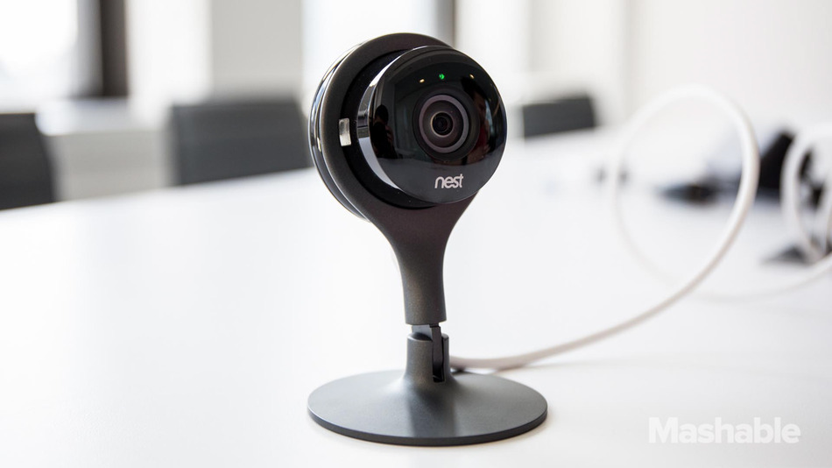
FPGA-Based Acceleration
Current computer vision applications:
  Low speed
  High power consumption
  Intense floating-point operation
Use FPGA for acceleration
  Bit-width matters
  Longer bit-width -> larger LUT -> lower freq. -> lower throughput
Floating-point v.s. fixed-point
Integers internally
Limited range with fixed precision
Determined by the position of the binary point
Very large dynamic data range
Precision deteriorates in large value
Notes:
As a result, in this work, I proposed to use FPGA to accelerate computer vision algorithms to reduce the processing time and lower power consumption. FPGA is good for its speed and low processing power, but the its disadvantage is its floating point computations. However, the lookup table based architecture is very sensitive to the bit-width of the variables used. As seen in the figure, the size of the lookup table grows exponentially as the bit-width increases. One possible solution is to use fixed-point numbers in small bit-width for data representation.

Slide 5
FPGA Resource Comparison
 | Fixed-Point |  |  |  | Floating-Point
# Bits | Reg. | LUTs | DSPs | f (MHz) | Reg. | LUTs | DSPs | f (MHz)
Addition
64 | 0 | 64 | 0 | 650 | 1034 | 800 | 0 | 268
32 | 0 | 32 | 0 | 650 | 541 | 397 | 0 | 390
16 | 0 | 16 | 0 | 650 | 224 | 171 | 0 | 397
13 | 0 | 13 | 0 | 650 | 193 | 142 | 0 | 411
Multiplication without DSPs
64 | 4292 | 4292 | 0 | 261 | 2422 | 2346 | 0 | 195
32 | 1094 | 1098 | 0 | 335 | 672 | 647 | 0 | 183
16 | 275 | 282 | 0 | 491 | 183 | 181 | 0 | 344
13 | 212 | 188 | 0 | 476 | 143 | 130 | 0 | 416
Multiplication with DSPs
64 | 990 | 496 | 16 | 239 | 471 | 294 | 15 | 294
32 | 115 | 22 | 4 | 383 | 106 | 118 | 8 | 306
16 | 0 | 0 | 1 | 473 | 89 | 71 | 6 | 357
13 | 0 | 0 | 1 | 473 | 80 | 64 | 6 | 389
Higher frequency and fewer resources
Notes:
We did some experiment by comparing the cost of implementing addition and multiplication operations on FPGAs and test the resource utilization. We have used 64-bit, 32-bit and 16-bit and 13-bit integers and floating-point values.
The 64, 32 and 16-bit floating point follows IEEE standards and 13-bit fixed-point has 5 exponent bits and 8 fractional bits.
The experiment is performed on a Xilinx Virtex 6 LX760 FPGA.
For additions, fixed-point v.s. floating-point, fixed-point has a big win.
It has almost not cost to perform addition (as the number of possible result is very limited).
On the other hand, floating-point addition is very expensive to compute.
However, for fixed-point multiplication, we can see that fixed-point uses doubled number of resources compared to the floating-point.
This is because two 32-bit integer multiplication results in a 64-bit value while 2 32-bit floating-point multiplication results in a 32-bit value.
So the lookup table is a lot larger in integer multiplication.
When we use on chi DSPs to replace some lookup table based logic in multiplication, the situation is different.
The fixed-point at low bit-width uses no extra resources. And the max frequency is very good too.
This table shows why we would like to use fixed-point for the FPGA based implementation.

Slide 6
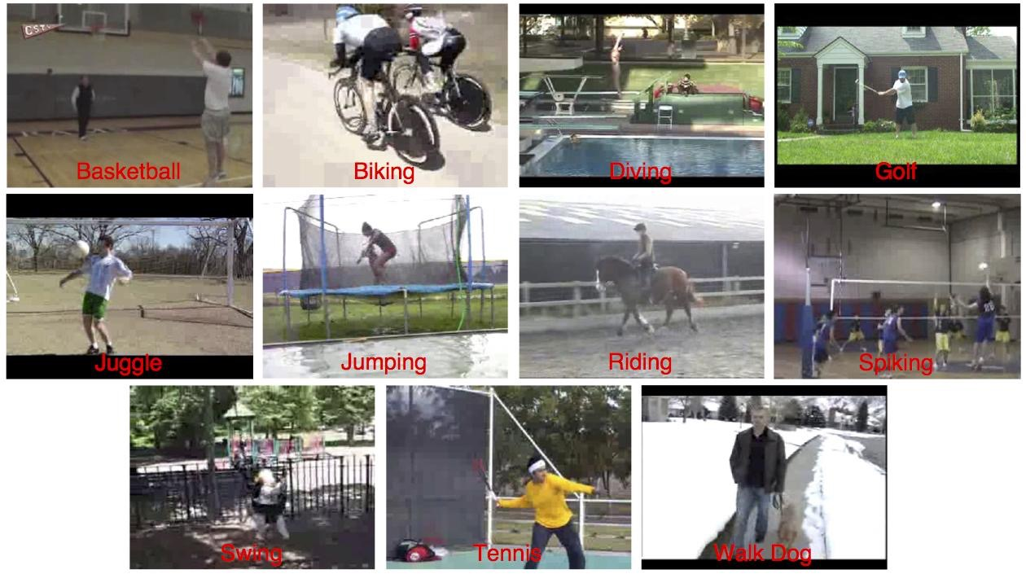
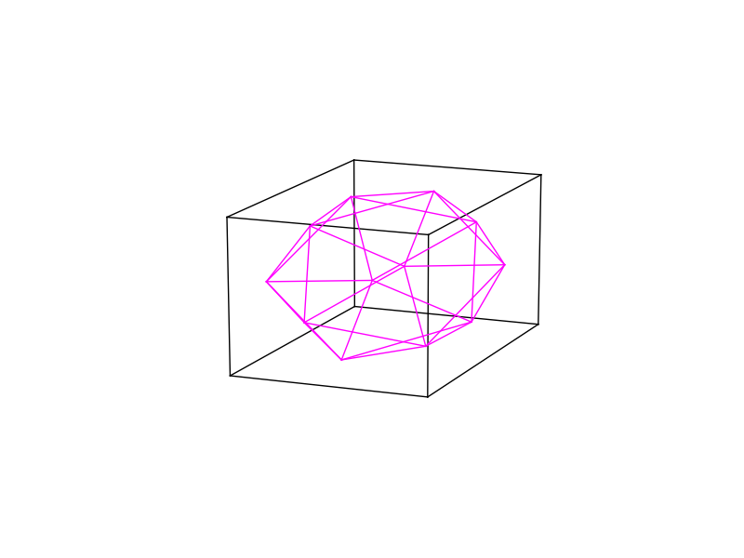
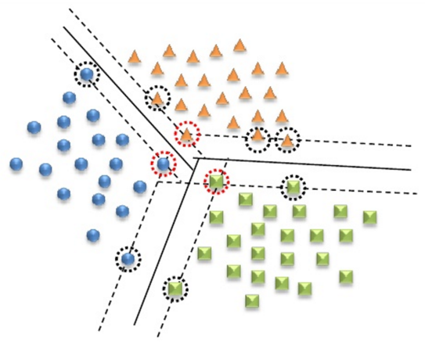
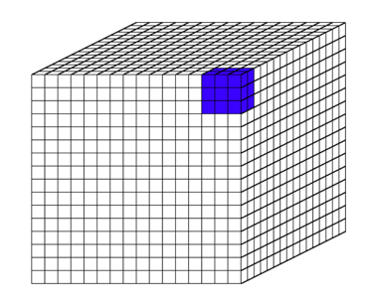
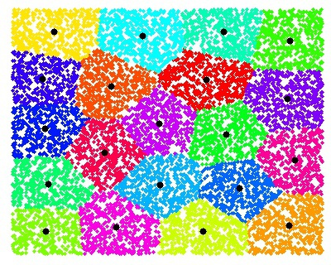
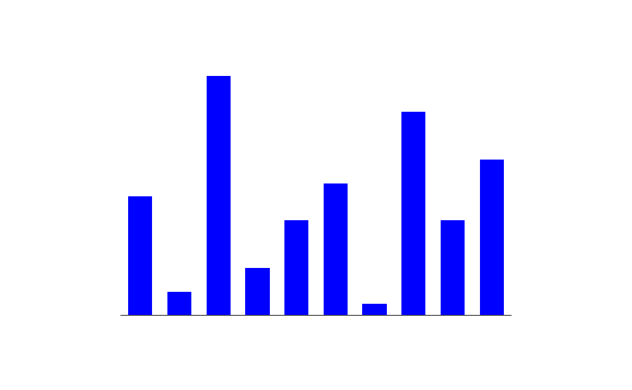
Action Recognition
Some of the most challenging topics in
computer vision
Low processing speed due to
complex model (features)
Recognition flow:
Histogram of Oriented Gradients in 3D (HOG3D)^{[2]}
Dense sampling of
interest points^{[1]}
Actions in UCF11 Dataset^{[2]}
Bag-of-Word
features^{[3-4]}
Multi-class classification (SVM)^{[5]}
[1] Heng W. et al. BMVC, 2009. [2] Alexander K. BMVC 2008. [3] Scott C. D., et al. JASIS, 1990. [4] Ona G. C. et al. CVPR 2001. [5] Chih-Chung C. ACM Trans. IST 2011.
Notes:
In this research, we have used the traditional feature extraction pipeline for a balance in speed and accuracy. Given a clip of video, instead of detecting interest points, we extract features at regular 3D locations across the video (and at multiple scales). The at each location, histogram of oriented gradient in 3D known as HOG3D algorithm is used to extract the features. All the features extracted in a video are then clustered using k-means algorithms. And the result is known as bag of words features. The finally a multi-class support vector machine is applied to classify the actions. Each one of the steps will be discussed shortly.

Slide 7
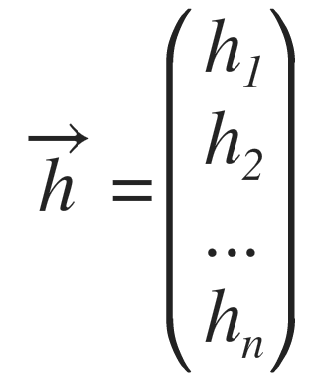
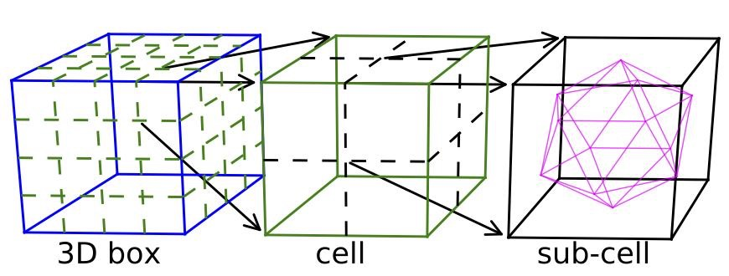
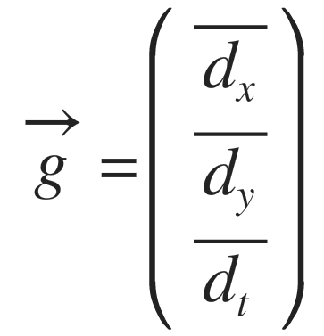
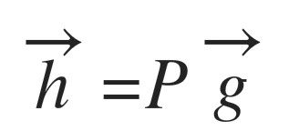
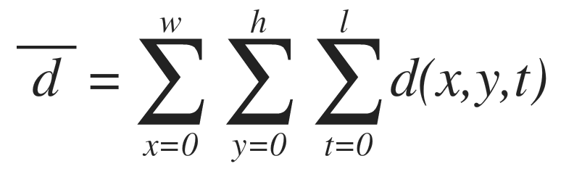
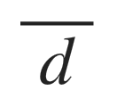
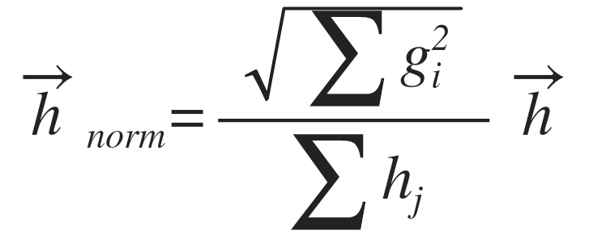
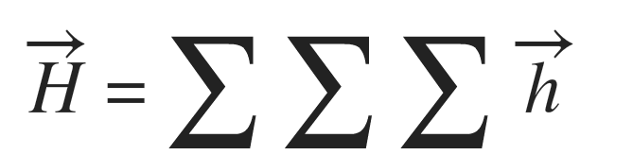
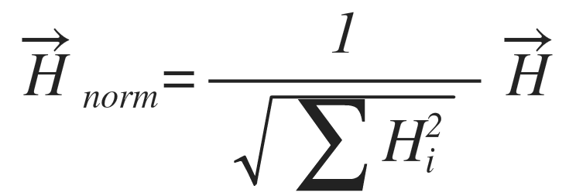
HOG3D Feature Extraction
Features are extracted per 3D box
3D box -> 4*4*4 cells
Cells -> 2*2*2 sub-cells
Sub-cell -> 10 histogram bins (gradients projection)
Vector add to combine sub-cell histograms into cells
Concatenate cell histogram to form box histogram
projection
n = 10
P is 10*3 mat.
gradient integration
Two normalizations
Normalize sub-cell histograms:
Normalize cell histograms:
Final HOG3D feature vector has 640 elements after concatenation (in row major order)
Notes:
First of all, let’s look at the HOG3D algorithms in detail. In this algorithm, each feature vector is extracted from a 3D box in a video (fames in time).
A 3D box is divided into 16 cells where the histograms are accumulated.
The cell is further divided into sub-cells to generate histogram vectors. As indicated by the name of this algorithm, the features of the histogram values are computed using three average gradients in a sub-cell as shown in this equation. The average gradients are equivalent to the sum of all the gradient values within a sub-cell. The three gradients which are computed separately are then projected into an icosahedron surface. And the projected values are the actual histograms. Here we have used half orientation which means that the each cell will have 10 histogram bins. Sub-cell histograms are normalized and accumulated inside a cell. Then cell histogram is normalized again and concatenated inside a box for form the actual feature vector. As I mentioned, there are several normalization processes happening here. The projected gradients are first thresholded by using a threshold value shown here. Any value that is smaller than the threshold is set to 0 and the rest is subtracted from this threshold. Note that we only take the absolute value of the projected gradients. Then the sub-cell histogram is passed to an l-1 normalization which means that it is normalized by the sum of histogram. The sub-cell histogram is accumulated by using a simple vector add operation. Finally the cell histogram (capital H) is normalized using L2 norm.
The final HOG3D feature is the concatenation of all cell histograms. The HOG3D feature has a dimension of 640 (8x8x8x10).

Slide 8
Bag-of-Words Features
Inspired by text processing^{[1]}
  Represent video clips by a set of descriptors
  Disregarding feature locality but keeping multiplicity
BOW Procedure
  Code-book generation
    K-means clustering
    Use 1000 centers
  Histogram generation
    Generate a histogram based on
    nearest distance the centers
    for each video clip (action)
    Histogram size: 1000 integers
[1] Scott C. D., et al. JASIS, 1990.
Notes:
The bag of word features are inspired by text processing. In this process, the raw features extracted directly from pixels are used build higher level of features using a clustering algorithm. The order and location of those features are disregarded but the multiplicity are kept after building the features. In our experiment, we use k-means algorithm to generate 1,000 centers. Then a histogram is built by assigning all the features in a video to one of the 1000 centers based on the nearest distance. For example, given a feature vector, we calculate its distance to all centers and find the index of the smallest distance center and increment the count in that center. This method is also known as the brutal force nearest neighbor search. At the end, our action features are converted from raw pixels to only 1000 centers. This reduction allows us to perform near camera feature extraction and only transmit back these 1000 integers instead of a video stream.

Slide 9


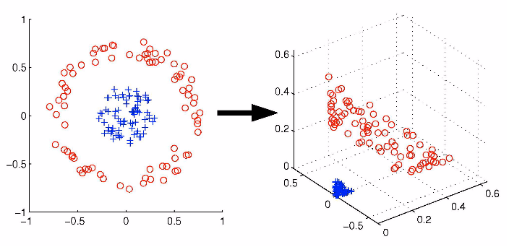

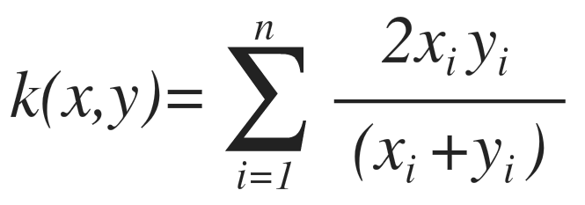
Multi-Class SVM Classification
One v.s. One Approach^{[1]}
  Build classifier for each pair of classes
  Number of classifiers:
Classification
  Pass data point to all classifiers
  Build a histogram of class votes
  The data point belongs to the class
  with max number of votes
The Kernel Trick
  Transform data into higher
  dimension
  Better performance
  kernel
[1] Ulrich H.-G. K. Advances in Kernel Methods, 1999.
Notes:
The last step in this process is a multi-class classification using support vector machine. The SVM was originally designed for binary classification. We have adopted the popular one versus one approach for multi-class classification. In one versus one approach, a classifier is built for each pair of classes. For example here, there are 3 classes. Class one two and three. We first build an SVM between class 1 and 2. Then we build SVM for class 1 and 3 as well as between class 2 and 3. To determine which class a point belongs to, we build a histogram of the class votes. For this point, we pass it to SVM 1-2, and it belongs to class 1. Then we pass it to SVM 1-3, and it belongs to class 1 too. So finally the class one’s vote is 2 and this is the maximum vote. Which means that this point belongs to class 1. So this is how the multi-class SVM works. Then Kernel tricks, is used to improve the accuracy of the SVM classifier by mapping data points into higher dimension. The points may be linearly separable in current dimension but can be separable in the higher dimension. The kernel we have used is this equation called chi-squared kernel.

Slide 10
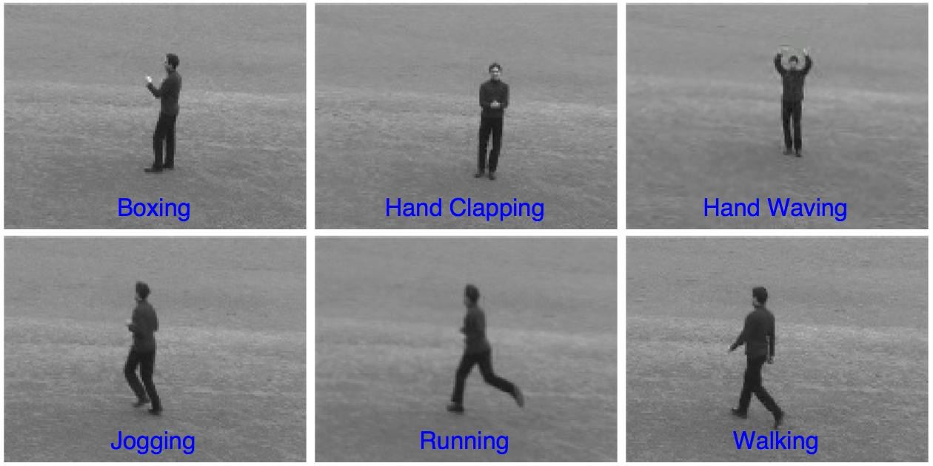
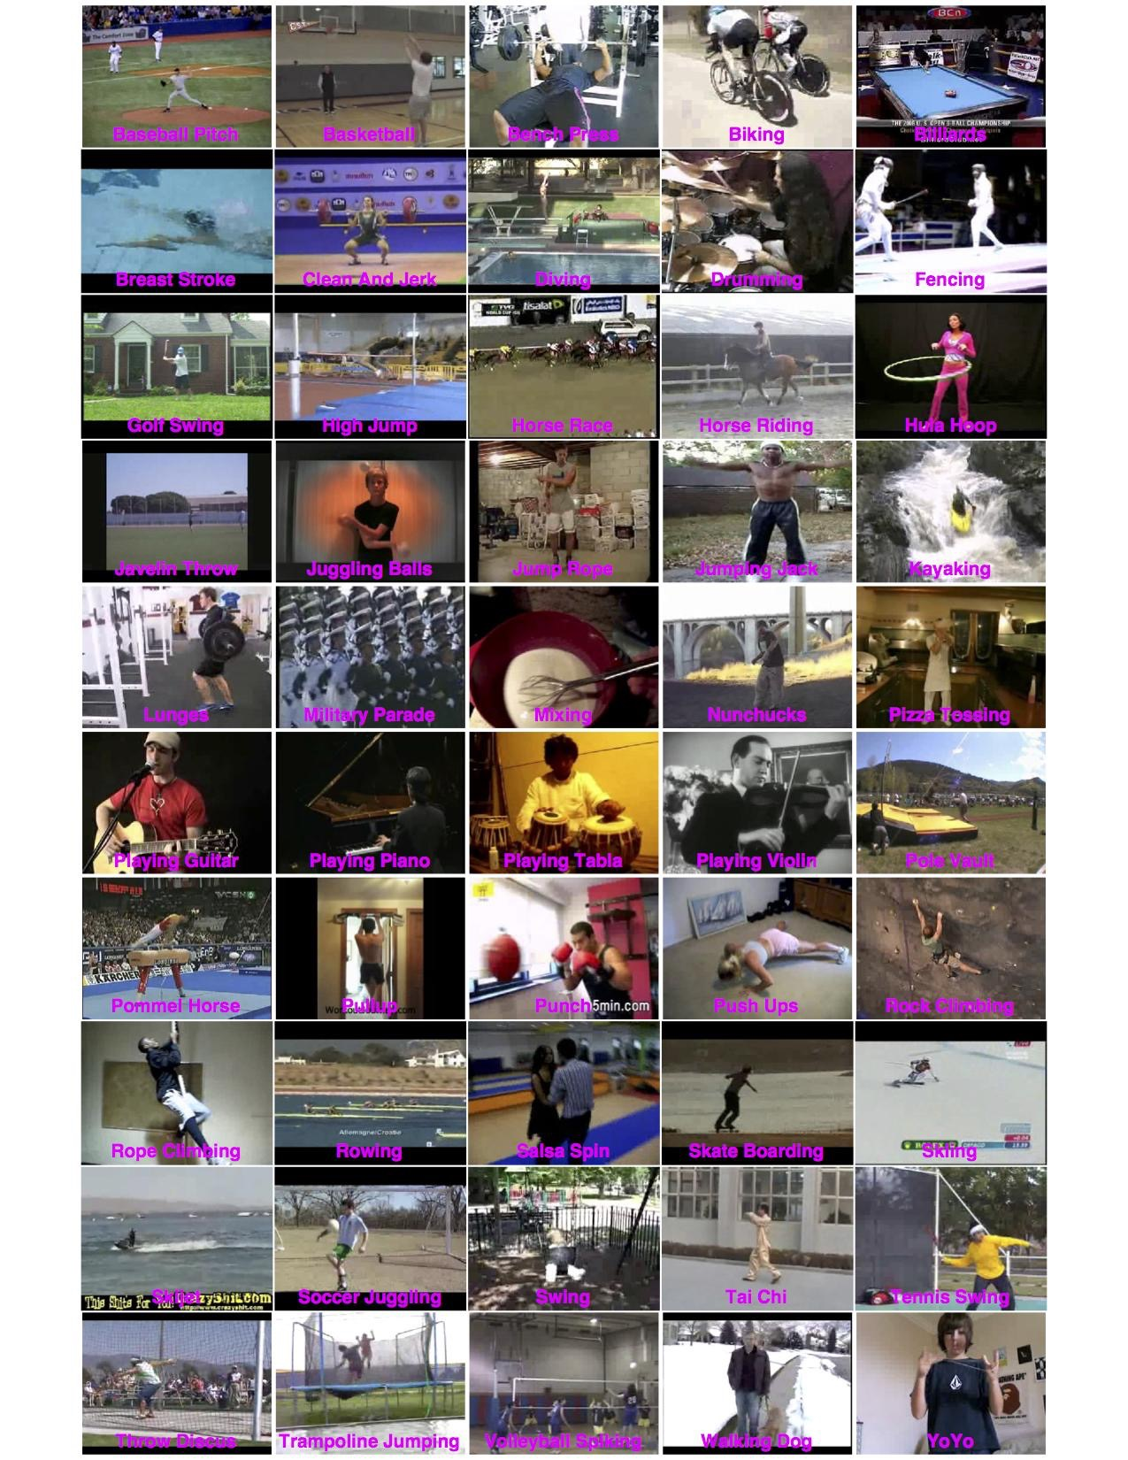
HAR Benchmarks
KTH Video Sequences^{[1]}
  Six actions, 600 video files with 160*120 frame size
UCF11^{[2]} and UCF50^{[3]} Dataset
UCF50 Dataset
KTH Sequences
UCF11 Dataset
[1] Christian S. et al. ICPR, 2004. [2] Jingen L. et al. CVPR 2009. [3] Kishore K. R. et al. ICECS 2012.
Notes:
To determine how the fixed-point implementation of HAR algorithm works, we have used 3 standard benchmarks for evaluation. The KTH sequence contains 6 actions with 25 different subjects. This sequence is recorded in controlled environment and is very simple. UCF11 is a dataset contains videos downloaded from youtube. There are total of 11 actions and each video clip contains one to multiple subjects. Also each action is divided into several different groups based on their similarity. This is a relatively difficult dataset. The UCF50 dataset is an extension of UCF11. It contains 50 different actions. This is the most difficult dataset we have used due to large number of actions being recognized with huge variations in subjects, backgrounds and camera motions. For the evaluation of UCF50 dataset, we only evaluate the actions that are not included in the UCF11.

Slide 11
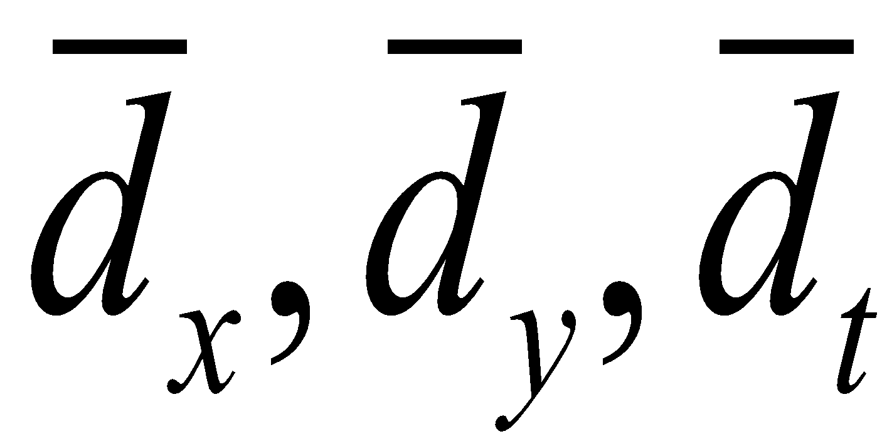
Fixed-Point Implementation
Fixed-Point Feature Extraction
  Study recognition performance under reduced bit-width
  HOG3D feature extraction
  Nearest neighbor search (histogram of code-word)
  Other operations in floating-point (K-means clustering, SVM training and cross-validation)
Bit-width for n-bit fixed-point
  Bit-width determined by analyzing the two benchmarks
dx, dy, dt
±0:8
I_{dx}, I_{dy}, I_{dt}
±16:8
pixel
0:8
Integral
Video
Mean-average
gradient
±10:(n-10)
Projection to
Icosahedron
Gradient
projection vector
10:(n-10)
L2 distance 10:2n
BOW 10:0
descriptor
0:n
cell hist
11:n-11
NN Search
Cell Hist.
L2 norm
hist 9:n-9
Cell Hist
Hist. Norm.

Slide 12
Fixed-Point Implementation
Fixed-point processing
Floating-point processing
dx, dy, dt
±0:8
I_{dx}, I_{dy}, I_{dt}
±16:8
pixel
0:8
Integral
Video
Mean-average
gradient
±10:(n-10)
Projection to
Icosahedron
Gradient
projection vector
10:(n-10)
L2 distance 10:2n
BOW 10:0
descriptor
0:n
cell hist
11:n-11
NN Search
Cell Hist.
L2 norm
hist 9:n-9
Cell Hist
Hist. Norm.
Notes:
We have constructed a fixed-point HOG3D features extraction algorithm in C++. The bit-width n passed to the program as a command line argument. We can select the bit-width at run time. Note that for an n-bit fixed-point computation, not all variables are n-bit. The exact bit-width is shown here. The input pixel is always 8-bit and the gradients are 9-bit (including signs). Then video integration is computed using 25 bit fxp. Note that upon this step, we have no precision loss. After that, 10 bit decimal and n-10 fractional for mean-average gradient. If n is smaller than 10, we simply set the fractional to 0 which means we just represent the range. Eventually, when we get BOW features, we have 1000 10 bit integers. Also note that the k-means clustering is performed in float-point and the centers are then converted to corresponding fixed-point (integer) values. For each bit-width, we extracted features and then perform k-means and build BOW features. Finally evaluate classification using cross-validation.

Slide 13
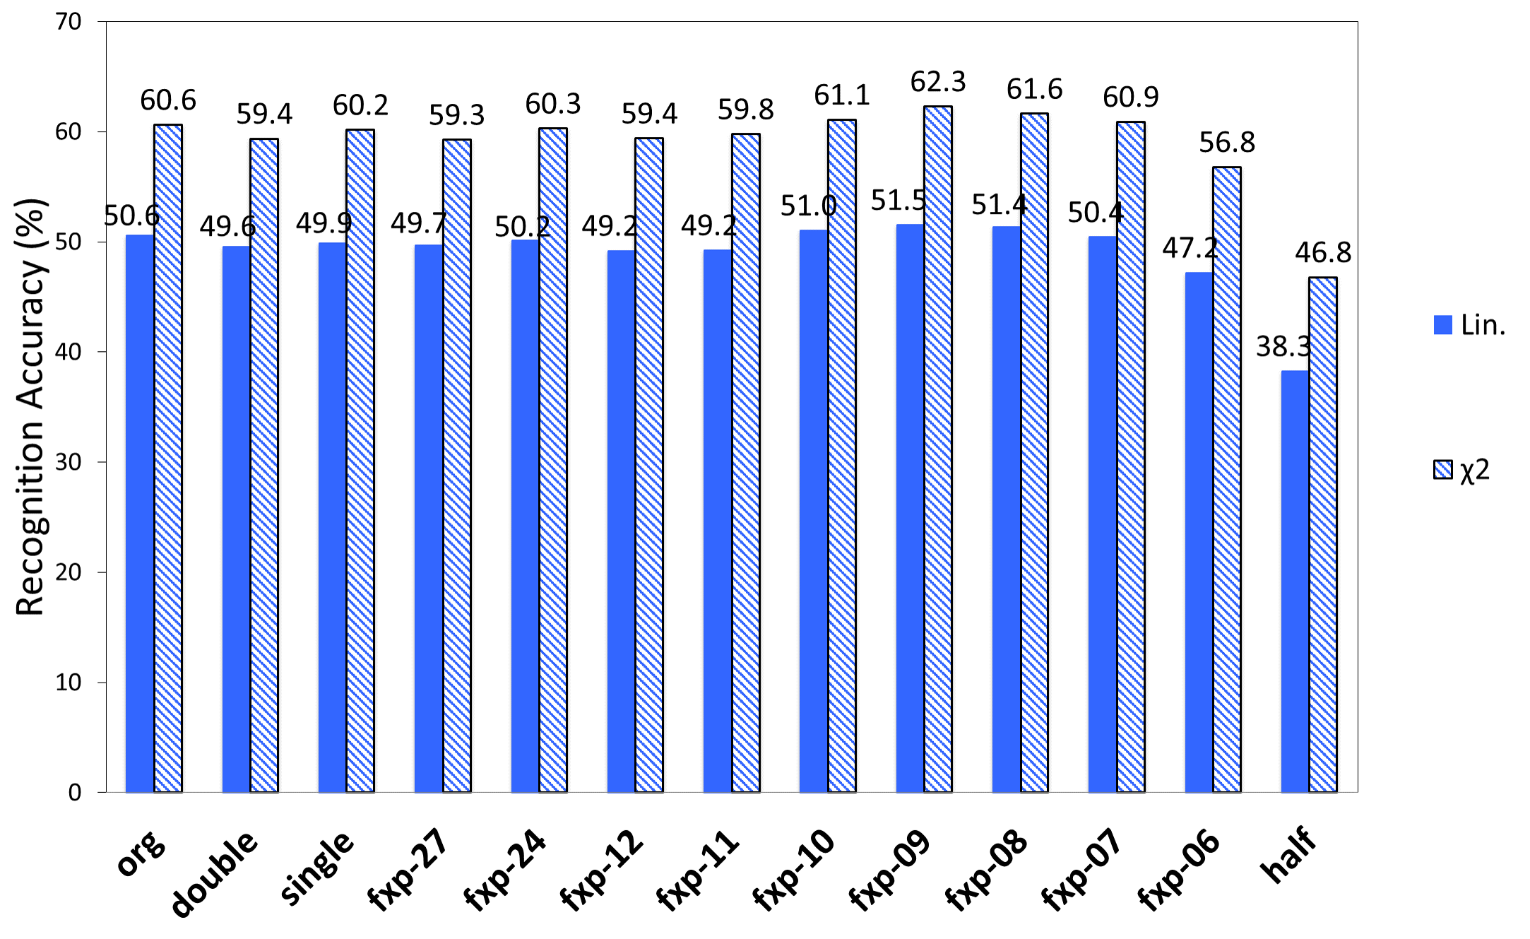
Recognition Results - UCF50
Notes:
This figure shows the result in cross-validation. The blue bar is the linear kernel and shaded bar is chi-squared kernel. This is the result for UCF50. In this test, the 8-bit and 7-bit fixed-point all outperforms the double precision floating-point. The half-precision is the worst in all cases.

Slide 14
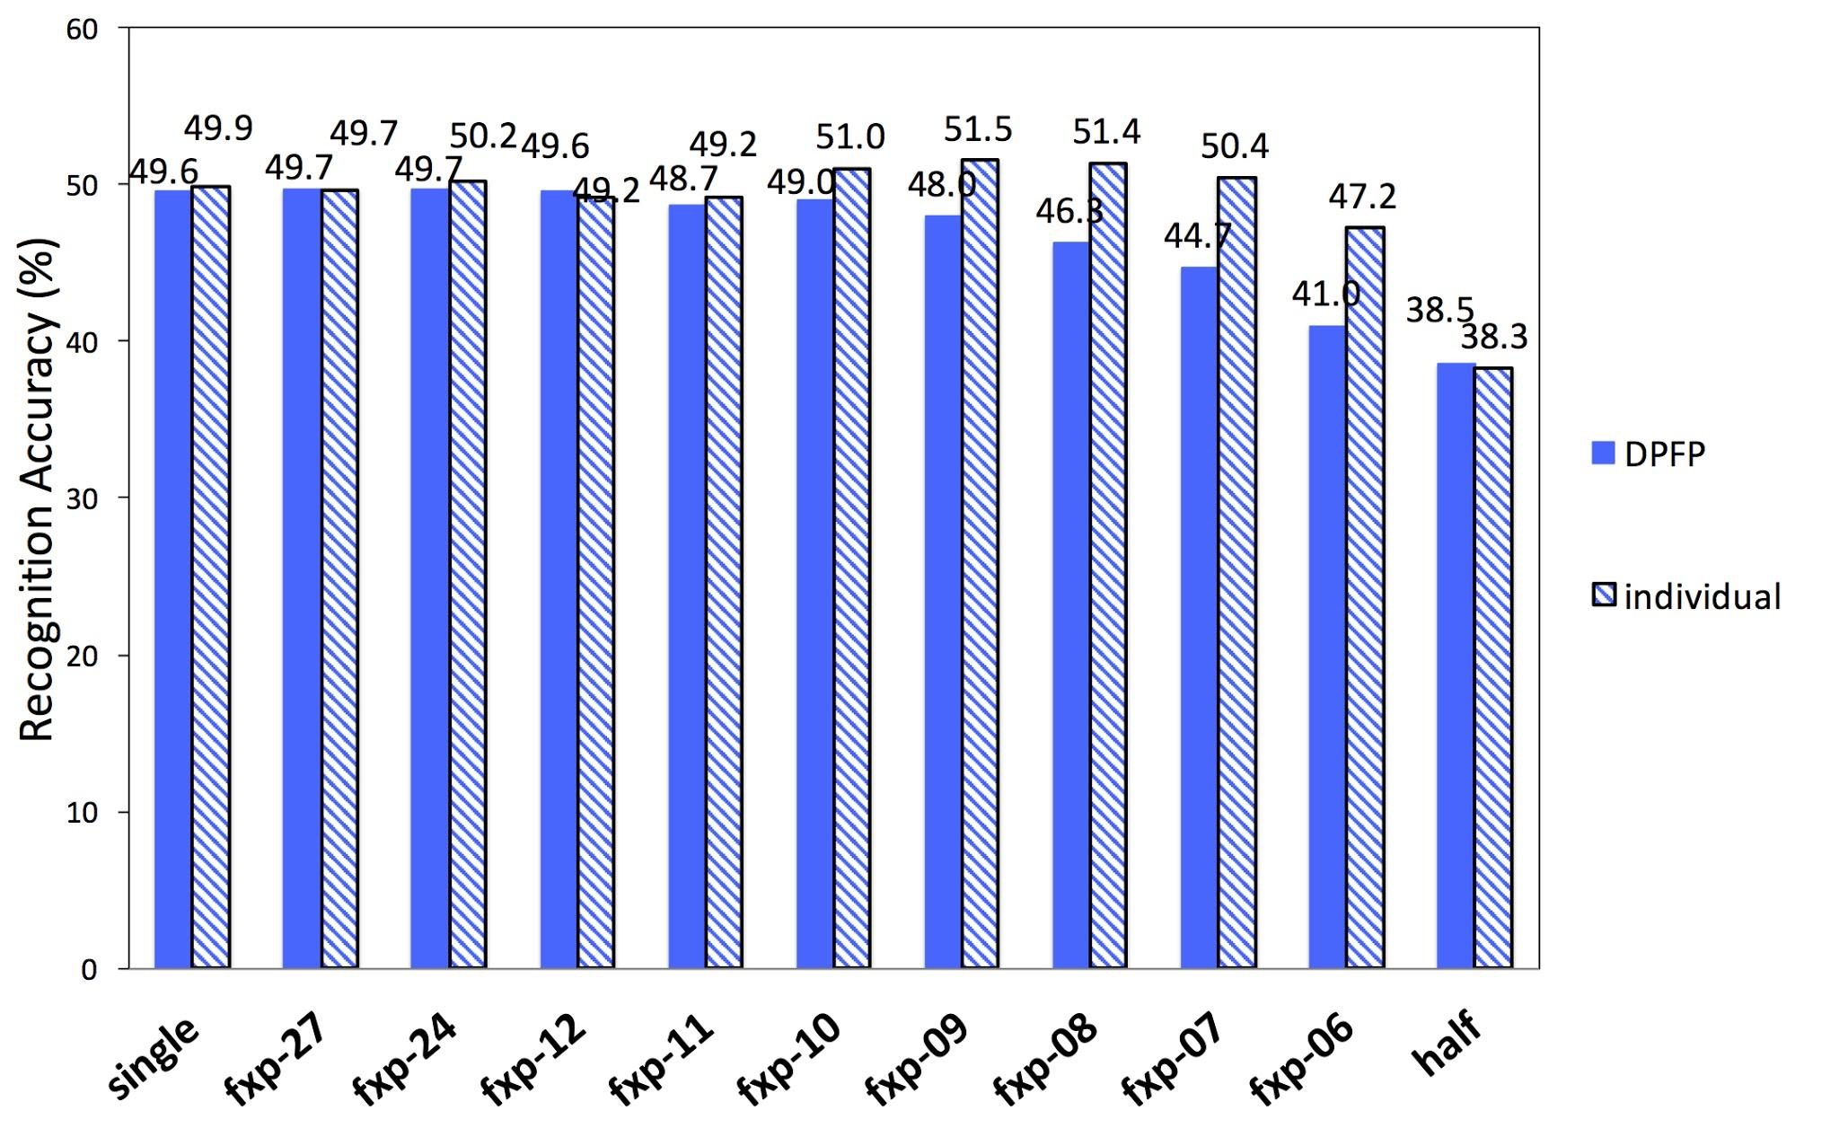
Effect of K-means - UCF50
Extract features in fixed-point
Build BOW features using centroids obtained from DPFP
Use Leave-One-Group-Out Cross Validation in SVM eval.
Notes:
So to study why the recognition works under low bit-width, we performed some further experiments. One thing to note is that for each bit-width, a k-means clustering is performed before building BOW features. So what if we don’t do k-means for each of the bit-width. Instead, use the centers generated by the DBFP values. Then perform cross-validation on using the BOW features. This figures shows the comparison between DPFP centers and individually trained centers as comparison. At high bit-width, the different between the two types of centers are very small. When the bit-width gets smaller, we observe a more significant different between the DPFP features and the individually trained features. The maximum difference here is at 6-bit fixed-point where using DPFP centers only have 41% accuracy but if you re-generate the centers by using k-means, the accuracy can be increased to 47.2%. This is a big difference.
individual means train the BOW features individually for each bit-width (as opposed to using DPFP features trained BOW)

Slide 15
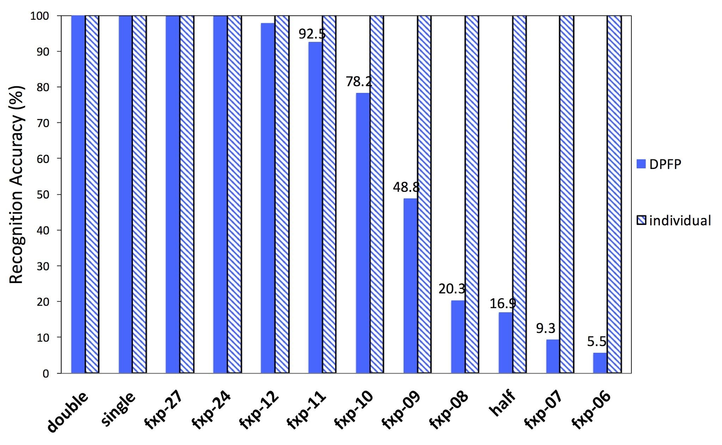
Effect of SVM Training - UCF50
Extract features in fixed-point
Build BOW using DPFP features
Use DPFP SVM model for recognition (no cross-validation)
Notes:
In addition to the effect of the k-means, we also studied if the SVM training has any effect on the actual result. To do that, we extract the features in fixed-point, and build BOW features using double precision floating-point centers. After that, we train a classifier using the DPFP BOW features. Then the SVM model is applied to all the BOW features at different bit-width. As comparison, the individual column is to use SVM model trained using BOW features at that bit-width. Because we directly applied the training data to test, the accuracy is expected to be 100%. On the other hand, when using DPFP features, the accuracy at low bit-width is very low.

Slide 16
Results Discussion
Re-building BOW features for features at each bit-width
Re-training SVM classifiers
Re-training can “compensate” for precision loss
Half-float performs worst in most cases
  Information loss at integral video/avg gradient
  Fixed-point implementation no information loss at early stage
  Information loss can be amplified at later stages
Notes:
To summarize the results, both k-means and SVM training can contribute the relatively high accuracy at low bit-width. The retraining process can actually compensate the precision loss during feature extraction. However, for half-precision floating-point, it seems that none of the above mentioned approach works. It is likely due to the information loss at integral video part. For fixed-point features, there is no information loss because there is no truncation. But for half-precision, as the integration value becomes larger, the precision is decreasing. The information loss is further amplified at later stages.

Slide 17
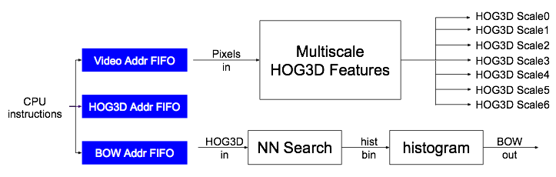
Implementation Overview
8-bit fixed-point
Vivado HLS + Verilog HDL (most parts)
  HLS: integral video + Cell HOG3D accumulation
  Verilog: All other parts
Platform: Virtex-6 LX760 on Convey HC-2ex
Two step implementation
  HOG3D cell features (97 frames with 320✕240 size)
  Nearest neighbor search (brute force, 1000 bins)
  Both steps are computation bound
Memory
Memory
Notes:
The FPGA implementation of the feature extraction involves two memory passes. One pass to generate HOG3D features and another pass to generate BOW features. The high level overview of the architecture is shown here. At the beginning, the CPU will send the base addresses to the FPAG address fifo. There are three types of base addresses, the input video, intermediate HOG3D features and the final BOW features. The video and BOW address are unique for each video, but the intermediate HOG3D features are re-used by using a circular FIFO. Everytime we pop our one address from FIFO to store current feature, once done, we put that address back into the FIFO for later use. One memory channel is used for pixel input and one for the HOG3D input. 7 channels are used for HOG3D output. Multi-scale HOG3D feature extraction are performed in parallel.

Slide 18
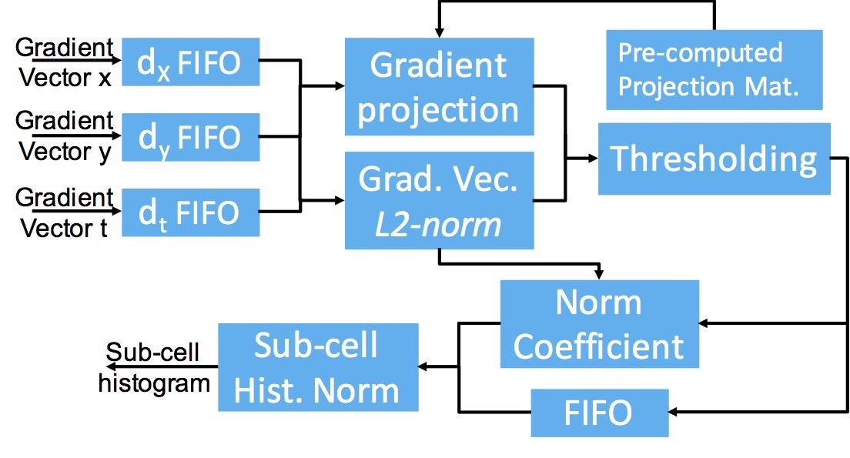
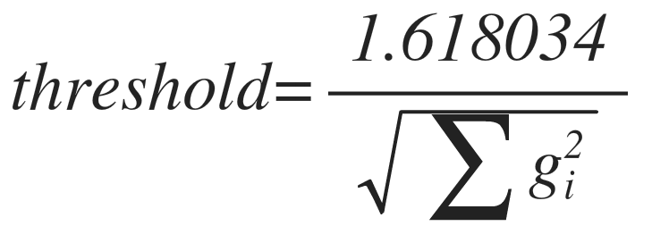
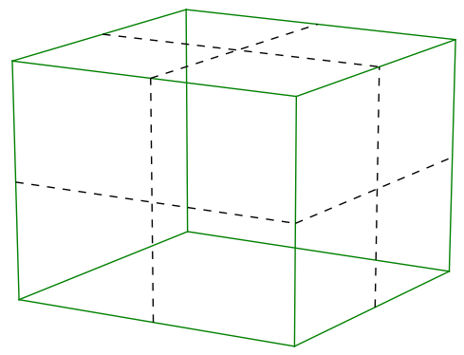
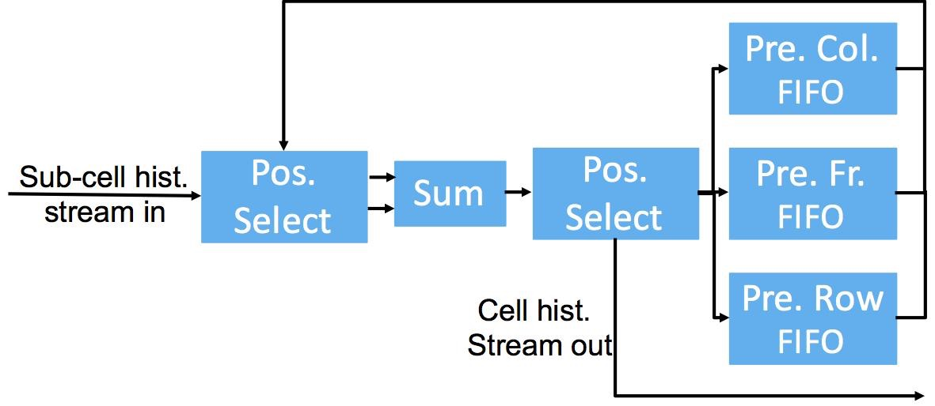
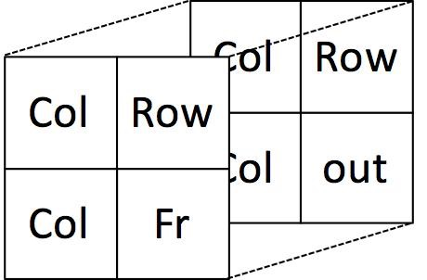
HOG3D Feature Extraction
Instantiate 7 copies
of feature extraction
(one for each scale)
HOG3D Cell with 8 sub-cells
8 sub-cells -> 1 cell
No overlapping between cells
Send cell histogram to RAM
FIFO selection based on position
Notes:
The video integration and gradient computation is implemented in Vivado HLS. Please refer our paper for the detailed optimization/implementation. We’ll focus on the extraction of HOG3D features part.
The sum of gradients is projected into the icosahedron space using a pre-computed projection matrix. This is a relatively straightforward pipelined implementation of several arithmetics. The projection and l2 norm of gradient vector are computed in parallel. This module needs 10 clock cycles to output the histogram which has 10 bins. So it will read new gradient vector every 10 clock cycles. Also note that we will have a separate histogram computation module for each scale. Another thing to note is that the normalization coefficient has a very large range, we used half-precision floating point for this division.
When the histograms are computed, they are streamed into this cell histogram accumulation module. There are 8 sub-cells per cell, but the sub-cell histograms are stream in in row-major order. So first we need to determine where current sub-cell belongs to. For example, it could be one of the eight positions in this figure. If it belongs column, it will be sent to a column fifo and combined with the next batch of histograms. If it belongs to this and this, it will be sent to row fifo to be combined with next row’s sub-cell histogram. If it belongs to here, it will be sent to frame fifo to be combined with sub-cell histograms in the next frame. Finally if it belongs to this corner, the histogram will be sent to the normalization module. The implementation is done in Vivado HLS. The generated cell histograms are sent back to main memory.

Slide 19
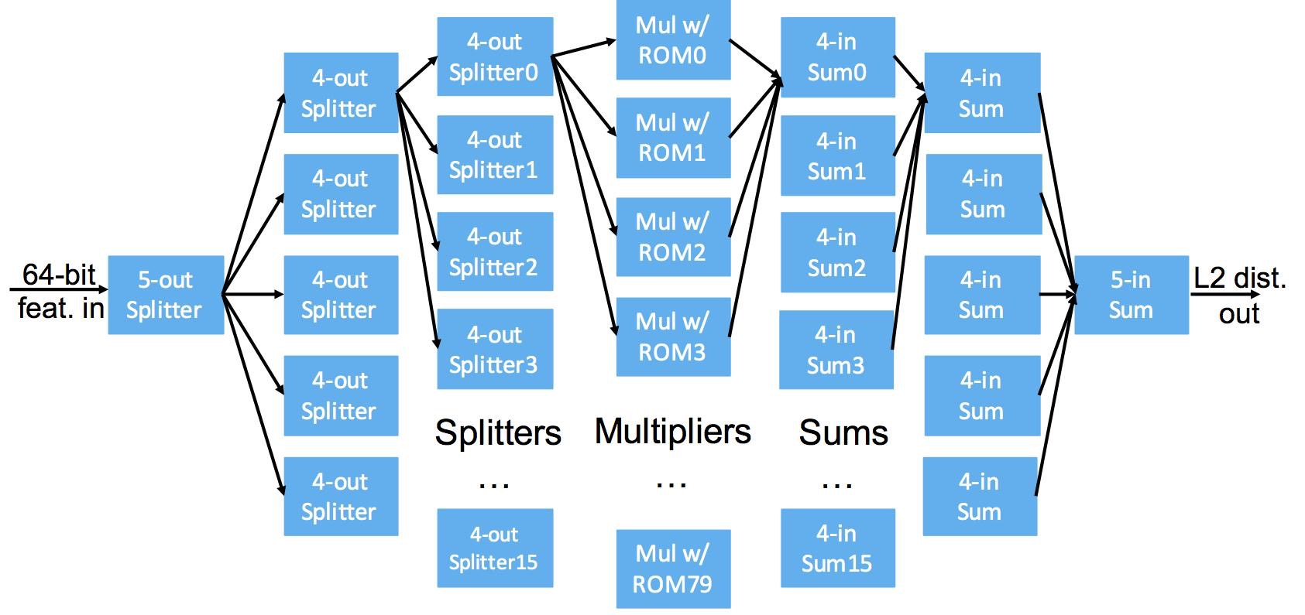
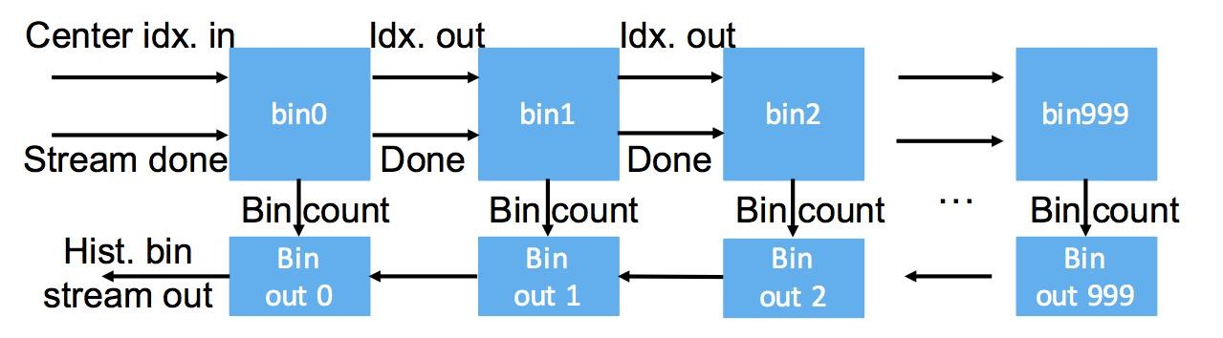
Generating BOW Features
NN Search
  640 data points
  1,000 centers (on-chip ROM)
  Parallel all 640 data points
  1,000 cc to finish a feature
Streamed Histogram Builder
  Each node check if the index belongs to it
  Yes: increment count
  No: pass to next node
  Counter to check when to finish and send done signal
  10,241 features/video
  stream out histogram and reset counter to 0

Slide 20
Synthesis Result
Xilinx ISE 14.7 with Convey PDK 2.0
Single FPGA
Attributes | Virtex-6 (Convey) (%)
Registers | 312,085 (32%)
LUTRam | 39,987 (30%)
LUTs | 197,025 (41%)
36KBrams | 247 (34%)
DSPs | 168 (19%)
Kintex-7 Ultrascale (%)
214,820 (32%)
15,068 (10%)
123,708 (37%)
265 (25%)
320 (20%)

Slide 21
Speedup Comparison
CPU: 8-core Xeon, 24G Ram C++ (TBB+SSE)
GPU: 4-core i7 8G Ram + Tesla K20c (CUDA 6.0)
FPGA: One Virtex-6 LX760 on Convey HC-2ex
Platform | Throughput (fps) | Speedup
CPU | 20.2 | 1
GPU | 1,616.0 | 80
one FPGA-fxp8 | 1,420.8 | 70
two FPGA-fxp8 | 2,841.6 | 140
FPGA speed is estimated using number of clock cycles to process the task at 150 MHz

Slide 22
Power Comparison
CPU: thermal design power (TDP)
GPU: NVIDIA System Management Interface (nvidia-sim)
FPGA: Xilinx Power Estimator (50% toggle rate)
Platform | Power (W) | Joules/Frame | Ratio (J/Frame)
CPU | 160.0 | 7.92 | 1
GPU | 85.0 | 0.053 | 149
1 FPGA | 28.1 | 0.020 | 396

Slide 23
Comparison With CNN
GPU Processing Speed Comparison
CNN Model^{[1]}
HOG3D is 75X faster, more suitable for real-time embedded applications
Platform | Throughput (fps)
HOG3D | 1,616.0
LRCNN^{[1]} | 21.0
[1] J. Donohue et al. Long-term recurrent convolutional networks for visual recognition and description. CVPR 2014

Slide 24
Conclusion
Fixed-point HAR Evaluation
  Retraining classifier/feature using reduced-precision features
  Evaluate accuracy using three benchmarks
  8-bit fixed-point works as well as DBFP (sometimes better)
  FPGA Implementation in 8-bit fixed-point
    First FPGA implementation targeting HAR
    70x speedup over multi-threaded CPU
    12.5% slower than GPU
    3x less power than GPU
Future work
  HOG3D + Auto-encoder hybrid model to increase accuracy
  Targeting on embedded platform (Kintex-7) instead of a supercomputer
  Fixed-point GPU implementation
Notes:
the 3x less power is for Watts and 2.66x less power is for J/frame.

Slide 25


