Slide 1
Accelerating Recurrent Neural Networks in Analytics Servers: Comparison of FPGA, CPU, GPU & ASIC
Presenter: Eriko Nurvitadhi, Accelerator Architecture Lab @ Intel Labs
Authors: E. Nurvitadhi, J. Sim, D. Sheffield, A. Mishra, S. Krishnan, D. Marr (Intel)

Slide 2
Recurrent Neural Networks (RNNs)
Days
(prediction)
O₀
O₁
O₂
O₃
O_{t}
O_{t}: output vector
Recurrent connection
NeuralNet
NN
NN
NN
NN
Sentence Completion Example
I_{t}
I₀
I₁
I₂
I₃
I_{t} : input vector
A
(word0)
Week
(word1)
Has
(word2)
Seven
(word3)
Great for analytics of data with sequences, popular in language modeling
Studied Gated Recurrent Unit (GRU): an RNN variant offering top accuracy

Slide 3
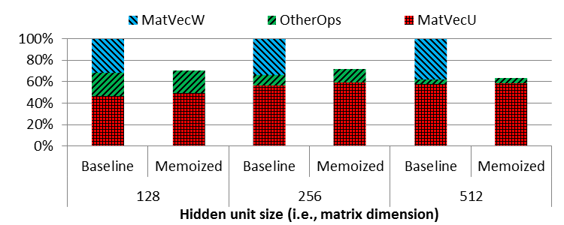
Software Profiling & Optimization on Xeon Server
GRU
O_{t}
$$z_{t}=σ (W_{z}. I_{t}+U_{z}.O_{t−1})$$
$$r_{t}=σ (W_{r}. I_{t}+U_{r}.O_{t−1})$$
Recurrent connection
O_{t-1}
×
+
×
1-
×
r_{t}
z_{t}
Õ_{t}
$$σ$$
$$σ$$
tanh
SGEMVs (MatVec*) on small/med matrices account for most of runtime
Memoization improves
performance by ~40%
$${\tilde{O}}_{t}=tanh(W. I_{t}+r_{t}.U.O_{t−1})$$
I_{t}
$$O_{t}=z_{t}.O_{t−1}+\left(1−z_{t}\right).{\tilde{O}}_{t}$$
I values known (i.e., words in vocab) → Memoize
Notes:
GRU software
Faster RNN from Yandex
Vary hidden units:128-512
from prior RNN/GRU papers
Penn Tree Bank dataset
10K vocab, 3K sentences
On an Intel Xeon Server
2.3 GHz E5-2699v3

Slide 4
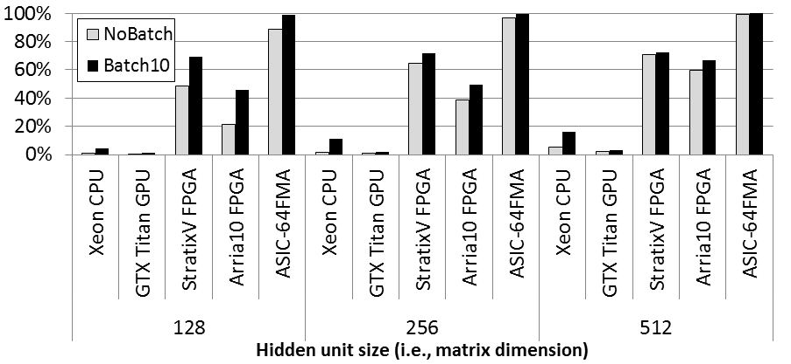
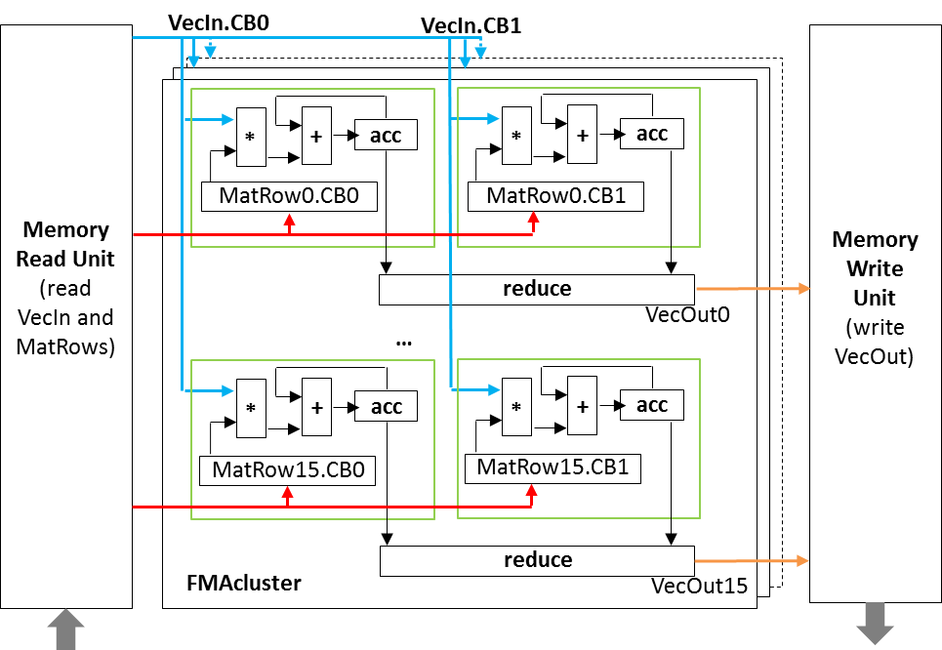
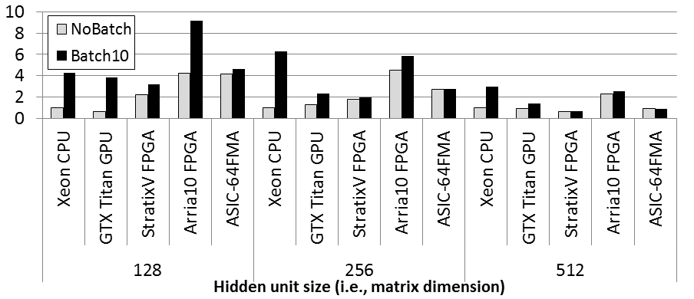
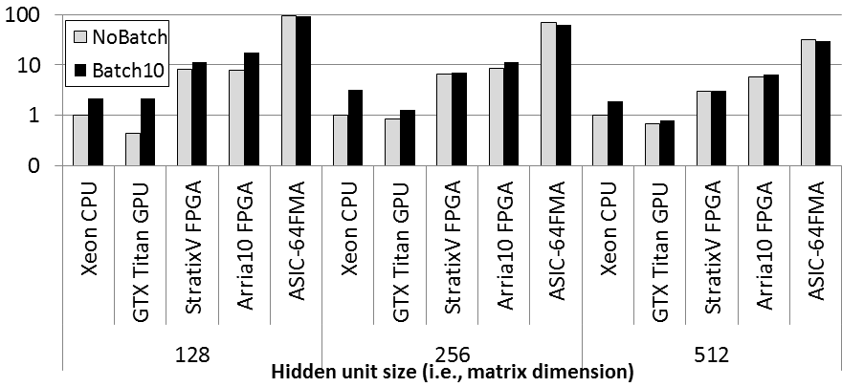
FPGA vs. ASIC vs. GPU vs. CPU
% FLOPs utilized
GEMV accelerator
Stratix V/Arria 10 FPGAs
Performance vs CPU
14nm ASIC
Titan X GPU
GEMV on optimized SW lib(MKL, cuBLAS)
Xeon CPU
Performance/Watt vs CPU
FPGA ~10x better in perf/watt vs CPU/GPU
FPGA ~7x worse in perf/watt vs ASIC

Slide 5
Accelerating Recurrent Neural Networks in Analytics Servers: Comparison of FPGA, CPU, GPU & ASIC
Presenter: Eriko Nurvitadhi, Accelerator Architecture Lab @ Intel Labs
Authors: E. Nurvitadhi, J. Sim, D. Sheffield, A. Mishra, S. Krishnan, D. Marr (Intel)

Slide 6
Gated Recurrent Unit (GRU)
GRU
O_{t}
“Update Gate”
$$z_{t}=σ (W_{z}. I_{t}+U_{z}.O_{t−1})$$
Standard RNN
O_{t}
“Reset Gate”
$$r_{t}=σ (W_{r}. I_{t}+U_{r}.O_{t−1})$$
Recurrent connection
O_{t-1}
O_{t-1}
Recurrent connection
×
+
Add to merge
×
1-
×
U
r_{t}
z_{t}
Õ_{t}
Current
History
tanh
$$σ$$
$$σ$$
tanh
W
$$O_{t}=tanh(W. It+U.O_{t−1})$$
Not so good in learning
long-term dependence. E.g.,
“I grew up in France, …,
I speak fluent French”
I_{t}
$${\tilde{O}}_{t}=tanh(W. I_{t}+r_{t}.U.O_{t−1})$$
I_{t}
$$O_{t}=z_{t}.O_{t−1}+\left(1−z_{t}\right).{\tilde{O}}_{t}$$
GRU: state-of-the-art RNN variant offering top accuracy

Slide 7
Software Profiling & Optimization on Xeon Server
GRU software
Faster RNN from Yandex
Vary hidden units:128-512
from prior RNN/GRU papers
Penn Tree Bank dataset
10K vocab, 3K sentences
On an Intel Xeon Server
2.3 GHz E5-2699v3
SGEMV operations (MatVeW, MatVecU) account for most of runtime
Memoization improves
performance by ~40%
Notes:
GRU software
Faster RNN from Yandex
Vary hidden units:128-512
from prior RNN/GRU papers
Penn Tree Bank dataset
10K vocab, 3K sentences
On an Intel Xeon Server
2.3 GHz E5-2699v3

Slide 8
Executive Summary
Recurrent Neural Network (RNN) is a key algorithm in data analytics
e.g., in language model (sentence completion, sentiment analyses, etc)
Gated Recurrent Unit (GRU) is state-of-the-art RNN variant
top accuracy & more compute efficient than LSTM (another RNN variant)
This work: study opportunity to FPGA-accelerate GRU in analytics servers
Profiling & found hotspot → dense matrix * vector on small/med matrices
New algorithmic optimization by memoization → ~40% speedups in SW
Developed accelerator, evaluate on FPGA and ASIC, compare w/ CPU, GPU
FPGA is ~10x better performance/watt vs CPU&GPU, ~7x worse than ASIC

Slide 9
GRU Computation Flow
hsz
Multiplication on U,Ur,Uz and W,Wr,Wz weight matrices account for most of compute
O_{t-1}
*
Ur
=
hsz
r_{t}
word_{t}
σ
esz
+
=
=
I_{t}
*
Wr
=
vsz
*
U
=
+
=
Words encodings
(In-memory lookup table)
$${\tilde{O}}_{t}$$
*
+
tanh
W
=
=
=
(1-z_{t}).${\tilde{O}}_{t}$
*
=
*
Uz
=
z_{t}
1-z_{t}
O_{t}
σ
+
=
=
1-
+
=
*
Wz
=
x
z_{t}.O_{t-1}

Slide 10
Proposed Optimization: Memoize It.Wr, It.W, It.Wz
hsz
O_{t-1}
*
Ur
=
hsz
r_{t}
Use more memory, but require less compute (i.e., no need to multiply W matrices)
word_{t}
σ
+
=
=
Words encodings.Wr
I_{t}.Wr
vsz
*
U
=
+
=
$${\tilde{O}}_{t}$$
Words encodings.W
I_{t}.W
+
tanh
vsz
=
=
(1-z_{t}).${\tilde{O}}_{t}$
*
=
*
Uz
=
z_{t}
1-z_{t}
O_{t}
σ
+
=
=
1-
+
=
Words encodings.Wz
I_{t}.Wz
vsz
x
z_{t}.O_{t-1}

Slide 11
FPGA vs. ASIC vs. CPU vs. GPU Study
Develop GEMV accelerator
Mapped to FPGA and ASIC
FPGA: Stratix V, Arria10
ASIC: 14nm Intel tech
Optimized CPU and GPU SW
CPU: MKL on Intel Xeon
GPU: cuBLAS on Nvidia Titan X
GEMV parameters
128x128 to 512x512 matrices
No batch and batch of 10
GEMV Accelerator Design

Slide 12
FPGA and ASIC Accelerators Studied
FPGA Accelerators
Accelerator Design | FPGA | ALMs | DSPs | BRAMs
8 clusters, 256 FMAs | Stratix v | 296K | 256 | 4MB
32 clusters, 1024 FMAs | Arria 10 | 224K | 1024 | 4MB
ASIC Accelerator

