Slide 1
Overcoming Resource Underutilization in Spatial CNN Accelerators
Yongming Shen, Michael Ferdman, Peter Milder
COMPAS Lab, Stony Brook University

Slide 2
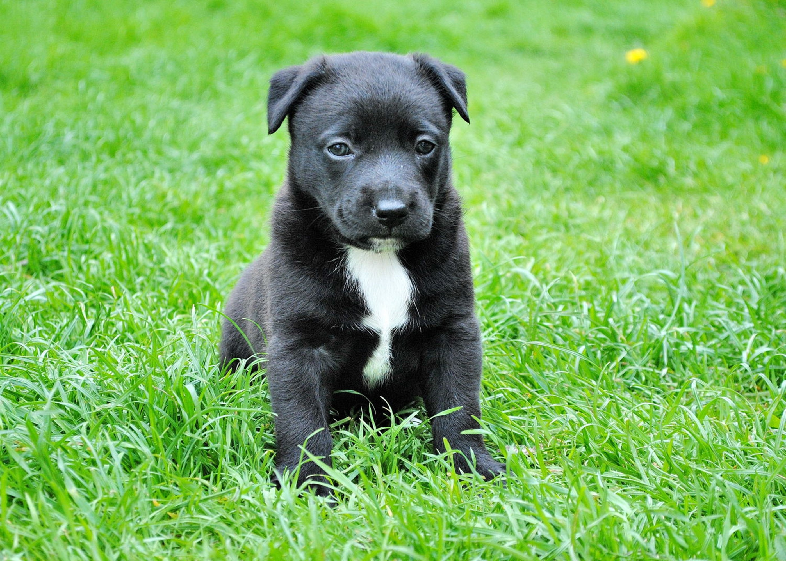
CNN on FPGAs
Convolutional Neural Networks (CNNs)
Best known method for object recognition [Simonyan, ICLR2015]
Massive amount of computation
Highly parallel, amenable to hardware acceleration
FPGA-based CNN Acceleration
Lots of compute units (DSP slices) →Exploit parallelism
Reconfigurable fabric →CNN-tailored caches and dataflow
Energy efficient
Conv. Layer 1
Conv. Layer 0
Conv. Layer 2
DOG

Slide 3
The Underutilization Problem
State-of-the-art: whole FPGA → one processor [Zhang, FPGA2015]
Single-CLP (Convolutional Layer Processor)
Dimension mismatch causes dynamic underutilization
Part of the compute array becomes idle
Only 74% average utilization with AlexNet on Virtex-7 485T
Less than 30% average utilization on larger FPGAs (~10K DSP slices)
40% Util.
FPGA
Conv. Layer 1
Conv. Layer 0
100% Util.
Conv. Layer 2
CLP
100% Util.
45% Util.

Slide 4
Our Multi-CLP Solution
Single large CLP → Multiple smaller CLPs
Total DSP-slice consumption remains the same
Each CLP optimized for a subset of layers
Multiple images in flight at the same time
Avoids data dependency between CLPs
AlexNet on Virtex-7 485T (simulation)
74% util. → 97% util., 1.3x speedup
AlexNet on FPGAs with ~10K DSP slices (model)
30% util. → 96% util., 3.2x speedup
FPGA
FPGA
CLP
CLP0
CLP1
CLP2

