Slide 1
Harnessing Programmable SoCs to Develop Cost-effective Network Quality Monitoring Devices
M. Ruiz, J. Ramos, G. Sutter, S. López-Buedo, J.E. López de Vergara, C. Sisterna
High-Performance Computing and Networking Research Group, Universidad Autónoma de Madrid, Spain and y NAUDIT HPCN, Spain
gustavo.sutter@uam.es

Slide 2
Motivation
Networks are pervasive: It is therefore essential to guarantee the quality of network links
Computer networks become a critical infrastructure, where malfunctions cannot be tolerated.
Therefore, monitoring devices are mandatory in order to assess the quality of network links
  Typical measures are: Bandwidth, packet loss, Delay and Jitter
However, a widespread deployment of network monitoring devices might not be economically feasible.

Slide 3
Solution: Key ideas
In multi-Gb/s links software-only solutions are no longer valid, because the timescales of current networks call for custom-hardware solutions.
We propose the use of Programmable System-on-Chip FPGAs (PSoCs) for enabling a comprehensive testing of networks.
Thus, we show that PSoCs are a perfect fit for network quality monitoring devices
Being that modern PSoCs goes up to 100 Gb/s, so it would be possible to use the proposed monitoring approach at both access and transport networks.

Slide 4


Time Synchronization
Quality monitoring devices will be placed at network edges as well as in the intermediate transport infrastructure
However, this strategy requires that all network monitoring devices are time-synchronized.
Time synchronization is not trivial. In local area networks PTP but not valid for Internet-wide measurements
The most common alternative is to use Global Positioning System (GPS) receivers (accuracy close to an atomic clock at a reasonable price).

Slide 5
Board Clock Analysis
For our proof-of-concept we chose a ZedBoard platform (Zynq-7020 part), and a GlobalTop Ladybird 3 GPS.
We use the reference GPS pulse per second (PPS) signal and measure the clock drift.
Error of clock after 72 hs of measured.
The accumulated error can be up to 0.5 sec per day.

Slide 6
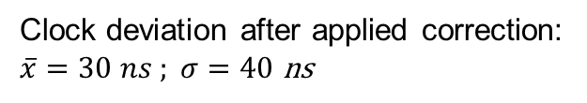
Board Clock Drift Correction
A hybrid solution that takes advantage of using a PSoC:
  Implement the clock synchronizer in hardware (a variable counter and a tuning module).
  And the algorithm to correct the drift in software (process in GNU/Linux OS implements Proportional-Integral (PI) controller) .
Clock deviation after applied correction:
$\overline{x}=30 ns ; σ=40$ ns

Slide 7
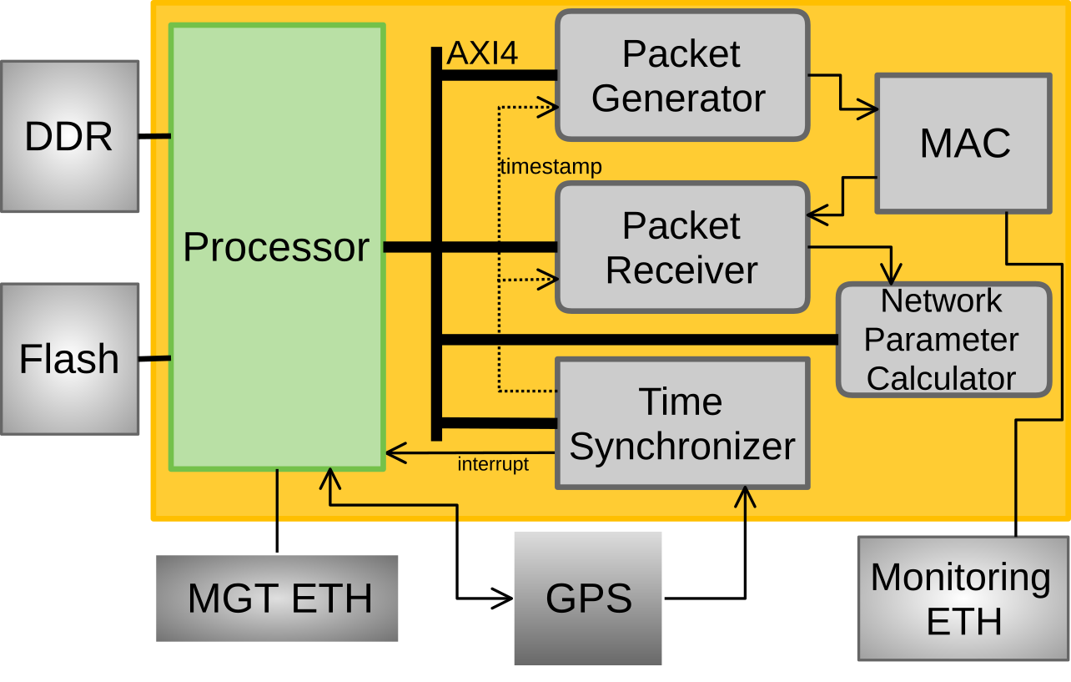
Network Measurement Architecture
We implement the packet-train technique [13]. The HW is controlled by ARM processor.
  A core dynamically generates User Datagram Protocol (UDP) precisely timestamped
  Another core receives packets and timestamp arrivals
  The network parameter calculator computes statistics
  We leveraged the Vivado-HLS tool in order to speed up development.

Slide 8
Results
In order to validate the prototype, throughput and delay was measured for different packet length and scenarios
The measured values are fairly close to theoretical ones, and the standard deviation is negligible.

Slide 9
Conclusions
We validate a low cost, low power (< 8,5 W) solution for network probes based on PSoC.
Throughput and delay could be measured with extremely high accuracy. Mandatory for 10 Gb/s and beyond
Low cost GPS-based mechanism for time synchroni-zation (achieving a clock drift of less than 110 ns)
The proposed proof-of-concept can be easily ported to 10/40/100 Gb/s links (since all blocks use std AXI interfaces)
Leveraged the use of high-level synthesis in order to reduce development time

Slide 10

Questions
See you at poster session

