Slide 1
Modeling Considerations for the Hardware-Software Co-design of Flexible Modern Wireless Transceivers
Benjamin Drozdenko, Matthew Zimmermann, Tuan Dao, Kaushik Chowdhury, Miriam Leeser
Northeastern University, Boston, MA
Field Programmable Logic and Applications (FPL)
August 29 – September 2, 2016
Acknowledgments:

Slide 2
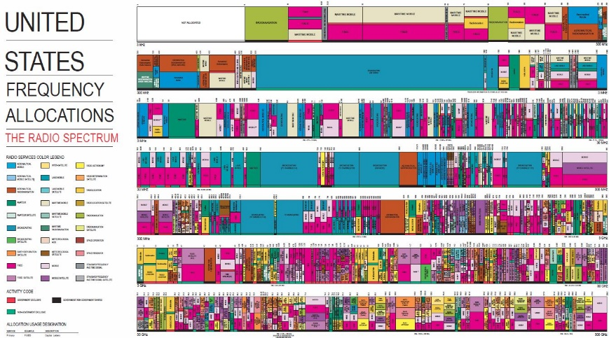
Wireless Transceivers: Prevalence and Challenges
Surge in wireless devices
10B devices today, 50B by 2050
$14 trillion business over next 10 years
2.4, 5.8 GHz:
802.11a/b Designated ISM Bands
LTE
Wi-Fi
54-60, 76-88,
470-698 MHz:
802.11af TV Whitespace Reuse
Challenges: Times Change
C1: Adapt to changing protocols to handle contention
C2: Maintain/increase bit rates
C3: Decrease energy usage and error rates
3.55-3.65 GHz:
Military RADAR Reuse
C4: Change center frequency to use new bandwidths
Notes:
Here, I tell a story! In recent years, the field of wireless technology has seen a tremendous surge in the diversity of devices, protocols, and applications. As the need grows for the use of wireless networks for more diverse, data heavy applications, wireless protocols must be adapted to meet the various needs of these applications. The current standard for wireless laptop communications is known as Wireless Firewall (Wi-Fi), using the 802.11g standard. This protocol has evolved to support multiple antenna operation in 802.11n, low power consumption in 802.11ah, and higher bit rates in 802.11ax. The latest standard for mobile phone technology is known as 4th generation (4G) long-term evolution (LTE), and many research projects are in place to prototype and test 5th generation (5G) technology.
The increase in the sheer number of devices has introduced several issues in wireless networking, including increased congestion, spectrum scarcity, larger data sizes, and increased demands for energy. First, modern-day wireless communications standards are constantly evolving to meet the needs of an increasing number of devices. Each protocol introduces new challenges that need to be addressed, including ways to address contention in an overcrowded wireless spectrum. Second, the problem of spectrum scarcity has caused the FCC to open up new bandwidths for use by multiple protocols. Statistics have shown that there are large differences in utilization of spectrum bandwidths.
While the bandwidths using LTE are frequently overutilized and congested, bandwidths reserved for other purposes may often be underused. For this reason, the FCC has opened up previously-reserved bandwidths for reuse, such as the TV whitespace bandwidths.
Third, the advent of big data and the emergence of streaming applications have brought about a need for sending more data in a shorter amount of time. For this reason, modern protocols must support higher bit rates and lower error rates. Finally, wireless mobile devices must be recharged infrequently; hence, devices must evolve to consume less energy.

Slide 3
HW-SW Prototyping Platform: Software Tools
HDL Coder: Create HW Description Language (HDL) code
Vivado: Synthesize, Implement, and Generate FPGA Bitstream
Embedded Coder: Generate C code for ARM Processor
MathWorks Simulink™ Model
FPGA
Zynq SoC
Transmit Path
Embedded Coder™
CPU
Ethernet
(to CPU)
1
2
3
4
5
6
C Code
ARM Executable
Receive Path
HDL Coder™
7
6
5
4
3
2
JTAG
(to FPGA)
HDL Code
FPGA Bitstream
Xilinx Vivado®
Host PC: Runs SW Tools
Zynq-Based Heterogeneous Computing System
Notes:
First, mention something about the HW we’re using, but don’t actually say what JTAG stands for.
Our HW consists of an RF front end, the ADI FMComms3 board; a Xilinx Zynq evaluation board; and a host computer. We attach an Ethernet cable and a JTAG cable between the host PC and the Zynq board and connect the FMComms3 board to the FPGA Mezzanine Card (FMC) slot on the Xilinx FPGA board. The FMComms3 features the wideband wireless AD9361 transceiver chip, which supports up to 2 transmit (Tx) and 2 receive (Rx) channels at bands from 70 MHz to 6.0 GHz. We use the ethernet cable to send start and stop signals from host PC to Zynq PS. The 802.11a transceiver system contains both a Tx path, from PS to PL to FMComms3, and a Rx path, from FMComms3 to PL to PS, as shown.
Second, mention the SW tools we’re using, and the HW-SW codesign workflow.
To target the hardware described above, we use commercially available tools from MathWorks and Xilinx as illustrated. We use MathWorks Simulink to create and simulate synchronous dataflow models. Specialized toolboxes from MathWorks, HDL Coder and Embedded Coder, allow us to target the PL and PS, respectively. Additional MathWorks hardware support packages allow us to interface with the Zynq SoC and the ADI FMComms3.
We start by making a Simulink model to capture all the information about the Zynq transceiver system. In this model, we set radio parameters such as sampling frequency and number of samples per frame. We distinguish one subsystem in the model to target for execution on the PL, presuming that all the other model components are targeted to run on the PS. We run the MathWorks HDL Workflow Advisor wizard to auto-generate an IP Core block for the Tx or Rx design under test (DUT). The wizard auto-generates a Vivado block diagram to combine the DUT with all the AXI interface components. The wizard creates a generated model to interact with the PL via AXI. Then, the wizard invokes Xilinx Vivado from the command line to synthesize, implement, and make a Bitstream. We program the PL with this bitstream.
Finally, we generate an executable for the PS using MathWorks tools. By setting the generated Simulink model to run in External mode, Simulink uses Embedded Coder to generate C code for all processing blocks in the Simulink model. Then, Simulink invokes Xilinx SDK to package and compile the executable for the PS. When we press the play button in the Simulink model, it sends a signal via Ethernet to launch the executable on the PS.

Slide 4
Modeling the HW-SW Divide Point: 7 Model Variants
Tx Path
1: Additive Scrambling
2: Convolutional Encoding
3: Block Interleaving
4: Digital (BPSK) Modulation
5: OFDM Modulation
6: Preamble Insertion
V7
SW HW
V6
SW HW
V5
SW HW
V4
SW HW
V3
SW HW
V2
SW HW
V1
SW HW
Rx Path
1: Preamble Detection
2: OFDM Demodulation
3: Digital Demodulation
4: Block Deinterleaving
5: Viterbi Decoding
6: Descrambling
FPGA
Zynq SoC
CPU
Transmit Path
1
2
3
4
5
6
Receive Path
6
5
4
3
2
1
Zynq-Based Heterogeneous Computing System
V1: SW-only model
V2: Adds Tx6 & Rx1 to HW
V3: Adds Tx5 & Rx2 to HW
V4: Adds Tx4 & Rx3 to HW
V5: Adds Tx3 & Rx4 to HW
V6: Adds Tx2 & Rx5 to HW
V7: HW-only model
Notes:
Briefly mention something about the “HW-SW divide point” and how it creates “model variants”.
Each design variant moves data once between PL and PS. The reason that there is only one HW/SW divide point is that transferring data between computing elements adds additional overhead that we want to minimize. In proposed work, I will incorporate more divide points.
For the transmitter, each design variant adds one new block in FPGA hardware. V1 has the complete processing in software on the ARM processor. Subsequent designs assign one or two additional components to the PL, starting with the component closest to the RF board. Seven different versions were explored, where V7 has the entire Tx chain implemented on the PL. These versions are identified in this graphic. V1 is a SW-only design that implements all functional blocks on the ARM processor. V2 moves the preamble insertion onto the PL. The preamble insertion block is placed at the end of the transmit processing chain, just before the RF front end. We apply OFDM modulation to the preamble beforehand and store the processed data in a lookup table. V3 adds the IFFT and cyclic prefix attachment components to HW. V4 adds the BPSK Modulation and Symbol-to-Subcarrier mapping components to HW. V5 adds the Block Interleaving component to HW. V6 adds the Convolutional Encoder component to HW. V7 is a HW-only design that only does file I/O on the PS and performs all processing on the PL fabric.
A similar approach is taken for the receiver model, for which we also model seven variants. The PS-Only design is designated V1, and PL implementation versions increase incrementally from there. V2 adds the Preamble Detection component to reconfigurable HW. The preamble detection method uses a matched filter block to efficiently correlate two frames of fixed-point input samples with the expected long preamble sequence. Each subsequent version from V3 to V7 adds an additional component of the frame recovery subsystem to the PL. V3 adds OFDM modulation to the PL, including cyclic prefix removal and FFT. The FFT block adds a latency of 159 samples before the output is valid. V4 adds BPSK demodulation and subcarrier-to-symbol mapping to the PL. It uses a delay line to gather the 64 valid samples and a selector to reorder them and remove the pilot and empty guard subcarriers. V5 adds block de-interleaving to the PL using a selector. V6 adds Viterbi decoding, which introduces a delay of two frames. V7 adds the Descrambler component to the PL.

Slide 5
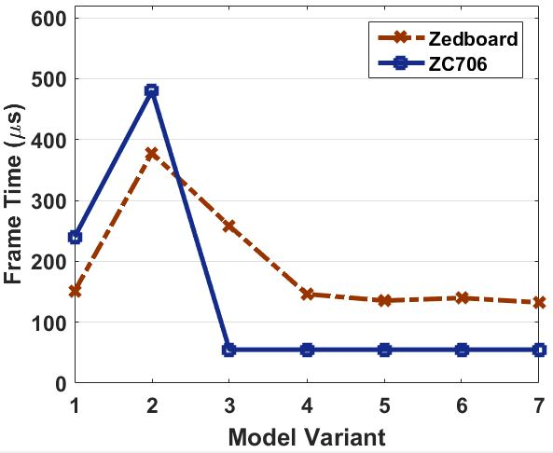
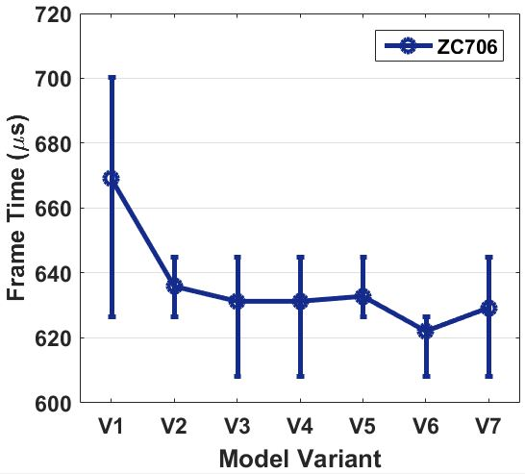
Results: CPU Execution Time Tx on Zedboard & ZC706, Rx on ZC706
Notes:
Say why this Tx slide has 2 lines: 1 for Zedboard, 1 for ZC706.
Main Points: Tx on Zynq
Moving one processing block from SW to HW does not necessarily cause speedup
Increase in Tx frame time on ZC706 from V1 to V2 is proof
V1 is SW-only, requires no AXI communication
Keeps all operations in SW
V2 adds small component to HW
Time saved < time spent on CPU-FPGA data transfer
Our modeling environment can identify location at which HW-SW interface is best placed
Main Points: Rx on ZC706
Rx maximum CPU frame time decreases as more blocks are moved onto the FPGA
Preamble detection is revealed to be the biggest bottleneck in the Rx model
Moving it in V2 results in the largest drop in frame time
Also drops with FFT in V3 & Viterbi Decoder in V6
Moving Descrambler in V7 does not show decrease, suggesting we can put it in SW
More Complete Text: Tx on Zynq
For the 802.11a Tx, the execution timing results on the PS are shown.
The maximum PS frame time decreases as more components are moved onto the PL. Moving the IFFT to PL in V3 results in the largest drop in frame time. Also, the ZC706 frame time of 55 μs is significantly lower than the Zedboard frame time. While the maximum frame time on the ZC706 does not decrease between V3 and V6, we have seen that the V7, the PL-only version, exhibits the lowest maximum and average frame time on both the Zedboard and the ZC706. To meet the 802.11a specifications, we would need to meet a 4 μs maximum frame time. Thus, further optimization is needed to reduce the PS frame time.
More Complete Text: Rx on ZC706
Say why this slide only has one line: preamble detection could not fit on the Zedboard FPGA, so we prototyped Rx only on ZC706.
Similar to the Tx, the Rx maximum PS frame time decreases as more components are moved onto the PL. Moving the preamble detection to PL in V2 results in the largest drop in frame time, but there are also significant drops when the FFT is moved in V3 and the Viterbi Decoder is moved in V6. Notably, moving the Descrambler component to PL in V7 does not show a decrease in frame time, suggesting that it may be better placed in SW.
These 2 plots show PS time, but the PL time is not shown. For an idea of how long the same operations take to process on the PL, we look for the maximum data path delay of the Tx and Rx. Since the FPGA implementation is inherently parallel, at under 320 ns, the Rx PL delay is faster than any SW implementation. This data path delay indicates that the Rx path on the PL can definitely keep up with the Tx, whose sample time is currently set to 1 μs. Our real challenge is meeting the 802.11a specification, for which the Rx PL sample time would need to be 50 ns. However, by implementing preamble detection in a different way and reducing the size of the matched filter, we could reduce the number of data dependencies, thereby decreasing the path delay significantly.

Slide 6
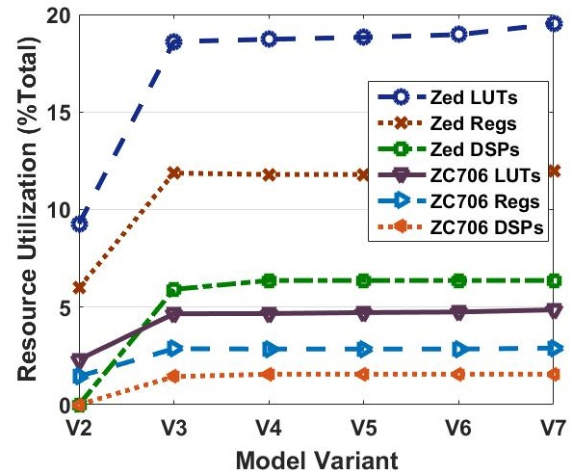
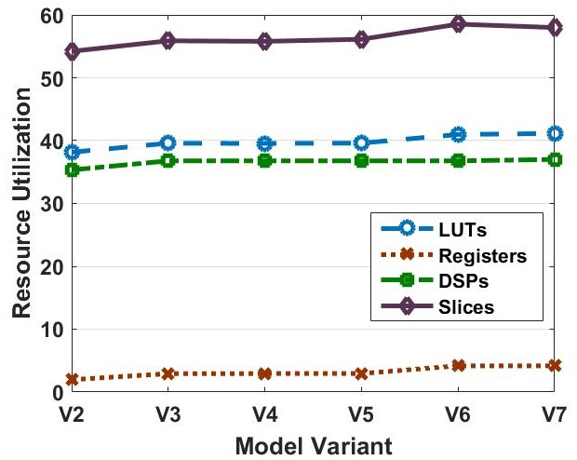
Results: FPGA Resource Utilization and Power Usage
Transmitter Res Util
Receiver Res Util
Power
PB | Tx | Rx
1 | 1.53 | 1.57
2 | 1.82 | 2.34
3 | 1.84 | 2.35
4 | 1.84 | 2.11
5 | 1.84 | 2.11
6 | 1.85 | 2.11
7 | 1.84 | 2.12
Notes:
Briefly: Just say that we looked at resource utilization & power.
Our Tx design can be accommodated on either the ZC706 or the Zedboard, although only the ZC706 has sufficient resources for the Rx implementation. These results show increasing lookup table (LUT), register, and digital signal processor (DSP) usage as more components are put onto the PL. The number of registers decreases slightly from V2 to V3 due to the different data types involved. The slice registers hold state information that reduces because V2 must transfer data in 32-bit sample form, while V3 holds data in single-bit form. V2 must hold each sample in complex, 16-bit fixed-point format before initiating IFFT processing, and 64 data samples make up a frame. In all model versions, even the PL-only variant, the FPGA is at less than 5% utilization on the ZC706 and 20% on the Zedboard, meaning that it retains many LUTs and registers for use by prospective component variations (e.g. QPSK), higher OSI layers and other designs.
Like the Tx, these Rx utilization results show increasing lookup table (LUT), register, and digital signal processor (DSP) usage as more components are put onto PL. The largest increase comes from the initial placement of preamble detection on the PL in V2. Note that the Rx uses a significant portion of the FPGA resources, with as much as 60\% of the total slices, the main grouping of logic resources. Still, we see that there remain many LUTs and registers for use by higher OSI layers or other designs.
A combined Tx and Rx design could be implemented on the ZC706 or more powerful boards. Such a combined design would be appropriate for a modern bidirectional transceiver, since even a designated Tx must have an Rx component to receive ACKs.
In addition to meeting timing and resource requirements, we are also interested in generating power efficient designs. Since the Zynq PS is based around an embedded ARM processor designed for low power, it is naturally more power efficient than alternative processors such as the x86 available on the host processor.
The Zynq platform always provides power to the ARM processor, therefore using FPGA fabric adds to the overall power consumption even though the FPGA fabric is more power efficient. The amount of FPGA power consumption is related to the SoC chip area and resource utilization; hence, each version of our Tx and Rx designs that puts another block onto FPGA fabric increases overall power consumption. Xilinx Vivado offers synthesis options for speed or area optimization that we plan to explore in future work.
The power results were derived by running the Vivado Power Report with fixed environmental settings (e.g. output load 5 pF, ambient temperature 25 \textdegree C). The Tx and Rx power consumption on the Zedboard and ZC706, respectively, are shown.
The Tx total power increases from 1.530 to 1.842 Watts as more components are placed on the PL. However, this increase of 312 mW is small when compared to the Tx PS consumption, which alone is 1.53 W on the Zedboard. As expected, the power increases as more components are added to the PL, most notably AXI in V2 and IFFT in V3.
The Rx total power also increases as more blocks are put on the PL, most notably AXI and preamble detection in V2 and FFT in V3. However, we see a significant decrease when BPSK is placed on the PL in V4. The reason is the data type change from samples to coded bits. Whereas V3 transfers 64 32-bit fixed point samples from PL to PS, V4 only transfers 48 bits packed into 2 32-bit integers. Thus, the load on the AXI interconnect is reduced by a factor of 32. From V4 to V7, the Rx power increases only 4 mW, which is minor compared to the ZC706 PS consumption of 1.566 W.

Slide 7
Results: Block Variants Preamble Detection
Block uses a matched filter to correlate 2 frames with a fixed set of coefficients
1st MF manually assembled from adders & multipliers
Not ideal: uses 99% of DSPs
2nd MF correlates with full long preamble
But long preamble composed of repetitions of training seq
3rd MF correlates with only the training sequence
2.38X reduction in path delay
1.12X reduction in power
MF Variant | Default | HDL Long | HDL Training
Data Path Delay (ns) | 500 | 314 | 132
% LUTs | 8.9 | 38.2 | 15.8
% Registers | 4.3 | 2.0 | 1.3
% DSPs | 99.2 | 35.3 | 14.7
Total Power (W) | 2.65 | 2.34 | 2.09
Notes:
Briefly: Just say that the “default” version of PD that uses individual multiply and add blocks uses a LOT of resources.
Thus, we focus on improving preamble detection, and explain the details and tradeoffs associated with its design.
Our preamble detection method uses a matched filter block to efficiently correlate two frames of fixed-point input samples with the expected long preamble sequence. When the complex magnitude exceeds a predefined normalized threshold, a flag is set to identify that the preamble was found. In addition, the index of maximum correlation is used by a selector block to choose which sample in the delayed frame is first OFDM demodulated.
Our modeling environment aided in the identification of preamble detection as a major source of path delay and resource utilization. Thus, we prototyped different versions of the preamble detection processing block for variant V2, which use different algorithms for the matched filter (MF) component. The first MF variant was manually assembled from the default components, which are a delay line and an array of multipliers and adders for each received sample. Since this default version auto-generates HDL for each individual multiplier and adder, it is not HDL optimized and it is very inefficient. The Vivado synthesis process used over 99\% of the DSPs for it, and it has a very long data path delay. Using the HDL-optimized MF with the full long preamble was therefore preferable. However, since the long preamble is composed of repetitions of a shorter training sequence, we found the best results using this training sequence for the MF coefficients instead. The HDL-optimized training MF showed a 2.38X reduction in data path delay over using the long preamble, as well as a 1.12X reduction in power and a smaller number of LUTs, registers, and DSPs utilized.
The modeling environment shows value for highlighting that preamble detection is a bottleneck. In addition, the resource utilization analysis identifies that the Zedboard can now be used for the Rx chain in addition to the ZC706. In the original long versions of the design, due to the large number of LUTs and DSPs needed, we were forced to use the ZC706. However, using the training version uses only a fraction of those LUTs and DSPs, meaning that the resources available on the Z-7020 SoC are sufficient for implementing all model variants, even the HW-only design.

Slide 8
Conclusions
Introduced modeling for HW-SW co-design of wireless transceivers
Enabled profiling of all processing blocks
Identify bottlenecks such as preamble detection
Explored various HW-SW divide points
Identify which model variants are most desirable
Detailed interfacing needed at divide point
Show when variants use more power from data transfer
Showed added FPGA power is a fraction of CPU power

Slide 9
Future Work
Perform live tests with online radio transmissions
Measure link latency and error rates
Develop rules to automate HW-SW co-designs
Make decisions about HW-SW divide point
Use newer hardware:
Altera Arria 10®
Xilinx Ultrascale+ MPSoC
Explore co-existence with modern protocols (802.11 & LTE)

