Slide 1
Relational Query Processing on OpenCL-based FPGAs
Zeke Wang, Johns Paul, Hui Yan Cheah (NTU, Singapore),
Bingsheng He (NUS, Singapore),
Wei Zhang (HKUST, Hong Kong)
Notes:
Good afternoon, everyone! My name is Zeke Wang, Nanyang Technological University in Singapore. Today I’ll present our paper about relational query processing on OpenCL-based FPGAs.

Slide 2
Outline
Background and Problem
Challenges
Observation
Our Solution
Experiment
Conclusion
Notes:
Here is outline of our paper.
First, I will talk about the background and problem

Slide 3
What is OpenCL?
OpenCL stands for Open Computing Language.
OpenCL has been developed for heterogeneous computing environments with a host-accelerator execution model.
CPU runs the control task.
FPGA runs the computing kernel.
Notes:
So what is OpenCL? OpenCL stands for Open Computing Language
OpenCL has been developed for heterogeneous computing environments with a host-accelerator execution model. In particular, CPU runs the host code and GPU/FPGA runs the kernel code.

Slide 4
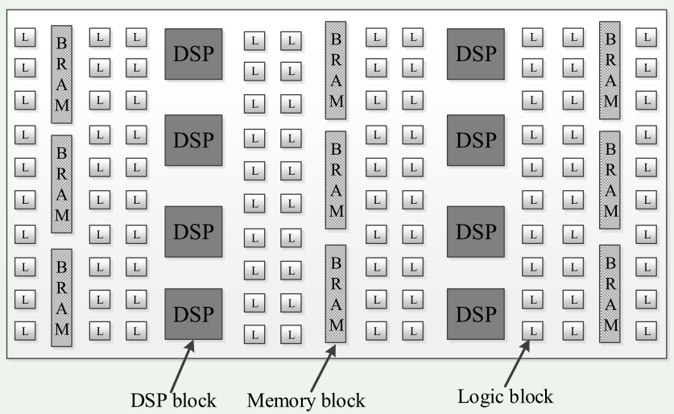
“Architectural Evolution” of FPGA
Hardware-centric → Fine-grained parallelism
Users need to program FPGA with hardware description languages (HDL) ☹
Notes:
Originally, the FPGA has distributed resource features, such as logic blocks, DSP blocks and memory blocks.
From the hardware centric point of view, FPGA can be used to achieve fine-grained parallelism.
However, users need to program FPGA with low-level hardware description languages, for example Verilog

Slide 5
“Architectural Evolution” of FPGAs: From OpenCL’s Perspective
Logic blocks
Memory blocks
External DDR
Users can program FPGA with OpenCL. ☺
Software-centric → FPGA as a parallel architecture.
Notes:
Fortunately, FPGA vendors such as Altera have started to develop OpenCL SDKs to address the programmability issues of FPGAs.
From the software centric point of view, the FPGA is viewed as a parallel architecture.
And users can program FPGA with OpenCL to use the computing ability of FPGAs, not HDL.
From OpenCL’s perspective, the global memory is implemented with external DDR.
Local memory is implemented with memory blocks, and primary memory is implemented with logic blocks.

Slide 6
Optimization Methods for OpenCL
Common optimizations
Thread Parallelism (TP)
Shared Memory (SM)
Memory Coalescing (MC)
FPGA-specific optimizations
Compute Units (CU)
Kernel Vectorization (SIMD)
Notes:
There are several optimization methods to accelerate the performance of OpenCL program.
They can be categorized into two types: common optimizations and FPGA-specific optimizations.
The common optimizations contain thread parallelism, shared memory and memory coalescing.
The FPGA-specific optimizations contain compute units (CU) and kernel vectorization (SIMD). We will talk about the FPGA-specific optimizations in the next slides.

Slide 7
Optimization (CU) on FPGA
CU: Compute units for the kernel
Computing performance doubles.
Memory performance:
Local memory performance doubles (private to its CU).
Global memory performance depends (CUs share).
Notes:
First, I will talk about the CU. This optimization method works when there are sufficient FPGA resources to replicate the pipeline.
For example, the figure shows the case with 2 compute units. Obviously, the computing performance doubles with 2 compute units.
About the memory subsystem, there are two observations.
First, local memory is private to each CU. So its scalability is good. And more Cus would not affect the performance of local memory.
Second, two CUs compete for the global memory bandwidth. So multiple CUs cannot improve the performance when
One CU has already fully utilized the memory bandwidth.

Slide 8
Optimization (SIMD) on FPGA
7
6
5
4
3
2
1
0
A=B+C
No SIMD
Kernel Vectorization (SIMD):It allows multiple work items (or threads) to execute in single instruction multiple data (SIMD) fashion.
Notes:
Second, I will talk about SIMD. It allows multiple work items to execute in single instruction multiple data (SIMD) fashion.
For example, the addition instruction has its own circuits.
If there are 8 work items to execute this instruction, it takes 8 cycles to finish the addition operation, one work item finished per cycle.
Now let me show the impact of the optimization method SIMD = 4. First, the addition instruction has 4 copies of custom circuits. This optimization method also requires sufficient FPGA resources to implement. So the computation can finish in two cycles, not the previous 8 cycles.
Another side effect is that SIMD can coalesce the memory accesses. In particular, if the work items 0, 1, 2 and 3 access consecutive global memory locations, their memory transactions can be combined into one wide memory transaction. Since there is no cache hierarchy on FPGA, so the number of memory transactions always determine the entire execution time.
Compared with CU, SIMD should be used whenever possible.
However, SIMD cannot work for all the OpenCL kernel. For example, the kernel with complex control flows, where different work items follow different control paths.

Slide 9
Optimization (SIMD) on FPGA
7
6
5
4
3
2
1
0
A=B+C
No SIMD
Kernel Vectorization (SIMD):It allows multiple work items to execute in single instruction multiple data (SIMD) fashion.
Notes:
Second, I will talk about SIMD. It allows multiple work items to execute in single instruction multiple data (SIMD) fashion.
For example, the addition instruction has its own circuits.
If there are 8 work items to execute this instruction, it takes 8 cycles to finish the addition operation, one work item finished per cycle.
Now let me show the impact of the optimization method SIMD = 4. First, the addition instruction has 4 copies of custom circuits. This optimization method also requires sufficient FPGA resources to implement. So the computation can finish in two cycles, not the previous 8 cycles.
Another side effect is that SIMD can coalesce the memory accesses. In particular, if the work items 0, 1, 2 and 3 access consecutive global memory locations, their memory transactions can be combined into one wide memory transaction. Since there is no cache hierarchy on FPGA, so the number of memory transactions always determine the entire execution time.
Compared with CU, SIMD should be used whenever possible.
However, SIMD cannot work for all the OpenCL kernel. For example, the kernel with complex control flows, where different work items follow different control paths.

Slide 10
Optimization (SIMD) on FPGA
A=B+C
7
6
5
4
3
2
1
0
No SIMD
With SIMD=4
4
0
A=B+C
5
1
A=B+C
6
2
A=B+C
7
3
A=B+C
Kernel Vectorization (SIMD):It allows multiple work items to execute in single instruction multiple data (SIMD) fashion.
Notes:
Second, I will talk about SIMD. It allows multiple work items to execute in single instruction multiple data (SIMD) fashion.
For example, the addition instruction has its own circuits.
If there are 8 work items to execute this instruction, it takes 8 cycles to finish the addition operation, one work item finished per cycle.
Now let me show the impact of the optimization method SIMD = 4. First, the addition instruction has 4 copies of custom circuits. This optimization method also requires sufficient FPGA resources to implement. So the computation can finish in two cycles, not the previous 8 cycles.
Another side effect is that SIMD can coalesce the memory accesses. In particular, if the work items 0, 1, 2 and 3 access consecutive global memory locations, their memory transactions can be combined into one wide memory transaction. Since there is no cache hierarchy on FPGA, so the number of memory transactions always determine the entire execution time.
Compared with CU, SIMD should be used whenever possible.
However, SIMD cannot work for all the OpenCL kernel. For example, the kernel with complex control flows, where different work items follow different control paths.

Slide 11
Optimization (SIMD) on FPGA
A=B+C
7
6
5
4
3
2
1
0
No SIMD
With SIMD=4
4
0
A=B+C
5
1
A=B+C
6
2
A=B+C
7
3
A=B+C
Kernel Vectorization (SIMD):It allows multiple work items to execute in single instruction multiple data (SIMD) fashion.
Notes:
Second, I will talk about SIMD. It allows multiple work items to execute in single instruction multiple data (SIMD) fashion.
For example, the addition instruction has its own circuits.
If there are 8 work items to execute this instruction, it takes 8 cycles to finish the addition operation, one work item finished per cycle.
Now let me show the impact of the optimization method SIMD = 4. First, the addition instruction has 4 copies of custom circuits. This optimization method also requires sufficient FPGA resources to implement. So the computation can finish in two cycles, not the previous 8 cycles.
Another side effect is that SIMD can coalesce the memory accesses. In particular, if the work items 0, 1, 2 and 3 access consecutive global memory locations, their memory transactions can be combined into one wide memory transaction. Since there is no cache hierarchy on FPGA, so the number of memory transactions always determine the entire execution time.
Compared with CU, SIMD should be used whenever possible.
However, SIMD cannot work for all the OpenCL kernel. For example, the kernel with complex control flows, where different work items follow different control paths.

Slide 12
Problem
OmniDB [1]: State-of-the-art OpenCL-based query processor on CPU/GPU
Kernel-based execution
Common optimization methods
Cost-based approach to schedule
How OmniDB performs on OpenCL-based FPGAs?
[1] Shuhao Zhang and et al. OmniDB: Towards Portable and Efficient Query Processing on Parallel CPU/GPU Architectures, VLDB’13.
Notes:
On one hand, we have OpenCL to program FPGA; on the other hand, OpenCL-based design and implementation for relational databases have been emerging on CPUs/GPUs. For example, OmniDB.
OmniDB is OpenCL-based database query processing running on CPU/GPU. It is obvious that OmniDB can achieve good performance on CPU/GPU.
It has two properties. First, it belongs to the layered design and kernel-based execution. Second, it contains one cost model to schedule the computing tasks among CPUs and GPUs.
One natural question is that how OmniDB performs on OpenCL-based FPGAs. We try to run OmniDB on FPGA.
It has serious performance problems on FPGA because of the architecture differences between CPU/GPU and FPGA.

Slide 13
Outline
Background and Problem
Challenges
Observation
Our Solution
Experiment
Conclusion
Notes:
Here is outline of our paper.
Now we will talk about the challenges when running OmniDB on OpenCL-based FPGAs.

Slide 14
Challenge (Large Exploration Space)
A single SQL query can have many possible query execution plans on FPGAs.
Each query has multiple operators, and each operator consists of multiple OpenCL kernels.
Each OpenCL kernel can have different FPGA-specific optimization combinations.
We also consider another dimension of using multiple FPGA images.
Notes:
The first challenge comes from the large exploration space. For each single SQL query, it can have many implementations. In particular, each query has multiple operators, and each operator can consist of multiple OpenCL kernels, each kernel has multiple FPGA-specific optimization combinations.
To make the things worse, we also consider another dimension of using multiple FPGA images.

Slide 15
Challenge (Long Synthesis Time)
☹
FPGA Image
OpenCL Program
2-4 hours
Running all the feasible query plans on real FPGAs is not a good idea.
We need one cost model to determine the optimal query plan via evaluation.
Notes:
As we all know that each optimization combination requires hours to compile (from OpenCL to FPGA bit-stream).
In order to get the optimal combination, we cannot choose to evaluate all the optimization combinations on real FPGAs, since it requires hundreds of hours to evaluate.
Therefore, one cost model is required to determine the optimal query plan via evaluating all the feasible query plans.

Slide 16
Outline
Background and Problem
Challenges
Observation
Our Solution
Experiment
Conclusion
Notes:
Now I will talk about the two observations which motivate our design to address the above challenges.

Slide 17
Observation
There is an FPGA-specific trade-off between the following two factors.
Optimization combination for each kernel
Reconfiguration overhead
More aggregative optimizations for each kernel ☺ →
More resources for each kernel ☺ →
More resources for the entire query →
More FPGA images ☹ →
Higher FPGA reconfiguration overhead ☹
Notes:
Now I will talk about the FPGA-specific trade-off between the two dimensions: optimization combination and reconfiguration overhead.
In general, More aggregative optimizations for each kernel will cost More resources for the kernel. Then, More resources are required for the entire query . In particular, more FPGA images are required and higher FPGA reconfiguration overhead appears.

Slide 18
Impact of Optimization Combination
Time and resource utilization of scanLargeArrays kernel (@prefix scan) with 128M tuples
More aggregative optimizations →
More resource utilization →
Higher performance
Notes:
Now I talk about the other observation, about the impact of optimization combination.
Let me use the scanLargeArrays kernel with 128M input tuples for example. The figure shows the relationship between (time, resource utilization) and optimization combination.
X-axis is the optimization combination, Y axis is the resource utilization and resource utilization.
Our observation here is that more aggregative optimization means more resource utilization and then higher performance.

Slide 19
FPGA Reconfiguration Overhead
According to Altera, FPGA reconfiguration overhead contains three sources.
Transfer the active contents (memory footprint) from FPGA memory to host memory via PCIe (roughly 2GB/s)
Fully reconfigure the FPGA (roughly 1914.6ms).
Transfer the active contents from host memory to FPGA memory via PCIe (roughly 2GB/s)
FPGA reconfiguration overhead is significant in the current FPGA board.
Notes:
Next, we talk about the other observation about the FPGA reconfiguration overhead.
According to Altera, FPGA reconfiguration overhead contains three sources. The first part is the time taken to transfer the active contents (memory footprint) from FPGA memory to host memory via PCIe. The seond part is the time taken to reconfigure the FPGA. The third part is the time to transfer the active contents from host memory between FPGA memory
The reason why to transfer the data between FPGA memory and host memory is that the FPGA reconfiguration will corrupt the FPGA DDR contents.

Slide 20
Outline
Background and Problem
Challenges
Observation
Our Solution
Experiment
Conclusion
Notes:
After talking about the observations, we talk about our solution.

Slide 21
Our Approach
Query processor: accelerated with FPGA-specific optimizations
FPGA-specific cost model: to determine the optimal query plan for the input query
Notes:
Our approach contains two parts. The first part is to accelerate query processor with FPGA-specific optimization methods. The second part contains one FPGA-specific cost model to determine the optimal query plan for the input query.

Slide 22
Query Processor (Operator Kernel Level)
The layered design of query processor contains four operators (constituting the SQL query).
Selection (5 operator kernels)
Order-by (2 operator kernels)
Grouping and Aggregation (7 operator kernels)
Join (2 operator kernels)
Notes:
We adopt the implementation of the query processor from OmniDB, which contains 4 operators. And the 4 operators can form any SQL query. Each operator contains several kernels to implement.
For the detailed description, please read our paper.
The selection operator contains 5 kernels, order-by contains 2 kernels, grouping and aggregation contains 7 kernels. Join contains 2 kernels.

Slide 23
Operator Kernel
Adopt the implementation of operator kernel from OmniDB, which has already explored the common optimizations
Thread Parallelism (TP)
Shared Memory (SM)
Memory coalescing (MC)
Mainly focuses on FPGA-specific optimizations
Compute units (CU)
Kernel Vectorization (SIMD)
Notes:
We adopt the implementation of primitives from OmniDB, which has already explored the optimizations, thread parallelism, shared memory and memory coalescing. Our paper mainly focuses on the FPGA-specific optimizations.

Slide 24
FPGA-specific Cost Model
We propose an FPGA-specific cost model to determine the optimal query plan for the input query.
The cost model follows the layered design.
Unit Cost (for each operator kernel)
Optimal query plan generation (dynamic programming based approach)
Notes:
In order to generate the optimal query plan for the input query, our approach is to use an FPGA-specific cost model. The cost model follows the layer design and contains two components, unit cost and optimal query plan generation.

Slide 25
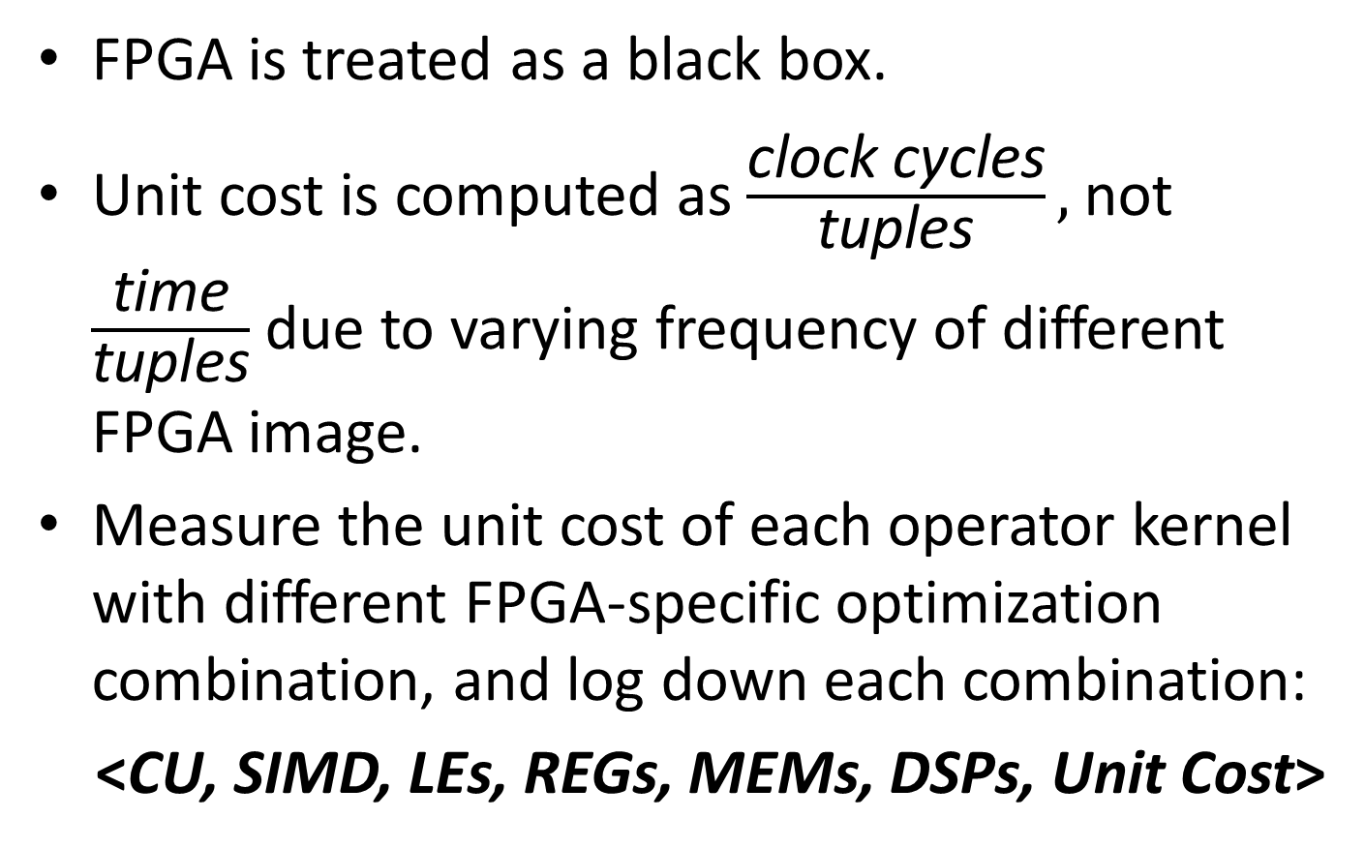
Unit Cost for Each Operator Kernel
FPGA is treated as a black box.
Unit cost is computed as$\frac{\text{clock} \text{cycles}}{\text{tuples}},$not $\frac{\text{time}}{\text{tuples}}$ due to varying frequency of different FPGA image.
Measure the unit cost of each operator kernel with different FPGA-specific optimization combination, and log down each combination:
<CU, SIMD, LEs, REGs, MEMs, DSPs, Unit Cost>
Notes:
FPGA is treated as a black box and the unit cost is supposed to be the number of total clock cycles divided by the number of tuples in the input relation. We do not use the elapsed time because the frequency varies with the FPGA image.
we measure the unit cost of each operator kernel with different FPGA-specific optimization combinations and the corresponding resource utilizations and unit costs.

Slide 26
Query Plan Generation
Given the input query, there are multiple feasible operator arrays.
Suppose one operator array with M operators ($O_{1}$, $O_{2}$, $⋯,O_{M}$) is mapped to the kernel array with N kernels ($K_{1}$, $K_{2}$, $⋯,K_{N}$).
Suppose N kernels execute sequentially.
$$K_{1}$$
$$K_{2}$$
$$K_{3}$$
$$…$$
$$K_{N−1}$$
$$K_{N}$$
Dynamic programming based approach is used.
Notes:
Now we talk about the query plan generation. Given the input query, the corresponding operator array contains M operators. The operator array is mapped to the kernel array which contains N kernels. Suppose N kernels execute sequentially. Dynamic programming based approach is used.

Slide 27
Benefit of Layered Design
Researchers can keep exploring other optimizations (e.g., kernel fusion) to further accelerate each operator kernel.
When the operator kernel is further optimized.
Profile and obtain new combination: <CU, SIMD, LEs, REGs, MEMs, DSPs, Unit Cost>
Re-run dynamic programming based approach to determine the optimal query plan for the queries which contain the optimized operator kernel.
Notes:
Benefit of Layered Design: Researchers can keep exploring other optimizations (e.g., kernel fusion) to further accelerate each operator kernel. When the operator kernel is further optimized. 1, Profile and obtain new combination: <CU, SIMD, LEs, REGs, MEMs, DSPs, Unit Cost>. 2, Re-run dynamic programming based approach to determine the optimal query plan for the query.

Slide 28
Outline
Background and Problem
Challenges
Observation
Our Solution
Experiment
Conclusion
Notes:
Now I will talk about the experiment which supports our solution.

Slide 29
Experimental Setup
Platform:
Terasic’s DE5-Net board: Altera Stratix V A7 and 4GB 2-bank DDR3
PCI-e 2.0 (X8)
Altera OpenCL SDK version 14.0
Workloads:
Four queries (Q1, Q2, Q3 and Q4)
Tuple format: <key, payload>. Both keys and payloads are 4-bytes.
We use Q3 for example.
Notes:
We conduct the experiment on Terasic’s DE5-Net board. We evaluate four queries.
The input data is a relation (i.e., table) with the tuple format of <key, payload>, in the format of column databases. Both keys and payloads are 4-byte. We use Q3 for example.

Slide 30
Details of Q3
SQL query:
SELECT S.key, SUM(S.payload) FROM S WHERE Lo ≤ S.paylaod ≤ Hi GROUP BY S.key
Q3: 12 operator kernels
Notes:
We show the details of Q3. And the right figure shows the corresponding kernels to implement the Q3. We can see that Q3 contain 12 operator kernels.
For the next slides, we will show the corresponding execution plan with the different size of Table S.

Slide 31
Generation of Execution Plans
Execution plan 1
FPGA image | LUTs | REGs | RAMs | DSPs | Freq.
Estimated | 151460 | 339134 | 2175 | 42 | 198
Measured | 154509 | 283131 | 1973 | 34 | 233
Execution Plan 2
FPGA image 1 | LUTs | REGs | RAMs | DSPs | Freq.
Estimated 1 | 187738 | 349051 | 2416 | 72 | 182M
Measured 1 | 184082 | 334093 | 2342 | 72 | 192.5M
FPGA image 2 | LUTs | REGs | RAMs | DSPs | Freq.
Estimated 2 | 179428 | 331045 | 2538 | 0 | 163M
Measured 2 | 134629 | 346087 | 2421 | 0 | 182M
FPGA image 3 | LUTs | REGs | RAMs | DSPs | Freq.
Estimated 3 | 155187 | 294559 | 1950 | 90 | 223M
Measured 3 | 171434 | 348651 | 2112 | 90 | 203M
Our cost model can roughly predict the resource utilization and frequency of each FPGA image.
Notes:
For different table size, our cost model recommends two execution plans.
The observation here is that our cost model can roughly predict the resource utilization and frequency of each FPGA image. Next we show the evaluation of Q3.

Slide 32
Break-even Point for Execution Plans
1: execution plan 1
2: execution plan 2
Measured: real FPGA
Estimated: cost model
Break-even point
Our cost model can roughly predict the performance for each execution plan.
Our cost model can recommend the optimal execution plan for different table sizes.
Notes:
From the figure x axis is the table size, y axis is elapsed time for Q3.
In the figure, 1 means the execution plan 1 and 2 means the execution plan 2.
Measured means the time when running on FPGA, Estimated means the time predicted by our cost model.
The first observation here is that our cost model can roughly predict the performance for each execution plan.
The second observation is that our cost model can predict the break-even point for Q3 and our cost model can recommend the optimal execution plan for different table sizes.

Slide 33
Comparison with OmniDB on FPGA
One FPGA image
OmniDB: one FPGA image without FPGA-specific optimizations
FPGA reconfiguration overhead > Benefit from the reduced execution time (more aggregative optimizations for each involved kernel.
Notes:
This slide shows that comparison with OmniDB on FPGA. The OmniDB means the implementation using one FPGA image without FPGA-specific optimizations.
When table size is less than 16M, only one FPGA image is used ,then the speedup is limited. There are two reasons. First, The FPGA reconfiguration overhead > the benefit from the reduced execution time. Second, Optimization level is limited for each operator kernel in one FPGA image.

Slide 34
Comparison with OmniDB on FPGA
Three FPGA images
OmniDB: one FPGA image without FPGA-specific optimizations
FPGA reconfiguration overhead < Benefit from the reduced execution time
Notes:
When table size is less than 16M, only one FPGA image is used ,then the speedup is limited. When the table size becomes larger, three FPGA images are used, and then the performance speedup becomes larger. And larger input table size will have higher performance speedup. The reason is that The FPGA reconfiguration overhead < the benefit from the reduced execution time which comes from more aggregative optimizations for each involved kernel.

Slide 35
Outline
Background and Problem
Challenges
Observation
Our Solution
Experiment
Conclusion
Notes:
Now comes to our conclusion.

Slide 36
Conclusion
Since the architecture of FPGA is significantly different from that of CPU/GPU and OpenCL-based query processing has already designed for CPUs/GPUs, we need to revisit it on FPGAs.
We develop an FPGA-specific cost model to determine the optimal query plan for the input query.
Our proposed approach can achieve significant speedup over OmniDB on FPGA.
Notes:
Here is our conlusion. OpenCL-based query processing has already designed for CPUs/GPUs, we need to revisit it on FPGAs, since the architecture of FPGA is significantly different from that of CPU/GPU.
Then, we develop a cost model to determine the optimal query plan for the input query.
Our proposed approach can achieve significant speedup over the state-of-the-art approach.

Slide 37
Wish List for Next-gen Database on FPGA
Larger DDR Size, higher memory bandwidth
PCI-e 3.0 (X16)
Retaining DDR contents during FPGA reconfiguration
Partial reconfiguration while using OpenCL (I know it is tough.)
Notes:
In order to achieve good performance on OpenCL-based FPGAs,

Slide 38
Q & A
Our Terasic’s DE5-Net FPGA board is denoted by Altera University Program.
We thank John Freeman (Altera) for support.
This work is supported by a MoE AcRF Tier 1 grant (MOE 2014-T1-001-145), an NUS startup grant and a HKUST startup grant (R9336).
Our research group: Xtra Computing Group http://pdcc.ntu.edu.sg/xtra/

