Slide 1
Annotation-Based Finite-State Transducers on Reconfigurable Devices
Raphael Polig, Kubilay Atasu, Christoph Hagleitner, Theresa Xu, Akihiro Nakayama
30 August 2016

Slide 2
Agenda
Introduction
IBM Care Management Analytics
Accelerator Design
Results

Slide 3
Text Analytics by example
(Reuters) - International Business Machines Corp said on Wednesday it had acquired AlchemyAPI, a fast-growing startup selling software that collects and analyzes unstructured text and data in ways big enterprises, website publishers and advertisers find useful.
…
Buyer | Target | Status
IBM | AlchemyAPI | Completed
Notes:
Information extraction
Find entities
Create relations
Involves several NLP steps such as tokenization, PoS tagging, shallow parsing
Several tools, algorithms, libraries but most if not all create annotations

Slide 4
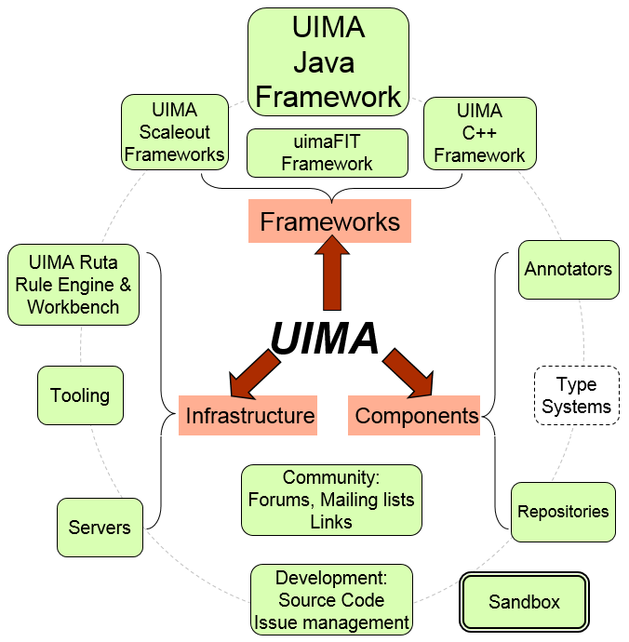
Apache UIMA
Notes:
Creates interoperability between different implementations
Specific set of process functions that the framework can call
Every annotator can have a Typesystem that defines what it produces
A type is somewhat of a struct that can inherit features of parent types

Slide 5
Apache UIMA by example
Notes:
Aggregate analysis engine
Made of primitives
One of them is the shallow parser we are talking about today that uses fine-state transducers

Slide 6
Finite-State Transducers
np = Token[_unilex="DT"]|<E> . Token[_unilex="JJ"]* . Token[_unilex="NN"] | Token[_unilex="NNS"] ;
Notes:
An FST is a finite-state machine with a set of states
And an input alphabet that allows it to transition from a set of initial states to a final state or match.
But it also has an output alphabet to create something while it transitions.
Set operations to set internal variables
Post operations to signal a valid data structure to the next FST or output
This creates FST cascades
The library we are using allows to write FST rules like this.
It is a bit like regular expressions over annotations.

Slide 7
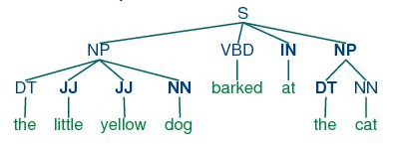
Shallow parsing
Notes:
It can be used for shallow parsing which for example tries to find noun phrases
The POS tags are created by another processing step so the parser can make use of them to create this representation which makes it easier to see who barked

Slide 8
Agenda
Introduction
IBM Care Management Analytics
Accelerator Design
Results

Slide 9
IBM Care Management Analytics
Notes:
IBM’s UIMA implementation plus a bunch of libraries to perfom NLP tasks
The advanced care insights team writes the rules to gain insight from patient records
This allows to gain insights from medical notes that are never stored in a structured form
Smoker? Heavy smoker?

Slide 10
UIMA Processing Pipeline
Aggregate Analysis Engine
Lexical Annotator 1
Lexical Annotator 2
Shallow Parser 1
Scanner
Scanner
FST
FST
FST
FST
Notes:
Let’s see how their processing pipelines look like
Always UIMA Aggregate Analysis Engines
One or more lexical analysis stages that perfom language detection, tokenization, POS tagging
One or more shallow parser stages
A single stage contains usually multiple so called scanners that are FST cascades and create a single final type of annotation such as a Number, Date, Medication

Slide 11
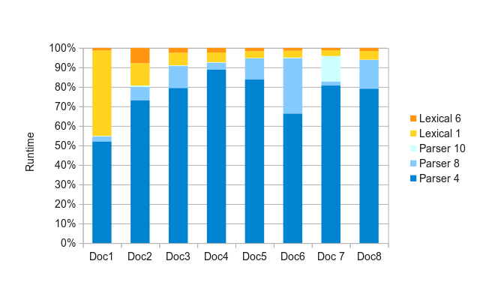
Profiling results
Lexical Annotators PoS Tagging Dictionaries Tokenization
Shallow Parsers Finite State Transducers (FSTs)
55 to 95% of the execution time is spent on FSTs

Slide 12
Agenda
Introduction
IBM Care Management Analytics
Accelerator Design
Results

Slide 13
Concept
UIMA
PEAR
Partitioning and Hardware Synthesis
POWER8
FPGA
CAPI
Transformed
PEAR
Synthesized
FPGA logic
Notes:
Starting from a PEAR file which combines all required files
Create FPGA logic for a set of selected scanners
Transform the descriptors in the PEAR file to make use of the FPGA

Slide 14
Hierarchical partitioning
Lexical Annotator 1
Lexical Annotator 1
Shallow Parser 1
Lexical Annotator 2
Lexical Annotator 2
Shallow Parser*
Shallow Parser 2
Hardware Parser
Notes:
Select the scanners to be offloaded
Reorder the remaining annotators
Create a new SW parser
Instantiate and configure the HW parser

Slide 15
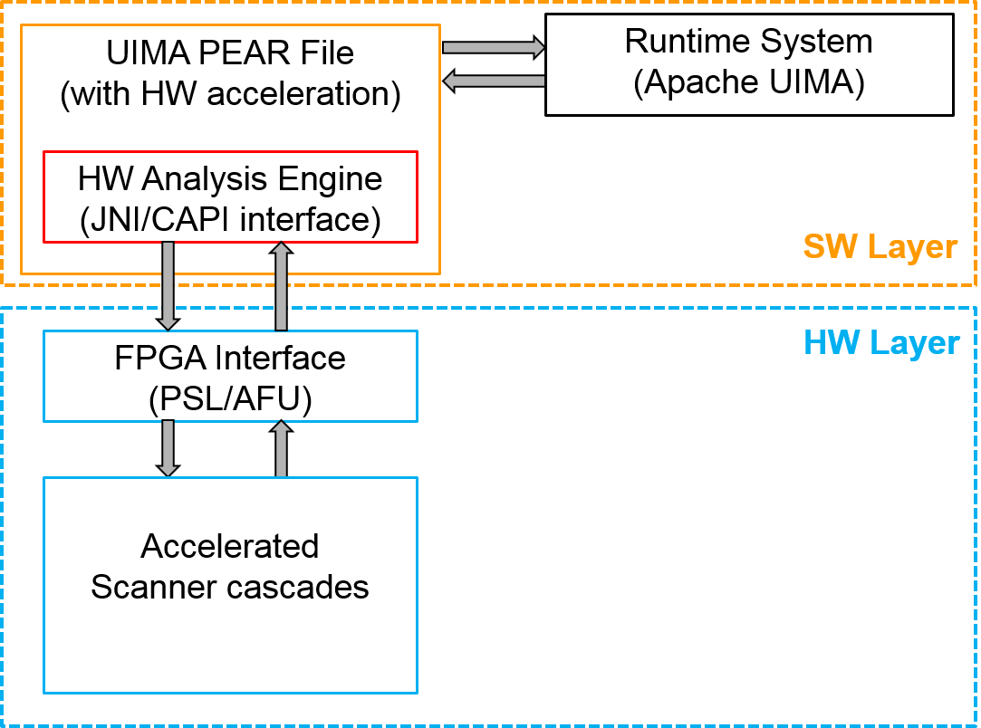
Overall system
Notes:
Transfer required annotations

Slide 16
Hardware layer
FPGA Interface
(PSL/AFU)
Type Decoder
Input Types
Scanner Cascade
Output Types
Type Multiplexer
Notes:
Scanner cascade == parser

Slide 17
Scanner – FST Cascade
Input Types
Finite State Machine
Controller
Enable
Signals
FST Cascade
Multiplexer
select
signals
Output Types
Notes:
Every scanner node is a FST cascade and holds multiple FSTs
Enable once all input

Slide 18
Example FST
State 5
State 6
Test Type1/
Set features
Test Type2/
Set Features
State 7
Test Type2/
Post Type4
Test Type1/
Post Type3
State 8
State 9

Slide 19
State Transition Logic & Storage
Type1_i_d
Type2_i_d
Character start offset
Character end offset
Token start id
Token end id
Feature1
Feature2
Character start offset
Character end offset
Token start id
Token end id
Feature3
Feature4
Valid if (Type1_i_v & Active[5])
Valid if Type2_i_v & Active[6]
Evaluate feature tests
Evaluate feature tests
Active[7] = 1 if one of these conditions holds
Storage
for State7
Active[7]
Character start offset
Character end offset
Token start id
Token end id
Feature1
Feature2
Feature3
Feature4
Character start offset
Character end offset
Token start id
Token end id
Feature1
Feature3
Character start offset
Character end offset
Token start id
Token end id
Feature2
Feature4
Type3_i_d
Type4_i_d
Notes:
Every state has registers that can capture the features that are set by incoming transitions and required by outgoing ones.
These are optimized if for example a feature is always forwarded

Slide 20
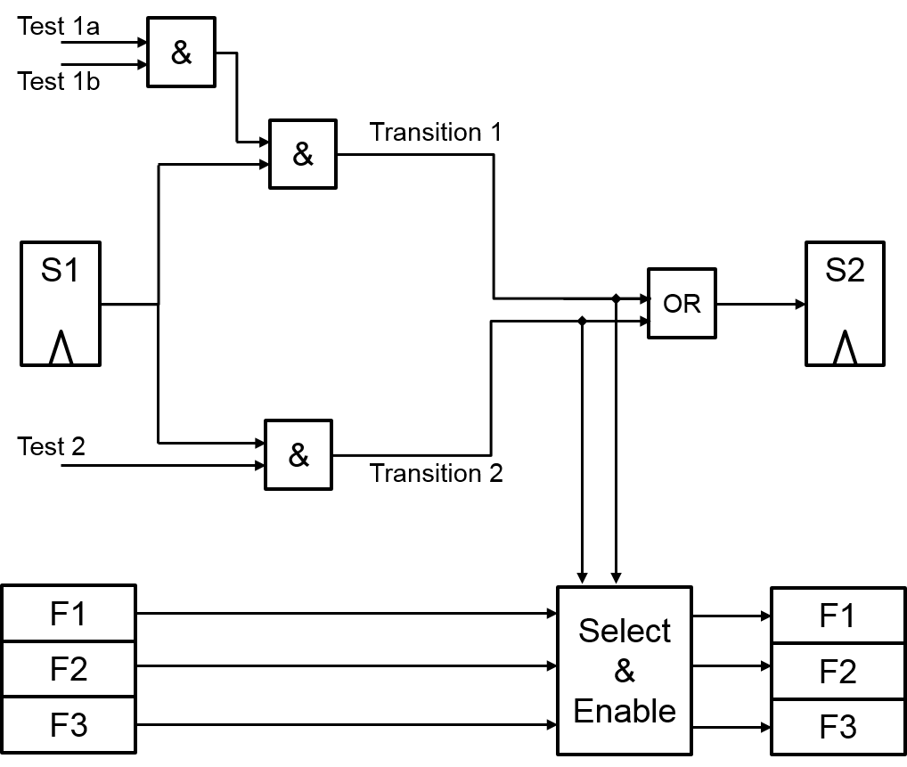
Hardware Transition Logic

Slide 21
Agenda
Introduction
IBM Care Management Analytics
Accelerator Design
Results

Slide 22
Resource usage – Stratix V A7
Target f = 100 MHz
Notes:
Complete FPGA CAPI, AFU, Parser
More inputs, less complex FSTs

Slide 23
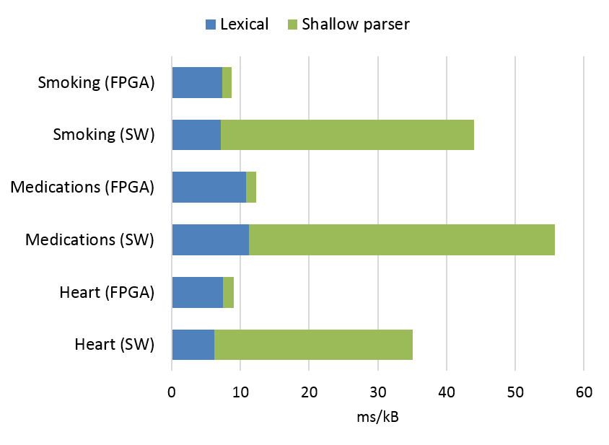
Normalized processing time
31x
5x
Target f = 100 MHz
Notes:
Processing time per kB
Parser only is up to 31x faster
End-to-end 3.8 to 5x

Slide 24
Thank you!

