Slide 1
Malte Vesper, Dirk Koch, Vipin Kizheppatt, and Suhaib A. Fahmy
JetStream: An Open-Source high-performance PCI Express 3 streaming library for FPGA-to-Host and FPGA-to-FPGA communication
https://maltevesper.github.io/JetStream

Slide 2
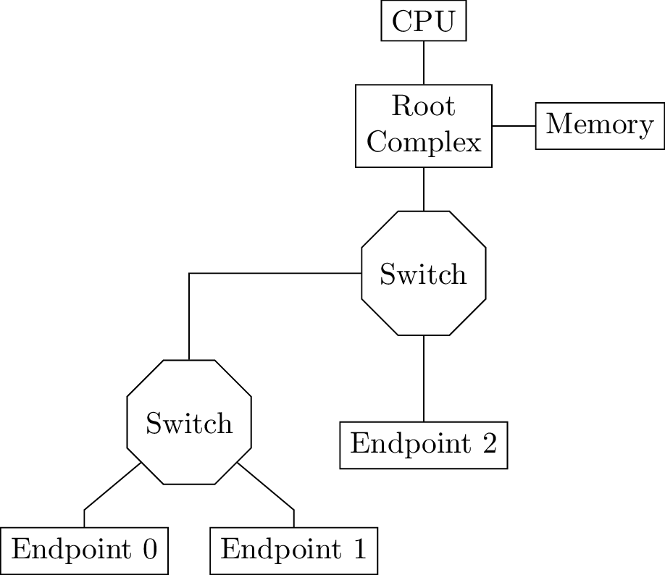
PCIe Hierarchy

Slide 3
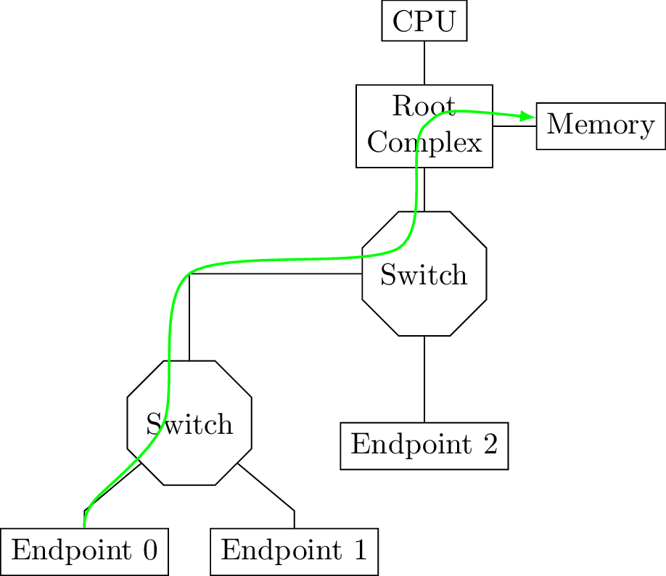
PCIe Hierarchy

Slide 4
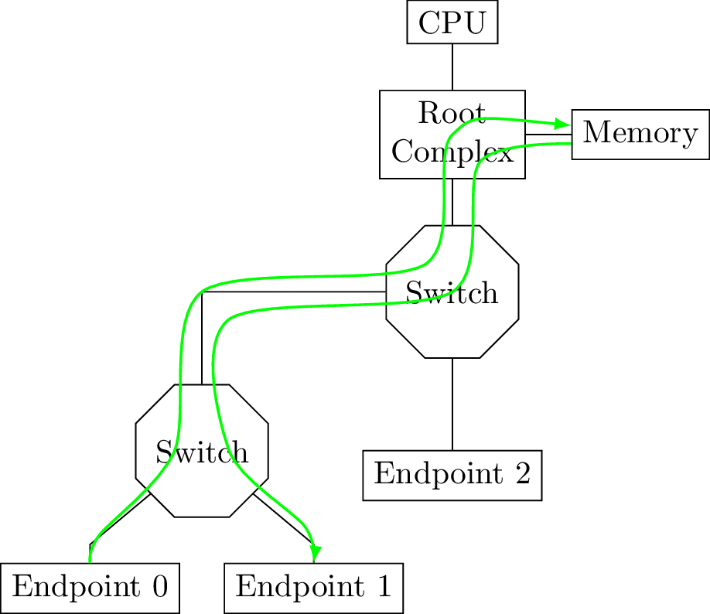
PCIe Hierarchy

Slide 5
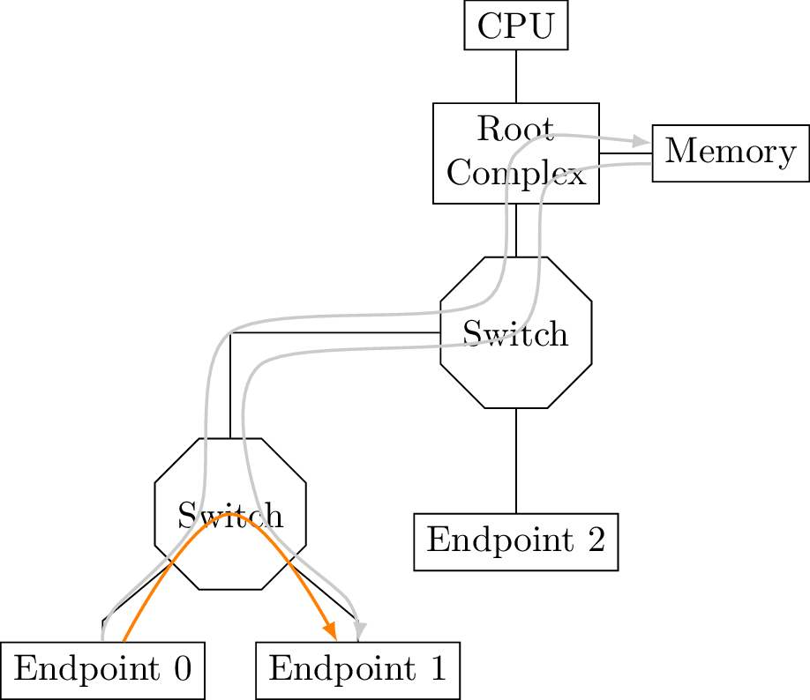
PCIe Hierarchy

Slide 6
OSI Layers
PCIe implements 3 of 7 OSI layers:
Transaction layer
Data link layer
Physical layer
Xilinx/Altera hard IP handles physical and data link layer ➔In the following Xilinx PCIe Gen 3 IP

Slide 7
Whats left to the user?
Chunk transfers (alignment/max packet sizes)
Manage number of outstanding requests
Provide mechanisms for channels
Create headers
Host driver

Slide 8
Related work
Commercial solutions
Expensive
Large and monolithic
Open source
No PCIe 3x8 (except ffLink)
Often not multi FPGA
➔details on comparison slide

Slide 9
Related Work
 | PCIeGen | ZeroCopy DMA | Asynchronous transfers | Multiboard support | Board-to-Board | Read MB/s | Write MB/s
EPEE | 2 | ✓ | ✓ |  |  | 3280 | 3198
DyRACT | 2 |  |  |  |  | 1474 | 1452
RIFFA 2.2 | 3x4 | ✓ |  | ✓ |  | 3040 | 3040
ffLink | 3x8 | ✓ |  |  |  | 6330 | 7060
Xillybus | 3x4 |  | ✓ | ✓ |  | 3500 | 3500
Northwest Logic | 3x8 | ? | ? | ? | ? | 5573 | 5981
JetStream | 3x8 | ✓ | ✓ | ✓ | ✓ | 6446 | 7086

Slide 10
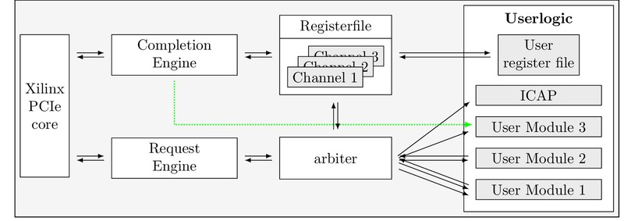
JetStream System Achitecture

Slide 11
Straddling
Header
Payload
Header
Payload
Payload
Header 2
Payload
Payload
Header
Payload
Header 2
Payload

Slide 12
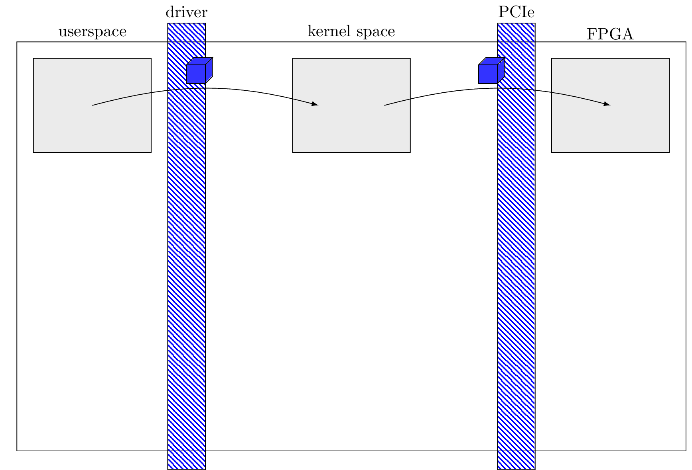
DMA Modes

Slide 13
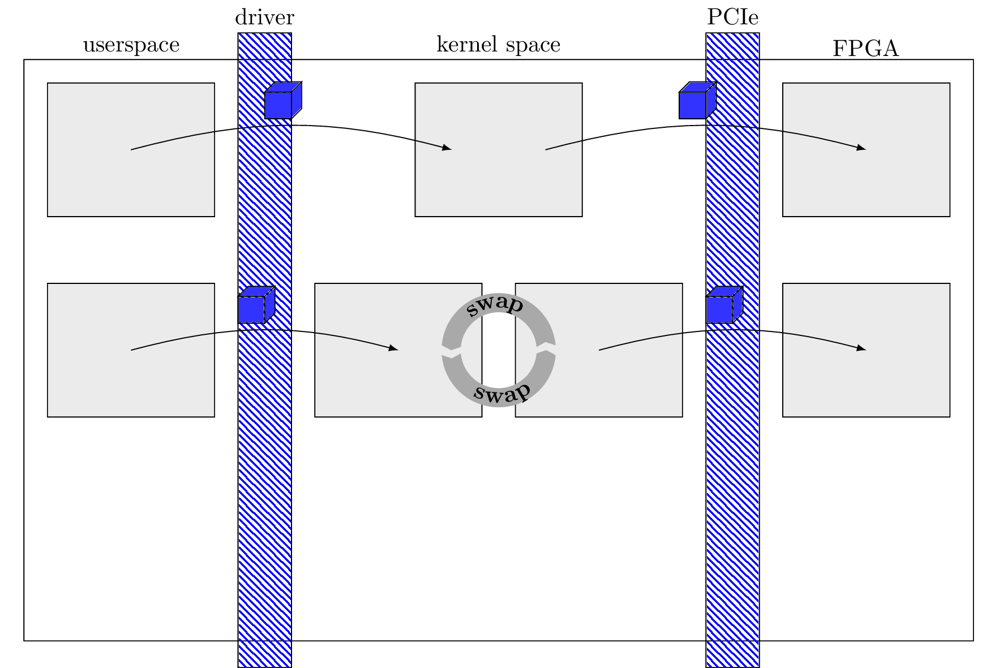
DMA Modes

Slide 14
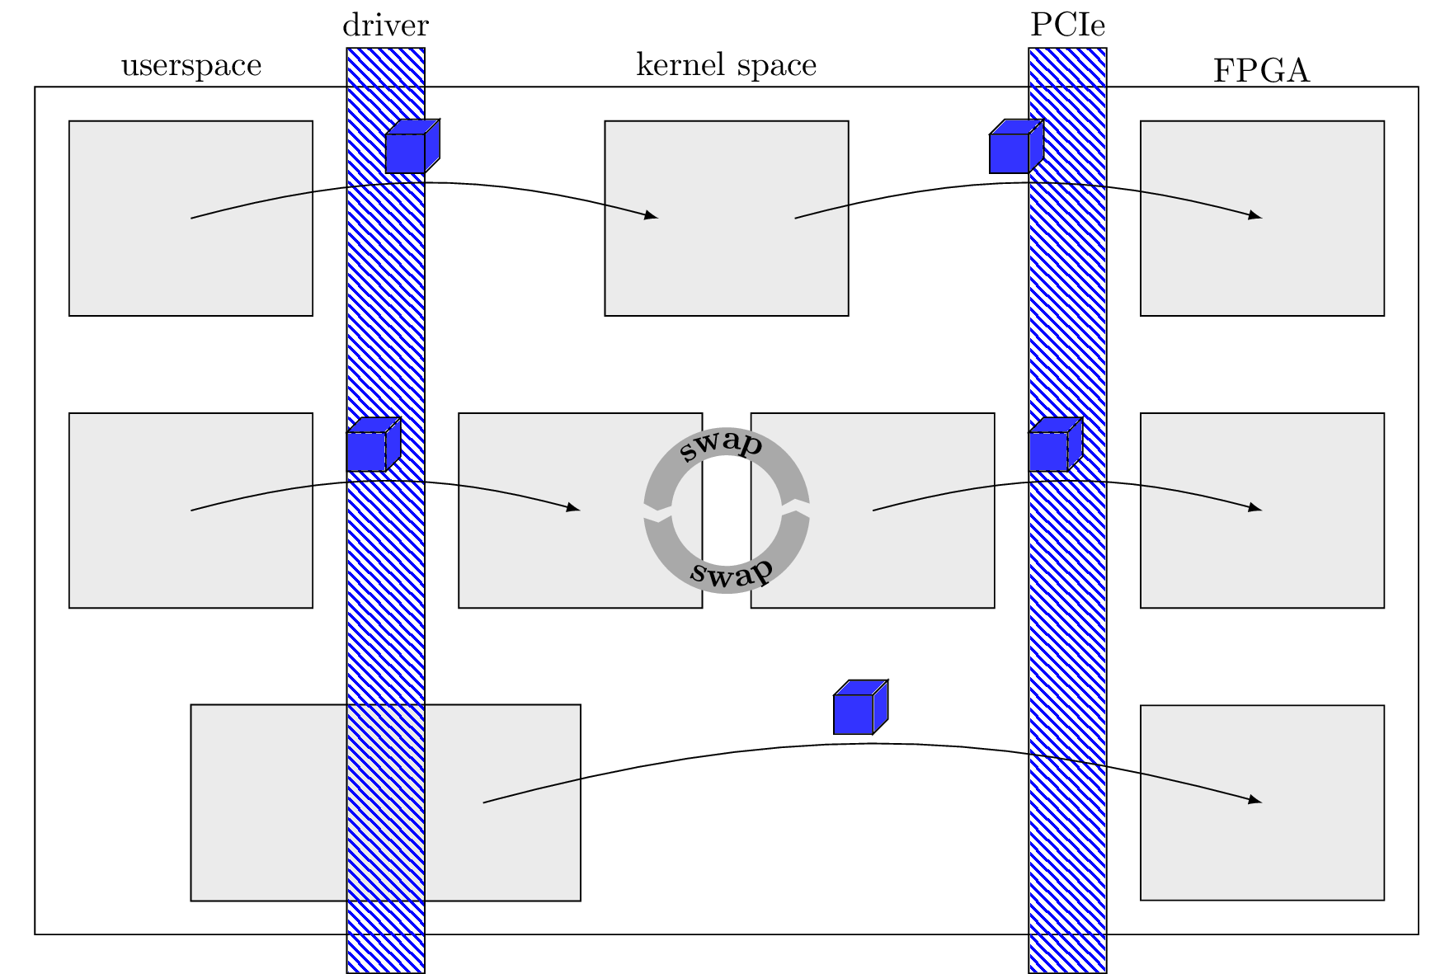
DMA Modes

Slide 15
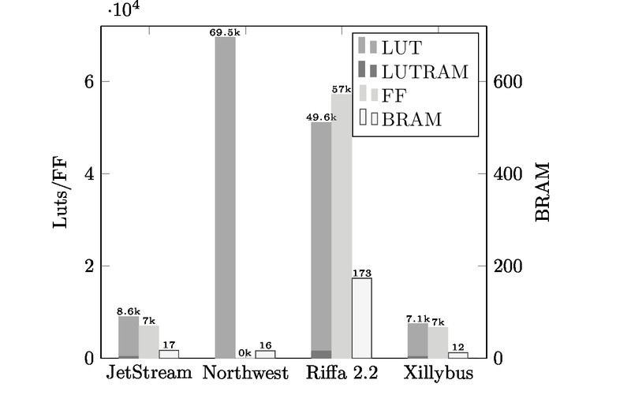
Resourceusage

Slide 16
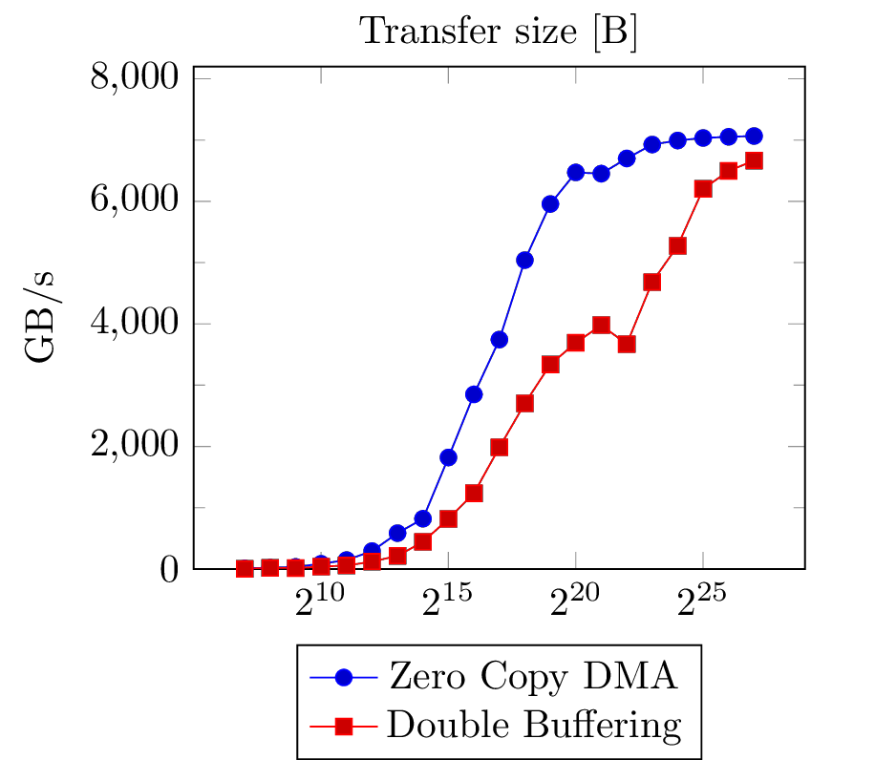
Transfersize vs Bandwidth

Slide 17
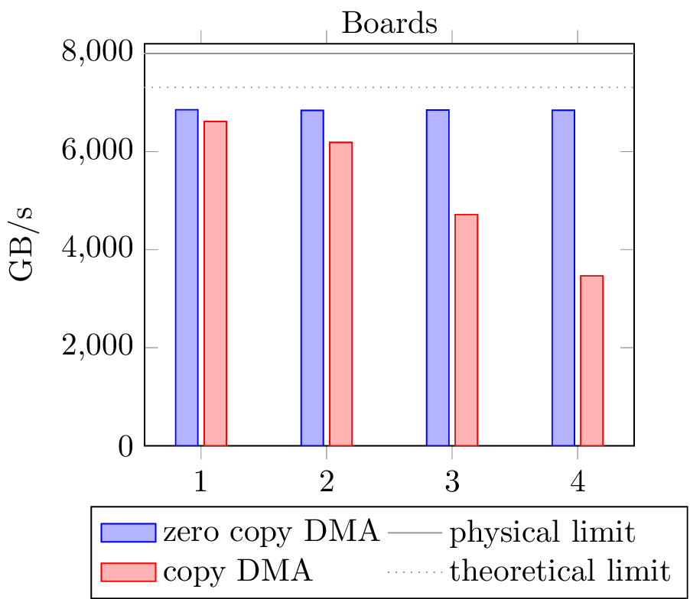
Speed

Slide 18
Stream benchmark

Slide 19
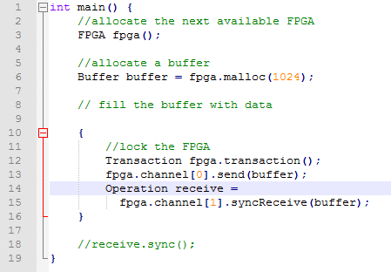
API-Example

Slide 20
Features
7 GB/s throughput
Direct Board-to-Board transfers
Transfer queues
User interrupts/registerfiles
Different DMA modes

Slide 21
Getting JetStream
https://maltevesper.github.io/JetStream/

Slide 22
Future Work
BlockIP
Parameters to disable alignment, chunking, ….
PCIe 4? → straddling on all interfaces
Altera port?

Slide 23
Questions
?
Thank you for your attention

