Slide 1
FMER: A Hybrid Configuration Memory Error
Recovery Scheme for Highly Reliable FPGA SoCs
Dimitris Agiakatsikas¹,
Ediz Cetin², Oliver Diessel¹
School of Computer Science and Engineering¹
School of Electrical Engineering and Telecommunications²

Slide 2
Highly Reliable FPGA-based SoC designs
User and configuration bits of SRAM-based FPGAs are vulnerable to soft-errors
Error masking: SoC implemented of K interconnected TMR-subsystems (partitions)
a) TMR: Modules + Voters + I/O pins
b) TMR: Modules + Voters
  c) TMR: Modules

Slide 3
Configuration memory error recovery
Scrubbing
    Energy wasting
    Increased MTTD
    Robust error recovery technique

Slide 4
Configuration memory error recover
Module-based Error Recovery (MER)
  Low energy consumption
  Rapid MTTD
  No error recovery in the configuration frames of the support resources (shaded region)

Slide 5
Configuration memory error recovery
FMER: A hybrid error recovery technique
  Errors in the conf. frames of the support resources (shaded area) recover with scrubbing
  Errors in the conf. frames of the modules recover with MER

Slide 6
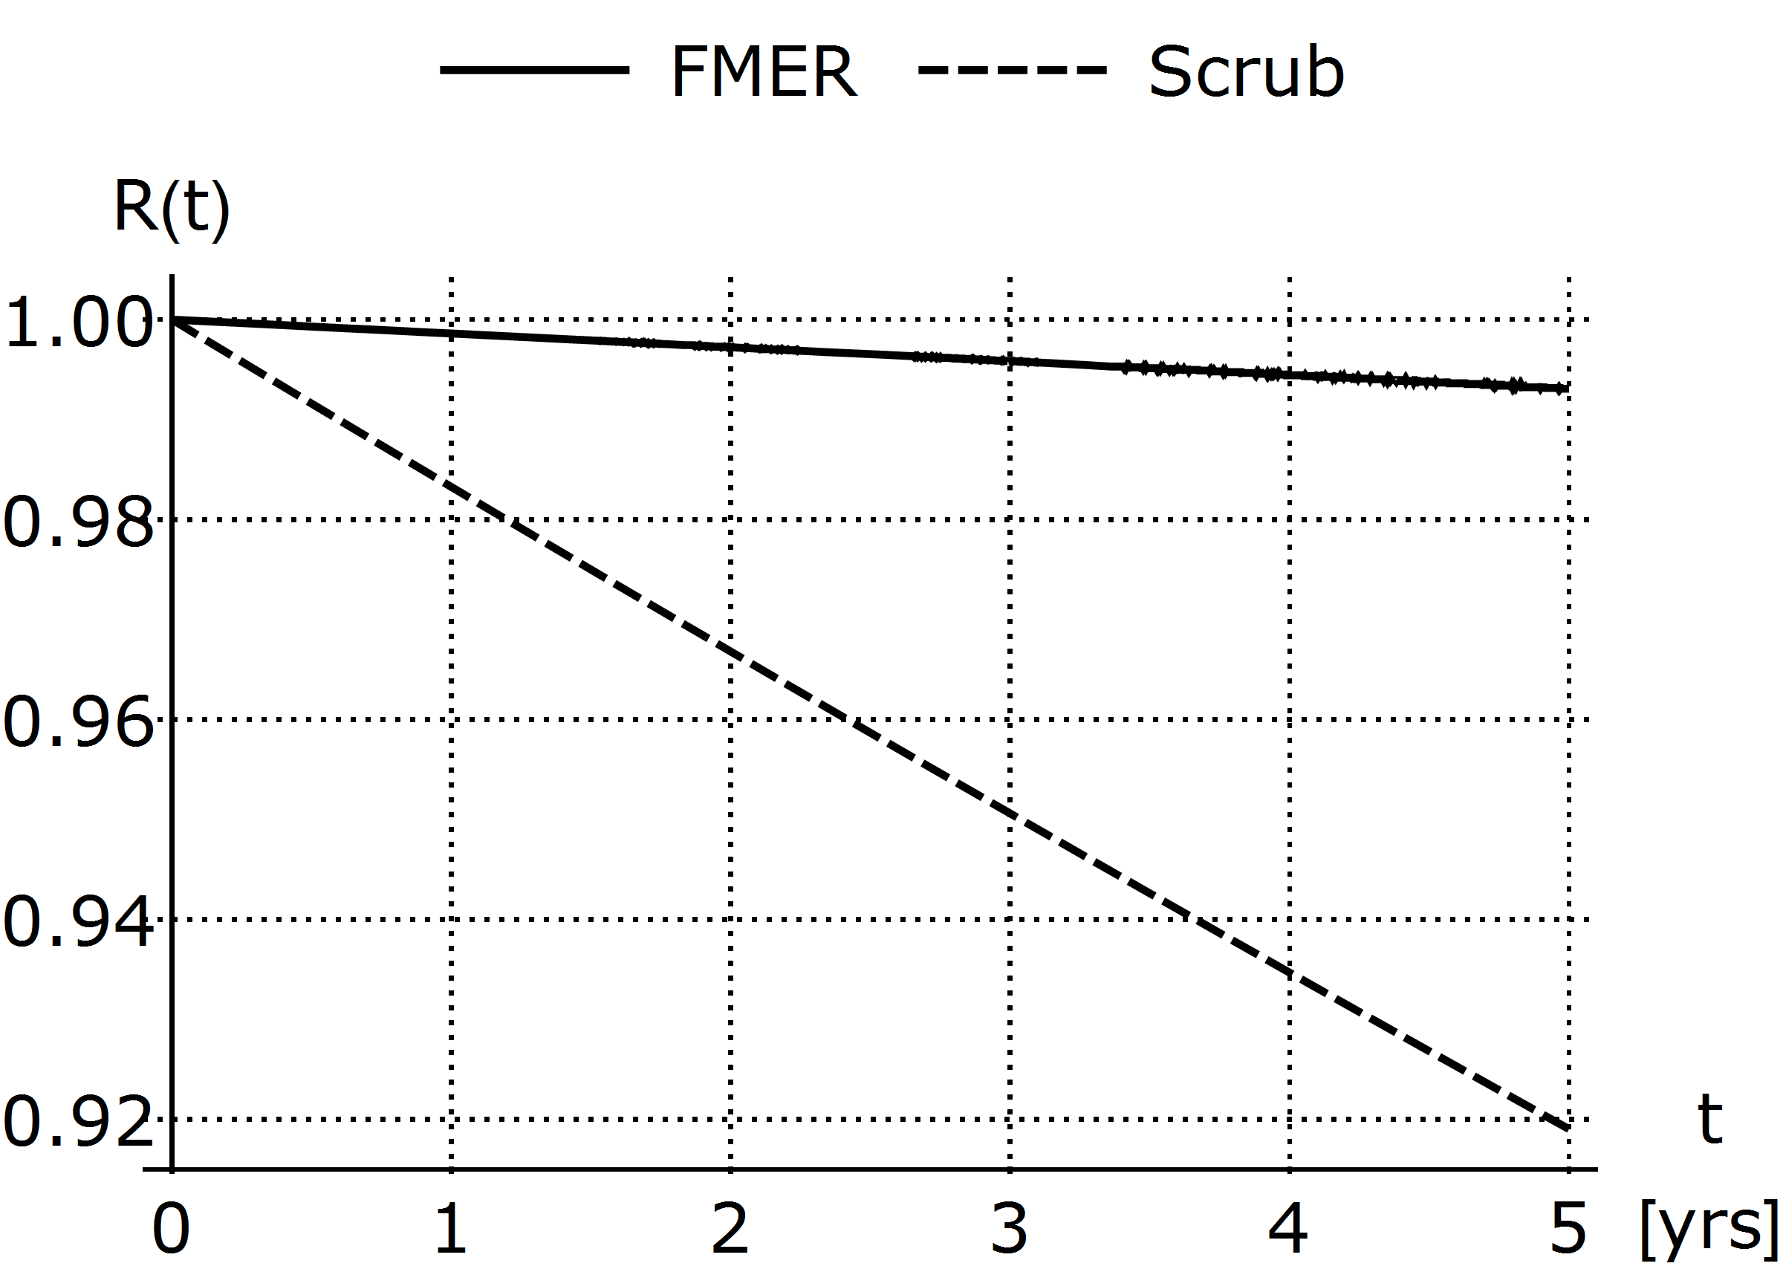
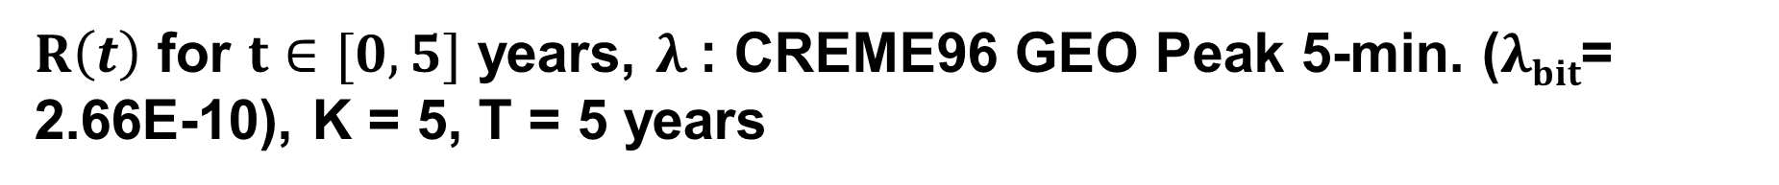
$R\left(t\right)$ for $t∈[0, 5]$ years, $λ$: CREME96 GEO Peak 5-min. ($λbit$= 2.66E-10), K = 5, T = 5 years

Slide 7
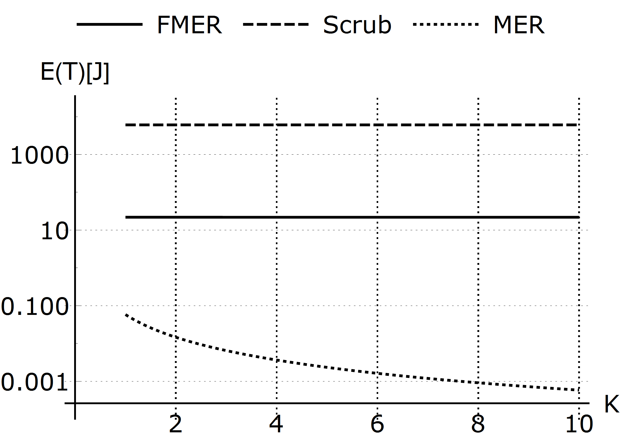
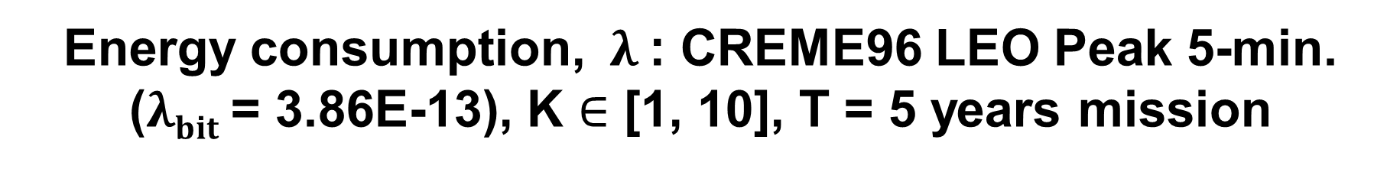
Energy consumption, $λ$: CREME96 LEO Peak 5-min. ($λbit$= 3.86E-13), K $∈$ [1, 10], T = 5 years mission
SoC/Scrub (K = 5)
  W_{Scrub} = 50 seconds
  R(T) = 0.999
  E(T) = 30441 Joules
SoC / FMER (K = 5)
  W_{FMER} = 219 seconds
  R(T) = 0.999
  E(T) = 110 Joules
  277X less energy than SoC/Scrub

Slide 8
Conclusions
FMER: Achieves higher reliability than scrubbing or MER
FMER: Saves significant energy compared to scrubbing alone

Slide 9
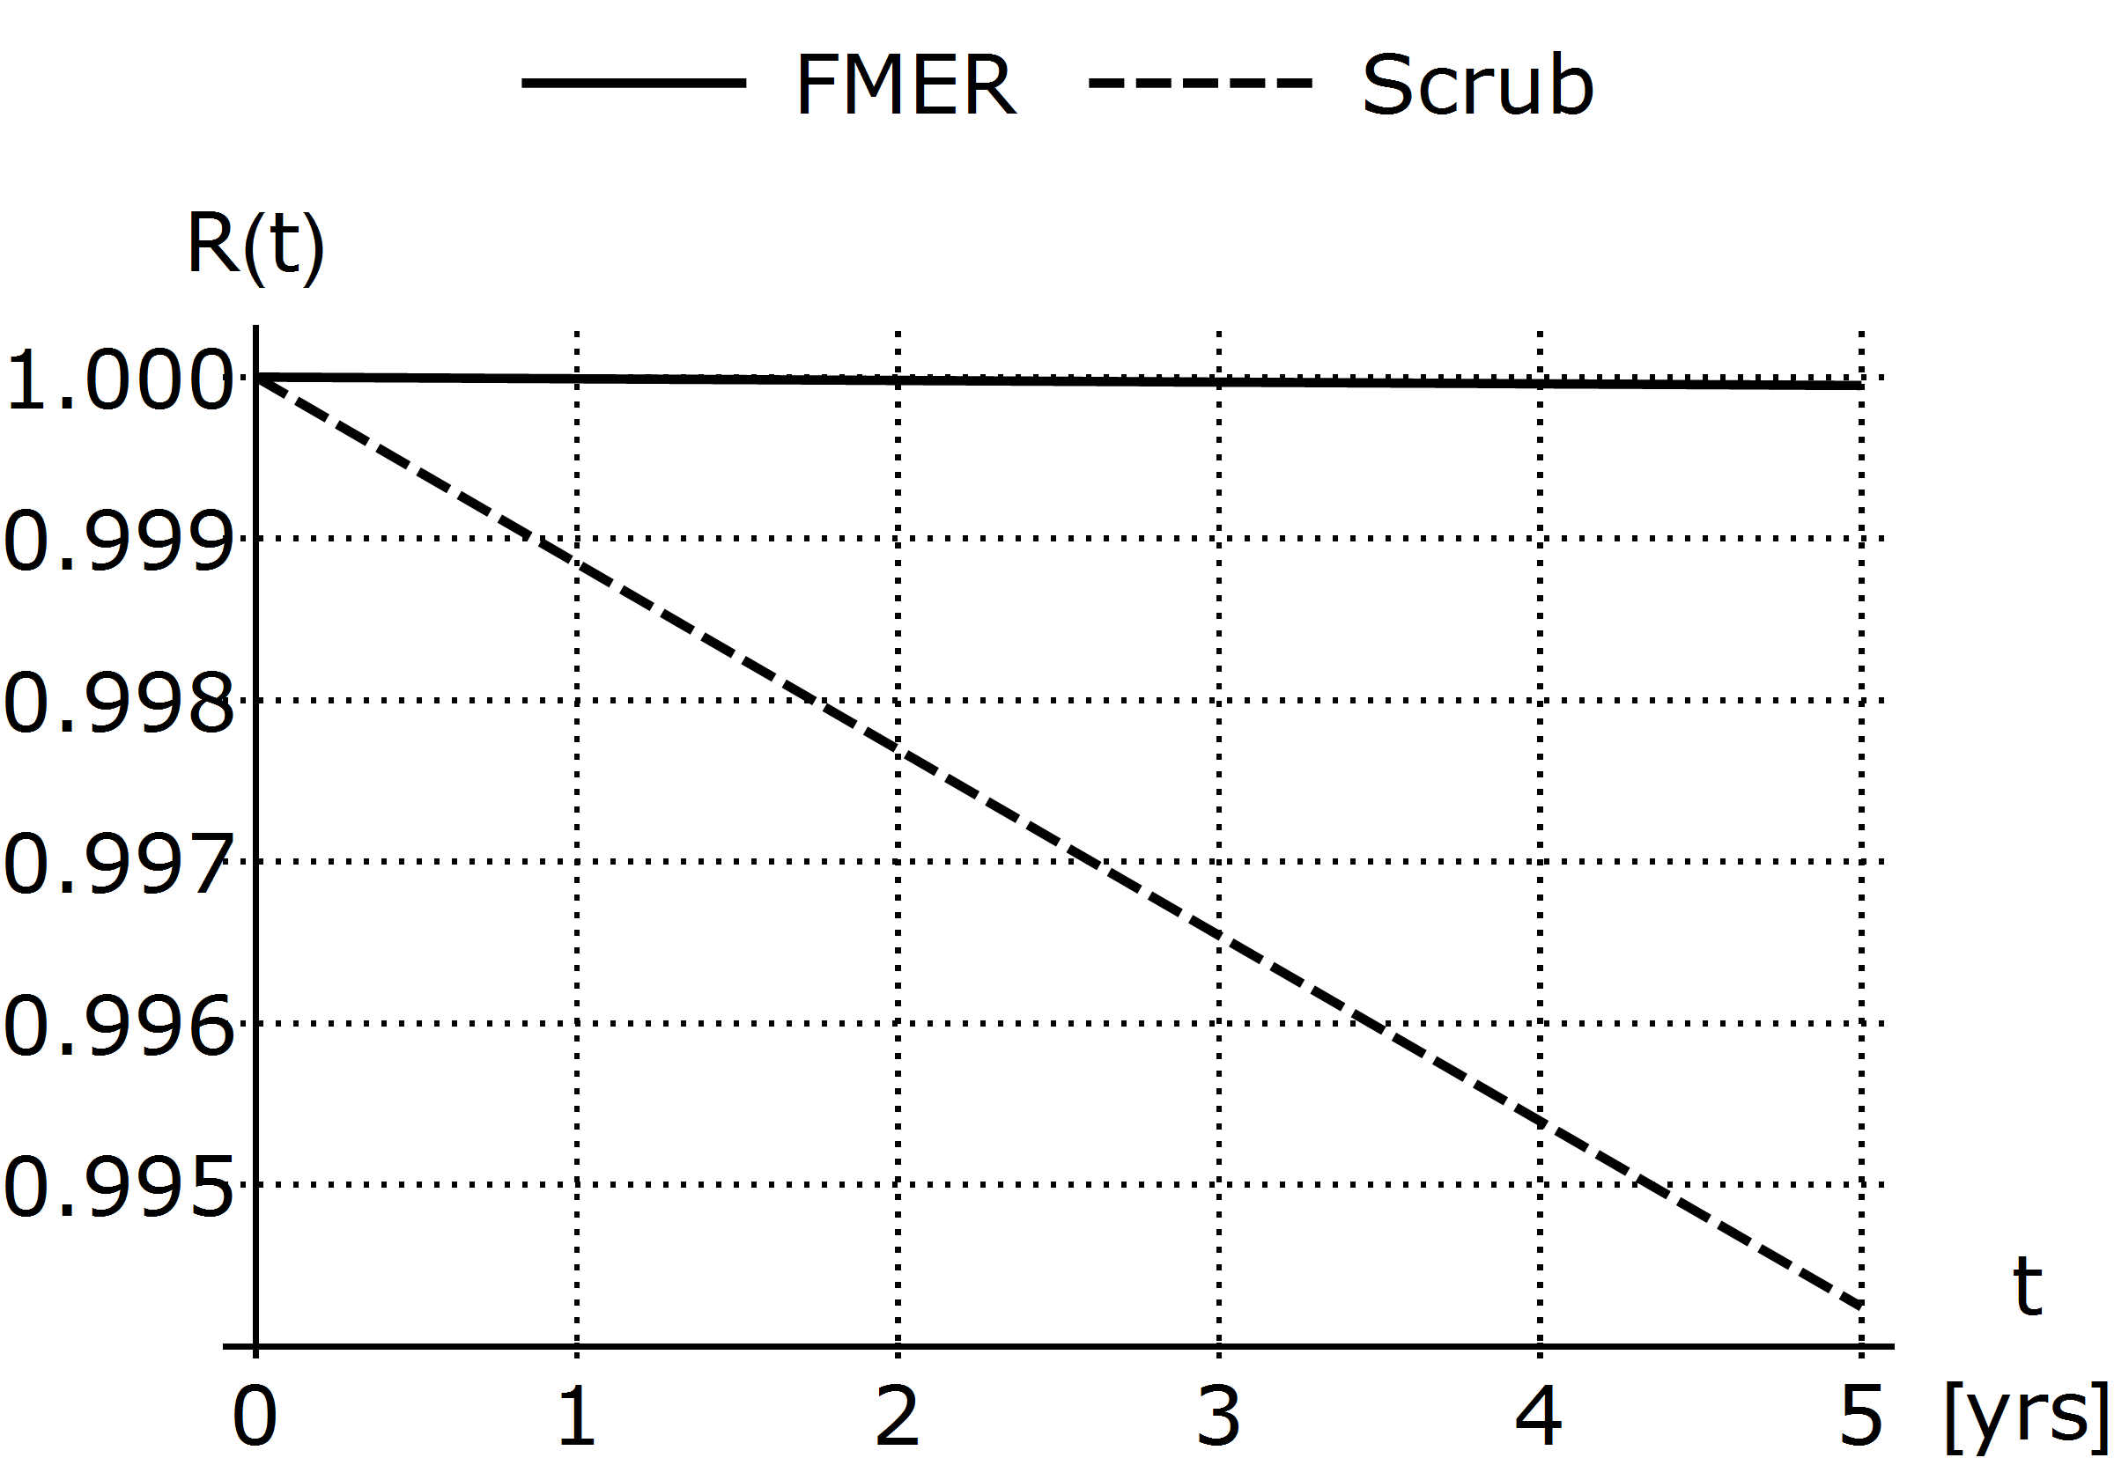
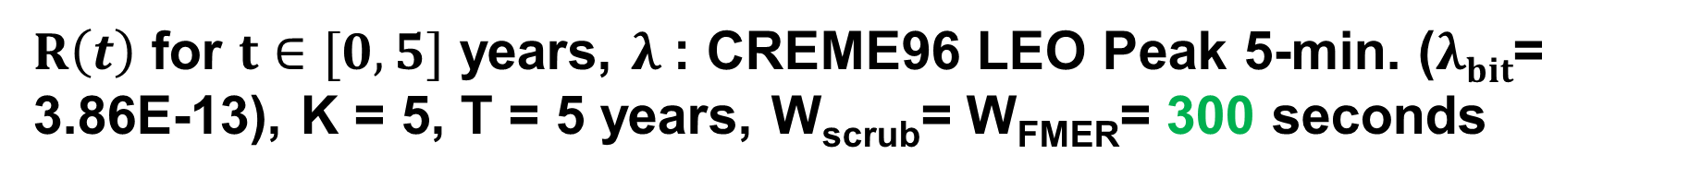
$R\left(t\right)$ for $t∈[0, 5]$ years, $λ$: CREME96 LEO Peak 5-min. ($λbit$= 3.86E-13), K = 5, T = 5 years, W_{scrub}= W_{FMER}= 300 seconds
R(T)_{FMER} = 0.99994
E(T)_{FMER} = 2030 J
2.5X less energy than SoC/Scrub
R(T)_{Scrub} = 0.994
E(T)_{Scrub} = 5075 J

Slide 10
Contributions
We propose FMER
We derive and compare the
  reliability
  availability
  energy consumption
of a TMR-based application SoC that utilizes either
  FMER
  or blind scrubbing
  or MER
  We show that SoC/FMER achieves the
  Highest Reliability and Availability
  Lowest energy consumption

Slide 11
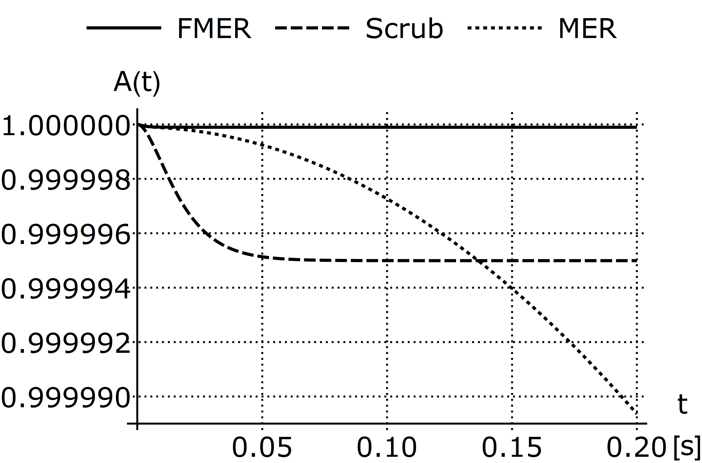
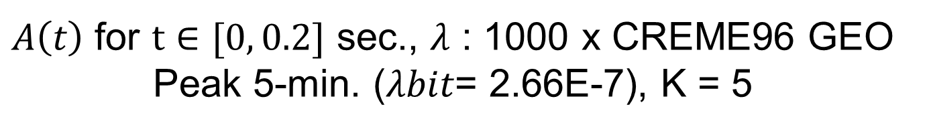
$A\left(t\right)$ for $t∈[0, 0.2]$ sec., $λ$ : 1000 x CREME96 GEO Peak 5-min. ($λbit$= 2.66E-7), K = 5

Slide 12
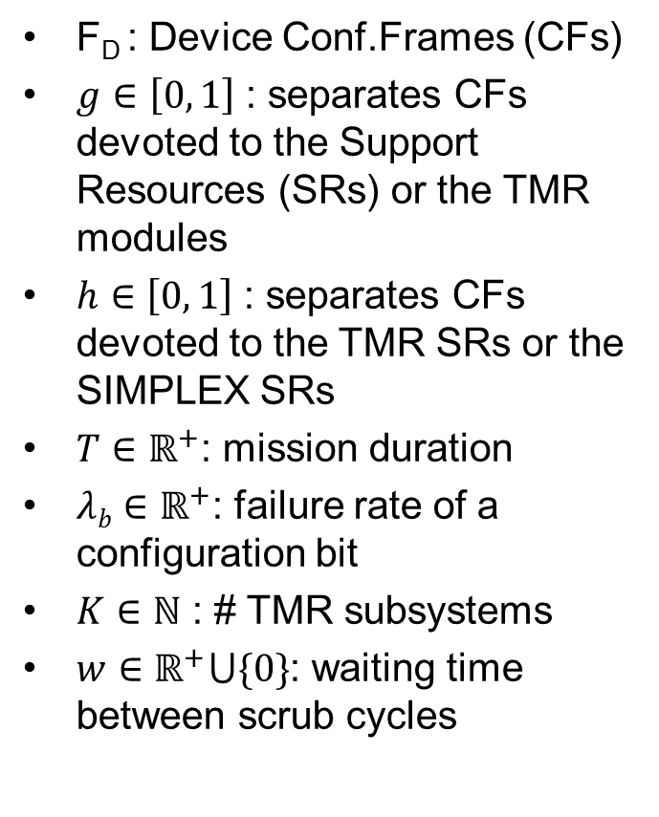
Design Formulation
F_{D} : Device Conf.Frames (CFs)
$g∈\left[0, 1\right]$ : separates CFs devoted to the Support Resources (SRs) or the TMR modules
$h∈\left[0, 1\right]$ : separates CFs devoted to the TMR SRs or the SIMPLEX SRs
$T∈ℝ^{+}$: mission duration
$λb∈ℝ^{+}$: failure rate of a configuration bit
$K∈ℕ$ : # TMR subsystems
$w∈ℝ^{+}⋃\{0\}$: waiting time between scrub cycles

Slide 13
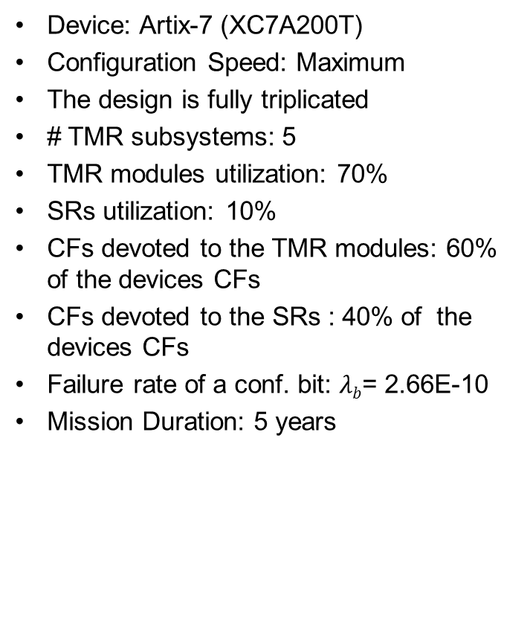
Case study

Slide 14
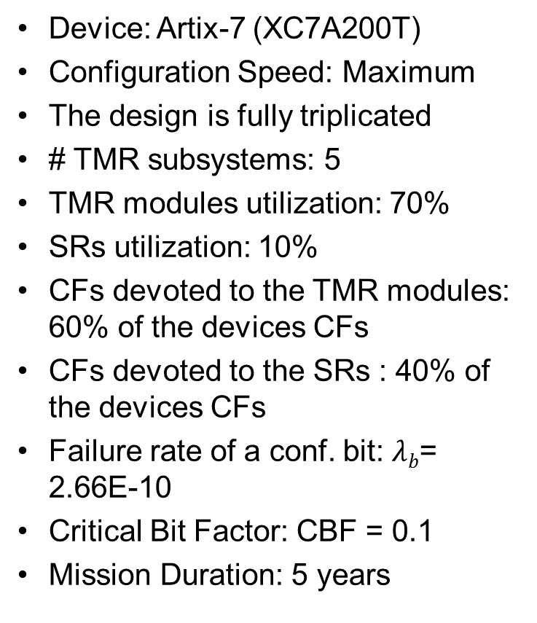
Results: System specifications
Device: Artix-7 (XC7A200T)
Configuration Speed: Maximum
The design is fully triplicated
# TMR subsystems: 5
TMR modules utilization: 70%
SRs utilization: 10%
CFs devoted to the TMR modules: 60% of the devices CFs
CFs devoted to the SRs : 40% of the devices CFs
Failure rate of a conf. bit: $λb$= 2.66E-10
Critical Bit Factor: CBF = 0.1
Mission Duration: 5 years

Slide 15
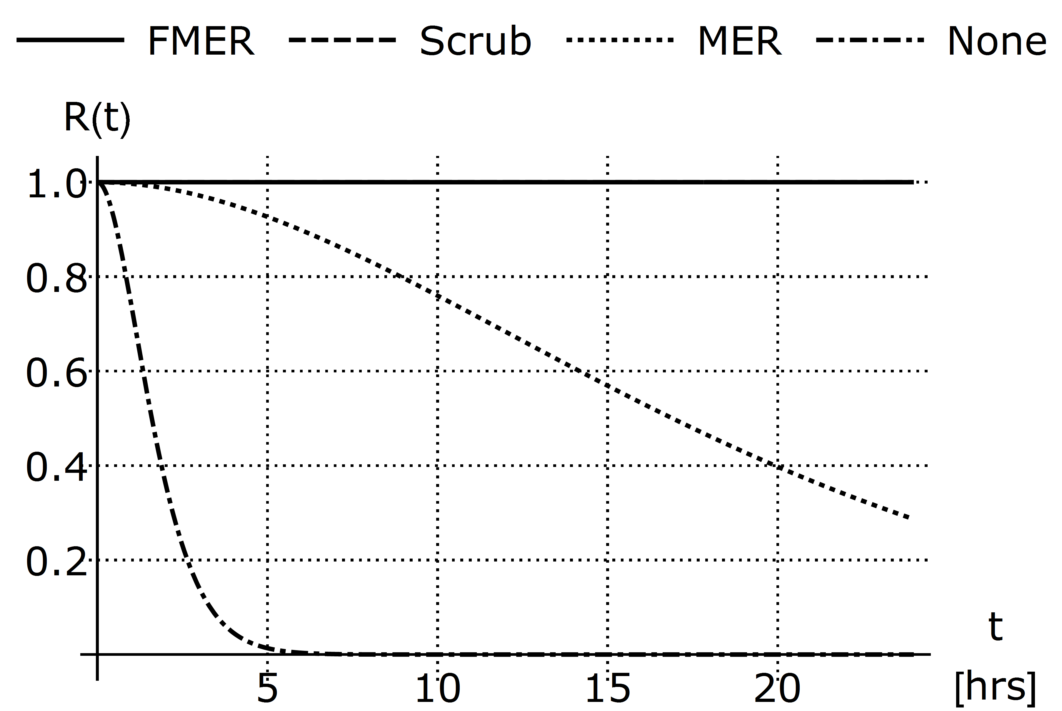
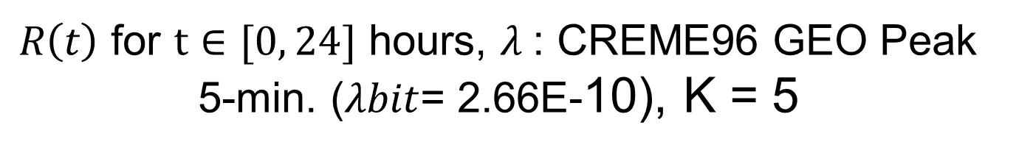
$R\left(t\right)$ for $t∈[0, 24]$ hours, $λ$: CREME96 GEO Peak 5-min. ($λbit$= 2.66E-10), K = 5

Slide 16
$R\left(t\right)$ for $t∈[0, 5]$ years, $λ$: CREME96 GEO Peak 5-min. ($λbit$= 2.66E-10), K = 5, T = 5 years
W_{scrub}= W_{FMER}= 0 s, E(T)_{scrub}= E(T)_{FMER}= 8.2E7 Joules

