Slide 1
Measure Twice and Cut Once: Robust Dynamic Voltage Scaling for FPGAs
Ibrahim Ahmed, Shuze Zhao, Olivier Trescases and Vaughn Betz
Email:ibrahim@ece.utoronto.ca
Notes:
Do not read the title

Slide 2
FPGA Power Consumption Challenge

Slide 3
FPGA Power Consumption Challenge
V_{DD} not scaling

Slide 4
FPGA Power Consumption Challenge
Obstacle against entering emerging low power/mobile market (IoT)
Must show superior perf/W to compete in Data centers
Need innovation to bring power down
“The future of continued scaling is dependent on adaptive power management and voltage scaling”, IEEE Fellow Kevin Zhang, VP of Intel's Technology and Manufacturing Group

Slide 5
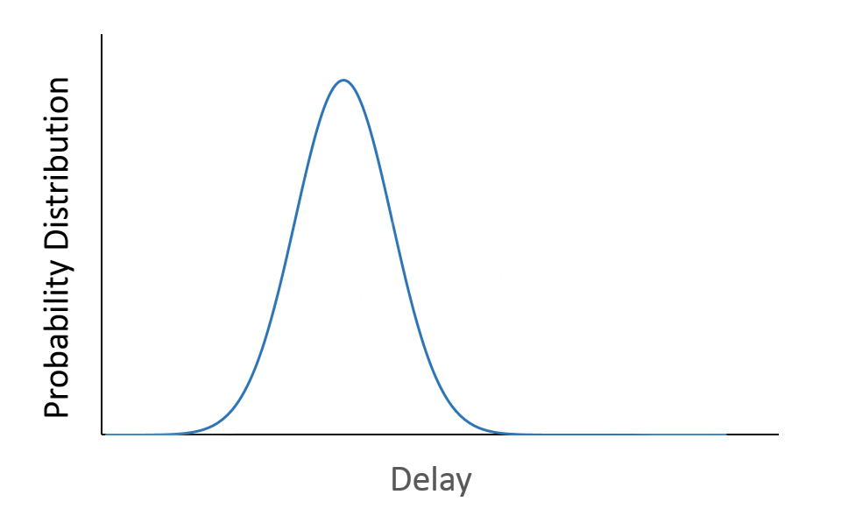
Worst-case Modelling is Wasteful
Devices have different delay -> Variation !!

Slide 6
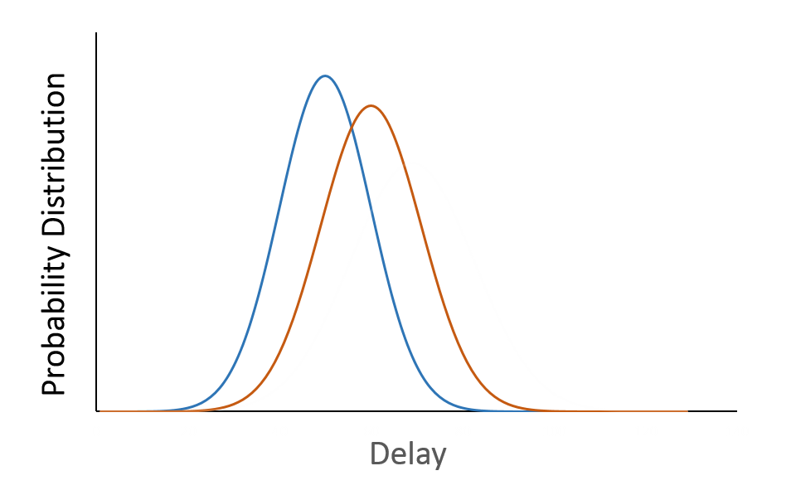
Worst-case Modelling is Wasteful
Delay is temperature dependant
High
Temperature

Slide 7
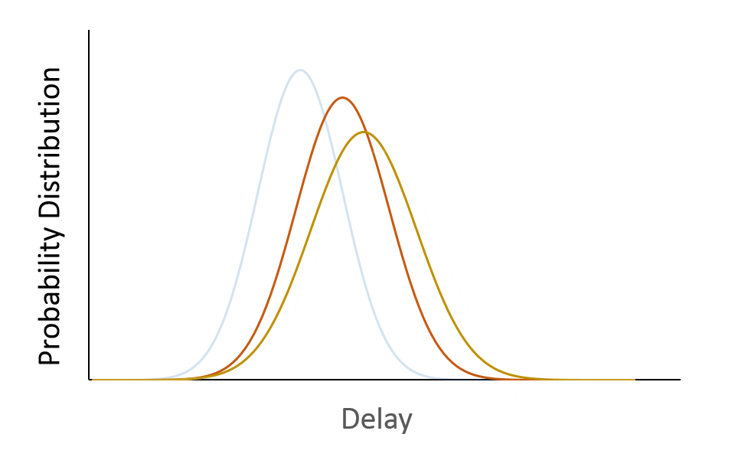
Worst-case Modelling is Wasteful
Delay is affected by V_{DD}
Lower V_{DD}

Slide 8
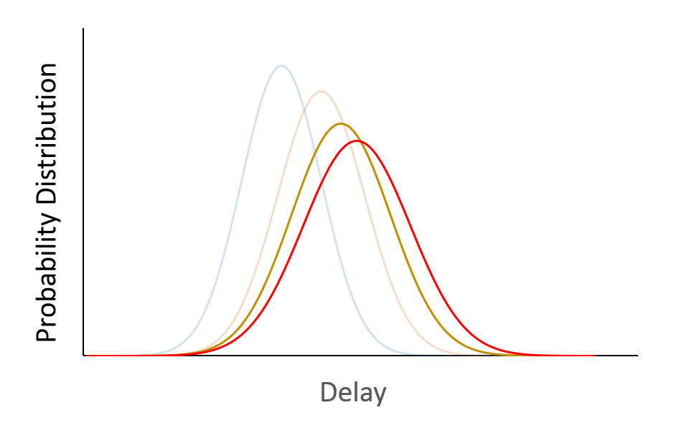
Worst-case Modelling is Wasteful
Aging also affects delay
End-of-life

Slide 9
Worst-case Modelling is Wasteful
Aging also affects delay
End-of-life
Static timing analysis (STA) accommodates the tail

Slide 10
Worst-case Modelling is Wasteful
Aging also affects delay
Timing models add margins for :-
Slow device
Worst temperature
Worst voltage droop
End-of-life effects
Guard-bands for noise, etc..
End-of-life

Slide 11
How significant are the added margins ?

Slide 12
How significant are the added margins ?
> 20 % reduction in V_{DD} without reducing Fmax

Slide 13
How significant are the added margins ?
Dynamic Voltage Scaling (DVS)
> 20 % reduction in V_{DD} without reducing Fmax

Slide 14
Dynamic Voltage Scaling
Find minimum V_{DD} that guarantees operation at required speed
V_{DD}, reduces both dynamic and static power
DVS has been commercially adopted by CPUs, but not FPGAs
FPGA’s programmability → unknown critical path at fabrication time
This work: exploit programmability to perform design & chip-specific calibration
P_{dynamic} α V_{DD}²
Static power drops even faster
Notes:
Dynamic power is quadratic in Vdd.
Static power is a bit more vomplicated p_stat = V_DD * I_leak, I_leak most important two forms are subthreshold and junction leakage
usubthreshold is exponenetial in Vgs – Vth and Vds affects Vth (DIBL)
DVS is not a new idea, the concept is out there for some time.
Fpga programmability, i.e. un-kown critical path, hard to recover from errors (unlike CPUs)
We propose to leverage the FPGA programmability to our advantage, off-line calibration

Slide 15
Outline
DVS proposal
Testing Procedure
FRoC
Results
Summary & Future work

Slide 16
Outline
DVS proposal
Testing Procedure
FRoC
Results
Summary & Future work

Slide 17
Conventional Design Cycle
One Measurement by STA
Application
HDL
Passes timing ✓
FPGA
Application
bit-stream
Program &
run application
with nominal
V_{DD}

Slide 18
DVS Proposal Overview
1st measurement by conventional STA (once per application)
Application
HDL
CAD
System
FPGA
FPGA
Calibration
bit-stream
Application
bit-stream
Replicated
critical
path
Critical
path
Heaters
Notes:
First step, application runs through a CAD system that performs conventional synthesis, P&R, etc.. To generate the application bit-stream
The first measurement is done using the conventional static timing analysis which reports pessimistic paths delays, from which we can identify critical paths.
The CAD system also spits out a calibration bit-stream that identically replicates the application critical path + heaters+ testing logic.

Slide 19
DVS Proposal Overview
Application
HDL
CAD
System
FPGA
FPGA
Power
stage
V_{DD}
Calibration
bit-stream
Application
bit-stream
Critical
path
Program & generate calibration table (CT)
2nd measurement by
on-chip calibration
(repeated for each FPGA)

Slide 20
DVS Proposal Overview
Application
HDL
CAD
System
FPGA
FPGA
Calibration
bit-stream
Application
bit-stream
V_{DD}
Power
stage
Program & generate calibration table (CT)
CT
Program &
run application
with DVS

Slide 21
DVS Proposal Overview
Application
HDL
CAD
System
Today’s talk
FPGA
FPGA
Calibration
bit-stream
Application
bit-stream
Program & generate calibration table (CT)
CT
Program &
run application
with DVS

Slide 22
Generating the Calibration Bit-stream
Performed on each FPGA at least once
For aging effects, calibration with every
power up
Capture all speed-limiting paths
Invisible to FPGA users
Fast
Robust
Automated Calibration
FRoC CAD tool

Slide 23
Outline
Motivation
DVS proposal
Testing Procedure
FRoC
Results
Summary & Future work

Slide 24
How to measure F_{max}
Stimulate with random inputs and check output ?
Does not guarantee exercising the critical path (CP)
To robustly measure the delay of a path :-
Off-path inputs must have a steady non-controlling value
Tested path
LUT
Steady 1/0

Slide 25
How to measure F_{max}
Stimulate with random inputs and check output ?
Does not guarantee exercising the critical path (CP)
To robustly measure the delay of a path :-
Off-path inputs must have a steady non-controlling value
Control over the edge transition from input → output
Tested path
LUT
/
Edge
1/0

Slide 26
Measuring the Delay of a Single Path
Application
FF
FF
FF
FF
FF
FF
LUT
LUT
Critical
path
(CP)
LUT
Replicate
LUT
LUT
LUT
FF
FF
FF

Slide 27
Measuring the Delay of a Single Path
Application
FF
FF
FF
FF
FF
FF
Critical
path (CP)
LUT
LUT
Replicate
LUT
LUT
LUT
LUT
FF
FF
FF

Slide 28
Measuring the Delay of a Single Path
Application
FF
FF
FF
FF
FF
FF
Critical
path
(CP)
LUT
LUT
Change LUT mask
XOR
LUT
LUT
XOR
FF
FF
FF

Slide 29
Measuring the Delay of a Single Path
Application
FF
FF
FF
FF
FF
FF
Edge₁
Critical
path
(CP)
LUT
LUT
Control edge
transition
XOR
Edge₂
LUT
LUT
XOR
FF
FF
FF

Slide 30
Measuring the Delay of a Single Path
Input stimulus
Application
FF
FF
FF
FF
FF
FF
Edge₁
FF
Error
detection
Critical
path
(CP)
LUT
LUT
Detect timing faults
XOR
Edge₂
XNOR
LUT
LUT
XOR
FF
FF
FF
FF
Error

Slide 31
A Single Path Delay is Not Robust
Many paths have delay close to the CP
Within-die variation may cause some other paths to be more critical
Varying V_{DD} affects FPGA elements delay differently
Robust; measure delay of many near critical paths
Fast; use 1 calibration bit-stream
Notes:
Measuring Fmax of an application by measuring only 1 cp is not robust
Many paths are very close to the cp delay
On-chip variation may cause some other parts to be more critical
Delay of RE and LE change differently with changing Vdd
This means that we must test many near critical paths that may overlap. ---- > robustness

Slide 32
Testing Disjoint Paths
Testing many disjoint paths is mostly easy
Repeat the same procedure for single path testing
Application
FF
FF
FF
FF

Slide 33
Testing Disjoint Paths
Testing many disjoint paths is mostly easy
Repeat the same procedure for single path testing
Application
Calibration
FF
FF
FF
FF
$$⨁$$
$$⨁$$
$$⨁$$
$$⨁$$
FF
Error
FF
FF
FF
Error

Slide 34
..but What to Do with Overlapping Paths?
Paths sharing a LUT through different inputs
Path₁
FF
S₁
LUT
A
LUT
C
FF
FF
S₂
LUT
B
Path₂

Slide 35
..but What to Do with Overlapping Paths?
Paths sharing a LUT through different inputs
To test Path₁, fix off-path input at C
Path₁
FF
S₁
LUT
A
LUT
C
FF
FF
S₂
LUT
B
Path₂

Slide 36
..but What to Do with Overlapping Paths?
Paths sharing a LUT through different inputs
To test Path₁, fix off-path input at C
Path₁ & Path₂ can’t be tested together
Path₁
FF
S₁
LUT
A
LUT
C
FF
FF
S₂
LUT
B
Path₂

Slide 37
..but What to Do with Overlapping Paths?
Paths sharing a LUT through different inputs
To test Path₁, fix off-path input at C
Path₁ & Path₂ can’t be tested together
Need 2 separate test phases
Path₁
FF
S₁
LUT
A
LUT
C
FF
FF
S₂
LUT
B
Path₂

Slide 38
..but What to Do with Overlapping Paths?
Fix_{A}
Paths sharing a LUT through different inputs
To test Path₁, fix off-path input at C
Path₁ & Path₂ can’t be tested together
Need 2 separate test phases
Path₁
FF
S₁
LUT
A
LUT
C
FF
FF
S₂
LUT
B
Path₂
-Add Fix control signals to keep LUT output constant
-Test controller cycles through test phases sequentially
Fix_{B}

Slide 39
LUT Masks for Testing
$$I_{1}$$
only added when required
Developed more LUT masks to test Cyclone IV carry-chains with the same controllability
$$I_{2}$$
K-LUT
$F=Fix ⋅\left(I_{1}⨁I_{2}…⨁I_{K−2}⨁{Edge}\right)+\overline{Fix}$
$$I_{K−2}$$
$$Fix$$
$$Edge$$
Fix off-path inputs
Break re-convergent fan-outs
Control edge transition
$$Fix$$

Slide 40
Can’t Test Everything with 1 Bit-stream
P₁
P₂
One or two LUT inputs used as control signals
LUT
P₃
P₄

Slide 41
Can’t Test Everything with 1 Bit-stream
P₁
P₂
One or two LUT inputs used as control signals
LUT
Edge
Fix

Slide 42
Can’t Test Everything with 1 Bit-stream
P₁
P₂
One or two LUT inputs used as control signals
Fixing LUT output does not break all re-convergent fan-outs
LUT
Edge
Fix
LUT
B
Path₂
LUT
A
LUT
C
Path₁

Slide 43
Can’t Test Everything with 1 Bit-stream
P₁
P₂
One or two LUT inputs used as control signals
Fixing LUT output does not break all re-convergent fan-outs
LAB inputs constraint
Carry-chains constraints
LUT
Edge
Fix
LUT
B
Path₂
LUT
A
LUT
C
Path₁

Slide 44
Outline
Motivation
DVS proposal
Testing Procedure
FRoC
Results
Summary & Future work

Slide 45
CAD System with FRoC
Proposed CAD system
Calibration
HDL
Calibration
bit-stream
Quartus
P&R
Quartus
STA
FRoC
Quartus
Application
HDL
Location &
Routing
Constraints
Application
bit-stream
1) Paths selection
2) Paths replication
3) Grouping replicated paths
4) Test controller generation

Slide 46
1) Path selection
Application circuit
FF
FF
FF
FF
LUT
LUT
LUT
FF

Slide 47
1) Path selection
P₅
Application circuit
Extract near critical paths from STA
{P₁, P₂, P₃, P₄, P₅}
FF
P₁
FF
P₂
P₃
FF
FF
P₄
4-LUT
4-LUT
4-LUT
FF

Slide 48
1) Path selection
P₅
Application circuit
Extract near critical paths from STA
{P₁, P₂, P₃, P₄, P₅}
Select which paths to test
Can’t test {P₂,P₃,P₄} in 1 bit-stream
FF
P₁
FF
P₂
P₃
FF
FF
P₄
4-LUT
4-LUT
Two inputs reserved for control signals (Fix , Edge)
4-LUT
FF

Slide 49
1) Path selection
P₅
Application circuit
Extract near critical paths from STA
{P₁, P₂, P₃, P₄, P₅}
Select which paths to test
Can’t test {P₂,P₃,P₄} in 1 bit-stream
Select the more critical paths
{P₁, P₂, P₃ , P₅}
FF
P₁
FF
P₂
P₃
FF
FF
4-LUT
4-LUT
4-LUT
FF

Slide 50
2) Path replication
P₅
Application circuit
FF
P₁
FF
P₂
P₃
FF
FF
4-LUT
4-LUT
Replication
+
Control Signals
4-LUT
FF

Slide 51
2) Path replication
P₅
Application circuit
Replicated Paths
P₅
FF
P₁
FF
P₂
P₃
FF
FF
FF
P₁
FF
P₂
P₃
FF
Fix₂
Fix₁
Edge₁
Edge₂
4-LUT
4-LUT
4-LUT
4-LUT
Fix₃
Replication
+
Control Signals
Edge₃
4-LUT
4-LUT
FF
FF

Slide 52
3) Grouping replicated paths
Replicated Paths
P₅
P₁
P₂
P₃
FF
FF
FF
Fix₂
Fix₁
Edge₁
Edge₂
4-LUT
4-LUT
Fix₃
Edge₃
4-LUT
FF

Slide 53
3) Grouping replicated paths
Replicated Paths
P₅
Minimising test phases -> minimises calibration time
P₁
P₂
P₃
FF
FF
FF
Fix₂
Fix₁
Edge₁
Edge₂
4-LUT
4-LUT
Fix₃
Edge₃
4-LUT
FF

Slide 54
3) Grouping replicated paths
Replicated Paths
P₅
Minimising test phases -> minimises calibration time
Graph coloring problem
P₁
P₂
P₃
FF
FF
FF
Fix₂
Fix₁
Edge₁
Edge₂
4-LUT
4-LUT
Fix₃
Edge₃
4-LUT
FF

Slide 55
3) Grouping replicated paths
Replicated Paths
P₅
Minimising test phases -> minimises calibration time
Graph coloring problem
P₁
P₂
P₃
FF
FF
FF
Fix₂
Fix₁
Edge₁
Edge₂
4-LUT
4-LUT
Fix₃
Edge₃
4-LUT
FF

Slide 56
3) Grouping replicated paths
Replicated Paths
P₅
Minimising test phases -> minimises calibration time
Graph coloring problem
P₁
P₂
P₃
FF
FF
FF
Fix₂
Fix₁
Edge₁
Edge₂
4-LUT
4-LUT
Fix₃
Edge₃
4-LUT
FF

Slide 57
3) Grouping replicated paths
Replicated Paths
P₅
Minimising test phases -> minimises calibration time
Graph coloring problem
P₁
P₂
P₃
FF
FF
FF
Fix₂
Fix₁
Edge₁
Edge₂
4-LUT
4-LUT
Fix₃
Edge₃
4-LUT
FF

Slide 58
3) Grouping replicated paths
Replicated Paths
P₅
Minimising test phases -> minimises calibration time
Graph coloring problem
Tested > 5000 paths using 17 phases only !!
P₁
P₂
P₃
FF
FF
FF
Fix₂
Fix₁
Edge₁
Edge₂
4-LUT
4-LUT
Fix₃
Edge₃
4-LUT
FF

Slide 59
4) Test controller generation
For each test phase :-
Set the appropriate control signals
Generates input stimulus
Detects timing faults
Replicated
paths
Input stimulus
Sink
registers
Control
signals
Test Controller
Error

Slide 60
Outline
Motivation
DVS proposal
Testing Procedure
FRoC
Results
Summary & Future work

Slide 61
Benchmarks & Target Chip
Dual-channel 51-tap low pass FIR filter
Full crossbar (Xbar) with 16 100-bit-wide-ports
Targeting Cyclone IV EP4CE115F29C7 (TSMC 60-nm technology)
Nominal V_{DD} 1.2 V
Application | LE utilization | Reported F_{MAX}
FIR filter | 67,505 (59 %) | 121 MHz
Crossbar | 26,579 (23 %) | 115 MHz

Slide 62
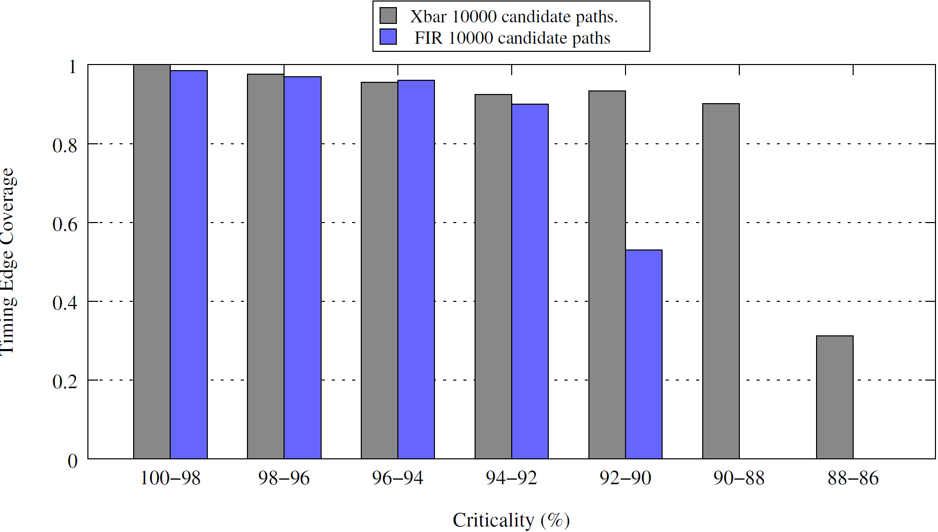
How Many Edges Are We Covering ?
Timing edge is a connection between
I & O of a cell (Cell delay) , O of a cell & I of another cell (connection delay)
Timing edge criticality = (longest path using this edge)/(CP delay)
Xbar 10000 candidate paths
FIR 10000 candidate paths
Covering more than 90 % of the more critical bins.
FRoC favours testing the more critical edges
Timing edge coverage
Criticality %

Slide 63
First, a Sanity Check
Need to validate the CT values
Selected benchmarks are feed-forward applications with no buried states
L
F
S
R
Application
M
I
S
R
Ref
=
Tested
BIST controller

Slide 64
How Many Paths to Measure ?
FIR
Xbar
1 path is not robust
Fan-out loading effects

Slide 65
Fan-out Correction & Guard-banding
Correcting for fan-out through the difference in reported delay (by Quartus STA) between the calibration and the application bit-streams
1 % for FIR & 5 % for Xbar
Guard-banding for IR-drop, crosstalk effects
5 % for both benchmarks (experimental values)

Slide 66
Generated CT & Power Savings
FIR
Xbar

Slide 67
Generated CT & Power Savings
FIR
Xbar
Nominal operation
Nominal operation

Slide 68
Generated CT & Power Savings
FIR
Xbar
Nominal operation
Nominal operation

Slide 69
Generated CT & Power Savings
FIR
Xbar
Nominal operation
Nominal operation
With DVS, run both application safely at 1 V
Save > 33 % total power consumption

Slide 70
Outline
Motivation
DVS proposal
Testing Procedure
FRoC
Results
Summary & Future work

Slide 71
Summary
Presented a DVS approach tailored for FPGA (off-line calibration)
Created FRoC tool to automate the calibration procedure
Achieve more than 33 % total power reduction

Slide 72
Future Work
Reducing guard-bands to enable more power savings
Complete fan-out modelling for tested paths
Account for IR-drop during calibration
# of required calibration bit-streams for full coverage
Testing hard blocks to find the safest minimum V_{DD}

Slide 73
Summary
Presented a DVS approach tailored for FPGA (off-line calibration)
Created FRoC tool to automate the calibration procedure
Achieve more than 33 % total power reduction

