Slide 1
Time-borrowing platform in the Xilinx UltraScale+ family of FPGAs and MPSoCs
Ilya Ganusov, Benjamin Devlin

Slide 2
Agenda
Time-borrowing concept
Hardware support for time-borrowing in UltraScale+
Time-borrowing algorithm based on ILP
Experimental results
Conclusion

Slide 3
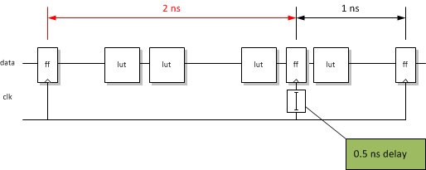
Time-borrowing
Improve F_{max} by redistributing slack between fast and slow paths
Uneven slack arises from
  Different logic depth
  Quantized routing
  Point-to-point vs high-fanout connectivity
  Control sets, routing congestion, and other PNR restrictions

Slide 4
Time Borrowing based on Clock Skew Scheduling
CRITICAL SETUP
PATH
JUST MEETS

Slide 5
Time Borrowing based on using pulsed latches
CRITICAL SETUP
PATH
JUST MEETS

Slide 6

Time Borrowing and Re-timing
$$Delay(i→j)≤T_{clock}$$
Re-timing
Time-borrowing
*
Practical differences
 | Re-timing | Time-borrowing
Transparency to user | Invasive netlist changes | No design changes
Granularity | Coarse | Fine-grain
Sensitivity to control sets (CE/RST) | Sensitive | Insensitive
Max WNS change | ∞ | HW-defined
*Sapatnekar and Deokar, Utilizing the retiming-skew equivalence in a practical algorithm for retiming large circuits, CAD 1996

Slide 7
Agenda
Time-borrowing concept
Hardware support for time-borrowing in UltraScale+
Time-borrowing algorithm based on ILP
Experimental results
Conclusion

Slide 8
UltraScale+ MPSoC Floorplan
Programmable delays
and pulse generators

Slide 9
Programmable Delay Hardware
Location
  Junction between distribution
  and leaf clocking
Quantity
  One per leaf clock track
  16 time-borrowing blocks per 960 FFs
Features
  5 clock delay taps + pulse generator
  Cascading for cost-efficient way of
  borrowing > 300ps

Slide 10
Clock Skew Scheduling and Pulsed Latches
Baseline leaf clock bypasses programmable delays
Bypass logic optimized for latency (minimizes extra variation, jitter)
FF
Clock skew scheduling
Pulsed latches

Slide 11
Agenda
Time-borrowing concept
Hardware support for time-borrowing in UltraScale+
Time-borrowing algorithm
Experimental results
Conclusion

Slide 12
Software flow
synthesis
Many strategies possible
  Use a subset of skews/pulse widths:
  minimize runtime
  Use all features, violate hold and fix with hold router: maximize Fmax
Time-borrowing algorithms
  Local greedy optimization
  Globally optimal ILP-based
This work (Vivado 2016.1)
  Do not violate hold
  Globally optimal ILP solution
place
route
Time-borrowing optimization
bitgen

Slide 13
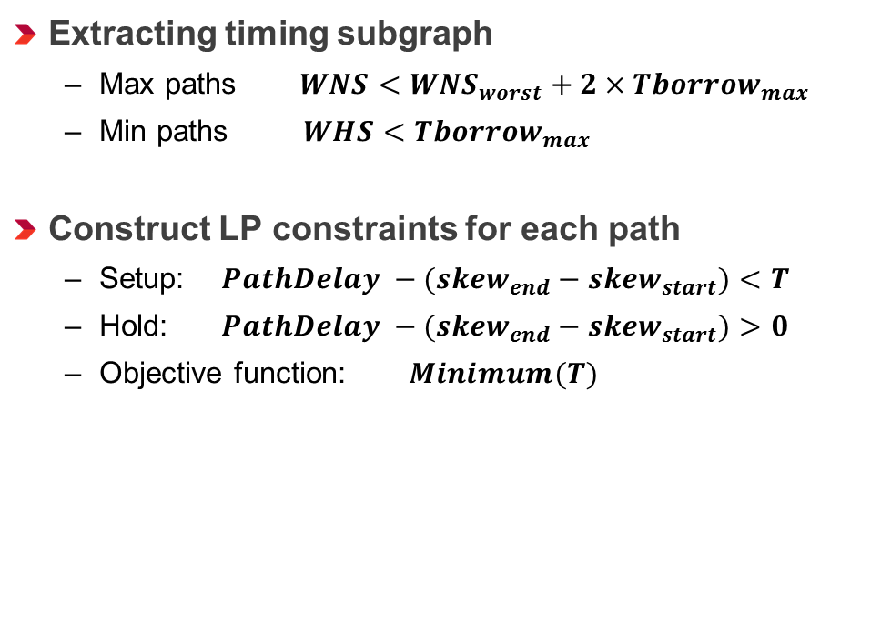
Time Borrowing Based on Global ILP algorithm
Extract timing subgraph
Extracting timing subgraph
  Max paths $WNS<{WNS}_{worst}+2×{Tborrow}_{max}$
  Min paths $WHS<{Tborrow}_{max}$
Construct LP constraints for each path
  Setup: $PathDelay −{(skew}_{end} − {skew}_{start})<T$
  Hold: $PathDelay −{(skew}_{end} − {skew}_{start})>0$
  Objective function: $Minimum(T)$
Construct LP formulation
LP solver
Deposit skew solution
report

Slide 14
Full Set of ILP constraints
Setup constraint
Hold constraint
Clock delay variation
Pulse width variation
Clock skew delay tap/pulsed latch
exclusivity

Slide 15
Agenda
Time-borrowing concept
Hardware support for time-borrowing in UltraScale+
Time-borrowing algorithm
Experimental results
Conclusion

Slide 16
Experimental setup
Vivado Design Suite version 2016.1
≈90 representative designs and Xilinx IP blocks
  Communications, test/measurement, emulation, etc
Implemented on UltraScale+ devices
  Fastest speed grade -3E
Metric | Min | Max | Avg
clk domains | 1 | 28 | 2
FMax | 77 MHz | 850 MHz | 300 MHz
LUT | 8k | 464k | 129k
FF | 3k | 586k | 123k
BRAM | 0 | 1152 | 187
DSP | 0 | 2700 | 195
Total designs | 89

Slide 17
Performance improvement results
Default time-borrowing configuration
  5 clock skew values [0, 41, 96, 168, 295]ps
  1 clock pulse width 295ps
Globally optimal ILP algorithm
  No hold violations allowed

Slide 18
Cascading programmable delays
Cost-efficient way to borrow > 300ps
  8 possible clock skew values [0, 41, 96, 168, 295][+295]*ps
  2 pulse widths [295, 610]ps
  No hold violations allowed

Slide 19
Hold Sensitivity Analysis
Impact of hold on Fmax
  5.5% Fmax with 0 hold violations
  router can potentially delay fast paths
  measure impact of adding hold margin
Results
- holdMargin

Slide 20
Location, cost, and performance
Why delay and replicate leaf clocks?
  Why not global clock buffers?
  Why not in the logic slice?
5% Fmax/unit area
1.3% Fmax/unit area
Replicated leaf architecture provides highest Fmax/$

Slide 21
Concluding Remarks
UltraScale+ architecture with programmable time-borrowing
  improves Fmax by re-distributing slack between fast and slow paths
  employs both clock skew scheduling and pulsed latches
  transparent to customer, no netlist changes
Performance results in production (Vivado 2016.1)
  5.5% gmean Fmax increase with zero-hold ILP-based algorithm
  higher Fmax possible when using cascades or increasing hold margin
Area- and runtime-efficient
  Less than 0.1% of additional chip area
  Less than 4 minutes of additional runtime on average

Slide 22
Thank you

