Slide 1
Body Bias Grain Size Exploration for a Coarse Grained Reconfigurable Accelerator
Yusuke Matsushita, Hayate Okuhara, Koichiro Masuyama, Yu Fujita, Hideharu Amano (Keio Univ.)
Notes:
Thank you Mr.Chairman for the introduction. /
My name is Yusuke Matsushita from Keio university./
Today, I will talk about a novel low power technique for a coarse grained reconfigurable accelerator./

Slide 2
Background : SOTB technology
A silicon on insulator (SOI) technology
SOTB technology
can widely control the trade-off
between delay and leakage power
by body bias.
→ The leakage current and delay of the transistors
can be controlled by using the body bias.
LEAP developed a novel SOI CMOS
technology called silicon on thin BOX (SOTB)
 | Reverse BodyBias | Forward BodyBias
delay | increase× | decrease○
leakage power | decrease○ | Increase ×
Notes:
Silicon on Insulator technology, SOI has received an attention as a low power semiconductor device.
The leakage power and delay time of transistors with SOI can be controlled by changing their threshold level of the transistors with
the body bias control./
Here, we focused a novel SOI CMOS technology called Silicon on thin BOX or SOTB. It was developed by Japanese
Low-power electronics association & project or (LEAP), / one of Japanese national projects.
It can widely change the leakage and delay by the body bias control. That is, when reverse bias is given, the leakage power is surpressed
while the delay is increased. On the other hand, when forward bias is given, the delay can be decreased but the leakage power is increased.

Slide 3
Background : CMA-SOTB
Cool Mega Array(CMA)[1]
is one of Coarse Grained Reconfigurable Accelerators (CGRA)
CMA consists of
Processing Element(PE)-Array
µ-controller
Data Memory
In order to keep the balance between
PE-Array operation speed and
µ-controller memory management
speed with body bias is used.
PE-Array
(12x8)
PE
PE
PE
PE
・・・
PE
PE
PE
PE
・・・
・・・
PE
PE
PE
PE
・・・
PE
PE
PE
PE
µ-controller
Data memory
[1]
Body Bias
Notes:
Cool Mega Array called CMA is one of Coarse Grained Reconfigurable Accelerator. CMA consists of Processing Element(PE)-Array as a computation
part , a micro-controller as memory management part, and Data memory to store the data. Note that PE-array is pure combinatorial circuits.
According to the arithmetic intensity of the target application, the balance between PE-Array operation speed and micro-controller memory management speed can be kept with body bias control.
We proposed methods to find the best body bias voltage.

Slide 4
Problem of Body Bias Control and proposed method
Problem of conventional Body Bias Control
Since the same body bias is supplied to all PEs,
this can cause a waste of leakage power.
Ex) PE3~8 are not used. But zero bias is
given to this PEs.
Body Bias Domain Partitioning
If body bias can be done
in finer granularity,
leakage power can be
further reduced.
However,
area overhead is increased.
Body bias optimization with Genetic
Algorithm is proposed.
Notes:
However, there is a problem in the conventional Body Bias Control method.
In conventional body bias control in CMA-SOTB, since the same body bias is supplied to all PEs, this can cause a waste of leakage power.
As an example, please take a look a part of the PE-Array assigned operation.
Case (a) shows an example of conventional body bias control.
White colored PE shows that zero bias is given, grey one shows it uses weak reverse bias and dark shows that the strong bias
is given.
In conventional body bias control, case (a), all PEs must use zero bias, even if no operation is assigned.
For this problem, Body Bias Domain Partitioning should be done.
Case (b) shows a case with a body bias domain size 1x2.
Case (c) shows a case with a body bias domain size 1x1.
when 1x2 domain size is used, they can receive strong weak bias. Using the finest grain, that is in case ( c), more number of
PEs can receive reverse bias.
Obviously, if body bias can be given in finer granularity, leakage power can be further reduced. However, for the well separation between each body bias domains , fine grain power domain increases area overhead.
In order to find the best body bias voltage for various size of power domain, we developed an optimization method based on Genetic Algorithm.

Slide 5
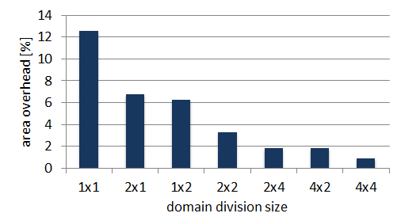
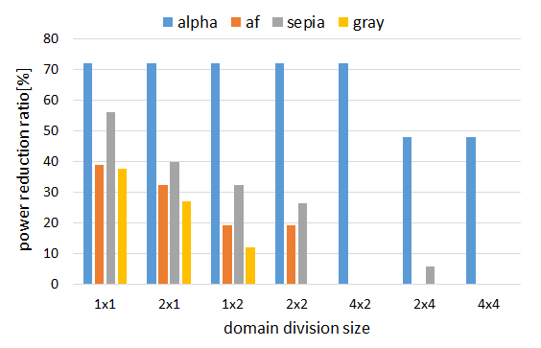
Evaluation
Image processing application (alpha, af, sepia, and gray)
Considering small area overhead(6%) and a large power reduction(35% on average), 2x1 is the best domain size.
Notes:
In this simulation, application programs for simple image processing (alpha, af, sepia, and gray) were used.
Please take a look at two figures.
The graph on the left shows area over head at each body bias domain size.
The overhead can be evaluated based on a real layout.
On the other hand, figure on the right shows power reduction ratio at each domain division size.
When the optimized body bias voltage is given, the leakage power is evaluated.
Note that it shows the reduction ratio, so larger one is more effective.
As the result, Considering small area overhead and a large power reduction, 2x1 is the best domain size.
Let’s discuss in front of our poster if you are interested in our project. Thank you.

