Slide 1
Accelerating particle identification for high-speed data-filtering using OpenCL on FPGAs and other architectures
for FPL 2016
Srikanth Sridharan
CERN
8/31/2016

Slide 3
Background 1/2
Upgrades planned for LHCb exp. at CERN
Capture 40M particle collisions per sec at LHCb
Or a new collision every 25ns
Generates data @40Tb/s
Need to capture 100% of the data
Currently capturing only 2.5%
* Projections from High Throughput Computing Project Status Report 22/6/16 by Niko Neufeld

Slide 4
Background 2/2
Need to process all data in large computing farm to reconstruct events
Impossible with just CPUs
Hence need for accelerators
FPGA attractive due to performance and power efficiency
OpenCL makes FPGAs more accessible

Slide 5
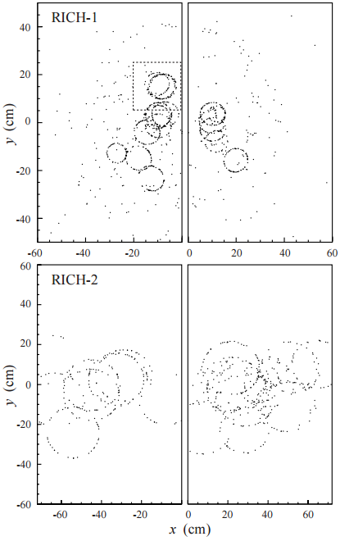
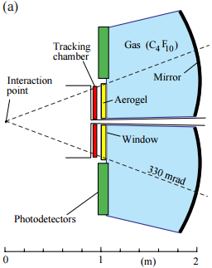
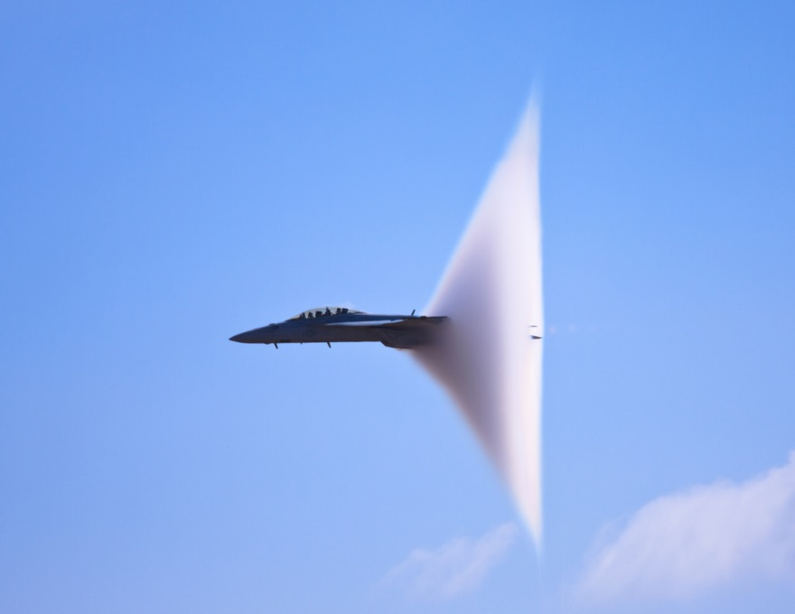
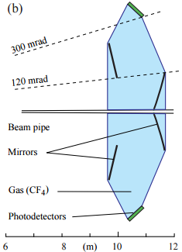
Ring Imaging Cherenkov Detector (RICH) concept
One of the sub detectors of LHCb
Charged particles faster than light produce cone of Cherenkov photons
Like the light equivalent of a sonic boom
Reflected on spherical mirrors and captured on photodetectors
Ring size ∝ Cherenkov angle
* Detector Images from “RICH pattern recognition” Note LHCb-98-040 by Forty, R, and O Schneider
Sonic boom image from http://strangesounds.org/wp-content/uploads/2013/08/sonic-boom.jpg

Slide 6
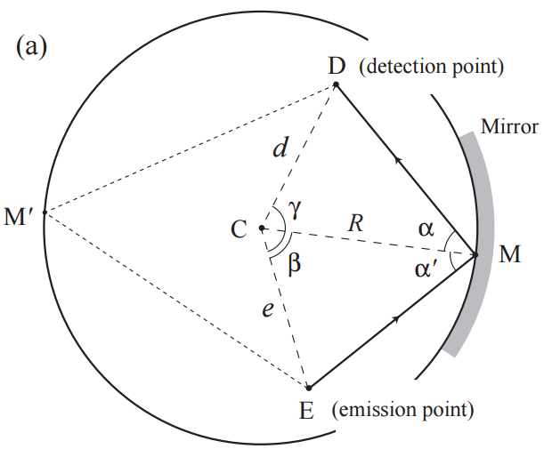
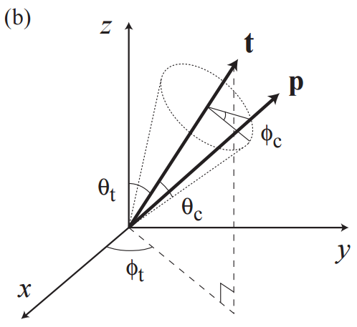
RICH - Ring Imaging Cherenkov Detector 2/2
Calculate Spherical reflection Point
Calculate Cherenkov angles
Cherenkov angle ∝ particle velocity⁻¹
Momentum and in turn Mass inferred from trajectory
Particle type inferred from velocity and mass
* Images from “RICH pattern recognition” Note LHCb-98-040 by Forty, R, and O Schneider

Slide 7
RICH Particle Identification Algorithm
50% of overall event reconstruction processes
Cherenkov angle reconstruction – 20% of RICH
Like inverse ray tracing in 3D space
Spherical mirrors make it more complicated
Solve system of Quadratic equations, cubic roots, matrix rotations, cross products and Eigen functions etc. in floating point
Parallelizable for n particle
Pipelinable

Slide 8
OpenCL implementation
Start from an existing single threaded C++ implementation as reference
Create an OpenCL kernel from scratch
Remove framework dependencies (Eg. Gaudi, Root)
Recreate library function equivalents
Datatype modifications (Eg. Gaudi::XYZPoint, Eigen3Vector etc.)
Implement, Parallelize and optimize the algorithm

Slide 9
Results of OpenCL implementation
Reference: Intel Core i7-4770

Slide 10
Performance per Watt
Metric | Devices
 | Stratix V FPGA | Nallatech 385 card with 1x Stratix V FPGA | Nvidia GeForce GTX 690 card with 2x GPU | 2x Intel Xeon E5-2650 CPU
Avg. Run-time for 10 Million Photons (μs) | 37017.44 | 37017.44 | 10345.13 | 32360.17
No. of Photons per microsecond (μs⁻¹) | 270.14 | 270.14 | 966.64 | 309.02
Power consumption (W) | 21.27 (Profiled) | 25 (Typ. Max) | 300 (Max) | 190 (TDP)
Estimated No. of Photons per microsecond per Watt (μs⁻¹W⁻¹) | 12.70 | 10.81 | 3.22 | 1.63

Slide 11
But…when factoring data transfer
Reference: Intel Core i7-4770

Slide 12
AVENUES FOR IMPROVING OVERALL RUNTIME ON FPGA
1.Overlapping computation and data transfer
Default case: Transfer time and kernel runtime for single blocking command queue
Opt 1: 10 Command queues with 1/10th data each, non blocking with event waitlist
Opt 2: Opt1 + flush after kernel

Slide 13
Improvement in numbers
Comparison of speedup for Overlapping and non Overlapping transfers
Small improvement but 10x transfer adds 10x latency
Type of Commands in Command Queue | No of Photons | Global work size | Speedup
Blocking (Default case) | 1e7 | 1e7 | 6.39
Nonblocking, No flush (Opt 1) | 1e7 | 10x 1e6 | 6.02
Nonblocking, Flush after kernel (Opt 2) | 1e7 | 10x 1e6 | 5.99
Blocking (Default case) | 1e6 | 1e6 | 5.43

Slide 14
2. Increasing the compute units on the FPGA / moving to a different FPGA
FPGA resource usage
DSPs – only resource heavily used
FPGA on Nallatech card: Stratix V GX variant with only 256 DSP blocks
Stratix V GS variants have 600-1963 DSP blocks
Potential to 2X throughput by increasing Computational Units
Move to Next gen FPGAs
Hard Floating Point units
Potentially could match GPU in raw performance
Resource | % of Resource used by OpenCL design
 | Kernel | Total
LEs | 10.8525 % | 22.4216 %
FFs | 9.34081 % | 16.4616 %
RAMs | 11.4844 % | 26.9531 %
DSPs | 79.2969 % | 79.2969 %
Avg. Utilization | 19.4127 % | 36.9868 %

Slide 15
Moving to a faster memory / low latency coherent memory access
3. Faster Memory
GeForce GTX690 card: GDDR5 with bw of 384GB/s
Nallatech FPGA card: DDR3 with bw of 25.6GB/s
4. Low latency coherent memory access
Intel QPI, IBM CAPI
~100x lower latency than PCIe
View of main memory
Already see significant improvements

Slide 16
5. Relaxing the Host centric OpenCL model
Host CPU at center of OpenCL model
Manages data transfers, kernel execution…
Device cannot start execution unless host issues commands
Add control latency on top of data latency
Unavoidable with opaque interfaces like PCIe
Can be replaced under SVM context
Device can schedule read and write by itself
Command queues and event wait list exists, but managed by host
Potential for device based command queues
More autonomy for devices

Slide 17
Conclusion
GPU has 1.8X better kernel performance over FPGA (normalized)
FPGA has 1.4X better overall performance over GPU (normalized)
FPGA has Order of magnitude better power efficiency & Performance/Watt
OpenCL – a game changer for FPGAs
Accelerated development time
~2weeks for OpenCL vs ~2months for RTL

