Slide 1
An FPGA-based High-Throughput Stream Join Architecture
C. Kritikakis, G. Chrysos, A. Dollas, D. Pnevmatikatos
ECE Department Technical University of Crete Contact author: pnevmati@ece.tuc.gr

Slide 2
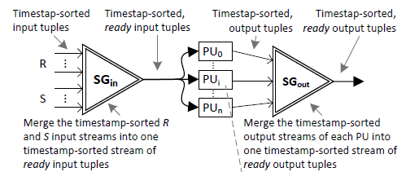
Motivation
Modern Data Mining Systems
Real-time processing
High-speed
High-volume data streams
Stream Join
Basic & important operator for data stream processing
Correlates information-tuples from multiple streams over a specific time-based window
ScaleJoin Algorithm
ScaleGate (SG): ADT for lock-free merging & time-stamping multiple incoming data streams
Processing Units (PUs): parallel processing elements that correlate incoming tuples

Slide 3
Contributions
First FPGA-based system to implement ScaleJoin [1] −one of the most efficient Stream Join algorithms
Substantially high throughput and processing rate
4x vs. the fastest multi-threaded stream join solution
an order of magnitude vs other multi-core solutions
Scalable, generic and extensible hardware-based architecture for streaming data mining applications

Slide 4
FPGA-based Architecture
Convey
HC-2 Platform

Slide 5
Performance Results
Metrics: Processing (without I/O) and throughput rates
Comparison: Official and other multi-threaded stream join solutions
Systems | Handshake system | ScaleJoin system | CellJoin system | FPGA-based ScaleJoin system
CPU Cores | 40 | 48 | 9 | 1 CPU + 4 Virtex6 FPGAs
CPU type | 2.2 GHz AMD Opteron | 2.6 GHz AMD Opteron | 1 PPE and 8 SPEs | 2.13 GHz Intel Xeon
Max Throughput Rate (tuples/sec) | 5125 | 3000 | 2000 | 12800
Max Processing Rate (Comps/sec) | 1.5 x 10⁹ | 4 x 10⁹ | - | 74 x 10⁹
Up to 2.5x higher throughput rate
Up to one order of magnitude higher processing rate

Slide 6
Conclusions
First FPGA-based solution for the ScaleJoin algorithm
Performance efficient solution vs. any other state-of-the-art published works
Extensible and scalable architecture
Generic, i.e. it can be used for any other streaming problem that combines information from multiple streams

Slide 7
Thank you for your attention!

