Slide 1
Model-Based Optimization of High Level Synthesis Directives
Charles Lo, Paul Chow

Slide 2
HLS Workflow
void func(…)
{
int array_1 [1024];
int array_2 [512];
loop1: for (…)
loop2: for (…)
}
Directives
Code Changes
Application
Tuned
HDL Module
Functional C/C++ Code

Slide 3
HLS Generators
void func(…)
{
int array_1 [1024];
int array_2 [512];
loop1: for (…)
loop2: for (…)
}
Directives
Code Changes
Low-DSP
Implementation
High-Throughput
Implementation
Functional C/C++ Code
Family of
Implementations
HLS Generator

Slide 4
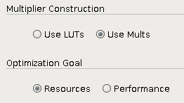
Parameter Selection
HLS Directives:
IP Generators:
set_directive_pipeline
-II <integer>
-enable_flush
-rewind
<location>
Xilinx Complex Multiplier (6.0)
THIS WORK: Automatically select directives to tune an HLS design
for particular objective and constraints
Notes:
HLS generators are given by the HLS environment,
Provide b

Slide 5
Outline
Problem Formulation
Model-Based Optimization
Intra-Program Transfer
Results
Conclusions & Future Work

Slide 6
Problem Formulation
LUT Utilization
$$\min{f(X)}$$
$$c\left(X\right)≤λ$$
Clock Period x Cycle Latency
$X:$Set of possible directive settings
Black Box: no model for $f(X)$ and $c(X)$
Complex interaction dependent on HLS and CAD tool implementation
Expensive: evaluation of $f\left(X\right), c\left(X\right)$is slow
Accurate area, clock frequency requires FPGA CAD flow

Slide 7
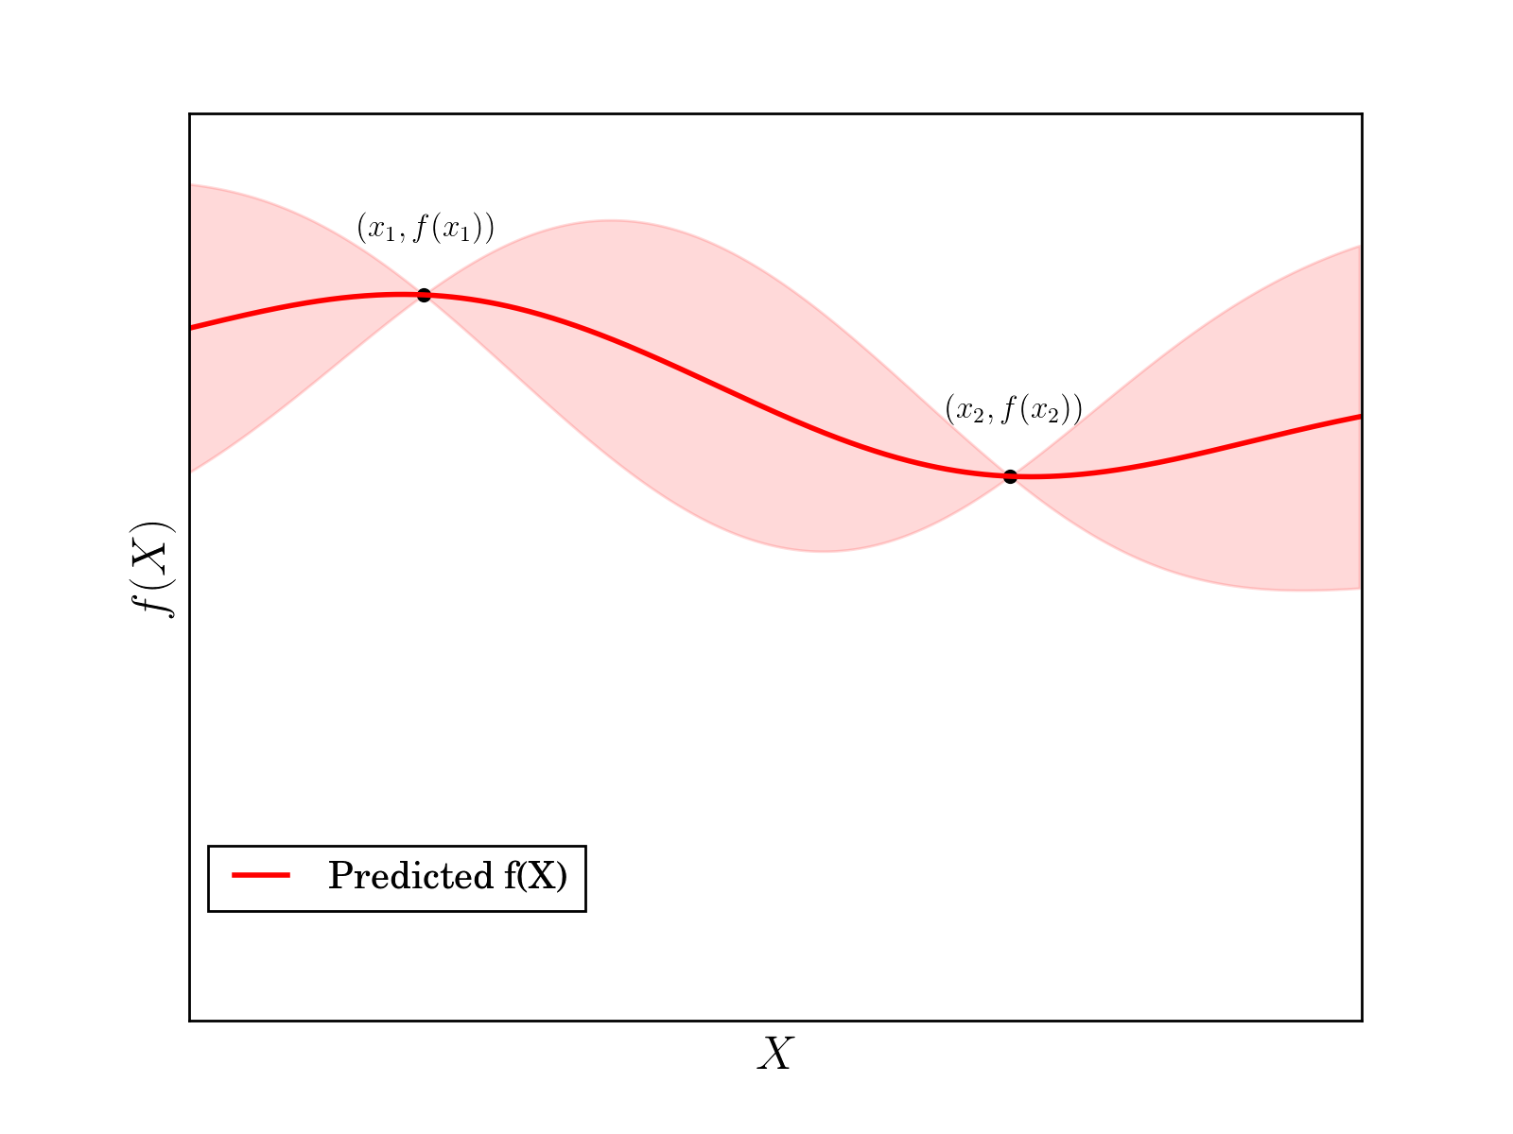
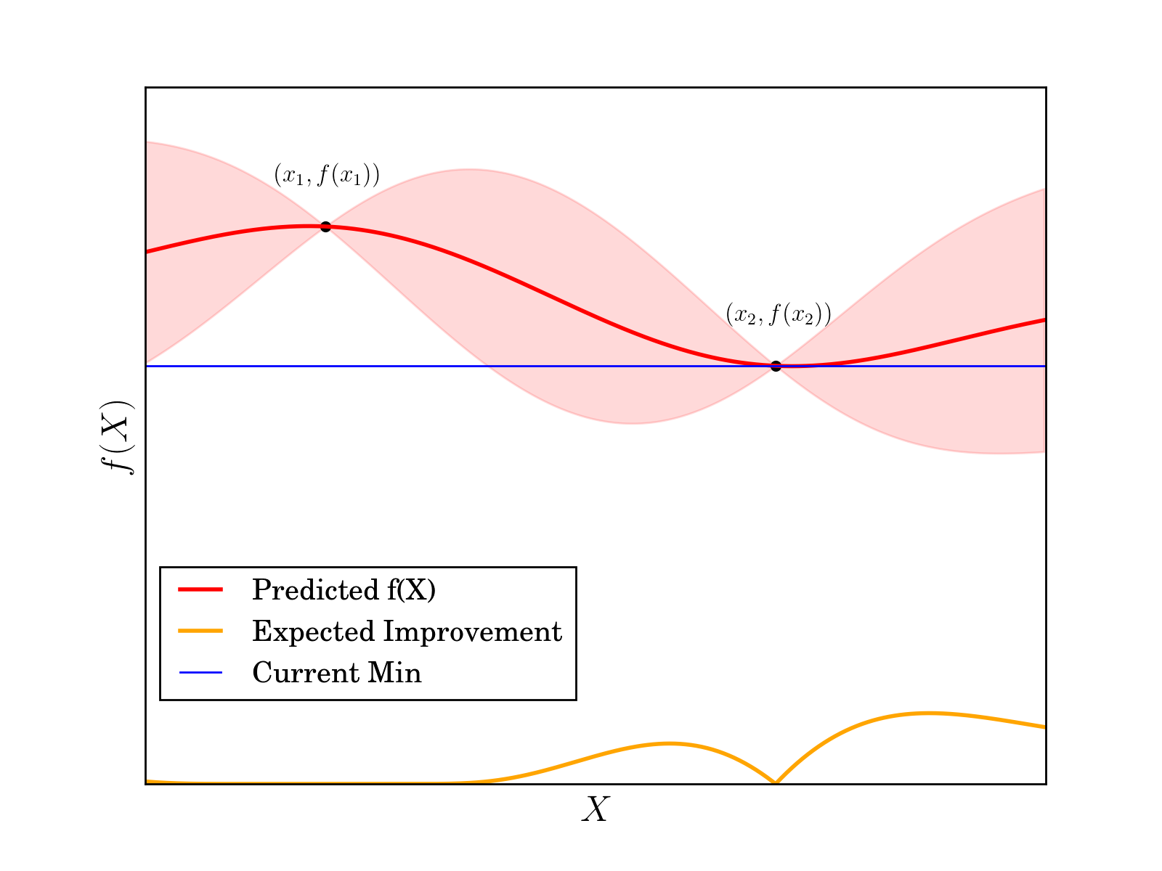
Sequential Model-Based Optimization
Expected Improvement:
$$E[\max\left(min−f\left(X\right), 0\right)]$$

Slide 8
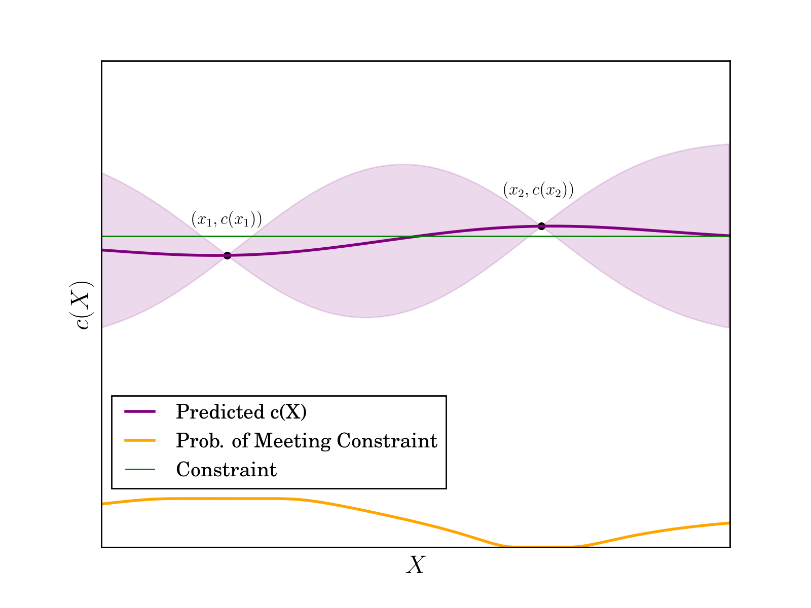
Constrained Optimization
Need a measure of distance between directive settings
$$E[\max\left(min−f\left(X\right), 0\right)]$$
$$p(c\left(X\right)≤\text{Constraint})$$

Slide 9
Relating Directive Options
Directive Setting 1
Directive Setting 2
set_directive_array_partition array_1 –factor 4
set_directive_array_partition array_2 complete
set_directive_pipeline loop_1
set_directive_unroll loop_2
set_directive_array_partition array_1 complete
set_directive_array_partition array_2 complete
set_directive_pipeline loop_2
set_directive_array_partition array_1 –factor 4
set_directive_array_partition array_2 complete
set_directive_pipeline loop_1
set_directive_unroll loop_2
set_directive_array_partition array_1 complete
set_directive_array_partition array_2 complete
set_directive_pipeline loop_2

Slide 10
Directive Representation
Design Space Description:
One-hot encoding:
4-D Vectors:
myfunc array_1:
directives:
array_partition:
- disable
- enable:
type:
- complete
- block –factor 4
complete
enable
0110
Squared Exponential Kernel: $k\left(x,x′ \right)=\exp{(−\frac{1}{2}⋅{\left(x−x^{′}\right)}^{T}M\left(x−x^{′}\right))}$

Slide 11
Directive Reuse
void func(…)
{
int array_1 [1024];
int array_2 [512];
loop1: for (…)
loop2: for (…)
}
partition, reshape
Transfer
unroll, pipeline
Idea: Application of a directive to different code structures has
similar effect

Slide 12
Relating Common Directives
Directive Setting 1
Directive Setting 2
set_directive_array_partition array_1 –factor 4
set_directive_array_partition array_2 complete
set_directive_pipeline loop_1
set_directive_unroll loop_2
set_directive_array_partition array_1 complete
set_directive_array_partition array_2 complete
set_directive_pipeline loop_2
set_directive_array_partition array_1 –factor 4
set_directive_array_partition array_2 complete
set_directive_pipeline loop_1
set_directive_unroll loop_2
set_directive_array_partition array_1 complete
set_directive_array_partition array_2 complete
set_directive_pipeline loop_2

Slide 13
Intra-Program Transfer
“disable array partition”
“partition array_2” or
“partition array_1”
“enable array partition”
Append distance function: $k\left(x_{1},x_{2}\right)+θ_{T}k_{T}(x,x^{′})$
Notes:
Want to compare along new axis

Slide 14
Experiment Setup
Three case studies from MachSuite [1]:
AES: 104, 976 points
Backpropagation: 23, 328 points
Radix Sort: 7, 776 points
Directives: loop pipeline, unroll, array partition
All design points evaluated to find global optima:
Vivado HLS 2015.4 HDL Evaluation
Target: Virtex 7 485T @ 200MHz
[1] B. Reagen et al., “MachSuite: Benchmarks for Accelerator Design and Custom Architectures,” IISWC 2014

Slide 15
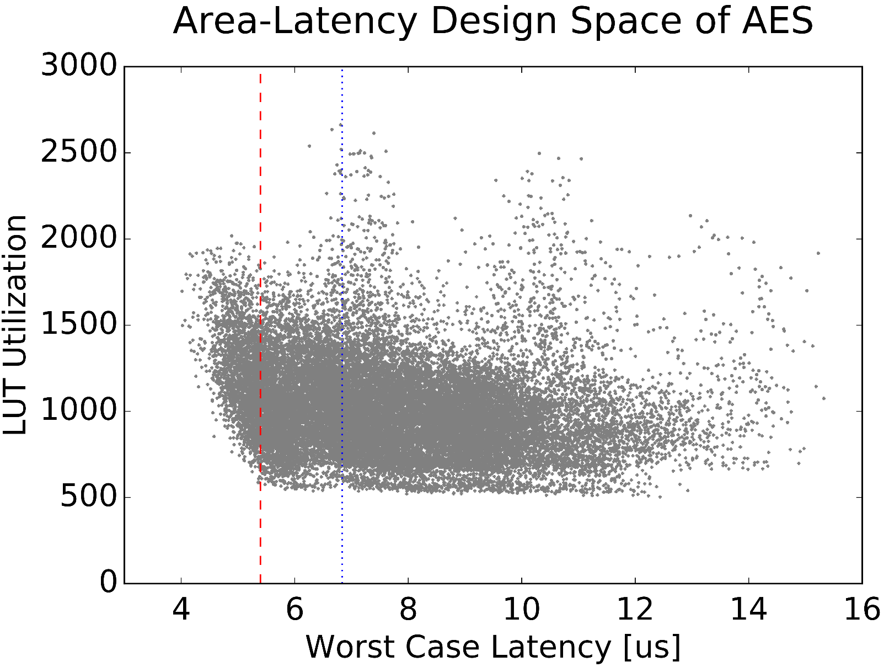
AES Design Space
30th percentile
50th percentile

Slide 16
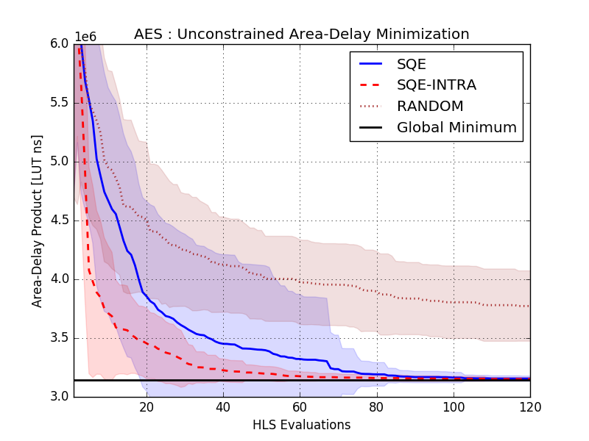
AES Unconstrained Optimization

Slide 17
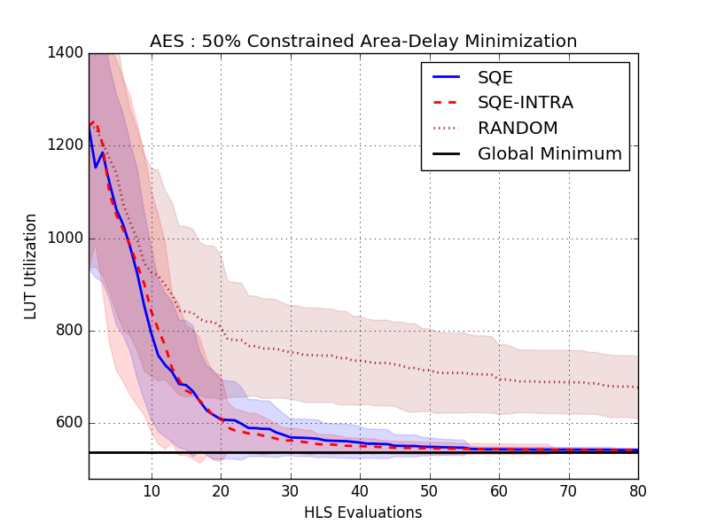
AES Constrained (50%) Optimization

Slide 18
Effects of Intra-Program Transfer
Transfer provides general directions to explore
Useful early in unconstrained problems
Constrained problems require more accuracy
In AES outer loops don’t follow trends
Pipelining an outer loop leads to unroll of inner loops
Different behaviour breaks assumption of transfer
Experiment: Ungroup outer loops in transfer kernel of objective function

Slide 19
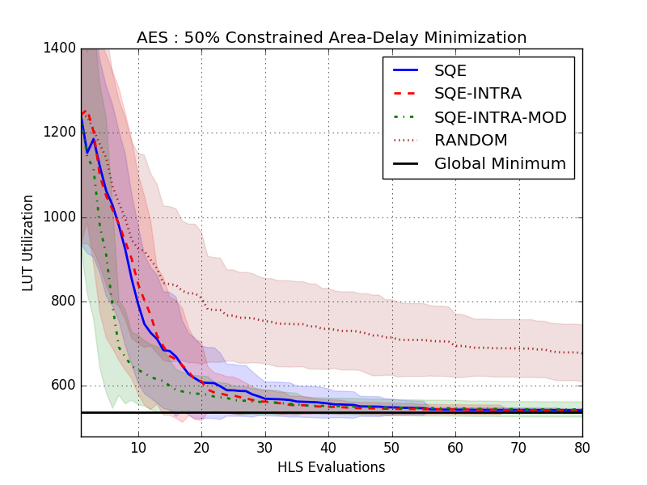
AES Constrained (50%) Optimization Revisited

Slide 20
Conclusions & Future Work
Conclusions:
Sequential Model-Based Optimization is effective in quickly optimizing HLS directives
Useful correlations exist between directives that can be exploited to improve optimization speed
Future Work:
Fine-tune relations between directives via source code analysis
Develop prior models to guide early optimization

Slide 21
Thanks!
Questions?
Charles Lo
locharl1@eecg.toronto.edu

