Slide 1
An Implementation Method of the Box Filter on FPGA
Sichao Wang and Tsutomu Maruyama
University of Tsukuba, JAPAN
Notes:
I’m the second author. This is my student’s work, but he could not come here today unfortunately. The title is “An implementation method of the box filter on FPGA”.

Slide 2
An FPGA Implementation of the Box Filter
We propose an implementation method of the box filter.
Exclusively designed for FPGAs with distributed and block RAMs
  Less memory usage
  High processing speed
Notes:
The box filter is widely used in image processing because of its low computational complexity.

Slide 3
Box Filter
The box filter is widely used in image processing because of its low computational complexity.
Notes:
The box filter is widely used in image processing because of its low computational complexity.

Slide 4
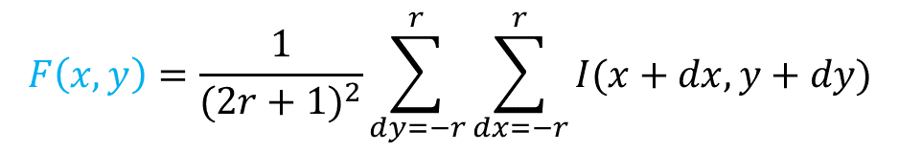




Box Filter
The box filter is widely used in image processing because of its low computational complexity.
An example of the box filter
$$x$$
$$r$$
$$r$$
$$y$$
$$F\left(x,y\right)=\frac{1}{{(2r+1)}^{2}}\sum_{dy=−r}^{r}{\sum_{dx=−r}^{r}{I(x+dx,y+dy)}}$$
the average of the pixels in the window
Notes:
Here, we consider to calculate the average of the pixels in this window.

Slide 5

Box Filter
The box filter is widely used in image processing because of its low computational complexity.
An example of the box filter
$$x$$
$$r$$
$$r$$
$$y$$
$$F\left(x,y\right)=\frac{1}{{(2r+1)}^{2}}\sum_{dy=−r}^{r}{\sum_{dx=−r}^{r}{I(x+dx,y+dy)}}$$
normalization
by the window size
the sum of the pixels in the window
Notes:
It is given by this equation. This term is the number of the pixels in the window, and this term gives the sum of the pixels.

Slide 6

Box Filter
The box filter is widely used in image processing because of its low computational complexity.
An example of the box filter
$$x$$
$$r$$
the computational complexity is ${(2r+1)}^{2}$
$$r$$
$$y$$
$$F\left(x,y\right)=\frac{1}{{(2r+1)}^{2}}\sum_{dy=−r}^{r}{\sum_{dx=−r}^{r}{I(x+dx,y+dy)}}$$
normalization
by the window size
the sum of the pixels in the window
Notes:
Its computational complexity is 2r+1 squared.

Slide 7
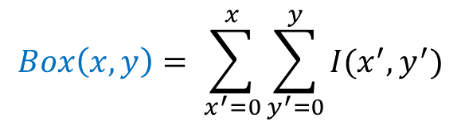
Box Filter
The box filter is widely used in image processing because of its low computational complexity.
An example of the box filter
$$x$$
$$y$$
$$Box\left(x,y\right)= \sum_{x^{′}=0}^{x}{\sum_{y^{′}=0}^{y}{I(x^{′},y^{′})}}$$
the sum of all intensity values from the origin
Notes:
Here, we define Box(x+r,y+r), which is the sum of the pixels form the origin.

Slide 8



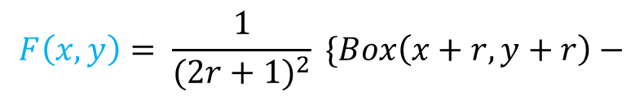


Box Filter
The box filter is widely used in image processing because of its low computational complexity.
An example of the box filter
$$x$$
$$x+r$$
$$r$$
$$r$$
$$y$$
$$y+r$$
$$F\left(x,y\right)= \frac{1}{{(2r+1)}^{2}} \{Box\left(x+r,y+r\right)−$$
$$Box\left(x−r−1,y+r\right)−$$
$$Box\left(x+r,y−r−1\right)+$$
$$Box\left(x−r−1,y−r−1\right) \}$$
Notes:
Then, F(x,y) can be obtained by this simple calculation.

Slide 9
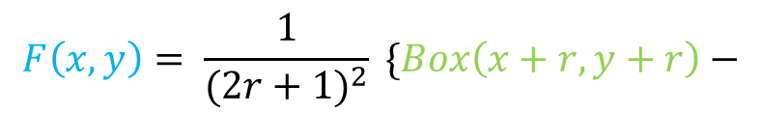
Box Filter
The box filter is widely used in image processing because of its low computational complexity.
An example of the box filter
$$x$$
$$x+r$$
$$r$$
$$r$$
$$y$$
$$y+r$$
$$F\left(x,y\right)= \frac{1}{{(2r+1)}^{2}} \{Box\left(x+r,y+r\right)−$$
$$Box\left(x−r−1,y+r\right)−$$
$$Box\left(x+r,y−r−1\right)+$$
$$Box\left(x−r−1,y−r−1\right) \}$$
Notes:
Box(x+r,y+r) is the sum of the pixels in this green box.

Slide 10


Box Filter
The box filter is widely used in image processing because of its low computational complexity.
An example of the box filter
$$x−r−1$$
$$x$$
$$x+r$$
$$r$$
$$r$$
$$y$$
$$y+r$$
$$F\left(x,y\right)= \frac{1}{{(2r+1)}^{2}} \{Box\left(x+r,y+r\right)−$$
$$Box\left(x−r−1,y+r\right)−$$
$$Box\left(x+r,y−r−1\right)+$$
$$Box\left(x−r−1,y−r−1\right) \}$$
Notes:
By subtracting Box(x-r-1,y+r), this orange box,

Slide 11
Box Filter
The box filter is widely used in image processing because of its low computational complexity.
An example of the box filter
$$x−r−1$$
$$x$$
$$x+r$$
$$r$$
$$r$$
$$y$$
$$y+r$$
$$F\left(x,y\right)= \frac{1}{{(2r+1)}^{2}} \{Box\left(x+r,y+r\right)−$$
$$Box\left(x−r−1,y+r\right)−$$
$$Box\left(x+r,y−r−1\right)+$$
$$Box\left(x−r−1,y−r−1\right) \}$$
Notes:
We can obtain the sum of the pixels in this region.

Slide 12


Box Filter
The box filter is widely used in image processing because of its low computational complexity.
An example of the box filter
$$x−r−1$$
$$x$$
$$x+r$$
$$r$$
$$y−r−1$$
$$r$$
$$y$$
$$y+r$$
$$F\left(x,y\right)= \frac{1}{{(2r+1)}^{2}} \{Box\left(x+r,y+r\right)−$$
$$Box\left(x−r−1,y+r\right)−$$
$$Box\left(x+r,y−r−1\right)+$$
$$Box\left(x−r−1,y−r−1\right) \}$$
Notes:
By further subtracting Box(x+r,y-r-1), this brown box,

Slide 13
Box Filter
The box filter is widely used in image processing because of its low computational complexity.
An example of the box filter
$$x−r−1$$
$$x$$
$$x+r$$
subtracted twice
$$r$$
$$y−r−1$$
$$r$$
$$y$$
$$y+r$$
$$F\left(x,y\right)= \frac{1}{{(2r+1)}^{2}} \{Box\left(x+r,y+r\right)−$$
$$Box\left(x−r−1,y+r\right)−$$
$$Box\left(x+r,y−r−1\right)+$$
$$Box\left(x−r−1,y−r−1\right) \}$$
Notes:
Its result becomes this region minus this region, because this region was subtracted twice.

Slide 14

Box Filter
The box filter is widely used in image processing because of its low computational complexity.
An example of the box filter
$$x−r−1$$
$$x$$
$$x+r$$
$$r$$
$$y−r−1$$
$$r$$
$$y$$
$$y+r$$
$$F\left(x,y\right)= \frac{1}{{(2r+1)}^{2}} \{Box\left(x+r,y+r\right)−$$
$$Box\left(x−r−1,y+r\right)−$$
$$Box\left(x+r,y−r−1\right)+$$
$$Box\left(x−r−1,y−r−1\right) \}$$
Notes:
Finally, by adding Box(x-r-1,y-r-1), this blue box,

Slide 15
Box Filter
The box filter is widely used in image processing because of its low computational complexity.
An example of the box filter
$$x−r−1$$
$$x$$
$$x+r$$
$$r$$
$$y−r−1$$
$$r$$
$$y$$
$$y+r$$
$$F\left(x,y\right)= \frac{1}{{(2r+1)}^{2}} \{Box\left(x+r,y+r\right)−$$
$$Box\left(x−r−1,y+r\right)−$$
$$Box\left(x+r,y−r−1\right)+$$
$$Box\left(x−r−1,y−r−1\right) \}$$
Notes:
The sum of the intensity value in this window can be obtained.

Slide 16

Box Filter
The box filter is widely used in image processing because of its low computational complexity.
An example of the box filter
$$x−r−1$$
$$x$$
$$x+r$$
$$r$$
$$y−r−1$$
the computational complexity is O(1), not affected by $r$
$$r$$
$$y$$
$$y+r$$
$$F\left(x,y\right)= \frac{1}{{(2r+1)}^{2}} \{Box\left(x+r,y+r\right)−$$
$$Box\left(x−r−1,y+r\right)−$$
$$Box\left(x+r,y−r−1\right)+$$
$$Box\left(x−r−1,y−r−1\right) \}$$
Notes:
Its computational complexity is Order one, and it is not affected by the window size w.

Slide 17
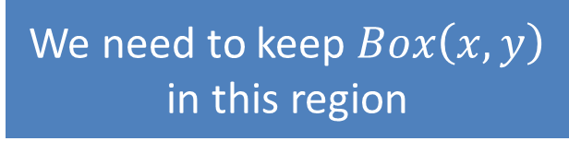
Box Filter
The box filter is widely used in image processing because of its low computational complexity.
An example of the box filter
We need to keep $Box\left(x,y\right)$ in this region
$$x−r−1$$
$$x$$
$$x+r$$
$$r$$
$$y−r−1$$
$$r$$
$$y$$
$$y+r$$
$$F\left(x,y\right)= \frac{1}{{(2r+1)}^{2}} \{Box\left(x+r,y+r\right)−$$
$$Box\left(x−r−1,y+r\right)−$$
$$Box\left(x+r,y−r−1\right)+$$
$$Box\left(x−r−1,y−r−1\right) \}$$
Notes:
However, we need to keep Box(x,y) in this region for this calculation method.

Slide 18
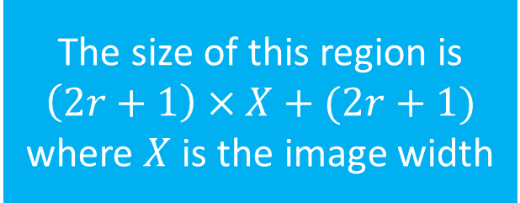
Box Filter
The box filter is widely used in image processing because of its low computational complexity.
An example of the box filter
We need to keep $Box\left(x,y\right)$ in this region
$$x−r−1$$
$$x$$
$$x+r$$
The size of this region is
$$\left(2r+1\right)×X+(2r+1)$$
where $X$ is the image width
$$r$$
$$r$$
$$y$$
$$y+r$$
$$F\left(x,y\right)= \frac{1}{{(2r+1)}^{2}} \{Box\left(x+r,y+r\right)−$$
$$Box\left(x−r−1,y+r\right)−$$
$$Box\left(x+r,y−r−1\right)+$$
$$Box\left(x−r−1,y−r−1\right) \}$$
Notes:
The size of this region is 2r+1 multiplied by X plus 2r+1. X is the image width.

Slide 19


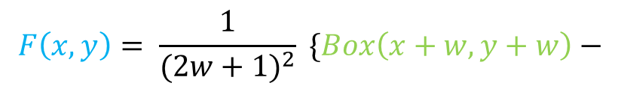
Box Filter
The box filter is widely used in image processing because of its low computational complexity.
An example of the box filter
We need to keep $Box\left(x,y\right)$ in this region
$$x−r−1$$
$$x$$
$$x+r$$
The size of this region is
$$\left(2r+1\right)×X+(2r+1)$$
where $X$ is the image width
$$r$$
$$r$$
$$y$$
$$y+w$$
It is proportional to the image width, and a large memory is required for processing high resolution images.
$$F\left(x,y\right)= \frac{1}{{(2w+1)}^{2}} \{Box\left(x+w,y+w\right)−$$
$$Box\left(x−w−1,y+w\right)−$$
$$Box\left(x+r,y−r−1\right)+$$
$$Box\left(x−r−1,y−r−1\right) \}$$
Notes:
This size is proportional to the image width, and a large memory is required for processing high resolution images.

Slide 20
Box Filter
Low computational complexity
Very high frame rate is possible by using an FPGA.
High memory usage
Its availability on FPGAs is limited for
    high resolution images, and
    applications that calculate cross-correlations.
Notes:
The features of the box filters are low computational complexity and high memory usage.

Slide 21
Box Filter
Low computational complexity
Very high frame rate is possible by using an FPGA.
High memory usage
Its availability on FPGAs is limited for
    high resolution images, and
    applications that calculate cross-correlations.
Notes:
Because of the low computational complexity, very high frame rate is possible by using FPGA.

Slide 22
Box Filter
Low computational complexity
Very high frame rate is possible by using an FPGA.
High memory usage
Its availability on FPGAs is limited for
    high resolution images, and
    applications in which a number of box filter are applied in parallel.
Notes:
However, its availability is limited for high resolution images, and applications that try to find the best matching from a number of candidates.

Slide 23
Box Filter
Low computational complexity
Very high frame rate is possible by using an FPGA.
High memory usage
Its availability on FPGAs is limited for
    high resolution images, and
    applications in which a number of box filter are applied in parallel.
    Stereo vision is one of such problems.
Notes:
Stereo vision is one of such problems.

Slide 24






Calculating Cross-correlation using Box Filter
An Example: Stereo Vision
$$x$$
$$x$$
$$W_{D−1}$$
$$W_{k}$$
$$W_{0}$$
…
…
target pixel and its window
$$D$$
left image
right image
For each window in one image,
find the most similar window in the target region in another image, and
calculate the distance from their disparity
Notes:
Here, we consider to calculate a stereo vision algorithm using the box filter. In the stereo vision, for each pixel in one image, the most similar region in another image is found, and the distance from the camera is calculated from the disparity.

Slide 25
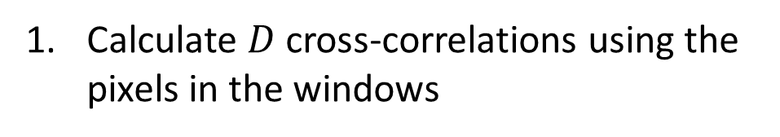
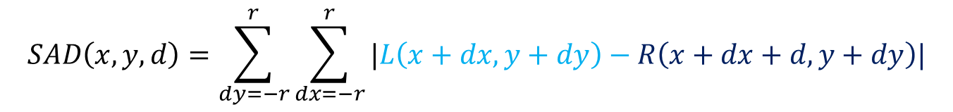

Calculating Cross-correlation using Box Filter
An Example: Stereo Vision
$$d$$
$$W_{D−1}$$
$$W_{k}$$
$$W_{0}$$
…
…
target pixel and its window
$$D$$
left image
right image
Calculate $D$ cross-correlations using the pixels in the windows
$$SAD\left(x,y,d\right)=\sum_{dy=−r}^{r}{\sum_{dx=−r}^{r}{|L\left(x+dx,y+dy\right)−R\left(x+dx+d,y+dy\right)|}}$$
Notes:
To find the best matching, D cross-correlations are calculated using the pixels in the window. In this example, the sum of the absolute difference is used to calculated the matching costs

Slide 26
Calculating Cross-correlation using Box Filter
An Example: Stereo Vision
$$d$$
$$W_{D−1}$$
$$W_{k}$$
$$W_{0}$$
…
…
target pixel and its window
$$D$$
left image
right image
Calculate $D$ cross-correlations using the pixels in the windows
$$SAD\left(x,y,d\right)=\sum_{dy=−r}^{r}{\sum_{dx=−r}^{r}{|L\left(x+dx,y+dy\right)−R\left(x+dx+d,y+dy\right)|}}$$
can be calculated using the box filter
Notes:
and the sum of the absolute difference can be calculated using the box filter.

Slide 27

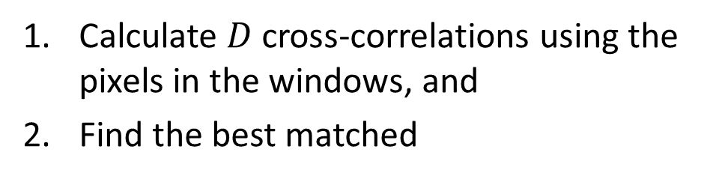
Calculating Cross-correlation using Box Filter
An Example: Stereo Vision
$$W_{D−1}$$
$$W_{k}$$
$$W_{0}$$
…
…
target pixel and its window
$$D$$
left image
right image
Calculate $D$ cross-correlations using the pixels in the windows, and
Find the best matched
$$d_{min}=\min_{0≤d<D}{SAD(x,y,d)}$$
Notes:
Then, d that gives the minimum cost is chosen as its disparity.

Slide 28


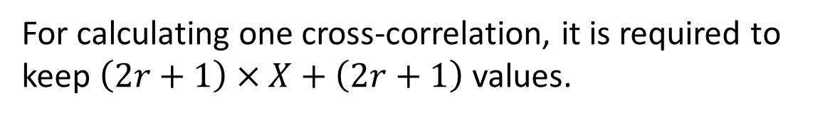
Calculating Cross-correlation using Box Filter
An Example: Stereo Vision
$$X$$
$$X$$
$$W_{k}$$
target pixel and its window
left image
right image
For calculating one cross-correlation, it is required to keep $\left(2r+1\right)×X+\left(2r+1\right)$ values.
Notes:
For calculating one cross-correlation, it is required to keep r2+1 multiplied by X + 2r+1 values.

Slide 29
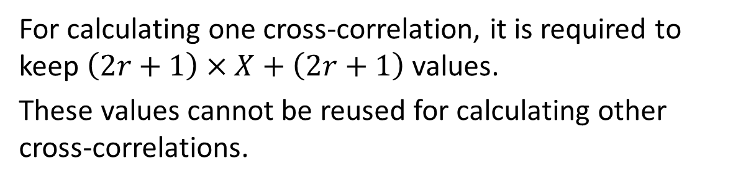
Calculating Cross-correlation using Box Filter
An Example: Stereo Vision
$$X$$
$$X$$
$$W_{k}$$
target pixel and its window
left image
right image
For calculating one cross-correlation, it is required to keep $\left(2r+1\right)×X+\left(2r+1\right)$ values.
These values cannot be reused for calculating other cross-correlations.
Notes:
These values cannot be reused for calculating other cross-correlations.

Slide 30
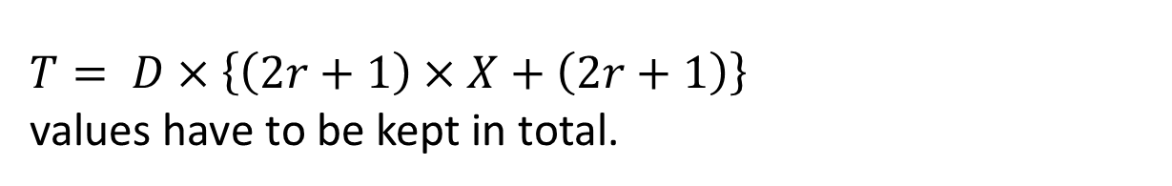
Calculating Cross-correlation using Box Filter
An Example: Stereo Vision
$$X$$
$$X$$
$$W_{k}$$
target pixel and its window
left image
right image
For calculating one cross-correlation, it is required to keep $\left(2r+1\right)×X+\left(2r+1\right)$ values.
These values cannot be reused for calculating other cross-correlations.
$T= D×\left\{\left(2r+1\right)×X+\left(2r+1\right)\right\}$ values have to be kept in total.
Notes:
So, D fold values have to be kept in total.

Slide 31
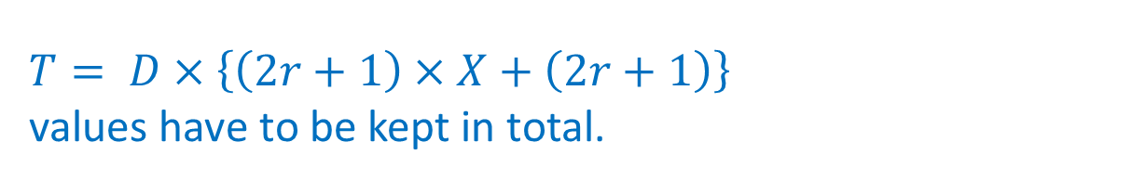
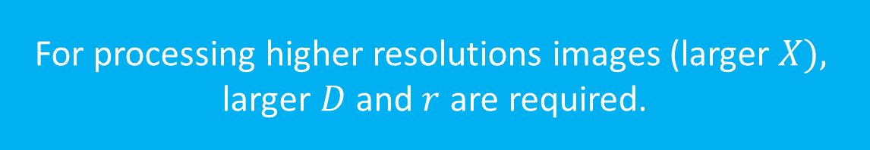
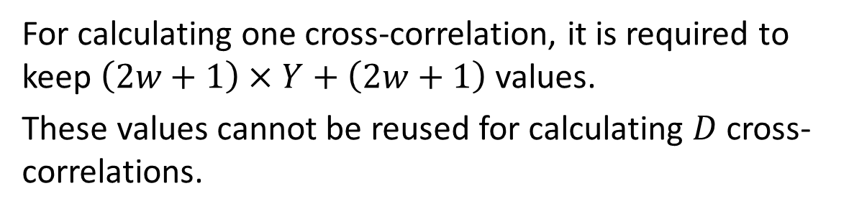
Calculating Cross-correlation using Box Filter
An Example: Stereo Vision
$$X$$
$$X$$
$$W_{k}$$
target pixel and its window
left image
right image
For calculating one cross-correlation, it is required to keep $\left(2w+1\right)×Y+\left(2w+1\right)$ values.
These values cannot be reused for calculating $D$ cross-correlations.
For processing higher resolutions images (larger $X),$ larger $D$ and$r$ are required.
$T= D×\left\{\left(2r+1\right)×X+\left(2r+1\right)\right\}$ values have to be kept in total.
Notes:
For processing higher resolution image, larger D and r are required.

Slide 32
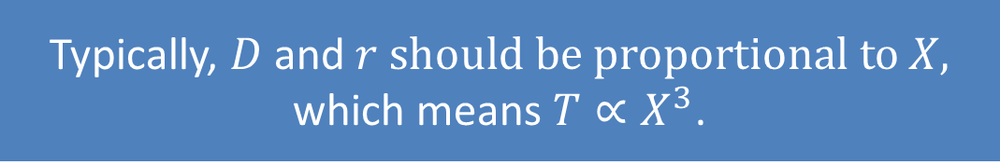
Calculating Cross-correlation using Box Filter
An Example: Stereo Vision
$$X$$
$$X$$
$$W_{k}$$
target pixel and its window
left image
right image
Typically, $D$ and$r should be proportional to X,$
which means $T∝X^{3}$.
For calculating one cross-correlation, it is required to keep $\left(2w+1\right)×Y+\left(2w+1\right)$ values.
These values cannot be reused for calculating $D$ cross-correlations.
For processing higher resolutions images (larger $X),$ larger $D$ and$r$ are required.
$T= D×\left\{\left(2r+1\right)×X+\left(2r+1\right)\right\}$ values have to be kept in total.
Notes:
Typically, D and r should be proportional to X, image width, thus T, the total memory size, is almost proportional to X cubed.

Slide 33
Box Filter – Our Approach
Change the scan direction to reduce the required memory size.
original scan direction
our scan direction
Notes:
In our approach, the scan direction is changed. In the original method, the image is scanned from left to right, up to bottom, but in our approach, the image is scanned in zigzag.

Slide 34
Box Filter – Our Approach
Change the scan direction to reduce the required memory size.
original scan direction
our scan direction
Notes:
Like this.

Slide 35
Box Filter – Our Approach
Change the scan direction to reduce the required memory size.
original scan direction
our scan direction

Slide 36


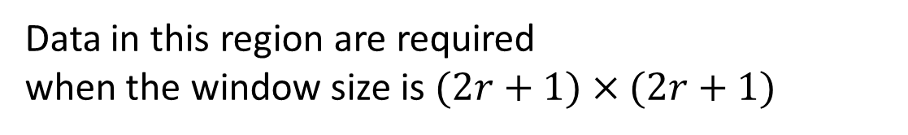

Box Filter – Our Approach
Details of the computation in our zigzag scan
Calculate $F\left(x,y\right)$ in this region using Box Filter
$$2r+1$$
$$s$$
$$s+2r$$
Data in this region are required when the window size is $(2r+1)×(2r+1)$
Notes:
In our zigzag scan, to calculate F(x,y) in this orange region, the pixels in this blue region are required when the window size is 2r+1 by 2r+1.

Slide 37




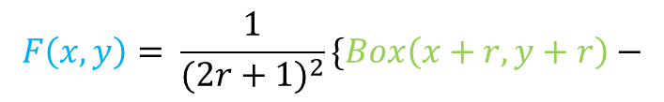


Box Filter – Our Approach
Details of the computation in our zigzag scan
Calculate $F\left(x,y\right)$ in this region using Box Filter
$$x$$
$$y$$
$$2r+1$$
$$s$$
$$s+2r$$
$$F\left(x,y\right)= \frac{1}{{(2r+1)}^{2}}\{Box\left(x+r,y+r\right)−$$
$$Box\left(x+r,y−r−1\right)−$$
$$Box\left(x−r−1,y+r\right)+$$
$$Box\left(x−r−1,y−r−1\right)\}$$
Notes:
F(x,y) can be calculated using the box filter by using this equation.

Slide 38
Box Filter – Our Approach
Details of the computation in our zigzag scan
$$x$$
$$y$$
$$2r+1$$
$$s$$
$$s+2r$$
$$F\left(x,y\right)= \frac{1}{{(2r+1)}^{2}}\{Box\left(x+r,y+r\right)−$$
$$Box\left(x+r,y−r−1\right)−$$
$$Box\left(x−r−1,y+r\right)+$$
$$Box\left(x−r−1,y−r−1\right)\}$$
Notes:
Here, note that the pixels are scanned in this direction.

Slide 39



Box Filter – Our Approach
Details of the computation in our zigzag scan
$$x$$
$$y$$
$$2r+1$$
$$s$$
$$s+2r$$
$$F\left(x,y\right)= \frac{1}{{(2r+1)}^{2}}\{Box\left(x+r,y+r\right)−$$
$$Box\left(x+r,y−r−1\right)−$$
$$Box\left(x−r−1,y+r\right)+$$
$$Box\left(x−r−1,y−r−1\right)\}$$
Notes:
Box(x+r,y+r) is the sum of the pixels in this green box.

Slide 40

Box Filter – Our Approach
Details of the computation in our zigzag scan
$$x$$
$$y$$
$$2r+1$$
$$s$$
$$s+2r$$
$$F\left(x,y\right)= \frac{1}{{(2r+1)}^{2}}\{Box\left(x+r,y+r\right)−$$
$$Box\left(x+r,y−r−1\right)−$$
$$Box\left(x−r−1,y+r\right)+$$
$$Box\left(x−r−1,y−r−1\right)\}$$
Notes:
Then, Box(x+r,y-r-1), this orange box, is subtracted,

Slide 41

Box Filter – Our Approach
Details of the computation in our zigzag scan
$$x$$
$$y$$
$$2r+1$$
$$s$$
$$s+2r$$
$$F\left(x,y\right)= \frac{1}{{(2r+1)}^{2}}\{Box\left(x+r,y+r\right)−$$
$$Box\left(x+r,y−r−1\right)−$$
$$Box\left(x−r−1,y+r\right)+$$
$$Box\left(x−r−1,y−r−1\right)\}$$
Notes:
Box(x-r-1,y+r), this brown box, is subtracted, and

Slide 42
Box Filter – Our Approach
Details of the computation in our zigzag scan
$$x$$
$$y$$
$$2r+1$$
$$s$$
$$s+2r$$
$$F\left(x,y\right)= \frac{1}{{(2r+1)}^{2}}\{Box\left(x+r,y+r\right)−$$
$$Box\left(x+r,y−r−1\right)−$$
$$Box\left(x−r−1,y+r\right)+$$
$$Box\left(x−r−1,y−r−1\right)\}$$
Notes:
Box(x-r-1,y-r-1), this blue box, is added,

Slide 43
Box Filter – Our Approach
Details of the computation in our zigzag scan
$$x$$
$$y$$
$$2r+1$$
$$s$$
$$s+2r$$
$$F\left(x,y\right)= \frac{1}{{(2r+1)}^{2}}\{Box\left(x+r,y+r\right)−$$
$$Box\left(x+r,y−r−1\right)−$$
$$Box\left(x−r−1,y+r\right)+$$
$$Box\left(x−r−1,y−r−1\right)\}$$
Notes:
And the sum of the pixels in this window can be obtained.

Slide 44
Box Filter – Our Approach
Calculate $F\left(x,y\right)$ in this region using Box Filter
$$x$$
$$y$$
$$2r+1$$
$$s$$
$$s+2r$$
$$F\left(x,y\right)= \frac{1}{{(2r+1)}^{2}}\{Box\left(x+r,y+r\right)−$$
$$Box\left(x+r,y−r−1\right)−$$
$$Box\left(x−r−1,y+r\right)+$$
$$Box\left(x−r−1,y−r−1\right)\}$$

Slide 45
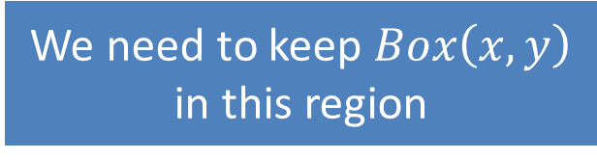
Box Filter – Our Approach
Details of the computation in our zigzag scan
$$x$$
$$y$$
$$2r+1$$
$$s$$
$$s+2r$$
We need to keep $Box\left(x,y\right)$ in this region
Notes:
In this case, Box(x,y) in this region have to be kept.

Slide 46
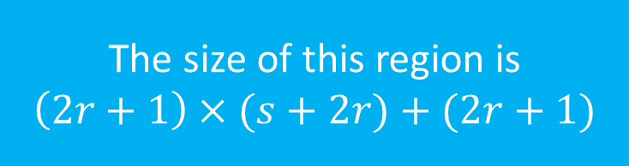
Box Filter – Our Approach
Details of the computation in our zigzag scan
$$x$$
$$y$$
$$2r+1$$
$$s$$
$$s+2r$$
The size of this region is
$$\left(2r+1\right)×(s+2r)+(2r+1)$$
We need to keep $Box\left(x,y\right)$ in this region
Notes:
The size of this region is 2r+1 squared + 2r+1. This size is much smaller than the original case.

Slide 47



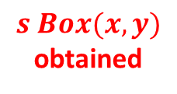


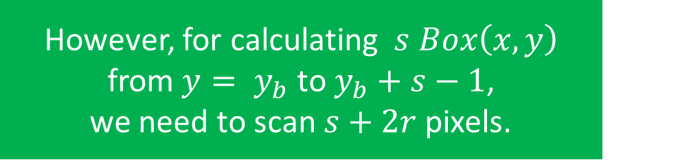

Box Filter – Our Approach
Details of the computation in our zigzag scan
$$x$$
$$r$$
However, for calculating $s Box\left(x,y\right)$ from$y= y_{b}$ to $y_{b}+s−1$, we need to scan $s+2r$pixels.
$$s+2r$$
pixels
scanned
$$y$$
$$s Box(x,y)$$
obtained
$$2w+1$$
$$r$$
$$r+2w$$
The size of this region is
$$\left(2r+1\right)×(s+2r)+(2r+1)$$
$$r$$
We need to keep $Box\left(x,y\right)$ in this region
Notes:
However, in this case, for calculating s Box(x,y), we need to scan s+r2 pixels.

Slide 48

Box Filter – Our Approach
Less memory usage
reduced from $\left(2r+1\right)×X+(2r+1)$ to
$\left(2r+1\right)×\left(s+2r\right)+\left(2r+1\right)$
Notes:
So, in our approach, less memory is required. Its size is reduced from 2r+1 by X 2r+1 to 2r+1 multiplied by s+2r + 2r+1.

Slide 49

Box Filter – Our Approach
Less memory usage
reduced from $\left(2r+1\right)×X+(2r+1)$ to
$\left(2r+1\right)×\left(s+2r\right)+\left(2r+1\right)$
but $2s+2r$ line buffers are required
Notes:
But, 2s+2r line buffers are required.

Slide 50


Box Filter – Our Approach
Less memory usage
reduced from $\left(2r+1\right)×X+(2r+1)$ to
$\left(2r+1\right)×\left(s+2r\right)+\left(2r+1\right)$
but $2s+2r$ line buffers are required
input
line buffers
current scan
$$2s+2r$$
next scan
$s+2r$line buffers are used for the current zigzag scan, and
$s$ line buffers are used to buffer the pixels for the next zigzag scan
Notes:
s+2r line buffers are used for the current zigzag scan, and s line buffers are used to buffer the pixels for the next zigzag scan.

Slide 51


Box Filter – Our Approach
Less memory usage
reduced from $\left(2r+1\right)×X+(2r+1)$ to
$\left(2r+1\right)×\left(s+2r\right)+\left(2r+1\right)$
but $2s+2r$ line buffers are required
input
line buffers
s$+2r$
current scan
$$s$$
next scan
$s+2r$line buffers are used for the current zigzag scan, and
$s$ line buffers are used to buffer the pixels for the next zigzag scan
Notes:
For example, while these s+r2 line buffers are used for the current zigzag scan, these s line buffers are used to buffer the pixels o the next s lines.

Slide 52


Box Filter – Our Approach
Less memory usage
reduced from $\left(2r+1\right)×X+(2r+1)$ to
$\left(2r+1\right)×\left(s+2r\right)+\left(2r+1\right)$
but $2s+2r$ line buffers are required
input
line buffers
$$s$$
current scan
$$s+2r$$
next scan
$s+2r$line buffers are used for the current zigzag scan, and
$s$ line buffers are used to buffer the pixels for the next zigzag scan
Notes:
Next, these s+r2 line buffers are used for the current scan, and these s line buffers are used to buffer the next s lines.

Slide 53


Box Filter – Our Approach
Less memory usage
reduced from $\left(2r+1\right)×X+(2r+1)$ to
$\left(2r+1\right)×\left(s+2r\right)+\left(2r+1\right)$
but $2s+2r$ line buffers are required
input
line buffers
$$s+2r$$
current scan
$$s$$
next scan
$s+2r$line buffers are used for the current zigzag scan, and
$s$ line buffers are used to buffer the pixels for the next zigzag scan
Notes:
Then, these s+2r lines are used for the current zigzag scan, and these s lines are used for the next scan.

Slide 54
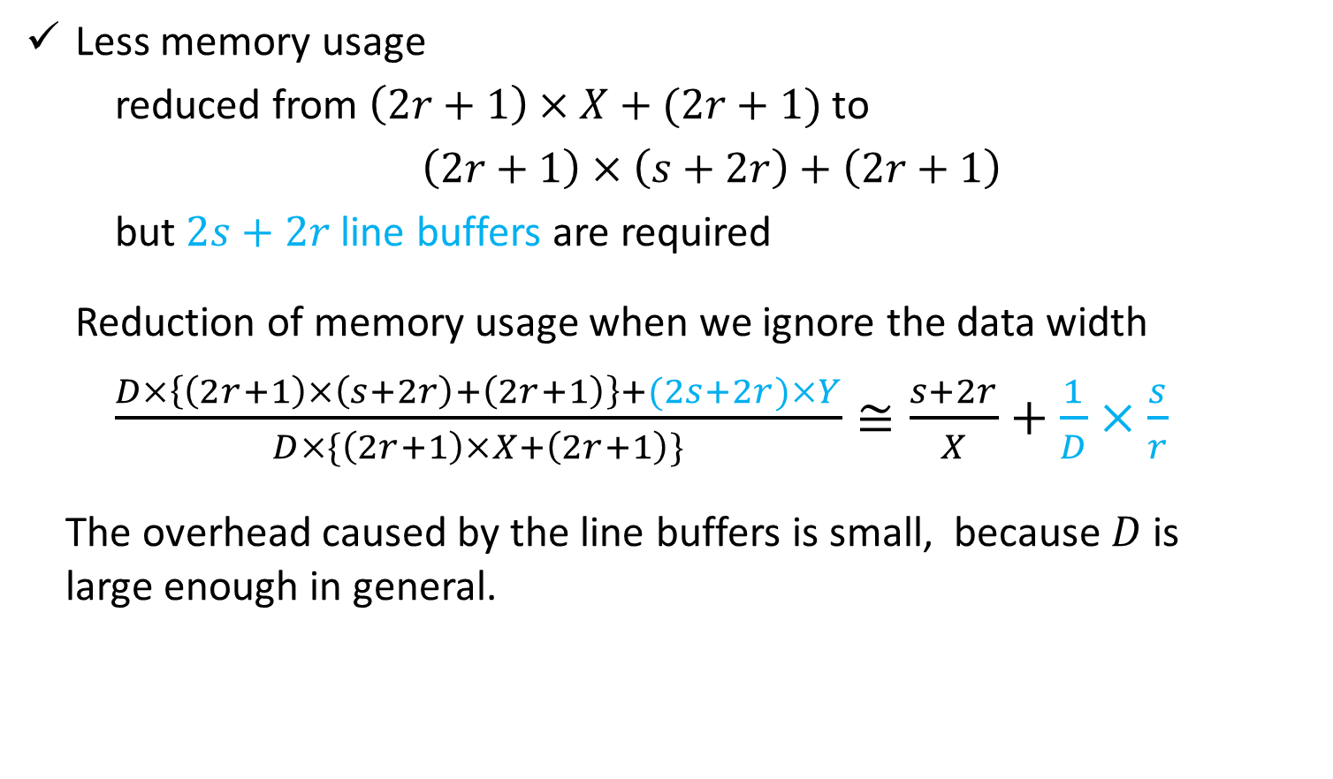
Box Filter – Our Approach
Less memory usage
reduced from $\left(2r+1\right)×X+(2r+1)$ to
$\left(2r+1\right)×\left(s+2r\right)+\left(2r+1\right)$
but $2s+2r$ line buffers are required
Reduction of memory usage when we ignore the data width
$\frac{D×\left\{\left(2r+1\right)×\left(s+2r\right)+\left(2r+1\right)\right\}+(2s+2r)×Y}{D×\{\left(2r+1\right)×X+\left(2r+1\right)\}}≅\frac{s+2r}{X}+\frac{1}{D}×\frac{s}{r}$
The overhead caused by the line buffers is small, because $D$ is
large enough in general.
Notes:
The reduction of the memory usage when we ignore the data width is given by this equation. The overhead caused by the line buffers is small because D is large enough in general.

Slide 55

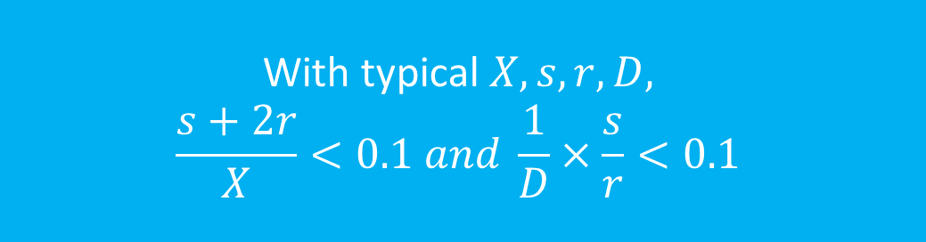
Box Filter – Our Approach
Less memory usage
reduced from $\left(2r+1\right)×X+(2r+1)$ to
$\left(2r+1\right)×\left(s+2r\right)+\left(2r+1\right)$
but $2s+2r$ line buffers are required
Reduction of memory usage when we ignore the data width
$\frac{D×\left\{\left(2r+1\right)×\left(s+2r\right)+\left(2r+1\right)\right\}+(2s+2r)×Y}{D×\{\left(2r+1\right)×X+\left(2r+1\right)\}}≅\frac{s+2r}{X}+\frac{1}{D}×\frac{s}{r}$
The overhead caused by the extra line buffers can be ignored,
because $D$ is large enough in general.
With typical $X,s,r,D,$
$$\frac{s+2r}{X}<0.1 and \frac{1}{D}×\frac{s}{r}<0.1$$
Notes:
With typical X, s, r and D, these terms are less than zero point one.

Slide 56
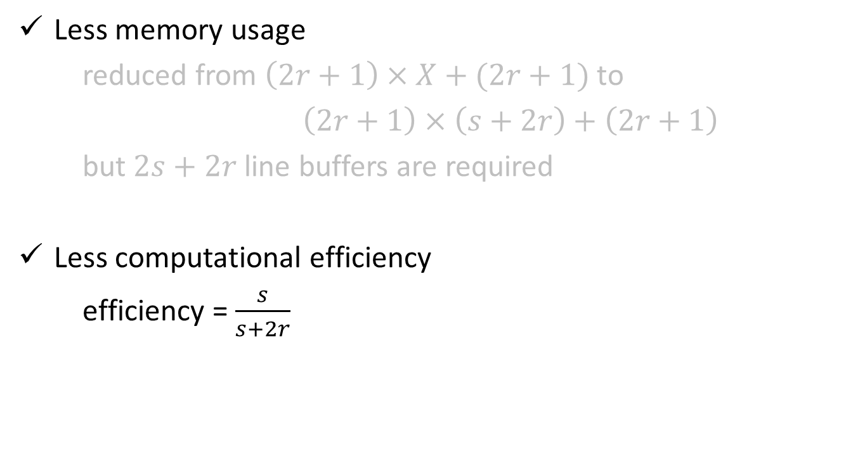
Box Filter – Our Approach
Less memory usage
reduced from $\left(2r+1\right)×X+(2r+1)$ to
$\left(2r+1\right)×\left(s+2r\right)+\left(2r+1\right)$
but $2s+2r$ line buffers are required
Less computational efficiency
efficiency = $\frac{s}{s+2r}$
Notes:
The computational efficiency by our zigzag scan is given by this equation.

Slide 57


Box Filter – Our Approach
Less memory usage
reduced from $\left(2r+1\right)×X+(2r+1)$ to
$\left(2r+1\right)×\left(s+2r\right)+\left(2r+1\right)$
but $2s+2r$ line buffers are required
Less computational efficiency
efficiency = $\frac{s}{s+2r}$
scan width = $r+2s$
output width = $r$
Notes:
The computational efficiency by our zigzag scan is given by this equation.

Slide 58
Box Filter – Our Approach
Less memory usage
reduced from $\left(2r+1\right)×X+(2r+1)$ to
$\left(2r+1\right)×\left(s+2r\right)+\left(2r+1\right)$
but $2s+2r$ line buffers are required
Less computational efficiency
efficiency = $\frac{s}{s+2r}$
current scan
scanned twice
next scan
Notes:
The computational efficiency by our zigzag scan is given by this equation.

Slide 59

Box Filter – Our Approach
Less memory usage
reduced from $\left(2r+1\right)×X+(2r+1)$ to
$\left(2r+1\right)×\left(s+2r\right)+\left(2r+1\right)$
but $2s+2r$ line buffers are required
Less computational efficiency
efficiency = $\frac{s}{s+2r}$
with practical $s$ and$r$, $0.5 <\frac{s}{s+2r}<1.0$
Notes:
With typical s and r, this is larger than zero point five, and less than one point zero.

Slide 60
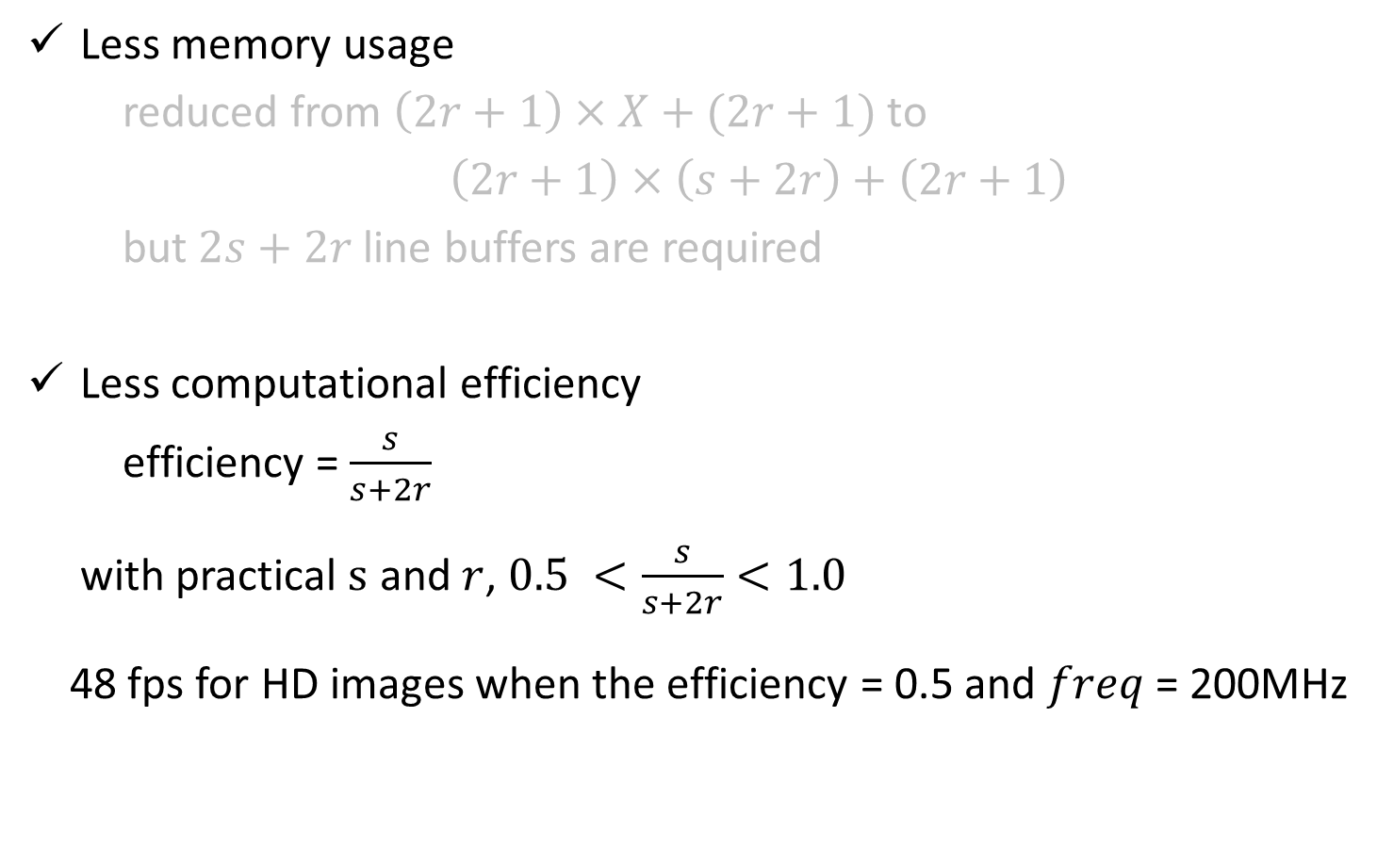
Box Filter – Our Approach
Less memory usage
reduced from $\left(2r+1\right)×X+(2r+1)$ to
$\left(2r+1\right)×\left(s+2r\right)+\left(2r+1\right)$
but $2s+2r$ line buffers are required
Less computational efficiency
efficiency = $\frac{s}{s+2r}$
with practical $s$ and$r$, $0.5 <\frac{s}{s+2r}<1.0$
48 fps for HD images when the efficiency = 0.5 and $freq$= 200MHz
Notes:
With this computational efficiency, the processing speed for HD images is 48fps, which is fast enough for many applications.

Slide 61
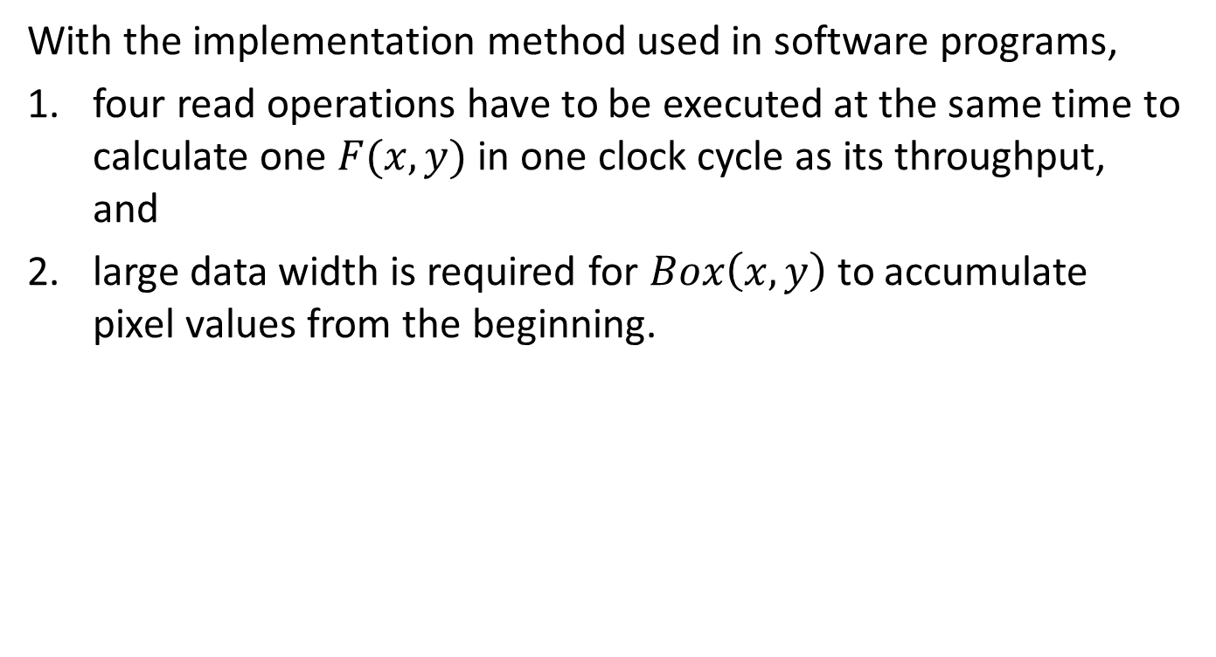
Box Filter – FPGA implementation
With the implementation method used in software programs,
four read operations have to be executed at the same time to calculate one $F(x,y)$ in one clock cycle as its throughput, and
large data width is required for $Box\left(x,y\right)$ to accumulate pixel values from the beginning.
Notes:
With the implementation used software programs, four read operations have to be executed at the same time to calculate one F(x,y) in one clock cycle as its throughput, and large data width is required for Box(x,y) to accumulate pixel values from the beginning.

Slide 62
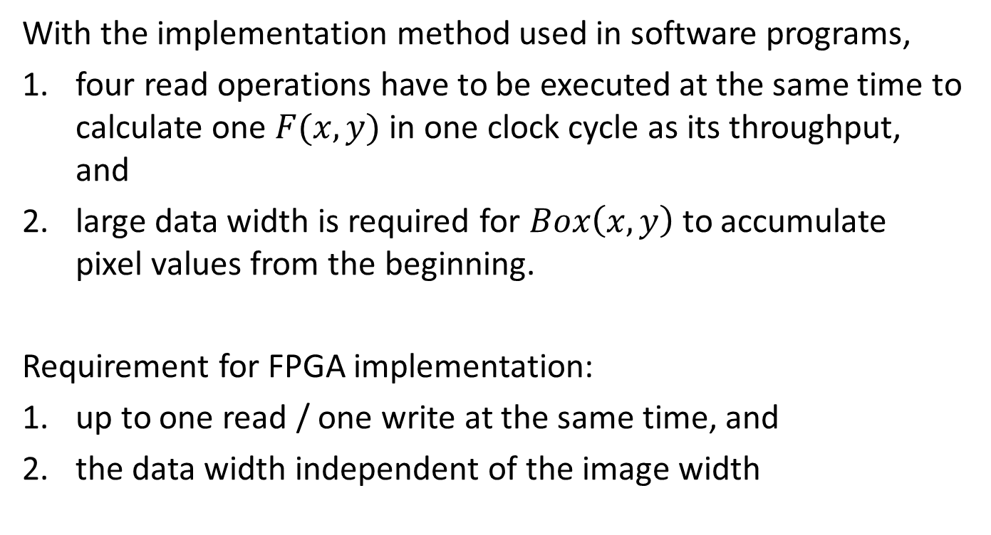
Box Filter – FPGA implementation
With the implementation method used in software programs,
four read operations have to be executed at the same time to calculate one $F(x,y)$ in one clock cycle as its throughput, and
large data width is required for $Box\left(x,y\right)$ to accumulate pixel values from the beginning.
Requirement for FPGA implementation:
up to one read / one write at the same time, and
the data width independent of the image width
Notes:
For implementing the box filter on FPGA, up to one read / one write at the same time is allowed, and the data width independent of the image width is required.

Slide 63
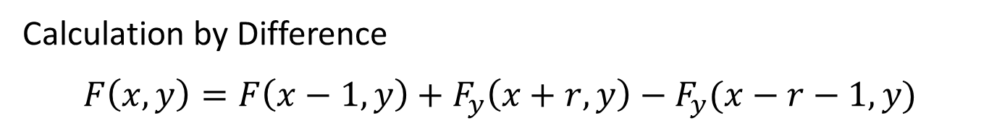
Box Filter – FPGA implementation
Calculation by Difference
$$F\left(x,y\right)=F\left(x−1,y\right)+F_{y}\left(x+r,y\right)−F_{y}(x−r−1,y)$$
Notes:
In our FPGA implementation, F(x,y), the sum of the pixels in the window, is calculated by using the difference as shown in this equation.

Slide 64
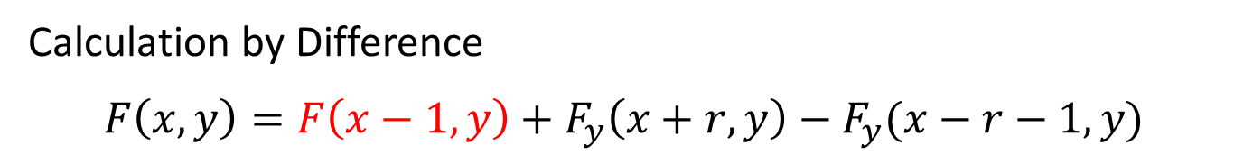



Box Filter – FPGA implementation
Calculation by Difference
$$F\left(x,y\right)=F\left(x−1,y\right)+F_{y}\left(x+r,y\right)−F_{y}(x−r−1,y)$$
$$x−1$$
$$x$$
$$y$$
Notes:
Here, suppose that F(x-1,y), the sum for the previous pixel, is already calculated.

Slide 65
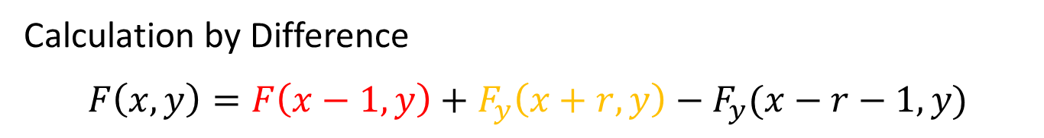
Box Filter – FPGA implementation
Calculation by Difference
$$F\left(x,y\right)=F\left(x−1,y\right)+F_{y}\left(x+r,y\right)−F_{y}(x−r−1,y)$$
$$x−1$$
$$x$$
$$y$$
Notes:
Then, by adding Fy(x+r,y), the sum of the pixels in this orange box,

Slide 66
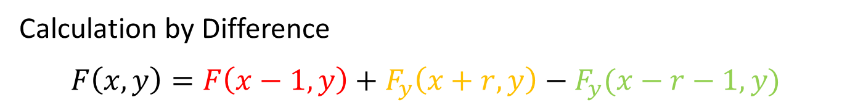
Box Filter – FPGA implementation
Calculation by Difference
$$F\left(x,y\right)=F\left(x−1,y\right)+F_{y}\left(x+r,y\right)−F_{y}(x−r−1,y)$$
$$x−1$$
$$x$$
$$y$$
Notes:
And subtracting Fy(x-r-1,y), the sum of the pixels in this green box,

Slide 67
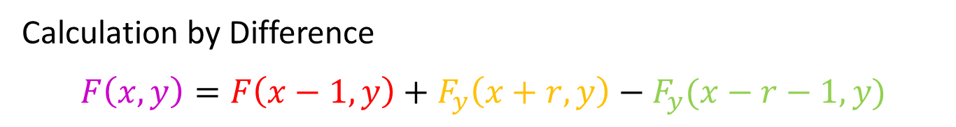
Box Filter – FPGA implementation
Calculation by Difference
$$F\left(x,y\right)=F\left(x−1,y\right)+F_{y}\left(x+r,y\right)−F_{y}(x−r−1,y)$$
$$x−1$$
$$x$$
$$y$$
Notes:
We can obtain the sum for the target pixel.

Slide 68
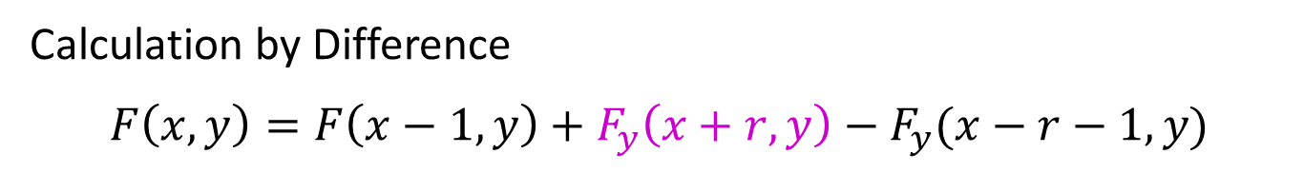
Box Filter – FPGA implementation
Calculation by Difference
$$F\left(x,y\right)=F\left(x−1,y\right)+F_{y}\left(x+r,y\right)−F_{y}(x−r−1,y)$$
Notes:
Furthermore, Fy(x+r,y) can also be calculated using difference.

Slide 69
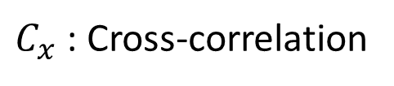
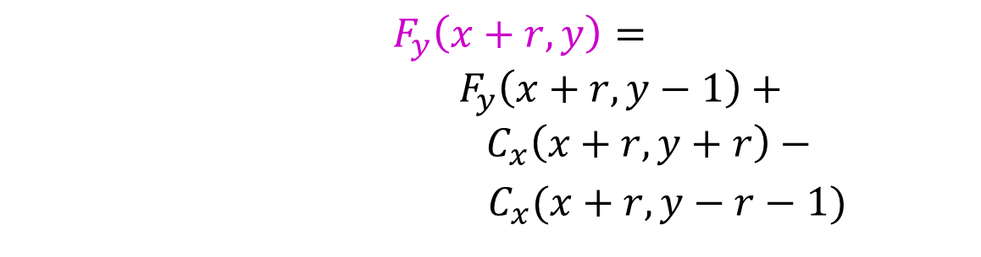
Box Filter – FPGA implementation
Calculation by Difference
$$F\left(x,y\right)=F\left(x−1,y\right)+F_{y}\left(x+r,y\right)−F_{y}(x−r−1,y)$$
$F_{y}\left(x+r,y\right)=$ ${ F}_{y}\left(x+r,y−1\right)+$
$${ C}_{x}\left(x+r,y+r\right)−$$
$C_{x}(x+r,y−r−1)$
$C_{x}$ : Cross-correlation
Notes:
Fy(x+r,y) is given by this equation.

Slide 70


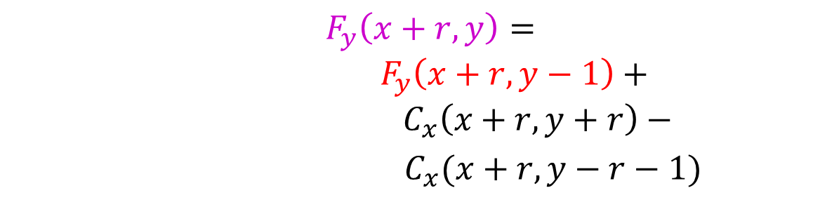
Box Filter – FPGA implementation
Calculation by Difference
$$F\left(x,y\right)=F\left(x−1,y\right)+F_{y}\left(x+r,y\right)−F_{y}(x−r−1,y)$$
$F_{y}\left(x+r,y\right)=$ ${ F}_{y}\left(x+r,y−1\right)+$
$${ C}_{x}\left(x+r,y+r\right)−$$
$C_{x}(x+r,y−r−1)$
$$x+r$$
$C_{x}$ : Cross-correlation
$$y−1$$
Notes:
Fy(x+r,y-1) is the sum of the pixels for pixel (x+r,y-1).

Slide 71
Box Filter – FPGA implementation
Calculation by Difference
$$F\left(x,y\right)=F\left(x−1,y\right)+F_{y}\left(x+r,y\right)−F_{y}(x−r−1,y)$$
$F_{y}\left(x+r,y\right)=$ ${ F}_{y}\left(x+r,y−1\right)+$
$${ C}_{x}\left(x+r,y+r\right)−$$
$C_{x}(x+r,y−r−1)$
$$x+r$$
$C_{x}$ : Cross-correlation
$$y−1$$
upper pixel
target pixel
Notes:
Fy(x+r,y-1) is the sum of the pixels for pixel (x+r,y-1).

Slide 72


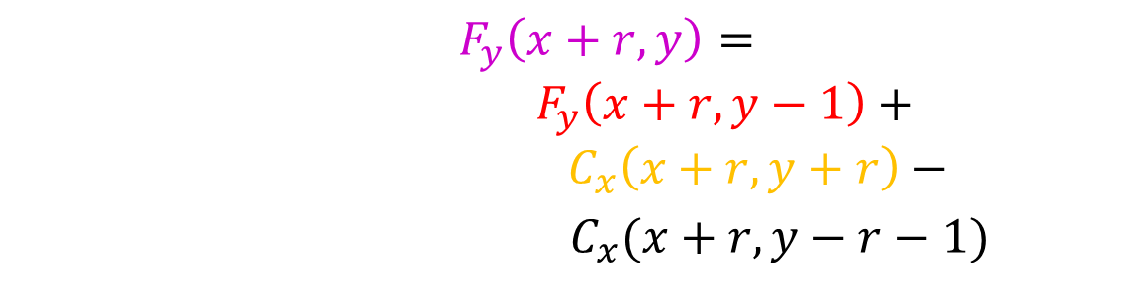
Box Filter – FPGA implementation
Calculation by Difference
$$F\left(x,y\right)=F\left(x−1,y\right)+F_{y}\left(x+r,y\right)−F_{y}(x−r−1,y)$$
$F_{y}\left(x+r,y\right)=$ ${ F}_{y}\left(x+r,y−1\right)+$
$${ C}_{x}\left(x+r,y+r\right)−$$
$C_{x}(x+r,y−r−1)$
$$x+r$$
$C_{x}$ : Cross-correlation
$$y−1$$
Notes:
Then, by adding the pixel at (x+r,y+r), this orange one,

Slide 73


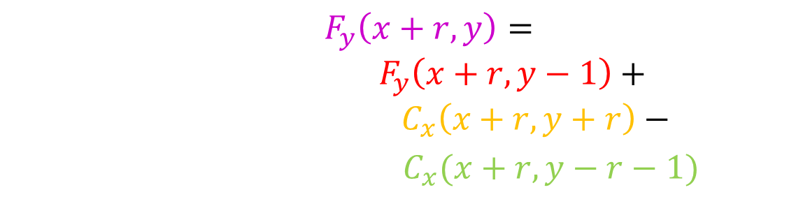
Box Filter – FPGA implementation
Calculation by Difference
$$F\left(x,y\right)=F\left(x−1,y\right)+F_{y}\left(x+r,y\right)−F_{y}(x−r−1,y)$$
$F_{y}\left(x+r,y\right)=$ ${ F}_{y}\left(x+r,y−1\right)+$
$${ C}_{x}\left(x+r,y+r\right)−$$
$C_{x}(x+r,y−r−1)$
$$x+r$$
$C_{x}$ : Cross-correlation
$$y−1$$
Notes:
and subtracting pixel at (x+r,y-r-1), this green one,

Slide 74

Box Filter – FPGA implementation
Calculation by Difference
$$F\left(x,y\right)=F\left(x−1,y\right)+F_{y}\left(x+r,y\right)−F_{y}(x−r−1,y)$$
$F_{y}\left(x+r,y\right)=$ ${ F}_{y}\left(x+r,y−1\right)+$
$${ C}_{x}\left(x+r,y+r\right)−$$
$C_{x}(x+r,y−r−1)$
$$x+r$$
$C_{x}$ : Cross-correlation
$$y−1$$
$$y$$
Notes:
we can obtain the sum of the pixels for (x+r,y)

Slide 75
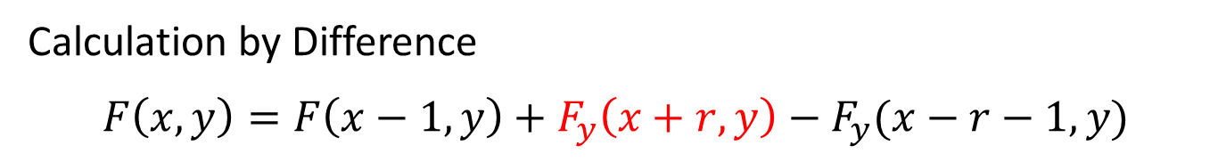
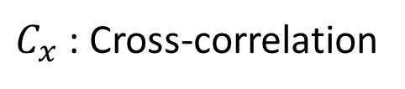
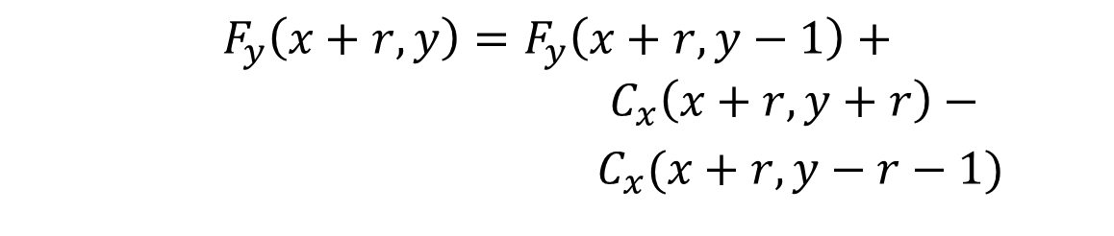
Box Filter – FPGA implementation
Calculation by Difference
$$F\left(x,y\right)=F\left(x−1,y\right)+F_{y}\left(x+r,y\right)−F_{y}(x−r−1,y)$$
$$F_{y}\left(x+r,y\right)=F_{y}\left(x+r,y−1\right)+$$
$${ C}_{x}\left(x+r,y+r\right)−$$
$C_{x}(x+r,y−r−1)$
$C_{x}$ : Cross-correlation
Notes:
This equation ｇives Fy(x+r,y).

Slide 76


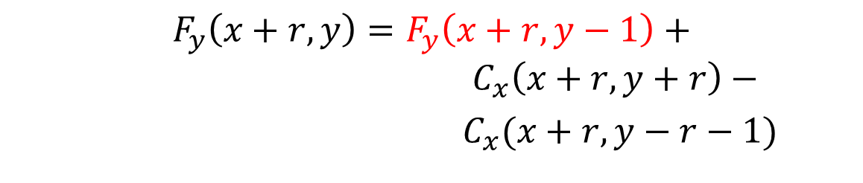
Box Filter – FPGA implementation
Calculation by Difference
$$F\left(x,y\right)=F\left(x−1,y\right)+F_{y}\left(x+r,y\right)−F_{y}(x−r−1,y)$$
$$F_{y}\left(x+r,y\right)=F_{y}\left(x+r,y−1\right)+$$
$${ C}_{x}\left(x+r,y+r\right)−$$
$C_{x}(x+r,y−r−1)$
$$x+r$$
$$y−1$$
Notes:
Here, suppose that the partial sum for the upper pixel is already calculated.

Slide 77
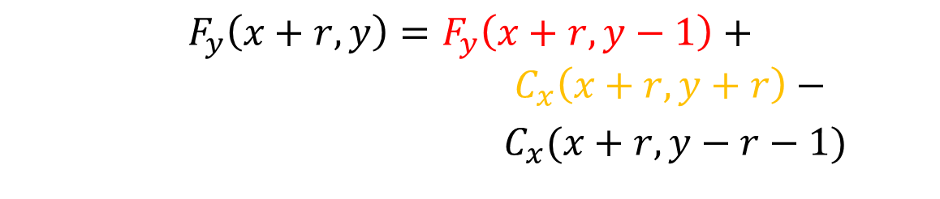
Box Filter – FPGA implementation
Calculation by Difference
$$F\left(x,y\right)=F\left(x−1,y\right)+F_{y}\left(x+r,y\right)−F_{y}(x−r−1,y)$$
$$F_{y}\left(x+r,y\right)=F_{y}\left(x+r,y−1\right)+$$
$${ C}_{x}\left(x+r,y+r\right)−$$
$C_{x}(x+r,y−r−1)$
$$x+r$$
$$y−1$$
Notes:
Then, by adding this pixel, actually the cross-correlation for this pixel,

Slide 78
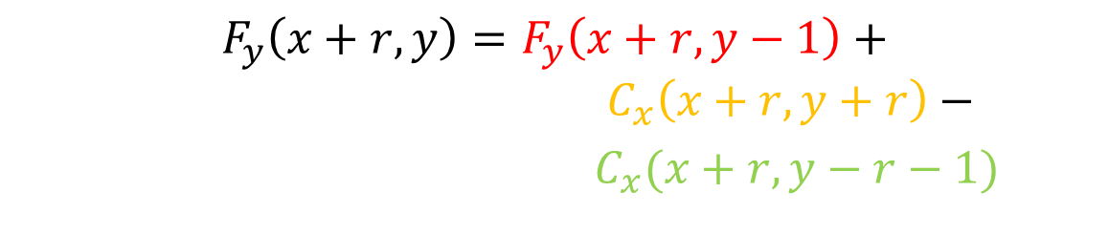
Box Filter – FPGA implementation
Calculation by Difference
$$F\left(x,y\right)=F\left(x−1,y\right)+F_{y}\left(x+r,y\right)−F_{y}(x−r−1,y)$$
$$F_{y}\left(x+r,y\right)=F_{y}\left(x+r,y−1\right)+$$
$${ C}_{x}\left(x+r,y+r\right)−$$
$C_{x}(x+r,y−r−1)$
$$x+r$$
$$y−1$$
Notes:
And subtracting this pixel

Slide 79
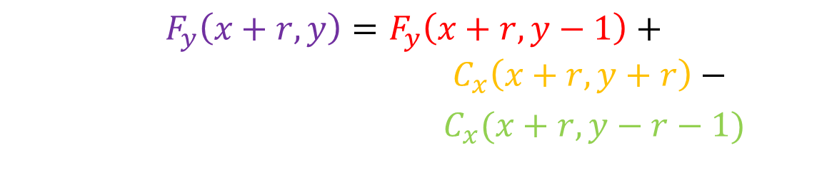

Box Filter – FPGA implementation
Calculation by Difference
$$F\left(x,y\right)=F\left(x−1,y\right)+F_{y}\left(x+r,y\right)−F_{y}(x−r−1,y)$$
$$F_{y}\left(x+r,y\right)=F_{y}\left(x+r,y−1\right)+$$
$${ C}_{x}\left(x+r,y+r\right)−$$
$C_{x}(x+r,y−r−1)$
$$x+r$$
$$y−1$$
$$y$$
Notes:
We can obtain the partial sum for the target pixel.

Slide 80
Box Filter – FPGA implementation
Details of our computation by the difference
Calculate $F\left(x,y\right)$ in this region using Box Filter
$$s$$
$$s+2r$$
Notes:
From here, I will explain the details of our calculation method. Here, F(x,y) in this orange region are calculated by scanning the pixels in this blue region in zigzag.

Slide 81



Box Filter – FPGA implementation
Details of our computation by the difference
$$x+r$$
$$y_{b}$$
$$s$$

Slide 82



Box Filter – FPGA implementation
Details of our computation by the difference
$$x+r$$
-
+
buffer: depth = $2r+1$
$$y_{b}$$
$$F_{y}=0$$
register
$$s$$
Notes:
This read arrow shows the scan direction. A register and a buffer the depth of which is 2r+1 are used to calculate Fy. The register is initialized to zero.

Slide 83


Box Filter – FPGA implementation
Details of our computation by the difference
$$x+r$$
-
$$C_{x}(x+r,y_{b}−r)$$
buffer: depth = $2r+1$
$$y_{b}$$
+
$$F_{y}=0$$
register
$$s$$
Notes:
First, the cross correlation of this pixel is calculated.

Slide 84


Box Filter – FPGA implementation
Details of our computation by the difference
$$x+r$$
$$0$$
-
$$C_{x}(x+r,y_{b}−r)$$
buffer: depth = $2r+1$
$$y_{b}$$
+
$$F_{y}$$
$$s$$
Notes:
It is added to Fy.

Slide 85
Box Filter – FPGA implementation
Details of our computation by the difference
$$x+r$$
$$0$$
-
$$C_{x}(x+r,y_{b}−r)$$
buffer: depth = $2r+1$
$$y_{b}$$
+
$$F_{y}$$
$$s$$
Notes:
It is also stored in the buffer.

Slide 86

Box Filter – FPGA implementation
Details of our computation by the difference
$$x+r$$
$$0$$
-
$$C_{x}(x+r,y_{b}−r+1)$$
+
buffer: depth = $2r+1$
$$y_{b}$$
$$F_{y}$$
$$s$$
Notes:
Then, the cross-correlation of the next pixel is calculated. It is added to Fy, and stored in the buffer.

Slide 87

Box Filter – FPGA implementation
Details of our computation by the difference
$$x+r$$
$$0$$
-
$$C_{x}(x+r,y_{b}−r+2)$$
+
buffer: depth = $2r+1$
$$y_{b}$$
$$F_{y}$$
$$s$$
Notes:
Then, the same sequence is repeated.

Slide 88

Box Filter – FPGA implementation
Details of our computation by the difference
$$x+r$$
$$0$$
-
+
buffer: depth = $2r+1$
$$y_{b}$$
$$F_{y}$$
$$C_{x}(x+r,y_{b})$$
$$s$$

Slide 89


Box Filter – FPGA implementation
Details of our computation by the difference
$$x+r$$
$$0$$
-
+
buffer: depth = $2r+1$
$$y_{b}$$
$$F_{y}$$
$$2r+1$$
$$s$$
$$C_{x}(x+r,y_{b}+r)$$
Notes:
When r2+1 cross-correlations are calculated

Slide 90

Box Filter – FPGA implementation
Details of our computation by the difference
$$x+r$$
$$0$$
-
+
buffer: depth = $2r+1$
$$y_{b}$$
$$F_{y}$$
$$F_{y}(x+r,y_{b})$$
$$s$$
Notes:
The value of the register becomes Fy(x+r,yb).

Slide 91




Box Filter – FPGA implementation
Details of our computation by the difference
$$x+r$$
$$0$$
-
+
buffer: depth = $2r+1$
$$y_{b}$$
$$F_{y}$$
$$F_{y}(x+r,y_{b})$$
$$s$$
$$F(x−1,y_{b})$$
RAM : depth = $s$
Notes:
Then, F(x-1,yb), the sum of pixels in this previous window, is fetched from a RAM. Its depth is s.

Slide 92





Box Filter – FPGA implementation
Details of our computation by the difference
$$x+r$$
$$0$$
-
+
buffer: depth = $2r+1$
$$y_{b}$$
$$F_{y}$$
$$s$$
$$F_{y}(x+r,y_{b})$$
$$F(x−1,y_{b})$$
-
+
$$F_{y}(x−r−1,y_{b})$$
buffer: depth = $s×(2r+1$)
RAM : depth = $s$
Notes:
At the same time, Fy(x-r-1,yb), the sum of the pixels in this blue box is fetched from a buffer, the depth of which is s multiplied by 2r+1.

Slide 93

Box Filter – FPGA implementation
Details of our computation by the difference
$$x+r$$
$$0$$
-
+
buffer: depth = $2r+1$
$$y_{b}$$
$$F_{y}$$
$$s$$
$$F_{y}(x+r,y_{b})$$
$$F(x−1,y_{b})$$
-
+
$$F_{y}(x−r−1,y_{b})$$
buffer: depth = $s×(2r+1$)
RAM : depth = $s$
Notes:
This sum was calculated when this column was scanned, and it was stored in this buffer.

Slide 94


Box Filter – FPGA implementation
Details of our computation by the difference
$$x+r$$
$$0$$
$F$($x,y_{b}$)$=F\left(x−1,y_{b}\right)+F_{y}\left(x+r,y_{b}\right)−F_{y}(x−r−1,y_{b})$
-
+
buffer: depth = $2r+1$
$$y_{b}$$
$$F_{y}$$
$$F_{y}(x+r,y_{b})$$
$$s$$
$$F(x−1,y_{b})$$
-
+
$$F_{y}(x−r−1,y_{b})$$
buffer: depth = $s×(2r+1$)
RAM : depth = $s$
Notes:
Then, this equation by difference is calculated

Slide 95

Box Filter – FPGA implementation
Details of our computation by the difference
$$x+r$$
$$0$$
-
+
buffer: depth = $2r+1$
$$y_{b}$$
$$F_{y}$$
$$s$$
$$F(x,y_{b})$$
-
+
buffer: depth = $s×(2r+1$)
RAM : depth = $s$
Notes:
And, F(x,yb), the sum for the target pixel, is obtained and store in this RAM.

Slide 96

Box Filter – FPGA implementation
Details of our computation by the difference
$$x+r$$
$$0$$
-
+
buffer: depth = $2r+1$
$$y_{b}$$
$$F_{y}$$
$$s$$
$$F_{y}(x+r,y_{b})$$
$$F(x,y_{b})$$
-
+
buffer: depth = $s×(2r+1$)
RAM : depth = $s$
Notes:
At the same time, Fy(x+r,yb) is stored in this buffer for later use.

Slide 97

Box Filter – FPGA implementation
Details of our computation by the difference
$$x+r$$
-
+
buffer: depth = $2r+1$
$$y_{b}$$
$$F_{y}$$
$$s$$
$$C_{x}(x+r,y_{b}+r+1)$$
-
+
buffer: depth = $s×(2r+1$)
RAM : depth = $s$
Notes:
Then, the cross-correlation of the next pixel is calculated

Slide 98


Box Filter – FPGA implementation
Details of our computation by the difference
$$x+r$$
-
+
buffer: depth = $2r+1$
$$y_{b}$$
$$F_{y}$$
$$F_{y}(x+r,y_{b}+1)$$
$$s$$
$$C_{x}(x+r,y_{b}+r+1)$$
$F_{y}\left(x+r,y\right)=$ $F_{y}\left(x+r,y−1\right)+$
${ C}_{x}\left(x+r,y+r\right)−C_{x}(x+r,y−r−1)$
-
+
buffer: depth = $s×(2r+1$)
RAM : depth = $s$
Notes:
Fy(x+r, yb+1) is obtained,

Slide 99
Box Filter – FPGA implementation
Details of our computation by the difference
$$x+r$$
-
+
buffer: depth = $2r+1$
$$y_{b}$$
$$F_{y}$$
$$F_{y}(x+r,y_{b}+1)$$
$$s$$
$$C_{x}(x+r,y_{b}+r+1)$$
-
+
buffer: depth = $s×(2r+1$)
RAM : depth = $s$
Notes:
Fy(x+r, yb+1) is obtained,

Slide 100


Box Filter – FPGA implementation
Details of our computation by the difference
$$x+r$$
-
+
buffer: depth = $2r+1$
$$y_{b}$$
$$F_{y}$$
$$F_{y}(x+r,y_{b}+1)$$
$$s$$
$$F(x−1,y_{b}+1)$$
-
+
buffer: depth = $s×(2r+1$)
RAM : depth = $s$
Notes:
F(x-1,yb+1), the sum for the previous pixel, is fetched from this RAM

Slide 101



Box Filter – FPGA implementation
Details of our computation by the difference
$$x+r$$
-
+
buffer: depth = $2r+1$
$$y_{b}$$
$$F_{y}$$
$$s$$
$$F_{y}(x+r,y_{b}+1)$$
$$F(x−1,y_{b}+1)$$
-
+
$$F_{y}(x−r−1,y_{b}+1)$$
buffer: depth = $s×(2r+1$)
RAM : depth = $s$
Notes:
Fy(x-1-1,yb+1), this blue box, is fetched from this buffer,

Slide 102

Box Filter – FPGA implementation
Details of our computation by the difference
$$x+r$$
-
+
buffer: depth = $2r+1$
$$y_{b}$$
$$F_{y}$$
$$s$$
$$F_{y}(x+r,y_{b}+1)$$
$$F(x−1,y_{b}+1)$$
-
+
$$F_{y}(x−r−1,y_{b}+1)$$
buffer: depth = $s×(2r+1$)
RAM : depth = $s$
Notes:
and by calculating the difference,

Slide 103

Box Filter – FPGA implementation
Details of our computation by the difference
$$x+r$$
-
+
buffer: depth = $2r+1$
$$y_{b}$$
$$F_{y}$$
$$s$$
$$F_{y}(x+r,y_{b}+1)$$
$$F(x,y_{b}+1)$$
-
+
buffer: depth = $s×(2r+1$)
RAM : depth = $s$
Notes:
F(x,yb+1), the sum for the target pixel, is obtained.

Slide 104
Box Filter – FPGA implementation
Details of our computation by the difference
$$x+r$$
-
+
buffer: depth = $2r+1$
$$y_{b}$$
$$F_{y}$$
$$s$$
-
+
buffer: depth = $s×(2r+1$)
RAM : depth = $s$
Notes:
By repeating the same sequence

Slide 105

Box Filter – FPGA implementation
Details of our computation by the difference
$$x+r$$
-
+
buffer: depth = $2r+1$
$$y_{b}$$
$$F_{y}$$
$$F_{y}(x+r,y_{b}+s−1)$$
$$s$$
-
+
buffer: depth = $s×(2r+1$)
RAM : depth = $s$

Slide 106

Box Filter – FPGA implementation
Details of our computation by the difference
$$x+r$$
-
+
buffer: depth = $2r+1$
$$y_{b}$$
$$F_{y}$$
$$F_{y}(x+r,y_{b}+s−1)$$
$$s$$
-
+
$$F(x−1,y_{b}+s−1)$$
buffer: depth = $s×(2r+1$)
RAM : depth = $s$

Slide 107

Box Filter – FPGA implementation
Details of our computation by the difference
$$x+r$$
-
+
buffer: depth = $2r+1$
$$y_{b}$$
$$F_{y}$$
$$F_{y}(x+r,y_{b}+s−1)$$
$$s$$
-
+
$$F(x−1,y_{b}+s−1)$$
buffer: depth = $s×(2r+1$)
$$F_{y}(x−r−1,y_{b}+s−1)$$
RAM : depth = $s$

Slide 108
Box Filter – FPGA implementation
Details of our computation by the difference
$$x+r$$
-
+
buffer: depth = $2r+1$
$$y_{b}$$
$$F_{y}$$
$$F_{y}(x+r,y_{b}+s−1)$$
$$s$$
-
+
$$F(x−1,y_{b}+s−1)$$
buffer: depth = $s×(2r+1$)
$$F_{y}(x−r−1,y_{b}+s−1)$$
RAM : depth = $s$

Slide 109

Box Filter – FPGA implementation
Details of our computation by the difference
$$x+r$$
-
+
buffer: depth = $2r+1$
$$y_{b}$$
$$F_{y}$$
$$F_{y}(x+r,y_{b}+s−1)$$
$$s$$
-
+
$$F(x,y_{b}+s−1)$$
buffer: depth = $s×(2r+1$)
RAM : depth = $s$
Notes:
we can obtain F(x, yb+s+1), the last one in this column, is calculated.

Slide 110

Box Filter – FPGA implementation
Requirement for the memory blocks for calculating one cross-correlation in one clock cycle.
dual-port access
-
+
buffer: depth = $2r+1$
$$y_{b}$$
$$F_{y}$$
$$s$$
-
dual-port access
+
dual-port access
buffer: depth = $s×(2r+1$)
RAM : depth = $s$
Notes:
For this calculation, three rams are used. The requirement for these three RMAs are to support dual-port access, one read and one write.

Slide 111

Box Filter – FPGA implementation
Required memory size
-
+
buffer: depth = $2r+1$
$$y_{b}$$
$$F_{y}$$
$$s$$
$2r+1<32$ in general
-
+
buffer: depth = $s×(2r+1$)
RAM : depth = $s$
Notes:
The size of this buffer is 2r+1, and less than 32 in general.

Slide 112
Box Filter – FPGA implementation
Required memory size
-
+
buffer: depth = $2r+1$
$$y_{b}$$
$$F_{y}$$
distributed RAMs can be used.
$$s$$
$2r+1<32$ in general
-
+
buffer: depth = $s×(2r+1$)
RAM : depth = $s$
Notes:
So, distributed RAMs can be used for this buffer.

Slide 113



Box Filter – FPGA implementation
Required memory size
-
+
buffer: depth = $2r+1$
$$y_{b}$$
$$F_{y}$$
distributed RAMs can be used.
$$s$$
$2r+1<32$ in general
-
$$s$$
+
$s$can be arbitrary, but when we consider the size of the line buffers, $s$ should be less than 64.
RAM : depth = $s$
Notes:
The size of this memory is s. s can be arbitrary, but when we consider the size of the line buffers, s should be less than 64.

Slide 114
Box Filter – FPGA implementation
-
+
buffer: depth = $2r+1$
$$y_{b}$$
$$F_{y}$$
distributed RAMs can be used.
$$s$$
$2r+1<32$ in general
-
$$s$$
+
$s$can be arbitrary, but when we consider the size of the line buffers, $s$ should be less than 64.
RAM : depth = $s$
distributed RAMs can be used.
Notes:
So, distributed RAMs can be used for this buffer.

Slide 115


Box Filter – FPGA implementation
Required memory size
-
+
buffer: depth = $2r+1$
$$y_{b}$$
$$F_{y}$$
distributed RAMs can be used.
$$s$$
$2r+1<32$ in general
-
+
buffer: depth = $s×(2r+1$)
$s$can be arbitrary, but when we consider the size of the line buffers, $s$ should be less than 64.
RAM : depth = $s$
distributed RAMs can be used.
Notes:
The size of this buffer is s multiplied by 2r+1.

Slide 116

Box Filter – FPGA implementation
Required memory size
-
+
buffer: depth = $2r+1$
$$y_{b}$$
$$F_{y}$$
distributed RAMs can be used.
$$s$$
$2r+1<32$ in general
-
under typical $s$ and $r$, $s×\left(2r+1\right)$ is less than 1024.
+
buffer: depth = $s×(2r+1$)
$s$can be arbitrary, but when we consider the size of the line buffers, $s$ should be less than 64.
RAM : depth = $s$
distributed RAMs can be used.
Notes:
With typical s and r, its size is less than 1024

Slide 117
Box Filter – FPGA implementation
Required memory size
-
+
buffer: depth = $2r+1$
$$y_{b}$$
$$F_{y}$$
distributed RAMs can be used.
$$s$$
$2r+1<32$ in general
-
under typical $s$ and $r$, $s×\left(2r+1\right)$ is less than 1024.
+
block RAMs can be used.
buffer: depth = $s×(2r+1$)
$s$can be arbitrary, but when we consider the size of the line buffers, $s$ should be less than 64.
RAM : depth = $s$
distributed RAMs can be used.
Notes:
So, block RAMs can be used

Slide 118

Box Filter – FPGA implementation
Memory usage
$$\frac{2r+1}{64}$$
-
+
buffer: depth = $2r+1$
$$y_{b}$$
$$F_{y}$$
distributed RAMs can be used.
$$s$$
$2r+1<32$ in general
-
+
block RAMs can be used.
buffer: depth = $s×(2r+1$)
RAM : depth = $s$
distributed RAMs can be used.
Notes:
The depth of the distributed RAM is 64. So, the usage of this memory becomes 2r+1 divided by 64.

Slide 119

Box Filter – FPGA implementation
Memory usage
$$\frac{2r+1}{64}<0.5$$
-
+
buffer: depth = $2r+1$
$$y_{b}$$
$$F_{y}$$
distributed RAMs can be used.
$$s$$
$2r+1<32$ in general
-
+
block RAMs can be used.
buffer: depth = $s×(2r+1$)
RAM : depth = $s$
distributed RAMs can be used.
Notes:
Its value is less than 0.5 under typical r.

Slide 120


Box Filter – FPGA implementation
Memory usage
$$\frac{2r+1}{64}<0.5$$
-
+
buffer: depth = $2r+1$
$$y_{b}$$
$$F_{y}$$
distributed RAMs can be used.
$$s$$
$2r+1<32$ in general
$\frac{s×(2r+1)}{512}×\frac{data width}{72}$ or $\frac{s×(2r+1)}{1024}×\frac{data width}{36}$
-
+
block RAMs can be used.
buffer: depth = $s×(2r+1$)
RAM : depth = $s$
distributed RAMs can be used.
Notes:
The usage of this block RAMs depends on the data width. It becomes this one when s by 2r+1 is less than 512, and this one when s by 2r+1 is larger than 512 and less than 1024.

Slide 121


Box Filter – FPGA implementation
Memory usage
$$\frac{2r+1}{64}<0.5$$
-
+
buffer: depth = $2r+1$
$$y_{b}$$
$$F_{y}$$
distributed RAMs can be used.
$$s$$
$2r+1<32$ in general
$\frac{s×(2r+1)}{512}×\frac{data width}{72}$ or $\frac{s×(2r+1)}{1024}×\frac{data width}{36}$
-
+
$\frac{s×(2r+1)}{512}$ , $\frac{s×(2r+1)}{1024}≅1.0$
block RAMs can be used.
$≅0.5 to 1.0$
buffer: depth = $s×(2r+1$)
RAM : depth = $s$
distributed RAMs can be used.
Notes:
These term is from point five to one point zero in general

Slide 122


Box Filter – FPGA implementation
Memory usage
$$\frac{2r+1}{64}<0.5$$
-
+
buffer: depth = $2r+1$
$$y_{b}$$
$$F_{y}$$
distributed RAMs can be used.
$$s$$
$2r+1<32$ in general
$\frac{s×(2r+1)}{512}×\frac{data width}{72}$ or $\frac{s×(2r+1)}{1024}×\frac{data width}{36}$
-
+
$\frac{data width}{72}$ , $\frac{data width}{36} <0.5$
block RAMs can be used.
$<0.5$
buffer: depth = $s×(2r+1$)
RAM : depth = $s$
distributed RAMs can be used.
Notes:
but these terms are less than 0.5 because the required data width is less than 18b in general.

Slide 123



Box Filter – FPGA implementation
Memory usage
$$\frac{2r+1}{64}<0.5$$
-
+
buffer: depth = $2r+1$
$$y_{b}$$
$$F_{y}$$
$\frac{data width}{72}$ , $\frac{data width}{36} <0.5$
distributed RAMs can be used.
$<0.5$
$2r+1<32$ in general
$$s$$
-
+
block RAMs can be used.
buffer: depth = $s×(2r+1$)
$$\frac{s}{64}$$
RAM : depth = $s$
distributed RAMs can be used.
Notes:
The usage of this memory is s divided by 64.

Slide 124

Box Filter – FPGA implementation
Memory usage
$$\frac{2r+1}{64}<0.5$$
-
+
buffer: depth = $2r+1$
$$y_{b}$$
$$F_{y}$$
$\frac{data width}{72}$ , $\frac{data width}{36} <0.5$
distributed RAMs can be used.
$<0.5$
$2r+1<32$ in general
$$s$$
-
+
block RAMs can be used.
buffer: depth = $s×(2r+1$)
$$\frac{s}{64}<0.5$$
RAM : depth = $s$
distributed RAMs can be used.
Notes:
This is also smaller than zero point five for typical s.

Slide 125


Box Filter – FPGA implementation
Memory usage
$$\frac{2r+1}{64}<0.5$$
-
+
buffer: depth = $2r+1$
$$y_{b}$$
$$F_{y}$$
$\frac{data width}{72}$ , $\frac{data width}{36} <0.5$
distributed RAMs can be used.
$<0.5$
$2r+1<32$ in general
$$s$$
-
Low memory usage
+
block RAMs can be used.
buffer: depth = $s×(2r+1$)
$$\frac{s}{64}<0.5$$
RAM : depth = $s$
distributed RAMs can be used.
Notes:
This is also smaller than zero point five for typical s.

Slide 126







Box Filter – FPGA implementation
In many stereo vision algorithms,
for each pixel in the left image, $D$cross-correlations are calculated, and the best matched is chosen,
$$x$$
$$x$$
$$W_{D−1}$$
$$W_{k}$$
$$W_{0}$$
…
…
target pixel and its window
$$D$$
left image
right image
Notes:
Here, we consider to apply our approach to a stereo vision algorithm. In the stereo vision, for each pixel in the left image, D cross-correlation are calculated, and the best matched is chosen.

Slide 127





Box Filter – FPGA implementation
In many stereo vision algorithms,
for each pixel in the left image, $D$cross-correlations are calculated, and the best matched is chosen,
for each pixel in the right image, $D$ cross-correlations are calculated, and the best matched is chosen,
$$x$$
$$x$$
$$W_{0}$$
$$W_{k}$$
$$W_{D−1}$$
…
…
$$D$$
target pixel and its window
left image
right image
Notes:
Then, for each pixel in the right image, D cross-correlations are calculated, and the best matched is chosen,

Slide 128



Box Filter – FPGA implementation
In many stereo vision algorithms,
for each pixel in the left image, $D$cross-correlations are calculated, and the best matched is chosen,
for each pixel in the right image, $D$ cross-correlations are calculated, and the best matched is chosen,
they are cross-checked to obtain reliably matching.
$$x−k$$
$$x$$
$$x−k$$
$$x$$
$$W_{k}$$
…
…
left image
right image
Notes:
Then, they are cross-checked to obtain reliable matching

Slide 129

Box Filter – FPGA implementation
In many stereo vision algorithms,
for each pixel in the left image, $D$cross-correlations are calculated, and the best matched is chosen,
for each pixel in the right image, $D$ cross-correlations are calculated, and the best matched is chosen,
they are cross-checked to obtain reliably matching.
Here, we consider to
calculate $D$ cross-correlations in parallel, and
calculate pixels in the left and right images in turn (one by one).
Notes:
Here, we consider to calculate D cross-correlations in parallel, and calculate step1 and 2 in turn.

Slide 130


Box Filter – FPGA implementation
For calculating $D$ cross-correlation for each pixel,$D$ sets of memory blocks are required.
$$D$$
-
+
buffer: depth = $2r+1$
$$y_{b}$$
$$F_{y}$$
-
+
buffer: depth = $s×(2r+1$)
RAM : depth = $s$
Notes:
For calculating D cross-correlations in parallel, D sets of memory blocks are required.

Slide 131





Box Filter – FPGA implementation
Memory usage of block RAMs
$$D$$
-
+
buffer: depth = $2r+1$
$$y_{b}$$
$$F_{y}$$
Left image
$$×$$
$$2$$
$\frac{s×(2r+1)×2}{512}×\frac{data width×D}{72×k}$ or
$\frac{s×(2r+1)×2}{1024}×\frac{data width×D}{36×l}$
Right image
$$×$$
$$2$$
-
+
$k,l$ : integer
buffer: depth = $s×(2r+1$)
RAM : depth = $s$
Notes:
In this case, the memory usage of block RAMs becomes this one or this one.

Slide 132

Box Filter – FPGA implementation
Memory usage of block RAMs
$$D$$
for left and right image
-
+
buffer: depth = $2r+1$
$$y_{b}$$
$$F_{y}$$
Left image
$$×$$
$$2$$
$\frac{s×(2r+1)×2}{512}×\frac{data width×D}{72×k}$ or
$\frac{s×(2r+1)×2}{1024}×\frac{data width×D}{36×l}$
Right image
$$×$$
$$2$$
-
+
$k,l$ : integer
buffer: depth = $s×(2r+1$)
RAM : depth = $s$
Notes:
The required memory depth becomes twice, because it is required to store the data for both left and right image to process the pixels in left and right image in turn.

Slide 133

Box Filter – FPGA implementation
Memory usage of block RAMs
$$D$$
$D$ cross-correlations
-
+
buffer: depth = $2r+1$
$$y_{b}$$
$$F_{y}$$
Left image
$$×$$
$$2$$
$\frac{s×(2r+1)×2}{512}×\frac{data width×D}{72×k}$ or
$\frac{s×(2r+1)×2}{1024}×\frac{data width×D}{36×l}$
Right image
$$×$$
$$2$$
-
+
$k,l$ : integer
buffer: depth = $s×(2r+1$)
RAM : depth = $s$
Notes:
The data width becomes D-fold for calculating D cross-correlations in parallel.

Slide 134



Box Filter – FPGA implementation
Memory usage of block RAMs
$$D$$
-
+
buffer: depth = $2r+1$
$$y_{b}$$
$$F_{y}$$
$$×$$
$$2$$
$\frac{s×(2r+1)×2}{512}×\frac{data width×D}{72×k}$ or
$\frac{s×(2r+1)×2}{1024}×\frac{data width×D}{36×l}$
$≅1.0$
$$×$$
$$2$$
-
$≅1.0$
+
buffer: depth = $s×(2r+1$)
RAM : depth = $s$
Notes:
In this case, the memory usage of block RAMs can be close to one point zero.

Slide 135




Box Filter – FPGA implementation
Memory usage of block RAMs
$$D$$
-
+
buffer: depth = $2r+1$
$$y_{b}$$
$$F_{y}$$
$$×$$
$$2$$
$\frac{s×(2r+1)×2}{512}×\frac{data width×D}{72×k}$ or
$\frac{s×(2r+1)×2}{1024}×\frac{data width×D}{36×l}$
$$×$$
$$2$$
-
+
$\frac{s×(2r+1)×2}{512}$ , $\frac{s×(2r+1)×2}{1024}≅1.0$
$≅1.0$
buffer: depth = $s×(2r+1$)
$\frac{data width×D}{72×k}$ , $\frac{data width×D }{36×l}$ $≅1.0$
RAM : depth = $s$
$≅1.0$
Notes:
In this case, all these term can be close to 1.0

Slide 136



Box Filter – FPGA implementation
Memory usage of distributed RAMs
$$D$$
$$\frac{2r+1}{64}×2$$
-
Left image
+
buffer: depth = $2r+1$
$$y_{b}$$
$$F_{y}$$
Right image
-
+
buffer: depth = $s×(2r+1$)
$$\frac{s}{64}×2$$
RAM : depth = $s$
Notes:
The memory usage of distributed RAMs becomes like this, because the pixels in the left and right image are calculated in turn.

Slide 137

Box Filter – FPGA implementation
Memory usage of distributed RAMs
$$D$$
$$\frac{2r+1}{64}×2$$
-
Left image
+
buffer: depth = $2r+1$
$$y_{b}$$
$$F_{y}$$
Right image
-
can be close to $1.0$
+
buffer: depth = $s×(2r+1$)
$$\frac{s}{64}×2$$
RAM : depth = $s$
Notes:
And the usage can be close to one point zero.

Slide 138

Box Filter – FPGA implementation
Our approach works well when the calculation of sufficiently large number of cross-correlation are required.
Distributed RAMs and block RAMs fit for the buffers required in our approach.
The computational efficiency is $\frac{s}{s+2r}$ . It becomes higher for larger $s$, but more line buffers are required ($2s+2r$ line buffers are required).
Notes:
Our approach works well when the calculation of sufficiently large number of cross-correlation are required.
Distributed RAMs and block RAMs fit for the buffers required in our approach. The computational complexity is r divided by r+2s. This becomes higher for larger r, but more line buffers are required.

Slide 139
Cost Aggregation with Guided Filter
A stereo vision algorithm proposed in
C.Rhemann, A.Hosni, M.Bleyer, C.Rother and M.Gelautz,
``Fast Cost-Volume Filtering for Visual Correspondence and Beyond'',
IEEE Computer Vision and Pattern Recognition (CVPR), 2011, pp.3017-3024
The box filter is repeatedly used in this algorithm to calculate the matching costs, and the computational complexity of this algorithm is considerably lower than other algorithms with the same matching accuracy.
We implement this algorithm on FPGA using our approach.
Notes:
Cost aggregation with guided filter is a stereo vision algorithm proposed in this paper.
In this algorithm, the box filter is repeatedly used to calculate the matching costs, and the computational complexity of this algorithm is considerably lower than other algorithms with the same matching accuracy.
We implement this algorithm on FPGA using our approach.

Slide 140






Cost Aggregation with Guided Filter
left image
right image
$$I_{left}(x,y)$$
$$I_{right}(x−d,y)$$
$$I_{left}(x+d,y)$$
$$I_{right}(x,y)$$
calculate matching cost between two pixels
calculate matching cost between two pixels
calculate matching cost between two pixels
calculate matching cost between two pixels
calculate matching cost between two pixels
calculate matching cost between two pixels
calculate matching cost between two pixels
calculate matching cost between two pixels
calculate matching cost between two pixels
calculate matching cost between two pixels
calculate matching cost between two pixels
calculate matching cost between two pixels
calculate matching cost between two pixels
calculate matching cost between two pixels
aggregate the costs
aggregate the costs
right image based
aggregate the costs
aggregate the costs
aggregate the costs
aggregate the costs
left image based
aggregate the costs
aggregate the costs
aggregate the costs
aggregate the costs
aggregate the costs
aggregate the costs
aggregate the costs using the box filter
aggregate the costs using the box filter
choose $d_{L}$ that gives the minimum sum
choose $d_{R}$ that gives the minimum sum
left-right consistency check
densification procedure
weighted median filter
outline of the algorithm
Notes:
This slide shows the outline of the algorithm. First, matching costs are calculated for left and right image. Then they are aggregated using the box filter. The disparity that gives the minimum matching cost is chose, and they are cross-checked. Finally, the obtained disparity map is imporved by densification procedure and weighed median filter.

Slide 141

Cost Aggregation with Guided Filter
left image
right image
$$I_{left}(x,y)$$
$$I_{right}(x−d,y)$$
$$I_{left}(x+d,y)$$
$$I_{right}(x,y)$$
calculate matching cost between two pixels
calculate matching cost between two pixels
calculate matching cost between two pixels
calculate matching cost between two pixels
calculate matching cost between two pixels
calculate matching cost between two pixels
calculate matching cost between two pixels
calculate matching cost between two pixels
calculate matching cost between two pixels
calculate matching cost between two pixels
calculate matching cost between two pixels
calculate matching cost between two pixels
calculate matching cost between two pixels
calculate matching cost between two pixels
parallelism $=D$
aggregate the costs
aggregate the costs
right image based
aggregate the costs
aggregate the costs
aggregate the costs
aggregate the costs
left image based
aggregate the costs
aggregate the costs
aggregate the costs
aggregate the costs
aggregate the costs
aggregate the costs
aggregate the costs using the box filter
aggregate the costs using the box filter
choose $d_{L}$ that gives the minimum sum
choose $d_{R}$ that gives the minimum sum
left-right consistency check
densification procedure
weighted median filter
outline of the algorithm
Notes:
This slide shows the outline of the algorithm. First, matching costs are calculated for left and right image. Then they are aggregated using the box filter. The disparity that gives the minimum matching cost is chose, and they are cross-checked. Finally, the obtained disparity map is imporved by densification procedure and weighed median filter.

Slide 142
Cost Aggregation with Guided Filter
left image
right image
$$I_{left}(x,y)$$
$$I_{right}(x−d,y)$$
$$I_{left}(x+d,y)$$
$$I_{right}(x,y)$$
calculate matching cost between two pixels
calculate matching cost between two pixels
calculate matching cost between two pixels
calculate matching cost between two pixels
calculate matching cost between two pixels
calculate matching cost between two pixels
calculate matching cost between two pixels
calculate matching cost between two pixels
calculate matching cost between two pixels
calculate matching cost between two pixels
calculate matching cost between two pixels
calculate matching cost between two pixels
calculate matching cost between two pixels
calculate matching cost between two pixels
parallelism $=D$
aggregate the costs
aggregate the costs
right image based
aggregate the costs
aggregate the costs
aggregate the costs
aggregate the costs
left image based
aggregate the costs
aggregate the costs
aggregate the costs
aggregate the costs
aggregate the costs
aggregate the costs
aggregate the costs using the box filter
aggregate the costs using the box filter
choose $d_{L}$ that gives the minimum sum
choose $d_{R}$ that gives the minimum sum
The most of the computation time is spent for these two steps.
left-right consistency check
densification procedure
weighted median filter
outline of the algorithm
Notes:
This slide shows the outline of the algorithm. First, matching costs are calculated for left and right image. Then they are aggregated using the box filter. The disparity that gives the minimum matching cost is chose, and they are cross-checked. Finally, the obtained disparity map is imporved by densification procedure and weighed median filter.

Slide 143

Cost Aggregation with Guided Filter
The outline of this algorithm
The matching cost between two pixels in the left and right images are calculated using their intensity and gradient.
The matching costs are aggregated along the $x$- and $y$-axis using guided filter.
For each pixel, $d∈[0,D −1]$ that gives the minimum cost is choses as its disparity.
Step 1. to 3. are executed twice (once for the left image and again for the right image).
The left-right consistency check is performed to choose the pixels with reliable matching.
For each unreliable pixels,
  densification procedure is applied, and
  the weighted median filter is applied to remove streak-line artifacts.

Slide 144

Cost Aggregation with Guided Filter
The outline of this algorithm
The matching cost between two pixels in the left and right images are calculated using their intensity and gradient.
The matching costs are aggregated along the $x$- and $y$-axis using guided filter.
For each pixel, $d∈[0,D −1]$ that gives the minimum cost is choses as its disparity.
Step 1. to 3. are executed twice (once for the left image and again for the right image).
The left-right consistency check is performed to choose the pixels with reliable matching.
For each unreliable pixels,
  densification procedure is applied, and
  the weighted median filter is applied to remove streak-line artifacts.
The most of the computation time is spent for these two steps.

Slide 145





Matching cost – 1st level
$c_{L}\left(x,y,d\right)$ : matching cost between $I_{left}\left(x,y\right)$ and $I_{right}\left(x−d,y\right)$
$$x$$
$$x−d$$
$$x$$
$$I_{left}(x,y)$$
$$I_{right}(x−d,y)$$
left image
right image
$$c_{L}\left(x,y,d\right)=\left(1−α\right)×c_{{color}_{L}}\left(x,y,d\right)+α×C_{{grad}_{L}}(x,y,d)$$
difference of color
difference of gradient
Notes:
In this stereo vision algorithm, the matching cost between two pixels is calculated using this equation first.

Slide 146
Matching cost – 1st level
$c_{L}\left(x,y,d\right)$ : matching cost between $I_{left}\left(x,y\right)$ and $I_{right}\left(x−d,y\right)$
$$u_{L}\left(x,y,d\right)=I_{left}(x,y)×c_{L}(x,y,d)$$
weight
Notes:
Then, it is weighted

Slide 147
Matching cost – 1st level
$c_{L}\left(x,y,d\right)$ : matching cost between $I_{left}\left(x,y\right)$ and $I_{right}\left(x−d,y\right)$
$$u_{L}\left(x,y,d\right)=I_{left}(x,y)×c_{L}(x,y,d)$$
Guided Filter
Notes:
Thi

Slide 148



Matching cost – 1st level
$c_{L}\left(x,y,d\right)$ : matching cost between $I_{left}\left(x,y\right)$ and $I_{right}\left(x−d,y\right)$
$$u_{L}\left(x,y,d\right)=I_{left}(x,y)×c_{L}(x,y,d)$$
$${\overline{u}}_{L}\left(x,y,d\right)=\frac{1}{{(2r+1)}^{2}}\sum_{dx=−r}^{r}{\sum_{dy=−r}^{r}{u_{L}(x+dx,y+dy,d)}}$$
$${\overline{c}}_{L}\left(x,y,d\right)=\frac{1}{{(2r+1)}^{2}}\sum_{dx=−r}^{r}{\sum_{dy=−r}^{r}{c_{L}(x+dx,y+dy,d)}}$$
$${\overline{I}}_{left}\left(x,y,d\right)=\frac{1}{{(2r+1)}^{2}}\sum_{dx=−r}^{r}{\sum_{dy=−r}^{r}{I_{left}(x+dx,y+dy)}}$$
$${\overline{I^{2}}}_{left}\left(x,y,d\right)=\frac{1}{{(2r+1)}^{2}}\sum_{dx=−r}^{r}{\sum_{dy=−r}^{r}{{I^{2}}_{left}(x+dx,y+dy)}}$$
Notes:
then, theses four values are calculated.

Slide 149




Matching cost – 1st level
$c_{L}\left(x,y,d\right)$ : matching cost between $I_{left}\left(x,y\right)$ and $I_{right}\left(x−d,y\right)$
$$2r+1$$
$$u_{L}\left(x,y,d\right)=I_{left}(x,y)×c_{L}(x,y,d)$$
$${\overline{u}}_{L}\left(x,y,d\right)=\frac{1}{{(2r+1)}^{2}}\sum_{dx=−r}^{r}{\sum_{dy=−r}^{r}{u_{L}(x+dx,y+dy,d)}}$$
$${\overline{c}}_{L}\left(x,y,d\right)=\frac{1}{{(2r+1)}^{2}}\sum_{dx=−r}^{r}{\sum_{dy=−r}^{r}{c_{L}(x+dx,y+dy,d)}}$$
$${\overline{I}}_{left}\left(x,y,d\right)=\frac{1}{{(2r+1)}^{2}}\sum_{dx=−r}^{r}{\sum_{dy=−r}^{r}{I_{left}(x+dx,y+dy)}}$$
$${\overline{I^{2}}}_{left}\left(x,y,d\right)=\frac{1}{{(2r+1)}^{2}}\sum_{dx=−r}^{r}{\sum_{dy=−r}^{r}{{I^{2}}_{left}(x+dx,y+dy)}}$$
Notes:
These values are the average in this window.

Slide 150
Matching cost – 1st level
$c_{L}\left(x,y,d\right)$ : matching cost between $I_{left}\left(x,y\right)$ and $I_{right}\left(x−d,y\right)$
$$2r+1$$
can be calculated using the box filter
$$u_{L}\left(x,y,d\right)=I_{left}(x,y)×c_{L}(x,y,d)$$
$${\overline{u}}_{L}\left(x,y,d\right)=\frac{1}{{(2r+1)}^{2}}\sum_{dx=−r}^{r}{\sum_{dy=−r}^{r}{u_{L}(x+dx,y+dy,d)}}$$
$${\overline{c}}_{L}\left(x,y,d\right)=\frac{1}{{(2r+1)}^{2}}\sum_{dx=−r}^{r}{\sum_{dy=−r}^{r}{c_{L}(x+dx,y+dy,d)}}$$
$${\overline{I}}_{left}\left(x,y,d\right)=\frac{1}{{(2r+1)}^{2}}\sum_{dx=−r}^{r}{\sum_{dy=−r}^{r}{I_{left}(x+dx,y+dy)}}$$
$${\overline{I^{2}}}_{left}\left(x,y,d\right)=\frac{1}{{(2r+1)}^{2}}\sum_{dx=−r}^{r}{\sum_{dy=−r}^{r}{{I^{2}}_{left}(x+dx,y+dy)}}$$
Notes:
and can be calculated using the box filter.

Slide 151

Matching cost – 2nd level
$$a_{L}\left(x,y,d\right)=\frac{{\overline{u}}_{L}\left(x,y,d\right)−{\overline{I}}_{left}(x,y)×{\overline{c}}_{L}(x,y,d)}{{\overline{I^{2}}}_{left}\left(x,y\right)−{\overline{I}}_{left}{(x,y)}^{2}+ε}$$
$$b_{L}\left(x,y,d\right)={\overline{c}}_{L}\left(x,y\right)−a_{L} (x,y,d)×{\overline{I}}_{left} (x,y)$$
Notes:
Then, these two terms are calculated from the four values.

Slide 152


Matching cost – 2nd level
$$a_{L}\left(x,y,d\right)=\frac{{\overline{u}}_{L}\left(x,y,d\right)−{\overline{I}}_{left}(x,y)×{\overline{c}}_{L}(x,y,d)}{{\overline{I^{2}}}_{left}\left(x,y\right)−{\overline{I}}_{left}{(x,y)}^{2}+ε}$$
$$b_{L}\left(x,y,d\right)={\overline{c}}_{L}\left(x,y\right)−a_{L} (x,y,d)×{\overline{I}}_{left} (x,y)$$
$${\overline{a}}_{L}\left(x,y,d\right)=\frac{1}{{(2r+1)}^{2}}\sum_{dx=−r}^{r}{\sum_{dy=−r}^{r}{a_{L}(x+dx,y+dy,d)}}$$
$${\overline{b}}_{L}\left(x,y,d\right)=\frac{1}{{(2r+1)}^{2}}\sum_{dx=−r}^{r}{\sum_{dy=−r}^{r}{b_{L}(x+dx,y+dy,d)}}$$
Notes:
Then, the average of them are calculated.

Slide 153


Matching cost – 2nd level
$$a_{L}\left(x,y,d\right)=\frac{{\overline{u}}_{L}\left(x,y,d\right)−{\overline{I}}_{left}(x,y)×{\overline{c}}_{L}(x,y,d)}{{\overline{I^{2}}}_{left}\left(x,y\right)−{\overline{I}}_{left}{(x,y)}^{2}+ε}$$
$$2r+1$$
$$b_{L}\left(x,y,d\right)={\overline{c}}_{L}\left(x,y\right)−a_{L} (x,y,d)×{\overline{I}}_{left} (x,y)$$
$${\overline{a}}_{L}\left(x,y,d\right)=\frac{1}{{(2r+1)}^{2}}\sum_{dx=−r}^{r}{\sum_{dy=−r}^{r}{a_{L}(x+dx,y+dy,d)}}$$
$${\overline{b}}_{L}\left(x,y,d\right)=\frac{1}{{(2r+1)}^{2}}\sum_{dx=−r}^{r}{\sum_{dy=−r}^{r}{b_{L}(x+dx,y+dy,d)}}$$
Notes:
These two values are the average in this window,

Slide 154
Matching cost – 2nd level
$$a_{L}\left(x,y,d\right)=\frac{{\overline{u}}_{L}\left(x,y,d\right)−{\overline{I}}_{left}(x,y)×{\overline{c}}_{L}(x,y,d)}{{\overline{I^{2}}}_{left}\left(x,y\right)−{\overline{I}}_{left}{(x,y)}^{2}+ε}$$
$$2r+1$$
can be calculated using the box filter
$$b_{L}\left(x,y,d\right)={\overline{c}}_{L}\left(x,y\right)−a_{L} (x,y,d)×{\overline{I}}_{left} (x,y)$$
$${\overline{a}}_{L}\left(x,y,d\right)=\frac{1}{{(2r+1)}^{2}}\sum_{dx=−r}^{r}{\sum_{dy=−r}^{r}{a_{L}(x+dx,y+dy,d)}}$$
$${\overline{b}}_{L}\left(x,y,d\right)=\frac{1}{{(2r+1)}^{2}}\sum_{dx=−r}^{r}{\sum_{dy=−r}^{r}{b_{L}(x+dx,y+dy,d)}}$$
Notes:
and can be calculated using the box filter again.

Slide 155
Matching cost – 2nd level
$$a_{L}\left(x,y,d\right)=\frac{{\overline{u}}_{L}\left(x,y,d\right)−{\overline{I}}_{left}(x,y)×{\overline{c}}_{L}(x,y,d)}{{\overline{I^{2}}}_{left}\left(x,y\right)−{\overline{I}}_{left}{(x,y)}^{2}+ε}$$
$$2r+1$$
$$b_{L}\left(x,y,d\right)={\overline{c}}_{L}\left(x,y\right)−a_{L} (x,y,d)×{\overline{I}}_{left} (x,y)$$
$${\overline{a}}_{L}\left(x,y,d\right)=\frac{1}{{(2r+1)}^{2}}\sum_{dx=−r}^{r}{\sum_{dy=−r}^{r}{a_{L}(x+dx,y+dy,d)}}$$
$${\overline{b}}_{L}\left(x,y,d\right)=\frac{1}{{(2r+1)}^{2}}\sum_{dx=−r}^{r}{\sum_{dy=−r}^{r}{b_{L}(x+dx,y+dy,d)}}$$
Notes:
In this computation, the value at the left-top is the average of this window, and

Slide 156
Matching cost – 2nd level
$$a_{L}\left(x,y,d\right)=\frac{{\overline{u}}_{L}\left(x,y,d\right)−{\overline{I}}_{left}(x,y)×{\overline{c}}_{L}(x,y,d)}{{\overline{I^{2}}}_{left}\left(x,y\right)−{\overline{I}}_{left}{(x,y)}^{2}+ε}$$
$$2r+1$$
$$b_{L}\left(x,y,d\right)={\overline{c}}_{L}\left(x,y\right)−a_{L} (x,y,d)×{\overline{I}}_{left} (x,y)$$
$${\overline{a}}_{L}\left(x,y,d\right)=\frac{1}{{(2r+1)}^{2}}\sum_{dx=−r}^{r}{\sum_{dy=−r}^{r}{a_{L}(x+dx,y+dy,d)}}$$
$${\overline{b}}_{L}\left(x,y,d\right)=\frac{1}{{(2r+1)}^{2}}\sum_{dx=−r}^{r}{\sum_{dy=−r}^{r}{b_{L}(x+dx,y+dy,d)}}$$
Notes:
the value at the right-bottom is the average of this window.

Slide 157

Matching cost – 2nd level
$$a_{L}\left(x,y,d\right)=\frac{{\overline{u}}_{L}\left(x,y,d\right)−{\overline{I}}_{left}(x,y)×{\overline{c}}_{L}(x,y,d)}{{\overline{I^{2}}}_{left}\left(x,y\right)−{\overline{I}}_{left}{(x,y)}^{2}+ε}$$
$$4r+1$$
$$b_{L}\left(x,y,d\right)={\overline{c}}_{L}\left(x,y\right)−a_{L} (x,y,d)×{\overline{I}}_{left} (x,y)$$
$${\overline{a}}_{L}\left(x,y,d\right)=\frac{1}{{(2r+1)}^{2}}\sum_{dx=−r}^{r}{\sum_{dy=−r}^{r}{a_{L}(x+dx,y+dy,d)}}$$
$${\overline{b}}_{L}\left(x,y,d\right)=\frac{1}{{(2r+1)}^{2}}\sum_{dx=−r}^{r}{\sum_{dy=−r}^{r}{b_{L}(x+dx,y+dy,d)}}$$
Notes:
So, these two values are affected by the matching cost in this large window.

Slide 158

Matching cost – 2nd level
Final matching cost
$${COST}_{L}\left(x,y,d\right)= {\overline{a}}_{L}\left(x,y,d\right)×I_{left}\left(x,y\right)+{\overline{b}}_{L}(x,y,d)$$
Disparity of $I_{left}(x,y)$
$$d_{L}\left(x,y,d\right)=\min_{d∈[0,D −1]}{{COST}_{L}(x,y,d)}$$
Notes:
Then, the final costs are calculated, and d that gives the minimum cost is chosen as its disparity.

Slide 159





Flow of matching cost calculation
$$I_{left}\left(x,y\right) \& I_{right}(x,y,d)$$
start from pixel data
$$c_{L}(x,y,d)$$
${\overline{u}}_{L}\left(x,y,d\right) \& {\overline{c}}_{L}\left(x,y,d\right) \& {\overline{I}}_{left}(x,y)$ $\& {\overline{I^{2}}}_{left}(x,y)$
box filter
$$a_{L}\left(x,y,d\right) \& b_{L}(x,y,d)$$
$${\overline{a}}_{L}\left(x,y,d\right) \& {\overline{b}}_{L}(x,y,d)$$
box filter
$${COST}_{L}(x,y,d)$$
final cost
Notes:
This slide shows the flow of the matching cost calculation. In this algorithm, the box filter is used in two stages.

Slide 160




Zigzag scan
$$I_{left}\left(x,y\right) \& I_{right}(x,y,d)$$
$$2r+1$$
$$2r+1$$
target pixel
window
$$n×r$$
Box Filter
Notes:
In this stereo vision algorithm. first, n multiplied by r pixels are scanned from top to bottom. 2r+1 is the window size, and n is an integer.

Slide 161


Zigzag scan
$$I_{left}\left(x,y\right) \& I_{right}(x,y,d)$$
$$n×r$$
$$(n−2)×r$$
Box Filter
$${\overline{u}}_{L}\left(x,y,d\right) \& {\overline{c}}_{L}\left(x,y,d\right) \&$$
${\overline{I}}_{left}(x,y)$ $\& {\overline{I^{2}}}_{left}(x,y)$
Notes:
Then, (n-r) multiplied by r these values are generated by using the box filter.

Slide 162
Zigzag scan
$$I_{left}\left(x,y\right) \& I_{right}(x,y,d)$$
$$n×r$$
Box Filter
$$(n−2)×r$$
Box Filter
$${\overline{u}}_{L}\left(x,y,d\right) \& {\overline{c}}_{L}\left(x,y,d\right) \&$$
${\overline{I}}_{left}(x,y)$ $\& {\overline{I^{2}}}_{left}(x,y)$
Notes:
Then, these n-r multiplied by r lines are scanned in zigzag again

Slide 163


Zigzag scan
$$I_{left}\left(x,y\right) \& I_{right}(x,y,d)$$
$${\overline{a}}_{L}\left(x,y,d\right) \&$$
$${\overline{b}}_{L}(x,y,d)$$
$$n×r$$
$$(n−4)×r$$
Box Filter
$$(n−2)×r$$
Box Filter
$${\overline{u}}_{L}\left(x,y,d\right) \& {\overline{c}}_{L}\left(x,y,d\right) \&$$
${\overline{I}}_{left}(x,y)$ $\& {\overline{I^{2}}}_{left}(x,y)$
Notes:
And (n-4) multiplied by r these values are obtained.

Slide 164

Zigzag scan
$$I_{left}\left(x,y\right) \& I_{right}(x,y,d)$$
$${\overline{a}}_{L}\left(x,y,d\right) \&$$
$${\overline{b}}_{L}(x,y,d)$$
$$n×r$$
$$(n−4)×r$$
Box Filter
$$(n−2)×r$$
Box Filter
$${\overline{u}}_{L}\left(x,y,d\right) \& {\overline{c}}_{L}\left(x,y,d\right) \&$$
${\overline{I}}_{left}(x,y)$ $\& {\overline{I^{2}}}_{left}(x,y)$
computational efficiency $=\frac{(n−4)×r}{n×r}=\frac{n−4}{n}$
Notes:
So, the computational complexity becomes n-4 divided by n.

Slide 165

Zigzag scan
$$n×r$$
$$(n−4)×r$$
Box Filter
Box Filter
current zigzag scan
Notes:
With this zigzag scan method, suppose that this is the current scan.

Slide 166



Zigzag scan
$$n×r$$
$$(n−4)×r$$
Box Filter
Box Filter
$$(n−4)×r$$
$$n×r$$
next zigzag scan
Notes:
Then, the next scan has to be overlapped like this.

Slide 167
Zigzag scan
Box Filter
Box Filter
scanned again
scanned again
Notes:
These lines have to be scanned twice.

Slide 168

Zigzag scan
computational efficiency $=\frac{(n−4)×r}{n×r}=\frac{n−4}{n}$
Box Filter
Box Filter
scanned again
scanned again

Slide 169

Zigzag scan
Buffer size for only the guided filter (estimated)
scan method |  | #block RMAs |  |  | dist.RAMs(KLUTs) | clock cycles per pixel
 | n | line buffers | others | total
zigzag | 6 | 48 | 65 | 113 | 11 | 6
 | 8 | 64 | 65 | 129 | 11 | 4
 | 12 | 96 | 130 | 226 | 22 | 3
 | 20 | 160 | 260 | 420 | 33 | 2.5
original |  | 0 | 2326 | 2326 | 0 | 1
 |  | 0 | 1163 | 1163 | 0 | 2
image width ($X$) = 1024, $r=4, D=64$
Notes:
This table show the number of the block RAMs and the size of the distributed RAMs that are required in our method and the original method. To achieve faster processing speed, larger n is required, and the required memory size becomes larger. However, the size is much smaller than that of the original method.

Slide 170

FPGA implementation
Written in Verilog targeting Virtex-7 FPGA series, and compiled by ISE ver. 14.7
$$X=1024, n=8, r=4, r_{w}=8, D=64, data_width=18b$$
The circuit size:
50.4K LUTs (49.4% is used for the weighted median filter)
47.5K registers
139 block RAMs (36Kb)
small enough for XC7K160T
(the second smallest one in Kintex-7 series)
Operational frequency:
221.1MHz
size of the weighted median filter
Notes:
We have implemented our method targeting Virtex-7 FPGA series. About 50K LUTs and 139 block RAMs are used, and this size is small enough for XC7K 160T, the second smallest on in Kinext-7 series. The operational frequency is 221MHz.

Slide 171

FPGA implementation
Written in Verilog targeting Virtex-7 FPGA series, and compiled by ISE ver. 14.7
$$X=1024, n=8, r=4, r_{w}=8, D=64, data_width=18b$$
The circuit size:
50.4K LUTs (49.4% is used for the weighted median filter)
47.5K registers
139 block RAMs (36Kb)
small enough for XC7K160T
(the second smallest one in Kintex-7 series)
Operational frequency:
221.1MHz
size of the weighted median filter
4 clock cycles per one disparity
163.8 fps for $640×480$ pixel image
66.2 fps for $1027×768$ pixel image
27.7 fps for $1600×1200$ pixel image
fast enough for most practical use
Notes:
In this implementation, four clock cycles are required to calculate one pixel, and its processing speed is fast enough for most practical use.

Slide 172
Comparison with other FPGA systems
Error rate in Middlebury benchmark set
 |  | tsukuba | Venus | Teddy | Cones | average
IGSM | CPU | 1.37 | 0.17 | 5.98 | 6.97 | 3.79
Wang et al. 2015 | FPGA | 3.27 | 0.89 | 12.1 | 7.74 | 5.61
our system | FPGA | 2.43 | 0.45 | 13.6 | 8.06 | 5.91
Jin et al. 2014 | FPGA | 2.17 | 0.60 | 12.4 | 8.97 | 6.95
one of the best software programs
the top two FPGA systems
Notes:
This table compares the matching accuracy of our system with one of the best software programs and the top two FPGA systems. Our error rate is higher the top FPGA system, but a bit better than the second one.

Slide 173
tsukuba
venus
teddy
cones
right image
our disparity
true disparity
Notes:
These are the right images, our disparity maps, and the true disparity maps.

Slide 174

Comparison with other FPGA systems
 | matching error (%) | circuit size |  | MDE/s (Mega disparity Estimation per second) | MDE/s/KLCs (MDE/s per Kilo LUTs or MDE/s per Kilo LEs)
 |  | KLUTs | #block RAMs
Wang et al. 2015 | 5.61 | 137.4 | 255 | 10472 | 76.2
our system | 5.91 | 50.4 | 139 | 3333 | 66.1
Jin et al. 2014 | 6.05 | 122.9 | 165 | 9362 | 76.2
circuit size
processing
speed
normalized by
image size
processing
speed
normalized by
image size &
circuit size
$$X=1024$$
Notes:
This table compares the circuit size and the processing speed. This column shows the processing speed normalized by image size, and this column shows that normalized by image size and the circuit size.

Slide 175
Comparison with other FPGA systems
 | matching error (%) | circuit size |  | MDE/s (Mega disparity Estimation per second) | MDE/s/KLCs (MDE/s per Kilo LUTs or MDE/s per Kilo LEs)
 |  | KLUTs | #block RAMs
Wang et al. 2015 | 5.61 | 137.4 | 255 | 10472 | 76.2
our system | 5.91 | 50.4 | 139 | 3333 | 66.1
Jin et al. 2014 | 6.05 | 122.9 | 165 | 9362 | 76.2
circuit size
processing
speed
normalized by
image size
processing
speed
normalized by
image size &
circuit size
$$X=1024$$
Our processing speed is slower than other systems, but less hardware resources are required.

Slide 176



Comparison with other FPGA systems
 | matching error (%) | circuit size |  | MDE/s (Mega disparity Estimation per second) | MDE/s/KLCs (MDE/s per Kilo LUTs or MDE/s per Kilo LEs)
 |  | KLUTs | #block RAMs
Wang et al. 2015 | 5.61 | 236.5 +99.1 | 464 +209 | 10472 | 76.2
our system | 5.91 | 50.4 +0 | 203 +64 | 3333 | 66.1
Jin et al. 2014 | 6.05 | 122.9 +0 | 330 +165 | 9362 | 76.2
$$X=1600$$
increase from $X=1024$
$$X=2048$$
circuit size
processing
speed
normalized by
image size
processing
speed
normalized by
image size &
circuit size
The increase of the circuit size for higher resolution images is less than other system.
Notes:
This table shows the circuit size when the image width is 1600 or 2048. The red numbers show the increase from X equal 1024. As shown in this table, The increase of the circuit size for higher resolution images is less than other systems.

Slide 177
Conclusions and future work
We proposed an implementation method of the box filter on FPGA, and showed its effectiveness through its implementation in a stereo vision system based on the cost aggregation with guided filter.
Our approach makes it possible to reduce the required on-chip memory size considerably.
The processing speed becomes slower by the necessity to overlap the zigzag scan, but it is still fast enough for many applications.
We need to evaluate our approach through more applications.

