Slide 1
SoC and FPGA Oriented High-quality Stereo Vision System
${\text{Yanzhe} \text{Li}}^{1,2}$, ${\text{Kai} \text{Huang}}^{1}$, ${\text{Luc} \text{Claesen}}^{2}$
$${}_{}^{1}{\text{Institute} \text{of} \text{VLSI} \text{Design}\text{, }\text{Zhejiang} \text{University}\text{, }\text{China}}$$
$${}_{}^{2}{\begin{aligned}\text{Engineering} \text{Technology}\text{ − }\text{Electronics}\text{−}\text{ICT} \text{Dept}\text{., } \\ \text{Hasselt} \text{University}\text{, }\text{Belgium}\end{aligned}}$$

Slide 2
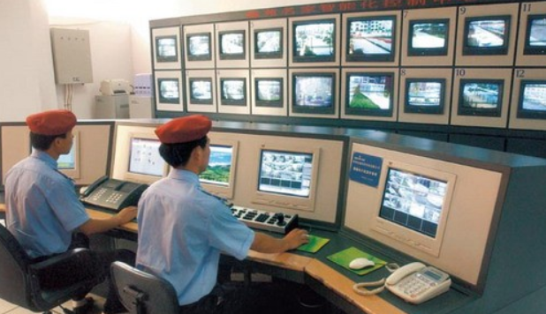
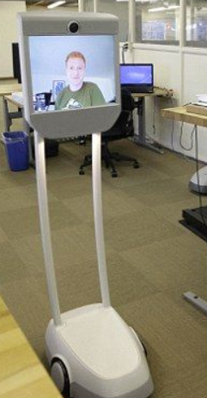
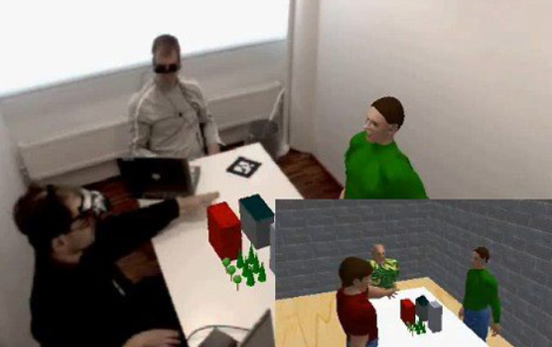
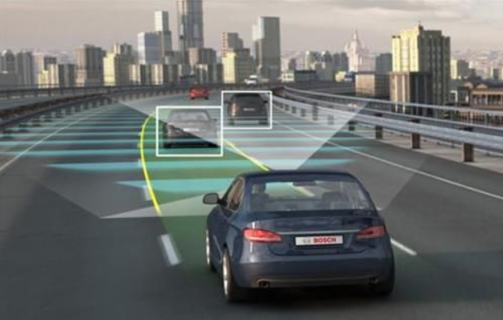
Stereo Vision
Introduction
Stereo vision is one of the most active research topics in computer vision and widely used in many applications.
Intelligent surveillance
3D video conferencing
autonomous vehicles
mobile robots
Intelligent surveillance
Algorithm
3D video conferencing
Implementation
mobile robots
Autonomous vehicles

Slide 3
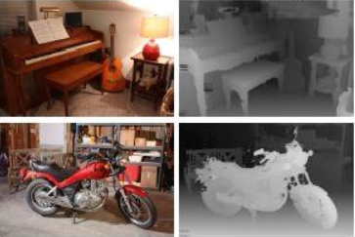
Stereo Matching
Stereo matching is a complicated and time-consuming procedure.
Introduction
Algorithm
Considering that many applications often require high-quality performance and real-time processing speed, hardware acceleration of stereo matching algorithms is inevitable.
DSPs: limited by the computational ability and fail to support real-time processing.
GPUs: always result in excessive power consumption.
FPGAs and ASICs: provide a balance between computational power and energy efficiency.
Implementation
Notes:
Stereo matching, which is treated as the key role in a stereo vision system, takes a pair of rectified images, estimates the movement of each pixel between two images and displays the associated movement in a disparity map.

Slide 4
Stereo Matching Algorithm
Introduction
Cost Calculation
Algorithm
Cost Aggregation
Disparity Selection
Implementation
Disparity Refinement
Notes:
In this paper, the mini-census and segmentation-based ADSW algorithms are combined to achieve a high matching accuracy. Different from many hardware designs without refinement, we present a disparity refinement step with segmentation information and find that it could improve the quality of initial disparity maps significantly.
Cost calculation, cost aggregation, disparity selection and disparity refinement are four well-defined steps in stereo matching algorithms. Here we utilize the mini-census transform in the cost calculation step and the segmentation based ADSW algorithm in the cost aggregation step. The refinement step consists of three stages: consistency check, disparity voting and invalid disparity inpainting. Finally, disparity maps of both images are finished simultaneously.

Slide 5
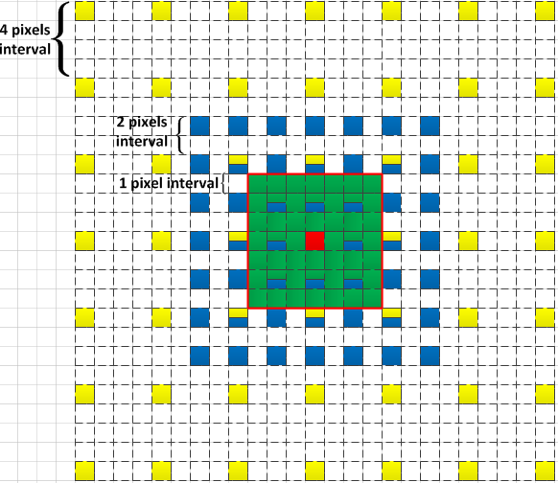
Hardware-oriented Optimization
Some optimizations are introduced to make the algorithm more hardware-compatible.
Converting color representation
A scale-and-truncate approximation of the weight function
A method called AWDE is introduced
A vertical-horizontal approach in disparity voting
Introduction
Algorithm
Implementation
AWDE method
Weight function
Notes:
To reduce computation complexity and make the algorithm more hardware-compatible, we propose some optimizations shown in the shaded blocks.
Luminance (Y) color representation is adopted instead of CIELAB color representation.
Manhattan distance is used rather than Euclidean distance to avoid square root computations.
A scale-and-truncate approximation of the weight function is proposed.
A method called AWDE is introduced. It uses different window sizes for different textures on the image and determines the window size by the mean absolute deviation (MAD) of the pixel in the center of 7x7 block.
To determine the most frequent disparity value in the window efficiently, a vertical-horizontal approach is applied. It firstly searches for the majority disparity in each column vertically, then picks out the majority one horizontally as the final disparity.

Slide 6
Hardware Architecture
A hardware architecture is designed for the proposed algorithm.
Algorithm
The fully pipelined architecture can be decomposed into three stages:
pre-processing
stereo-matching
post-processing
Implementation
Experiments
Notes:
The key to improve throughput is to be a fully pipelined architecture, which can be decomposed into three stages: pre-processing, stereo-matching and post-processing.
The pre-processing stage does not deal with any disparity information and performs pixel-based operations on each pixel for both images independently.
The stereo-matching stage operates on the transformed data and computes disparity maps. Here the computing structure combines the disparity-level parallelism with the pixel-level parallelism for cost aggregation.
The post-processing stage is implemented to refine the initial disparity maps when they are ready.

Slide 7
Hardware Architecture
Pre-processing: a register matrix employed to provide pipelined window
Stereo-matching: Pdis x Prow in parallel
Post-processing: consistency check, disparity voting and invalid disparity inpainting
Algorithm
Implementation
Experiments
Notes:
In the pre-processing stage, as the operations are all window-based, register matrix is employed to provide pipelined window content. The whole register matrix of 7 × 7 is used for window size determination. Meanwhile the six green ones are used for the mini-census transform and the center column of red ones are used for segmentation. Finally, a result of 12 (2+6+4) bits is written into the line buffer.
In the stereo-matching stage, the weight generator receives segmentation information from both images depending on the window size of the center pixel and computes weight coefficients. The circuit that generates the weight coefficient of a single pixel is shown. The cost aggregator calculates the Hamming distances as matching costs and shifts them with the according weights. The final aggregated cost is computed by summing the weighted scores using a tree adder, then normalizing it. In the post-processing stage, the consistency check module compares the initial disparity maps and segmentation information in order to generate one more bit which labels each disparity as valid or not. The disparity voting module updates the center disparity in the 25 × 25 support window using the vertical-first method. Here, a bitwise fast voting technique is applied to handle each column. It drives each bit of the most frequent disparity independently from the other bits so that the hardware cost depends on the number of disparity bits in binary. While counting bit votes, the valid information must be taken into account.

Slide 8
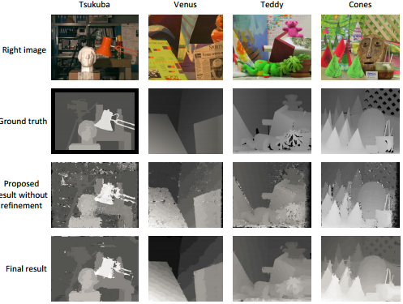
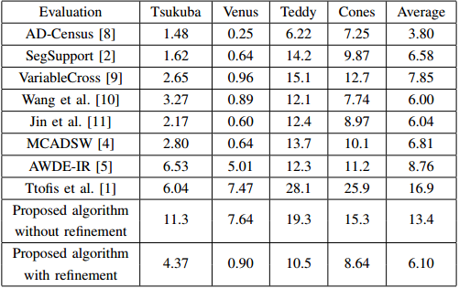
Experiments
To discuss the quality of our design, the disparity maps are evaluated based on the Middlebury benchmarks.
Algorithm
Implementation
Experiments
Results of high-definition images
Accuracy comparison on Middlebury benchmarks
2016/9/14
True disparity maps and experimental results
Notes:
The table lists the accuracy comparison with some state-of-art implementations. The error rate is the overall error rate with the tolerance of one disparity level.
The comparison shows that the accuracy of our design is not only among the best in hardware accelerated stereo systems, but also competitive with current software implementations.
The refinement step contributes significantly to the final disparity maps and many visual improvements are obvious, including the elimination of speckle noise, few errors at the image borders and sharply delineated edges. To further evaluate the proposed algorithm, some high definition images are used. Here the image pair of Art is at a 1110 × 1390 resolution for a 128-pixel disparity range.

Slide 9
Conclusion and Future Work
Conclusion
We proposed a stereo matching algorithm based on the mini-census transform and segmentation-based ADSW. The disparity refinement step with segmentation information has been presented.
A fully pipelined and scalable hardware architecture is designed with hardware-oriented optimizations.
Future Work
A part of global matching algorithms can be introduced into the algorithm.

Slide 10
Thank You
Yanzhe Li
liyz<at>vlsi.zju.edu.cn
Luc Claesen
luc.claesen<at>uhasselt.be

