Slide 1
Exploring the Use of Shift Register Lookup Tables for Keccak Implementations on Xilinx FPGAs
Authors: Jori Winderickx¹, Joan Daemen² and Nele Mentens¹ ¹ KU Leuven, ESAT/COSIC & iMinds, Leuven, Belgium ² STMicroelectronics, Belgium; Radboud University, Nijmegen, Netherlands
FPL 2016 – 1 September 2016

Slide 2
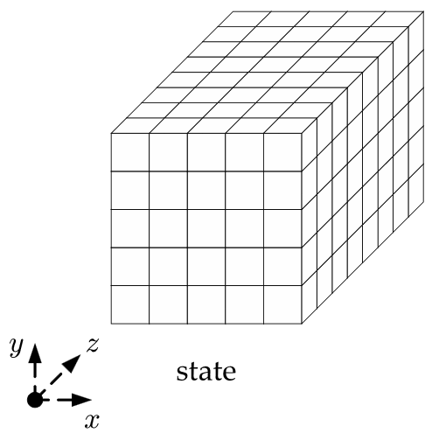
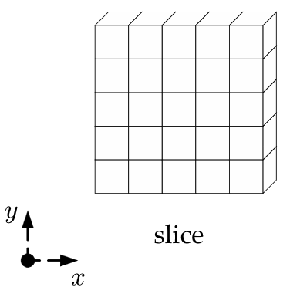
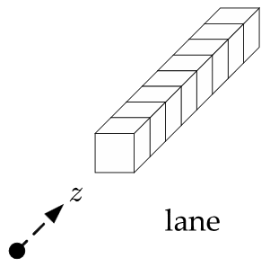
Keccak
FIPS 202 (SHA-3) standard
Rho in Shift registers
Slice-based
Xilinx FPGA
SRL in LUT of SLICEM
Representation of the state in Keccak
For more information on Keccak: http://keccak.noekeon.org/

Slide 3
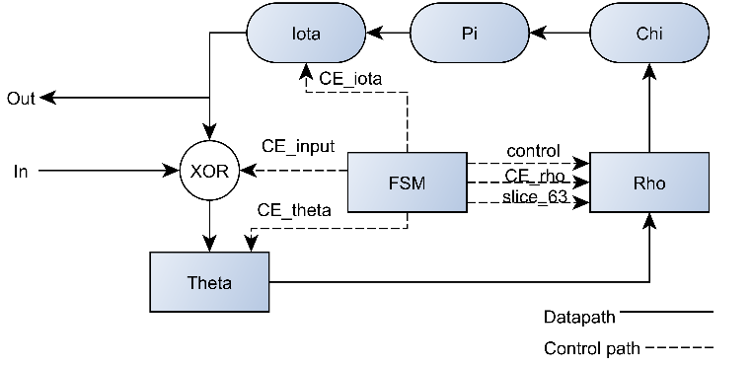
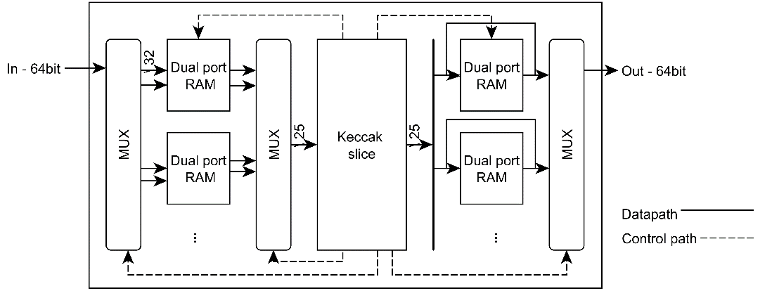
SRL-oriented architecture
Basic architecture
Interface compliant

Slide 4
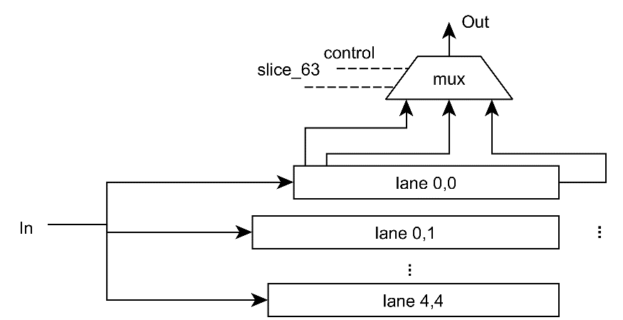
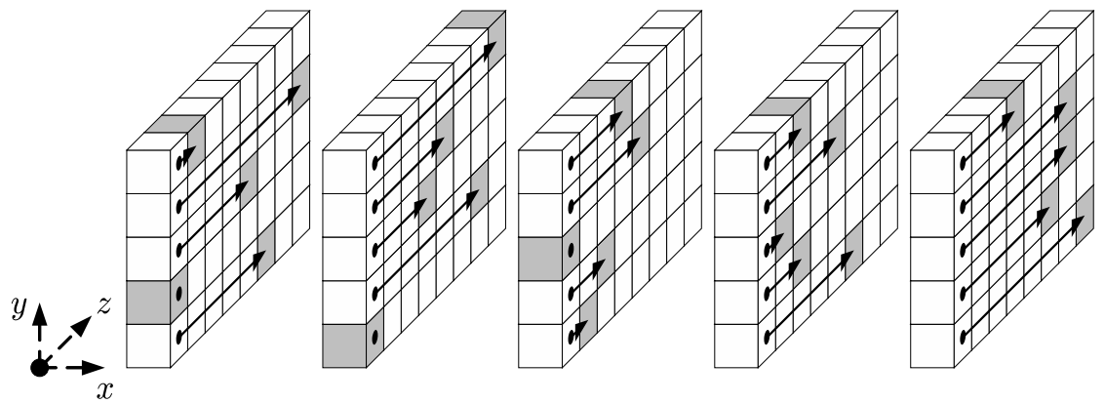
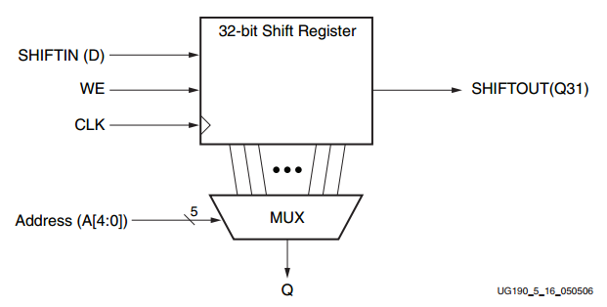
Implementation of Rho
State storage
Rho mapping
Translations within the lanes
Implementation of Rho
Rho applied to the lanes
Shift register in a SLICEM slice

Slide 5
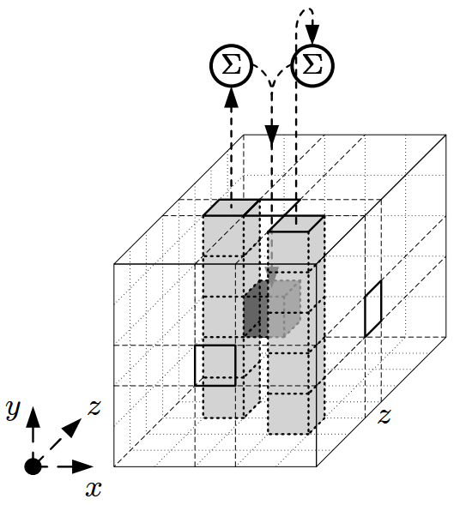
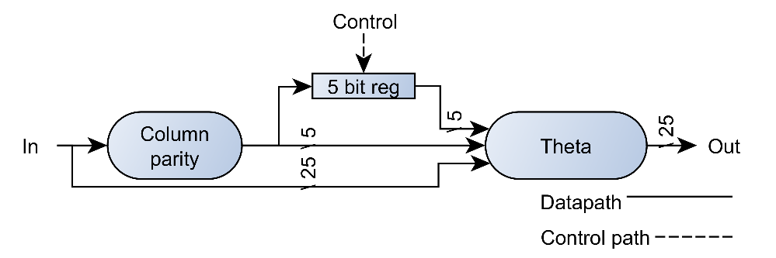
Implementation of Theta
Theta mapping
It adds to each bit a[x][y][z] the bitwise sum of the parities of two columns: that of a[x − 1][·][z] and that of a[x + 1][·][z − 1].
Theta implementation
Theta applied to a single bit

Slide 6
Results
Custom interface
Smallest size and relative high throughput
Common interface
Larger in size and lower throughput than most
State structure | Architecture | Platform | Slices(+RAM) | T.put(Mbit/s) | Freq(MHz) | Efficiency(Mbit/s/slice)
Lane | [1] | Virtex-6 | 144 | 128 | 250 | 0.89
 | [2] | Virtex-5 | 151(+3) | 501 | 520 | 3.32
Slice | [3]* | Virtex-5 | 372 | 813 | 159 | 2.18
 | [4] | Virtex-5 | 140 | 81 | 200 | 0.58
 | This paper WB | Virtex-5 | 255(+12) | 104 | 168 | 0.40
 | This paper | Virtex-5 | 134 | 156 | 248 | 1.16
* Keccak slice implementation of B. jungk [3] is scaled to Keccak-f[1600]

Slide 7
References
[1] S. Kerckhof, F. Durvaux, N. Veyrat-Charvillon, F. Regazzoni, G. M. de Dormale, and F. Standaert, “Compact fpga implementations of the five sha-3 finalists,” CARDIS, 2011.
[2] I. San and N. At, “Compact keccak hardware architecture for data integrity and authentication on fpgas,” ISJ, 2012.
[3] B. Jungk and J. Apfelbeck, “Area-efficient fpga implementations of the sha-3 finalists,” ReConFig, 2011.
[4] B. Jungk, “FPGA-based Evaluation of Cryptographic Algorithms,” Ph.D. dissertation, Goethe University Frankfurt, Frankfurt, 2015.

