Slide 1


A Survey on Reconfigurable Accelerators for Cloud
Computing
Dr. Christoforos Kachris,
Prof. Dimitrios Soudris
ICCS/NTUA, Greece

Slide 2
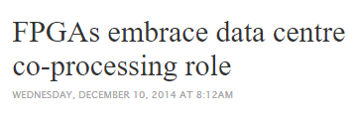


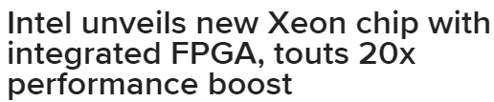


Accelerators in data centers
By 2020, Intel predicts a third of cloud providers will use FPGAs, analysts noted in a keynote at their annual data center event…

Slide 3



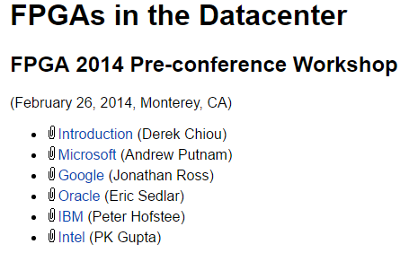
FPL 2016
FPGA 2014:

Slide 4
Data Center Requirements
Traffic requirements increase significantly in the data centers but the power budget remains the same (Source: ITRS, HiPEAC, Cisco)

Slide 5
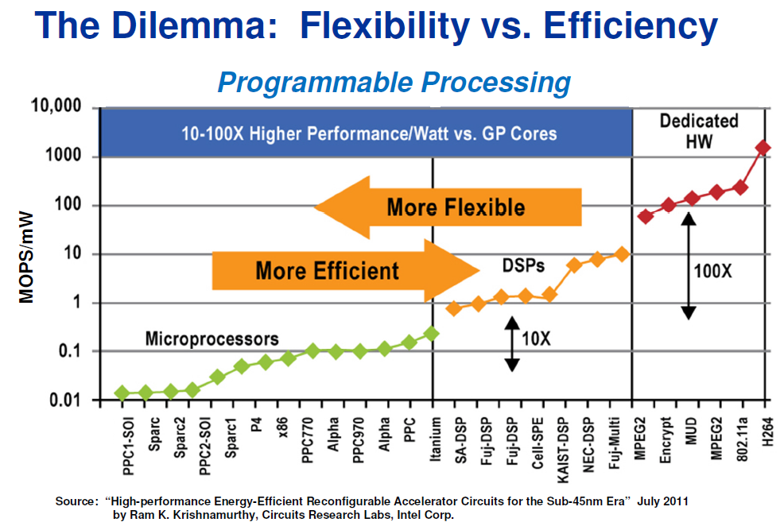
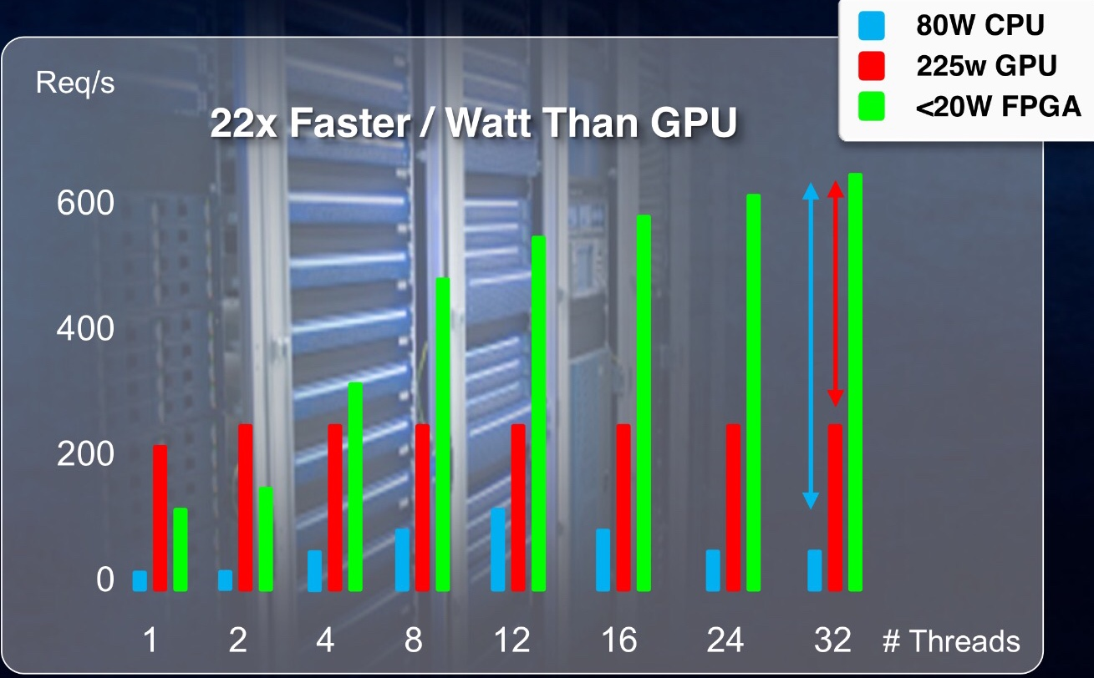
Hardware accelerators
HW acceleration can be used to reduce significantly the execution time and the energy consumption of several applications (10x-100x)
[Source: Xilinx, 2016]
Notes:
A solution that can be used to overcome this problem is the use of application-specific accelerators. Specialized multicore processors with application-specific acceleration modules can leverage the underutilized die area to overcome the
initial power barrier, delivering significantly higher performance for the same power envelope. The main idea is to use the abundant die area by implementing application-specific accelerators and dynamically powering up only those accelerators suitable for a given workload.

Slide 6
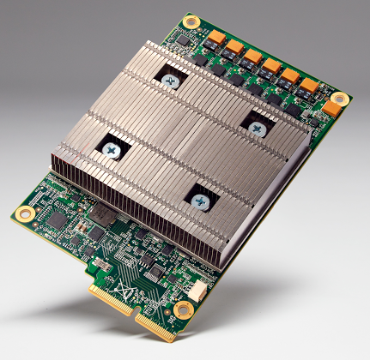
Google application Specific Accelerators deployed in DC
Google Has Built A Custom Chip For Machine Learning
The result is called a Tensor Processing Unit (TPU), a custom ASIC we built specifically for machine learning — and tailored for TensorFlow.
Google has been running TPUs inside the data centers for more than a year, and have found them to deliver an order of magnitude better-optimized performance per watt for machine learning.
This is roughly equivalent to fast-forwarding technology about seven years into the future (three generations of Moore’s Law).

Slide 7
A survey on HW accelerator for Cloud computing
HW accelerators
  Search engine and Page ranking
  MapReduce
  Spark
  Memcached
  Databases
FPGAs in the cloud framework

Slide 8
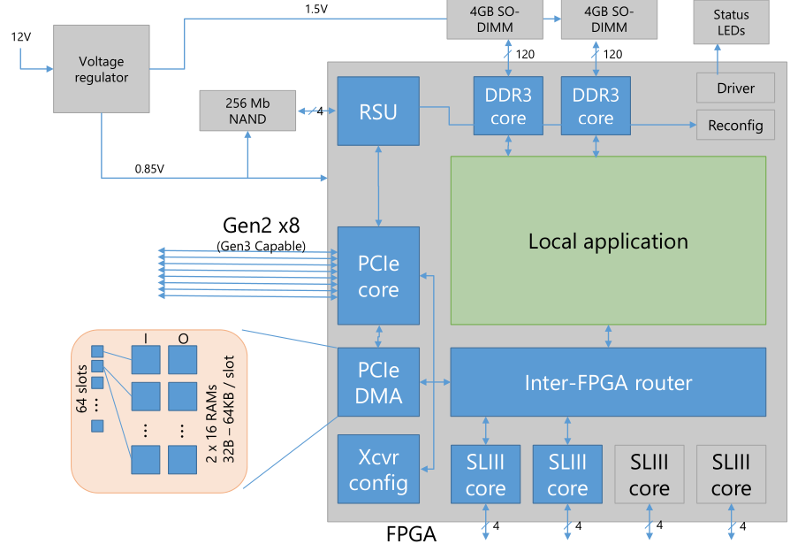
Web search and Page Ranking
MS Catapult:
Bing web search engine
95% higher throughput per server
Or, (while maintaining equivalent throughput) Tail latency: reduced by 29%.

Slide 9
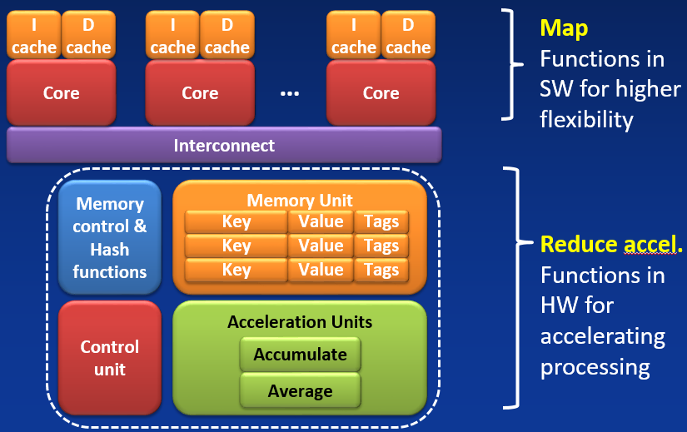
MapReduce Accelerator
C. Kachris, D. Diamantopoulos, G. C. Sirakoulis, and D. Soudris, “An fpga-based integrated mapreduce accelerator platform,” Journal of Signal Processing Systems, pp. 1–13, 2016.
C. Kachris, G. C. Sirakoulis, and D. Soudris, “A reconfigurable mapreduce accelerator for multi-core all-programmable socs,” in System-on-Chip (SoC), 2014 International Symposium on, Oct 2014, pp. 1–6

Slide 10
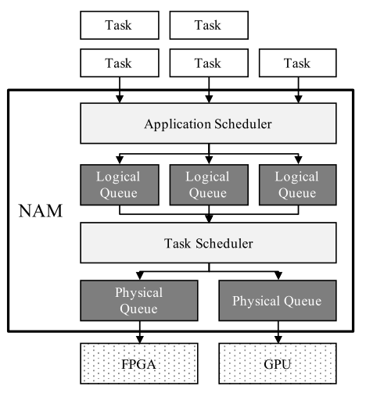
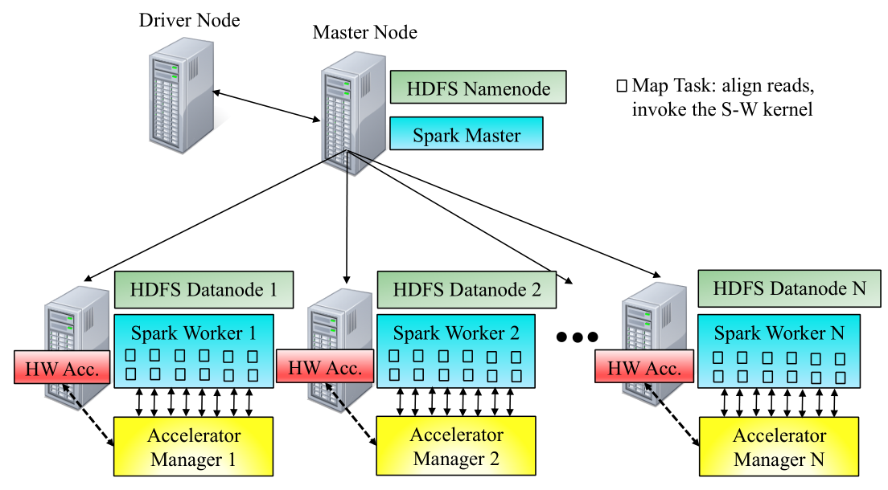
Spark Accelerator
J. Cong, M. Huang, D. Wu, and C. H. Yu, “Invited – heterogeneous datacenters: Options and opportunities,” in Proceedings of the 53rd Annual Design Automation Conference, ser. DAC ’16. New York, NY, USA: ACM, 2016, pp. 16:1–16:6
When Apache Spark Meets FPGAs: A Case Study for Next-Generation DNA Sequencing Acceleration
Deploying Accelerators At Datacenter Scale Using Spark, Spark Summit

Slide 11
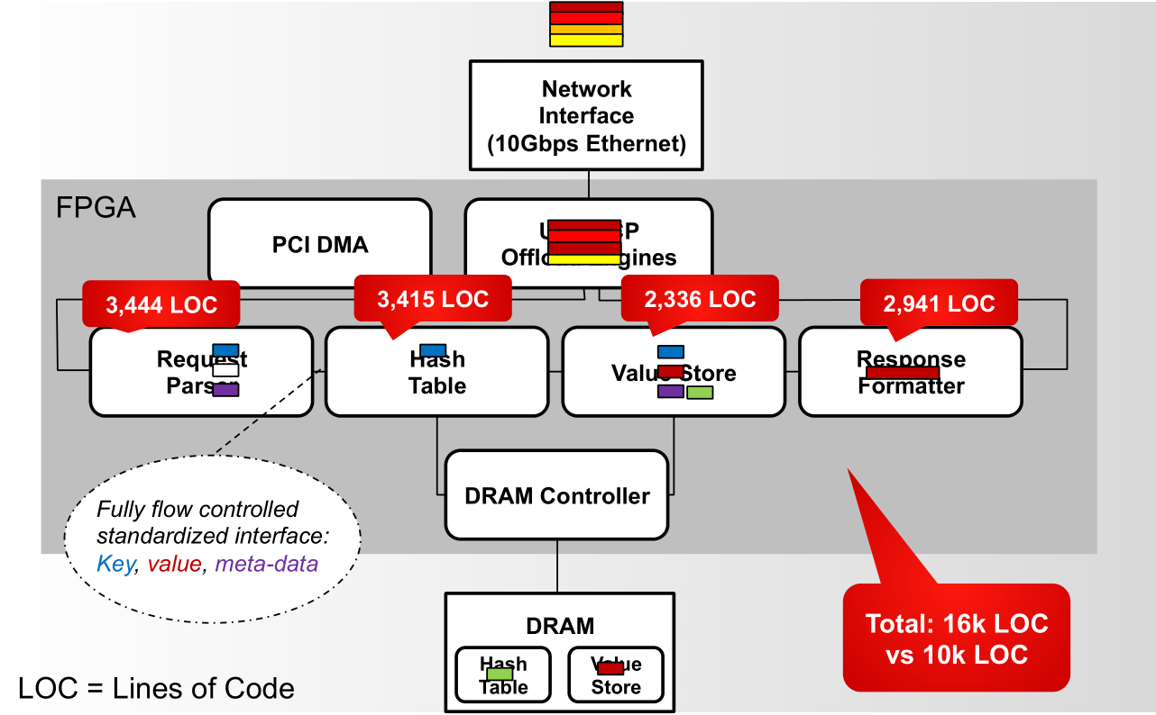
Memcached accelerator
36x in RPS/Watt with low variation
M. Blott, L. Liu, K. Karras, and K. Vissers, “Scaling out to a single-node 80gbps memcached server with 40terabytes of memory,” in Proceedings of the 7th USENIX Conference on Hot Topics in Storage and File Systems, ser. HotStorage’15. Berkeley, CA, USA: USENIX Association, 2015

Slide 12
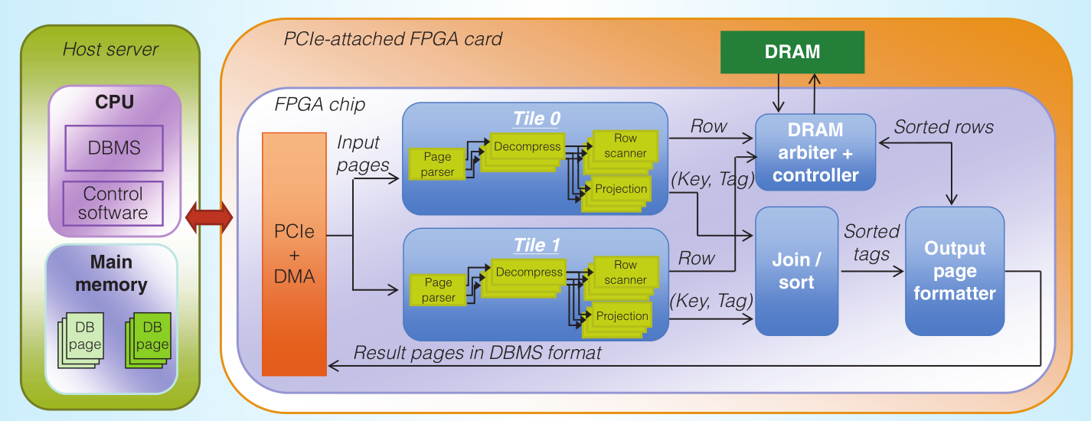
In-memory Databases
7x to 14x speedup for most queries
Source: [B. Sukhwani, H. Min, M. Thoennes, P. Dube, B. Brezzo, S. Asaad, and D. E. Dillenberger, “Database analytics: A reconfigurable-computing approach,” IEEE Micro, vol. 34, no. 1, pp. 19–29, Jan 2014.]

Slide 13
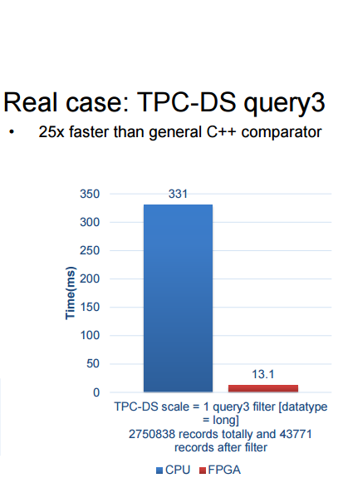
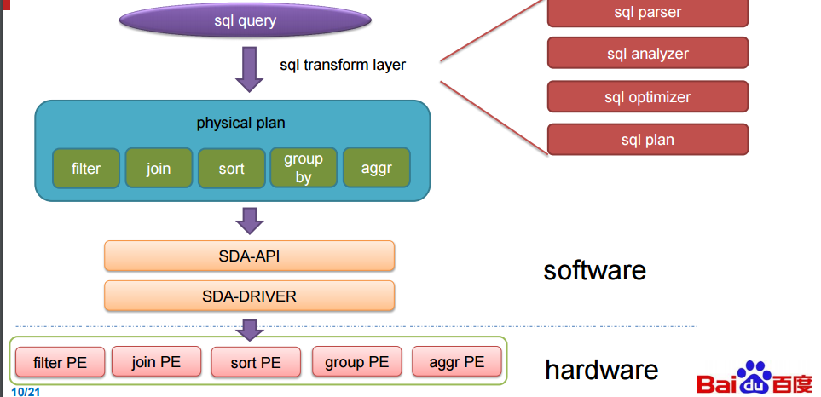
SQL Databases
[Source: Jian Ouyang, Baidu, Hot Chips 2016]
Baidu has recently presented an FPGA-based acceleration for data centers for the SQL databases

Slide 14
A survey on HW accelerator for Cloud computing
HW accelerators
  Search engine and Page ranking
  MapReduce
  Spark
  Memcached
  Databases
FPGAs in the cloud framework

Slide 15
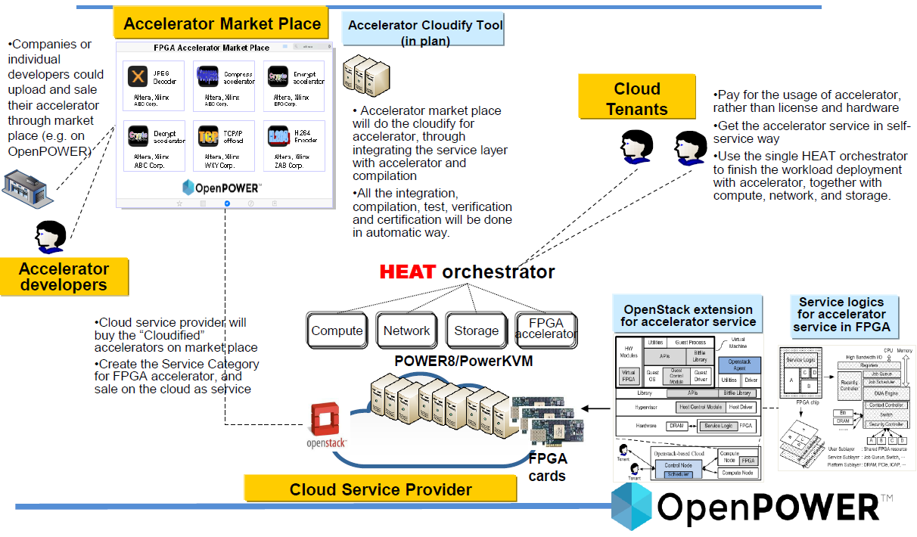
IBM’s OpenPower IP Store

Slide 16
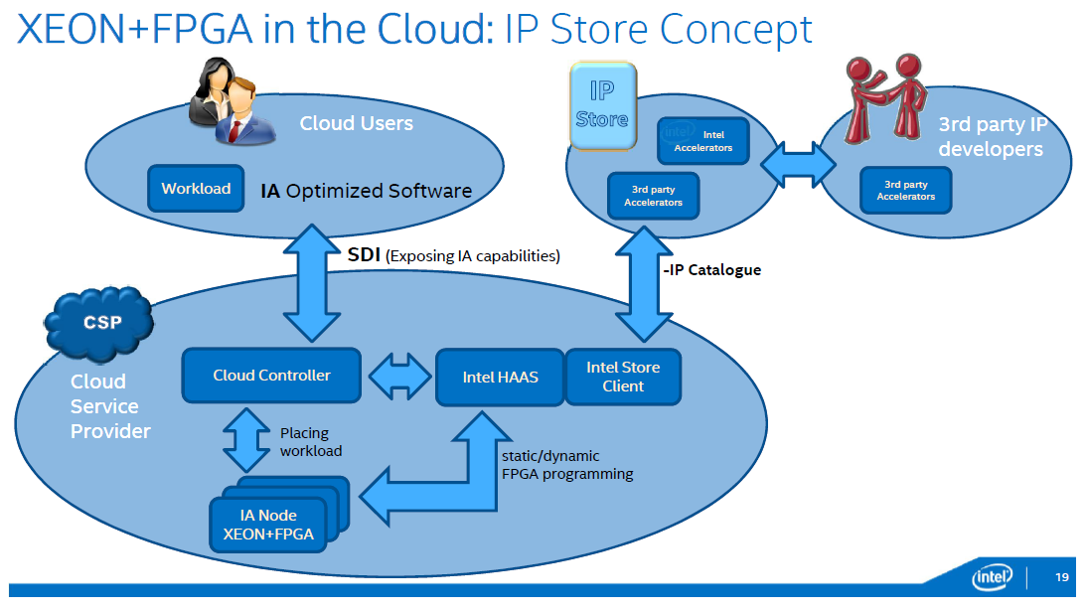
Intel’s vision on IP Store

Slide 17
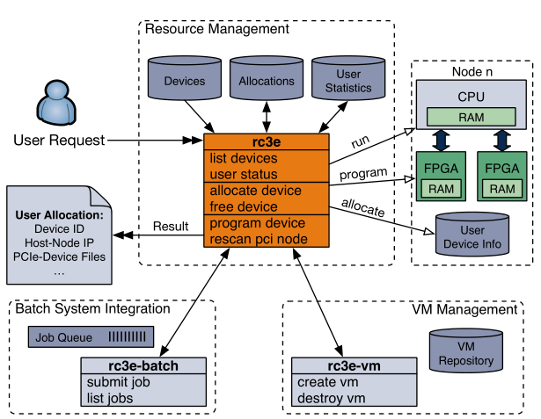
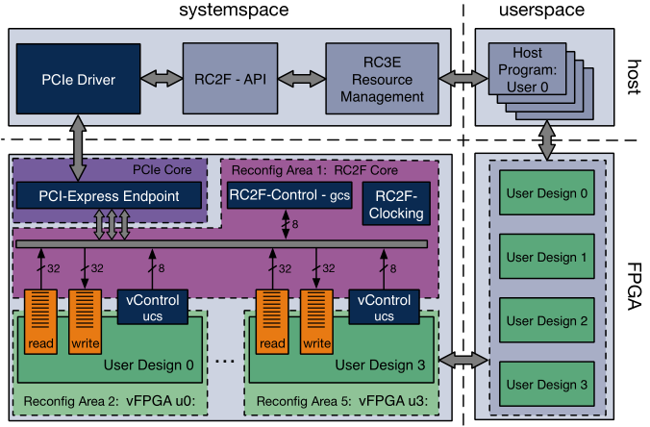
RC3E, Dresden University
Source: [O. Knodel and R. G. Spallek, “RC3E: provision and management of reconfigurable hardware accelerators in a cloud environment,” in 2nd International Workshop on FPGAs for Software Programmers, 2015]

Slide 18
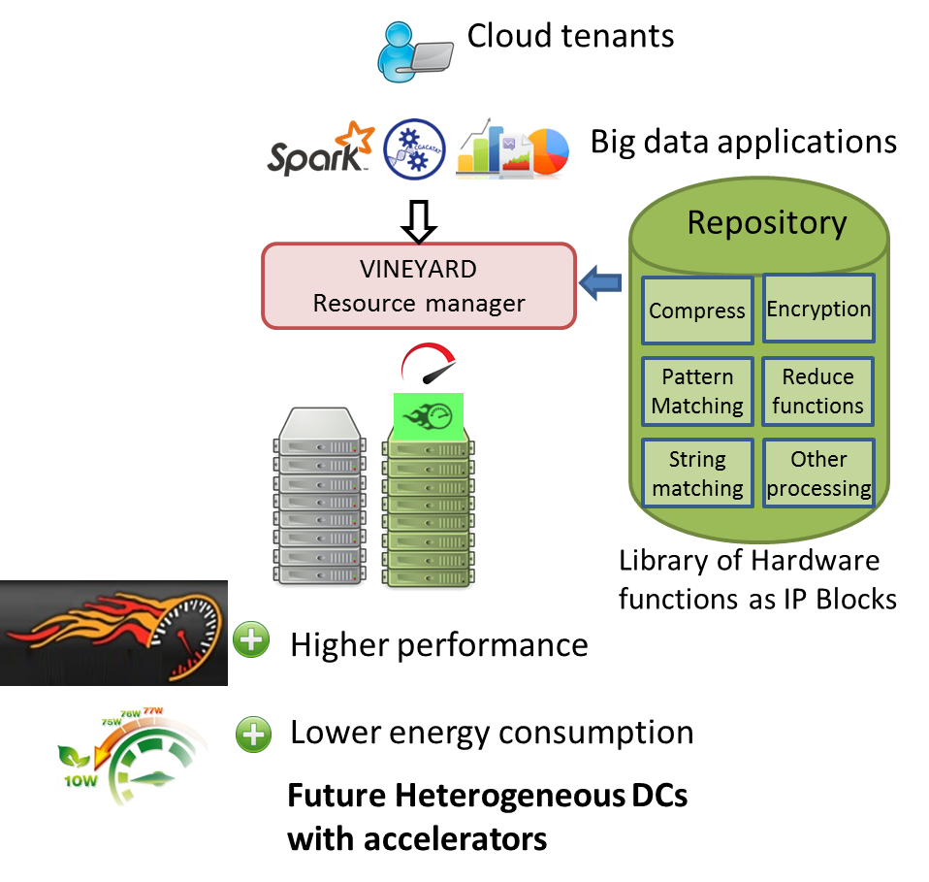
The VINEYARD approach
An App-store for Hardware accelerators as IPs
Foster the development of an eco-system with Hardware accelerators as IPs in the same way as software packages.
Load the required functions based on the application requirements
[ www.vineyard-h2020.eu ]

Slide 19
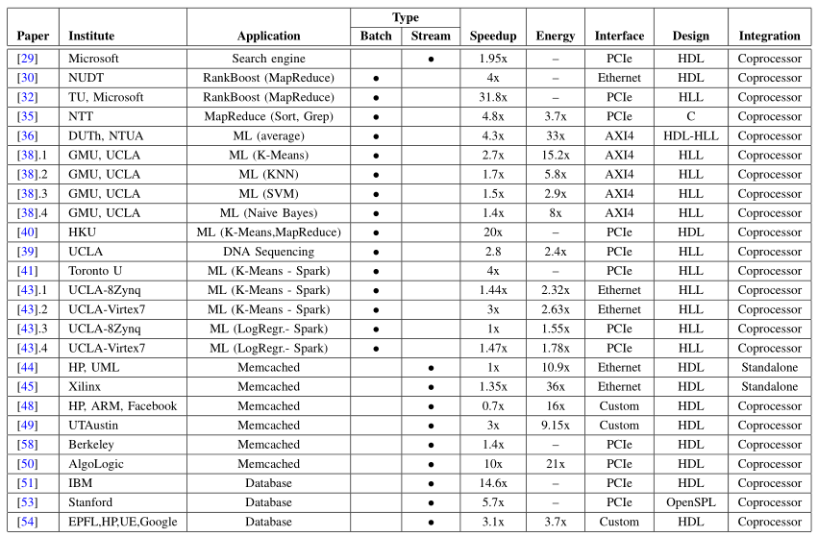
HW Accelerators for Cloud Computing

Slide 20
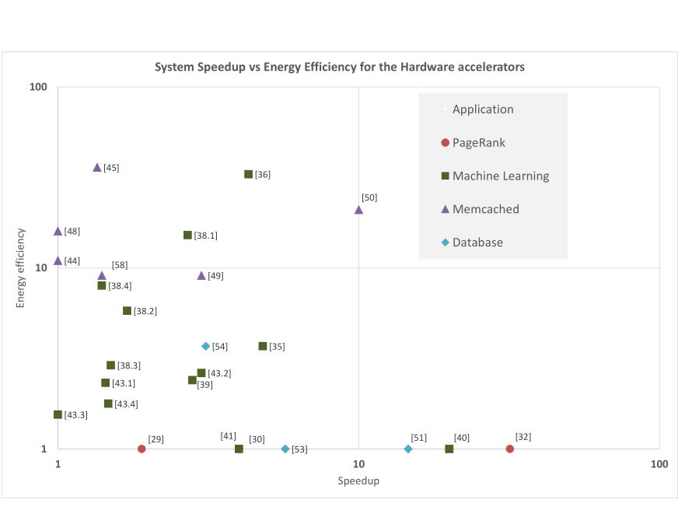
Speedup vs Energy efficiency

Slide 21
Batch vs Streaming applications

Slide 22
Speedup per category
Page Rank applications achieve the higher speedup
Memcached application achieve higher energy efficiency

Slide 23
Communication Interface
Designs with PCIe offers the higher speedup
But due to communication overhead offers low energy efficiency

Slide 24
HDL vs HLL
HDL and HLLs offer almost the same speedup!
HDL: Higher energy efficiency (but this may depend also on the application)

Slide 25
FPGAs in HyperScale Data Centers
The ecosystem of Hardware IPs in the embedded system world can be adopted in the data centers.
Accelerators IPs can foster the innovation of IPs in the domain of cloud computing and big data analytics

Slide 26
Roadmap
Paradigm shift (From Homogeneous Data Centers to Heterogeneous Data Centers)
IaaS, PaaS, SaaS for accelerators
3rd party Hardware IP developers contribute to a common market place for Hardware Accelerators in the same way as Embedded systems

Slide 27











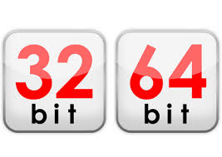





Convergence on Os
Vendor Specific OS in mobiles
Vendor Agnostic OS
Vendor Agnostic OS,
Architecture specific
Vendor Specific OS in PCs

Slide 28
Convergence on FPGA AppStore
Vendor-specific accelerator
Accelerator1
Vendor-agnostic Platform-specific
Accelerator1
Platform-agnostic
Accelerator1
GPU
VendorA
VendorB
VendorC
VendorD
GPU
FPGA
FPGA
Accelerator2
Accelerator2
…
Accelerator2
…
IP Store Options

Slide 29
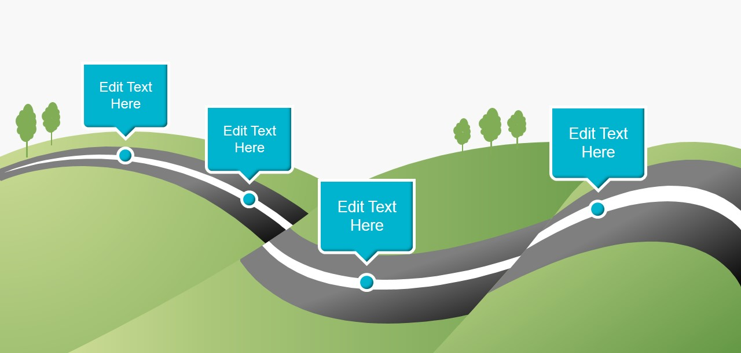
Roadmap on FPGAs in the Cloud
Compress
  FPGA
    Xilinx (a,b,…)
    Altera (a,b,..)
Compress
  FPGA
    Xilinx
    Altera
Special
HW accel
Compress
Compress
  FPGA
  GPU
  Xeon Phi
Vendor-specific
AppStore
Platform-agnostic AppStore
Vendor-agnostic
Platform-specific
AppStore

Slide 30
Thank you for your time
Questions?
More info:
kachris@microlab.ntua.gr
www.vineyard-h2020.eu
This work has received funding from the European Union’s Horizon 2020 research and innovation programme under grant agreement No 687628 - VINEYARD

